Slide 1
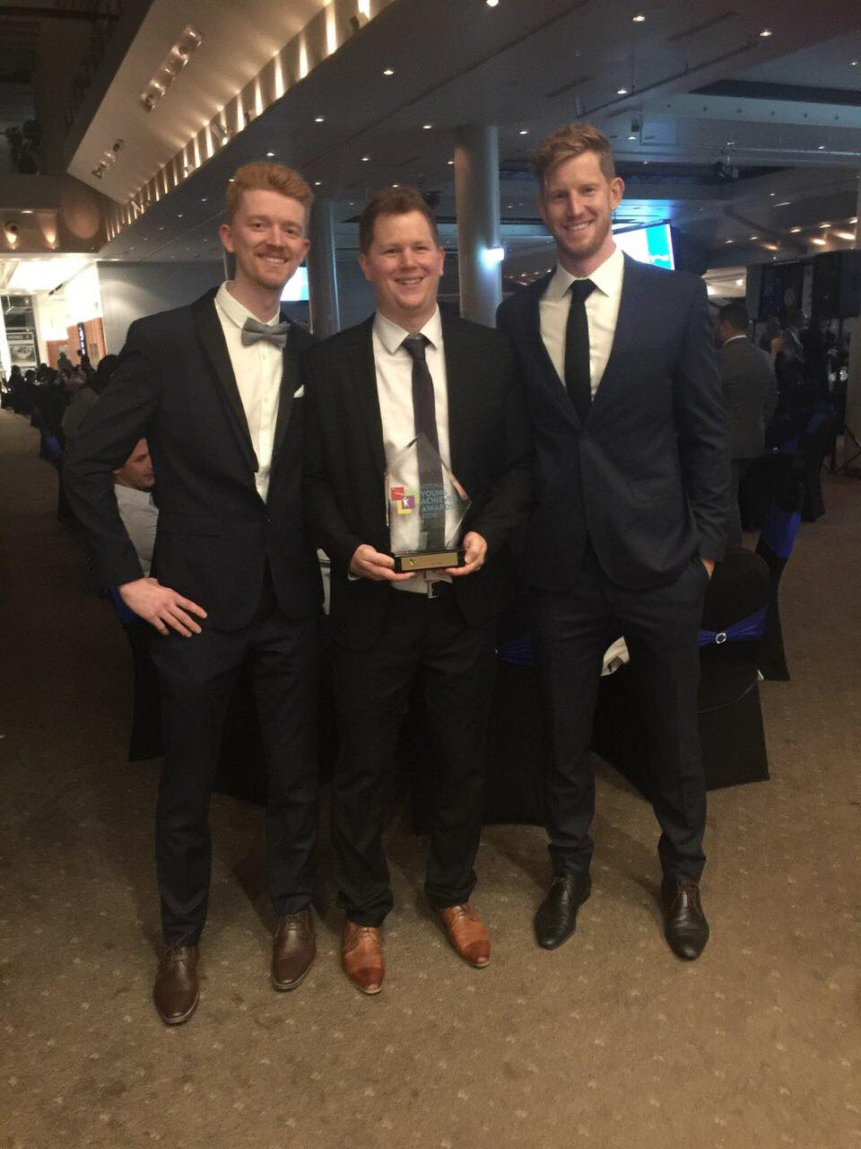

Slide 2
The Impact of Community
1. Family/Friends and Church Commuunity
2. Sports Community
3. Work/Business Community
4. TAFE Community
‘The power of community is irreplaceable’

Slide 3
Family/Friends & Church Community
- People being present
- Knowing you are not alone dealing with negative symptoms coming from illness
- Educating people (proactiveness of Mum)

Slide 4
Sports Community
- Cricket and Basketball
- Educating Teammates
- Acceptance of teammates
- Positive team environment
- Continual secure environment for Tom to lean on (Emerald Cricket Club)

Slide 5
Work/Business Community
St Josephs College, Ferntree Gully
- Supportive Principal and staff
- Team Environment with colleagues
- Flexible working hours
- Counsellor
- Transition into own small business

Slide 6
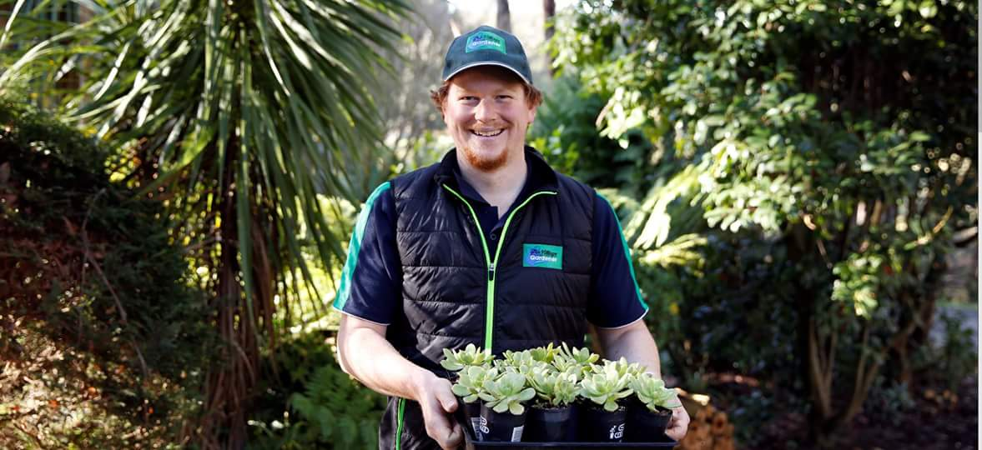

Slide 8
TAFE Community
1. Access to Support Services
- Access Ability Advisor- Sophie Holloway
- Counsellor
2. Care Plan
- Flexible learning/modified assessment
3. Horticulture teachers/staff
- Weekly debriefing/check in
- Affirmation/encouragement and positive voice
4. Educate Peers
- Addressed the class: shared Mental Health story openly
- Strategically pairing with other students for assessments
- Keynote speaker at R U OK day

Slide 9
