Slide 1
Do internships launch careers? A review of the Stepping Into Program
empowering and connecting employers to be actively inclusive of customers and employees with disability

Slide 2
About the Australian Network on Disability
Notes:
At 30 June 2018, there were a total of 216 members, 94 or 44% private sector, 91 or 42% public sector and 31 or 14% from the education or for purpose sectors.

Slide 3
Stepping Into by numbers, 30 June 2018
Since the Program commenced in 2005:
1,031 internships
2,865 student applications
111 participating employers
During 2017-18:
47 employers
47 universities
835 applications
190 internships

Slide 4
Shattering old stereotypes
During the 2017-18 financial year, applications were received from students studying in their penultimate or final year from 47 universities across Australia including:
255 different Bachelor degrees
68 different Masters’ level degrees
21 different graduate diplomas
3 different PhD topics.

Slide 5
Stepping Into Program Growth 2005-2018
Year | Students applied | Internships
2005 | 7 | 7
2006 | 30 | 16
2007 | 34 | 26
2008 | 74 | 36
2009 | 82 | 39
2010 | 120 | 45
2011 | 135 | 55
2012 | 200 | 58
2013 | 287 | 76
2014 | 174 | 77
2015 | 264 | 94
2016 | 186 | 134
2017 | 437 | 178
2018 | 835 | 190
Total | 2,865 | 1,031
Notes:
The table shows the increase in students applicants and internships for each year from 2005 to 2018. In 2005 there were 7 applicants and internships. In 2018, there were 835 applicants and 190 internships.

Slide 6
Stepping Into students have better employment outcomes
Source: WestWood Spice/AND survey to 2014-18 Stepping Into interns and applicants, October 2018.
Notes:
Employment outcomes for those without disability (GradStats average 2015-2017) was 88 percent.
Employment outcomes for those who did a SIP internship was 80 percent (70/87)
Employment outcomes for those who did an internship (that was not SIP) was 67percent (10/15)
Employment outcomes for students who didn’t do an internship was 58 percent (22/38)

Slide 7
Stepping Into students have better employment outcomes
Stepping Into interns are
More likely to be employed in a role related to their studies (73% compared with 66%)
More likely to be in full-time employment (50.6% compared with 45.7%)
Less likely to be in casual employment (10.8% compared with 32.6%)
More likely to be in part-time work that was their preference (37.5% compared with 29%)
Source: WestWood Spice/AND survey to 2014-18 Stepping Into students, October 2018.

Slide 8
To what extent has the Stepping Into internship Program benefited your career to date?
Former intern responses – percentage who strongly agree | or agree
I was able to include it in my resume | 94%
I felt more confident applying for jobs | 91%
I gained additional skills | 88%
It helped me perform better at job interviews | 82%
I could confidently request workplace adjustments | 66%
I had a network of contacts to draw on | 64%
No benefit | 3%
Source: WestWood Spice/AND survey to 204-18 Stepping Into interns, October 2018.
Notes:
When asked the former interns to what extent has the Program benefited the career to date. 94% was able to include it in their resume. 91% felt more confident applying for jobs. 88% gained additional skills. 82% helped them perform better at job interviews. 66% could confidently request workplace adjustments. 64% had a network of contacts to draw on. 3% replied no benefit.

Slide 9
“Year 1 participation was all about ‘doing the right thing, a social good’…then we realized even if they don’t have an A+ on their academic record they know how to think and work through problems and have a lot of get up and go. From Year 2 it was all about getting great interns…they’ve all been exceptional individuals.”

Slide 10
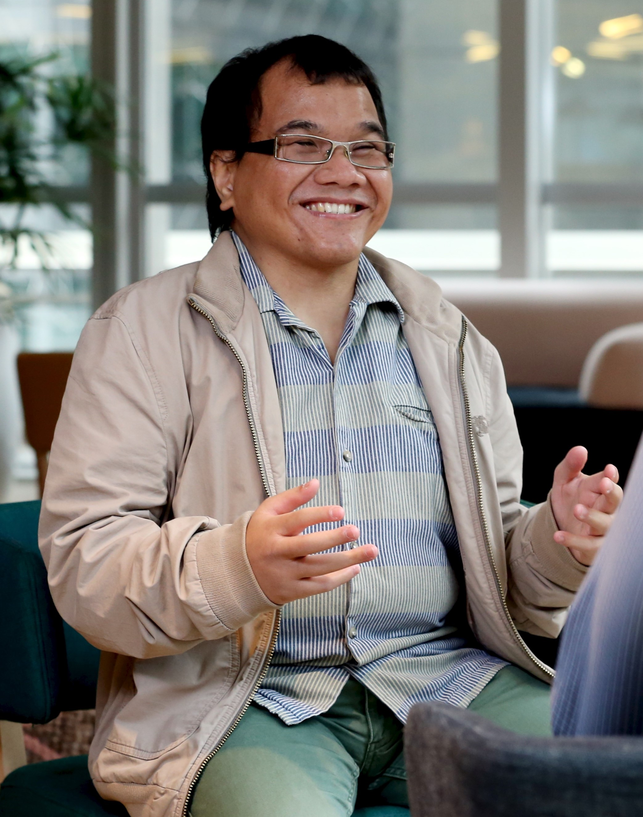
“Stepping Into breaks the barriers that many people with disability face. Employers that participate in the program are committed to ensuring that people with disability are given a fair go.”
Source: Interview with former Stepping Into intern, November 2018.

Slide 11
99% of 426 interns who responded to our survey immediately after the internship said they would recommend it to others.

Slide 12
www.and.org.au 1300 363 645
12

