Slide 1
Michelle Kerr, Senior Student Equity Officer, Team Leader Disability Services
Topic: Building a Disability Management System
Disability Services: Student Life & Community
Building a Disability Management System from the ground up: taking into consideration privacy, multiple user groups, and record management principles

Slide 2
Topics:
Context - Background
System Functionality
Privacy - Permissions
Multiple user groups – Stakeholders
Record management principles – Lessons learnt

Slide 3
Building a Disability Management System from the ground up: taking into consideration privacy, multiple user groups, and record management principles
DMS: Context
custom built
SharePoint platform
roll out in 2015, with ongoing enhancements
Active student records held approx. 1200 registered students
educational adjustment plans – online view and t PDF adjustment plans emailed to students.
The DMS delivers end to end registration processes for Disability Services Unit as well as communication functions with students, Schools and Faculties and the Exams team. It is integrated with the Central Student Management System and has reporting capability.
enhancements – integration with the Student Central System (‘source of truth’), notification functionality, reporting disability categories and expiring medical documentation, online registration site, audit log & report.

Slide 4
 | System Functionality | Yes/No | Comments
1 | Online registration form | Yes | Separate site enabling student access that feeds into DMS (staff access only)
2 | Send / Receive email correspondence and display a log | Yes | Batch email
3 | Configurable forms, back-office, emails (templates) | Yes
4 | Privacy & Security – Separate access and permissions for different staff groups | Yes | Multiple User Groups
5 | Auto notifications / Alerts /reminders | Yes | (E.g. Auto notification to the Disability Adviser for a call-back from an academic)
6 | Integration with Student system | Yes | course details, program, school, faculty, admit type, academic status and study load
7 | Current Student information | Yes | DOB, name, email & phone, start date University from University centralised database

Slide 5
 | System Functionality | Yes/No | Comments
8 | Reports & Dashboards | Yes | Exams report, disability categories report, expiring medical docs, accessibility requirements report
9 | A case management system, which disseminates the students’ adjustments to relevant departments/faculties | Yes | Adjustment information is recorded and is used to populate students adjustment plan [Letter of Support]
10 | Repository for student records (medical documentation, release of information), adjustment plans, case notes, accessibility requirements | Yes | Medical documentation – issue date and expiry date recorded
11 | Referrals | Yes | Record of referral to counselling & psychology, Health service, other etc.
12 | End-to-end service delivery | Yes | Benefits for Students: Streamlined delivery with accuracy and timeliness of sending out adjustment plans to students each session

Slide 6
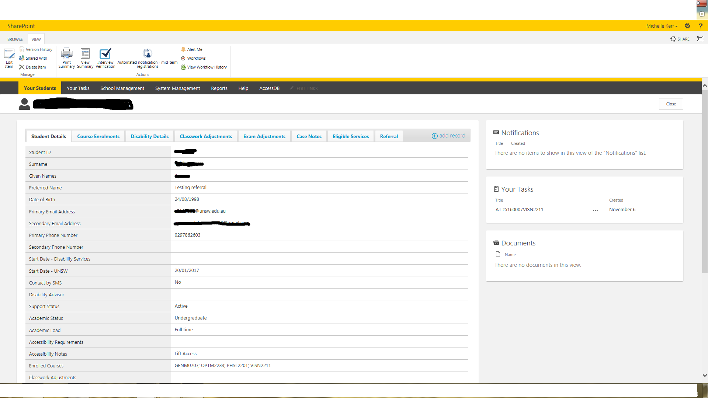
DMS: Student profile

Slide 7
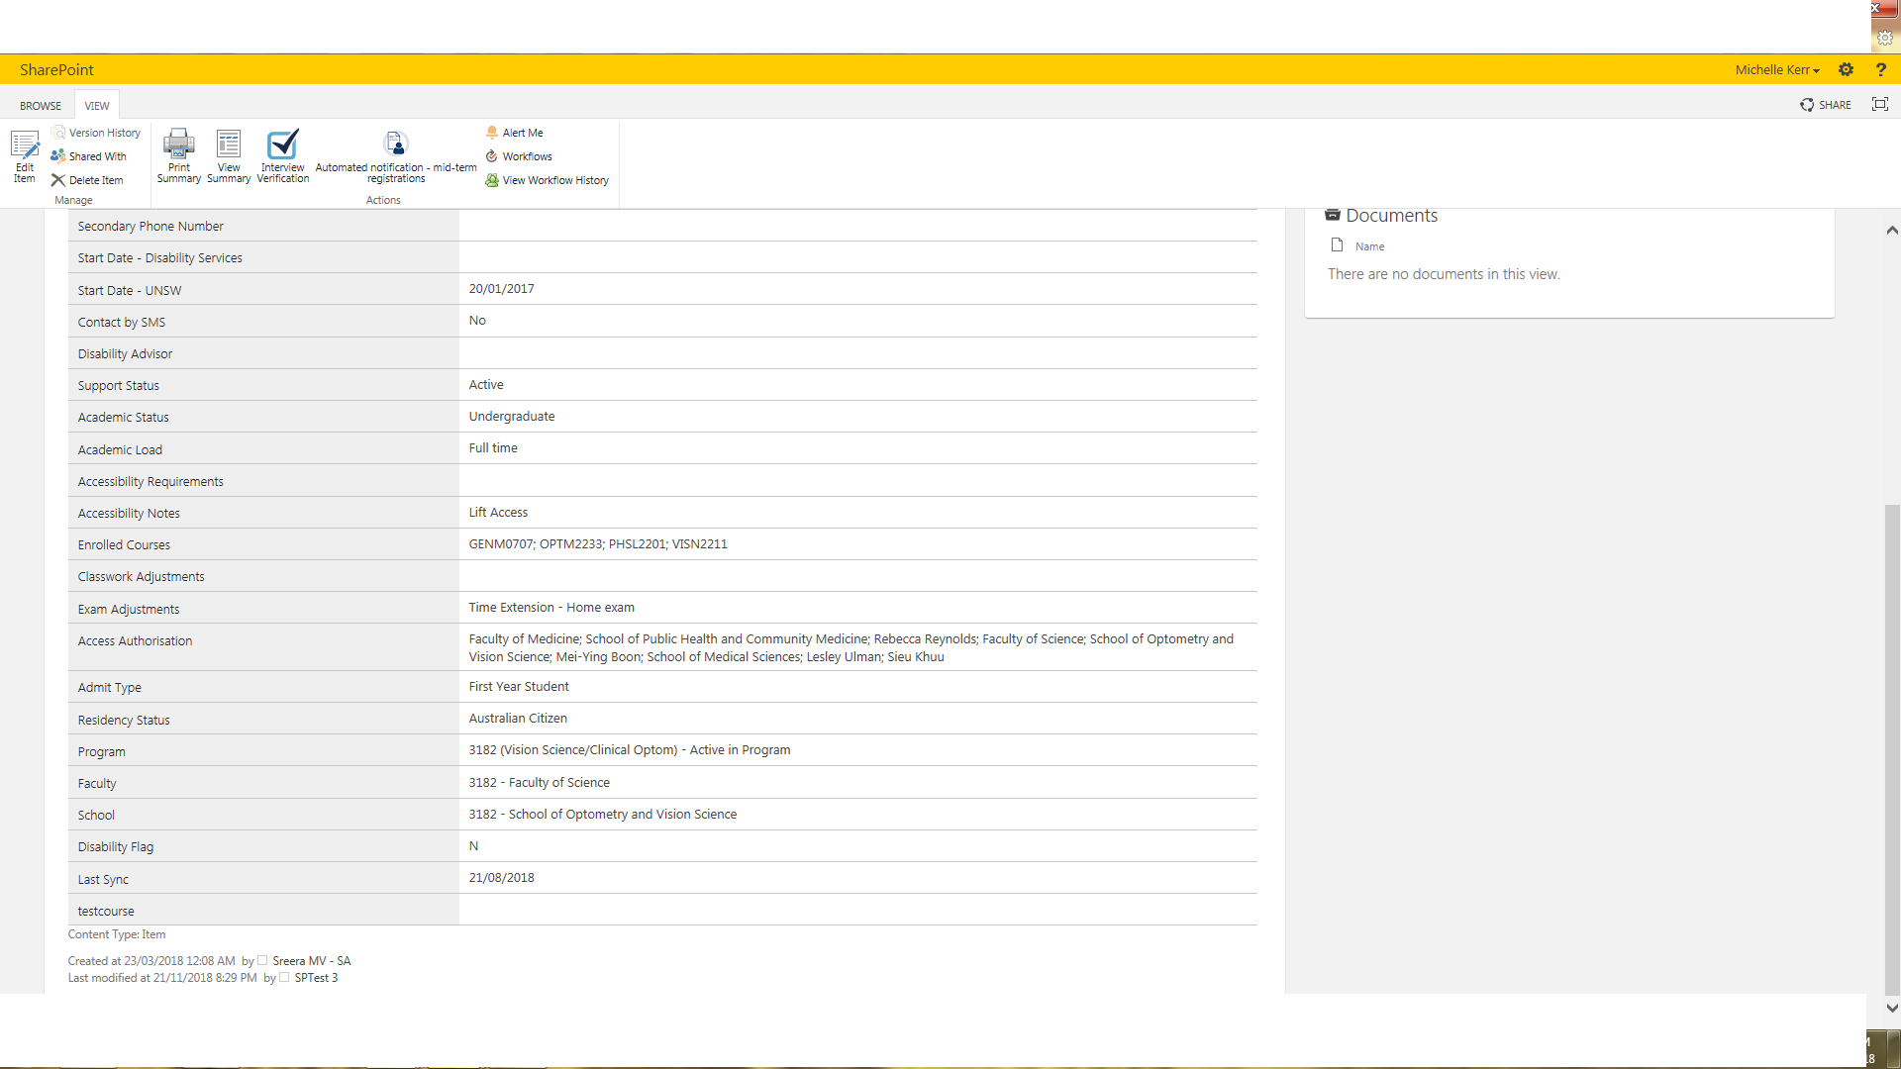
DMS: Student profile

Slide 8
Privacy - Permissions
the DMS builds on collaborative learning and teaching relationships with Schools and Faculties by enabling multiple user groups to access online adjustment information while maintaining the privacy and integrity of more sensitive records such as medical documentation and case notes within the Unit
SiMs [Student Central System] are read-only to enable a ‘single source of truth, i.e. accuracy
Educational Adjustment records, case notes etc., are edit fields – DA only
Compliance & quality controls i.e. audit log/reporting [recommended to track changes in the system]

Slide 9
Multiple user groups – Stakeholders
Identify early who your stakeholders are because that will determine your user groups and how you set up your permissions
Who can see adjustment information in DMS?
ALL DMS users who have permission can access the system BUT have different ‘views’
Hierarchical permission structure
Automated access for Academics
Multiple formats – online view & printable documents

Slide 10
Record management Principles – Lessons learnt
Identifying user groups – conduct focus groups & test
Business process should drive functionality
Ask for feedback regularly [User groups]
Include a ‘help’ site
Manage your notification emails – ‘Less is more’
Sensitivity of information – restrict access – check Privacy legislation and include T& C, i.e. User agreement
User friendly – ability to send Communications – ‘Welcome’ email [start of term], notifications & messages
Further information CONTACT: michellekerr66@gmail.com

