Slide 1
USEP: enhancing success for students with disabilities in graduate employment
Gabrielle O’Brien | Manager, Student Diversity and Inclusion |Griffith University
David Swayn | National Disability Coordination Officer | STEPS Group Australia
Natalie Searson | Mylestones Employment and Griffith USEP Consultant
Kate Carroll, University of Wollongong

Slide 2

Acknowledgement
We acknowledge the traditional custodians of the land we meet on today. We pay respect to the Elders, past and present, and extends that respect to other Aboriginal and Torres Strait Islander peoples.

Slide 3
Outline
“I’m not interested in being an inspiration. I just want the same opportunities as everyone else.”
Christina Ebersohl
The challenge
Funding, DES, and Partnerships
Case studies
University Case Study – Griffith

Slide 4
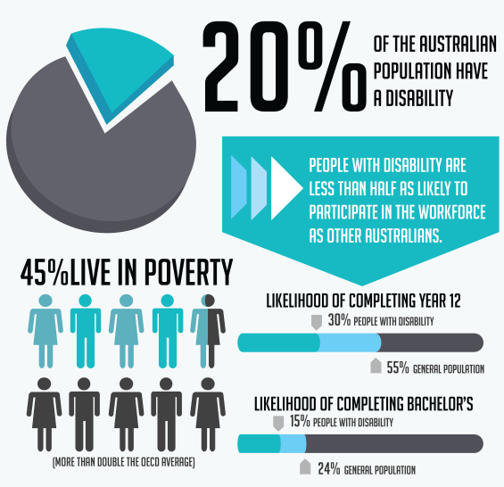
National context
People with a disability are twice as likely to be in the bottom 20% of gross household incomes.
Notes:
Over 4 million people in Australia have some form of disability. That's 1 in 5 people.
19% of men, and 18% of women have disability.
43% of people over 55 years have one or more disabilities.
2.2 million Australians of working age (15 – 64 years) have disability.
1 in 6 Australians are affected by hearing loss. There are approximately 30,000 Deaf Auslan users with total hearing loss
Vision Australia estimates there are currently 357,000 people in Australia who are blind or have low vision
An estimated 10% of the population has dyslexia. That’s more than two million Australians (Source: Dyslexia Australia).
45% of the population will experience a mental health disorder during their lifetime (Black Dog Inst).
Source: Australian Bureau of Statistics, Survey of Disability, Ageing and Carers 2012.

Slide 5
National context
National enrolment numbers for SWD grew by 102% from 2008 to 2016 – the largest increase of any equity group.
GWD overall employment rate is 78.7% vs those without at 86.9%.
GWD are more likely to report they are not fully using their skills or education.
GWD are the second lowest performing equity group in terms of employment outcomes, the lowest being nEsb.
Source: 2017 QILT Graduate Outcome Survey, Universities Australia 2018 Data Snapshot
Notes:
National enrolment share for SWD was 4.4% in 2008 rising to 6.2% in 2015¹
This is 60,019 domestic students, of which 21,111 were commencing students.
Graduates with a disability in f-t employment at 56.2% vs those without at 68.8%²
Barriers include negative employer attitudes, lack of accessibility (e.g. built and digital environments); and lack of appropriate specialised employment services (WHO, 2011).
Lack of awareness of university careers services and Disability Employment Services
Disability Employment Services (DES) need improvement with 40.4% of job seekers who participated in disability employment assistance have remained unemployed while only 30.7% of the job seekers found employment.
Lack of dedicated graduated employment support for graduates

Slide 6

How students are getting a job
Top 3 sources for students to get graduate jobs:
advertisement on the internet
family or friends
University careers services
Employment agencies represented 2.2% with no specific data about Disability Employment Services’ contribution.
Gradstats - Employment and Salary outcomes of recent Higher Education graduates

Slide 7
Will graduate candidates with disability
share their disability with employers?
Source: Australian Association of Graduate Employers candidate survey, 2017.
Notes:
Disclosure/Sharing information / who / how / when – why & why not
Important point – 28.81% NOT SURE. No plan?

Slide 8

The challenge
Barriers e.g. negative employer attitudes, lack of accessibility
Lack of appropriately skilled employment services for GWD
Lack of awareness of uni careers services & DES
Low success rates of DES
Lack of DES services for graduates
Notes:
National enrolment share for SWD was 4.4% in 2008 rising to 6.2% in 2015¹
This is 60,019 domestic students, of which 21,111 were commencing students.
Graduates with a disability in f-t employment at 56.2% vs those without at 68.8%²
Barriers include negative employer attitudes, lack of accessibility (e.g. built and digital environments); and lack of appropriate specialised employment services (WHO, 2011).
Lack of awareness of university careers services and Disability Employment Services
Disability Employment Services (DES) need improvement with 40.4% of job seekers who participated in disability employment assistance have remained unemployed while only 30.7% of the job seekers found employment.
Lack of dedicated graduated employment support for graduates

Slide 9
The opportunity: Who’s got the funding?
DES Vs. HEDSP

Slide 10



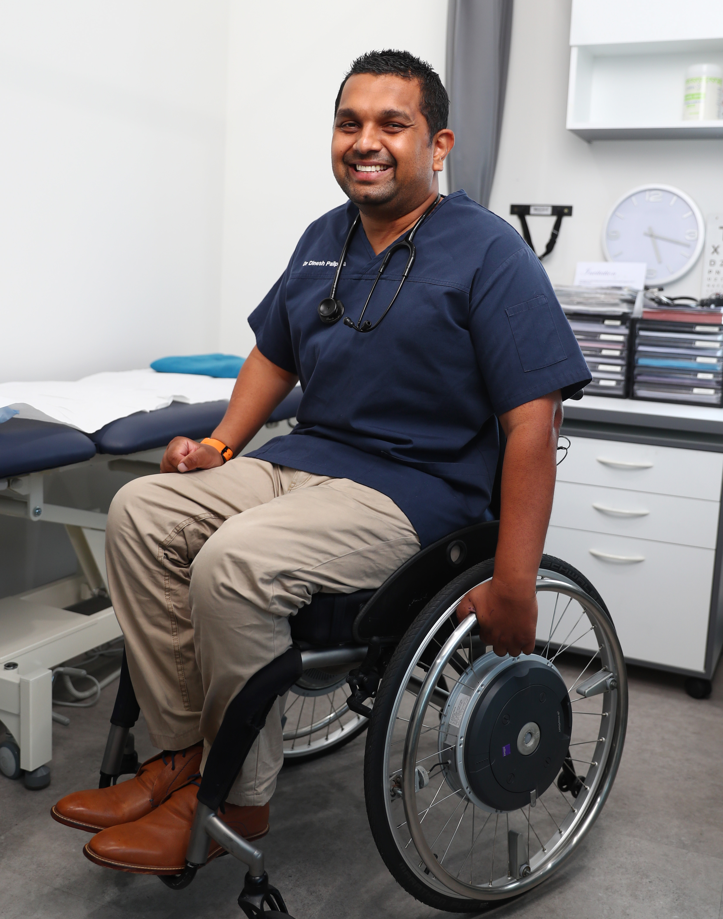

The work of DES (Disability Employment Services)
Support for job-seekers with disability to find and keep a job
Support in the workplace
Training and career development
Current vacancies
Referral to other services e.g. NDIS
Notes:
Financial support for job-seekers and employers
Example: workplace modifications and assessments, wage subsidies, productivity payments, running your own business and workplace support.
Support for job-seekers finding or changing jobs
Example: finding and keeping a job, working with Disability Employment Services (DES) providers, writing résumés and applications, preparing for interviews and more.
Support in the workplace
Advice on workplace modification, disclosure, training/support for co-workers, negotiating flexible work arrangements and returning to work.
Training and career development
Career development, finding training courses, transitioning from study into work, work experience.
Current vacancies
Referral to other services such as the National Disability Insurance Scheme

Slide 11
Barriers as seen by DES consultants
 | N=220
Employer attitudes - lack knowledge and/or skill to hire people with disability | 70%
Lack of a national approach to promoting graduates with disability to employers | 58.2%
Lack of early assistance - students are unable to register into DES until after they finish full time study | 44.5%
Societal expectation - there is not a high expectation that people with disability will get employed after study | 23.6%
Lack of wage subsidies to incentivise big employers | 25%
Students - students aren't proactive and don't seek their own work | 15.5%
Other | 3.6%

Slide 12
The challenge for DES
Focus for DES based on different client cohorts
Different focus and linkages to industry
Limited experience working with HEd to place students
DES consultants may have no HEd experience themselves
Some knowledge gaps working with graduates
Limited partnerships with Universities

Slide 13
USEP
National de-identified data to guide decision making
Best practice highlights are shared
A platform for combined engagement – Employers & Policy
Collaboration across industries and sectors
National website
Articles & social media for students
Professional development & skillsets are shared
How does a USEP partnership work?
Notes:
Local partnership/collaboration is formed to build a solid transitional link for SWD to external service after University,
Students get access to one-on-one support in the final year to lock in a graduate job on campus and then transition to provider for support. Provider becomes skilled and capable of working with graduates.
Partnerships work together across institutions to advance the employment of graduates with a disability maximizing existing resources, programs, supports.
Program is customized to suit the local context.

Slide 14

The first 50 (voluntary student provided data)
92% studied on campus
68% are or were full time students
36% are on a Disability Support Pension
52% want FT work, 32% want PT, Balance a mix
Only 53.2% have had degree related work experience
54.3% have not completed any paid work while at Uni
65.7% have not worked with a DES before.
Source: Questionnaire results from students who have worked with USEP consultants across four universities.

Slide 15












Active Partners

Slide 16
Student Case Study 1
“Will any work place even hire someone with a disability, how will I be treated in the work place, and how do I tell my soon to be Boss that I have a disability?”
Rachel has had a life time of negotiating with educators about dyslexia
Bullying and judgment were real threats in school (Teachers, Students)
Zoology – a competitive field
Received coaching about having ’the conversation’ with an employer, practiced this and leading from strength and passion about the industry.
Worked together to apply for graduate roles
Was successful obtaining a 6 month contract in exact desired field, which ended
Came back to consultant after University
Now working two jobs in the field with one job becoming the primary.
Some of the biggest concerns for me were…
Am I smart enough?
How much will my Dyslexia impact my studying?
Would there be a facility on campus that would be able to help me?
Will anyone understand me or will I be alienated?
Is it worth it?
Can I do it?

Slide 17
Student Case Study 2
“Throughout my whole degree I continuously compared myself to my peers and so the prospect of entering employment was extremely intimidating as I saw my peers as being more competitive candidates than myself.”
Susan did not disclose her disability on enrolment and has had negative experiences doing this in the past.
Was connected in her last year with USEP consultant by referral from DSO
Received coaching about negotiating with an employer for reasonable adjustments
Opportunities for students with disability were highlighted and applied for together
Practiced interviews and scenarios together
“This experience proved to be invaluable and I have been lucky enough to accept a graduate position in the Australian Public Service starting 2019. Furthermore Natalie’s guidance has meant I now have a better understanding of my rights in a work place, how to communicate with management as issues arise and how to communicate the reasonable adjustments I may require to overcome my barriers to employment.”

Slide 18

Lessons so far
Clear plan, objectives and communication strategy
Strong focus on engaging students
Strong web presence and internal promotion is essential
Dedicated staffing and resources
Perseverance and timing
Relationship building/personal touch

Slide 19

Things we’re working on
Data collection – locally and nationally
NDCO’s are hosting relevant and free training with guest speakers e.g. MyPlus, Panel Discussions
Improving partnership connections
Consultant handbook
Practical articles and promotion via website www.usep.com.au

Slide 20

Contacts
Gabrielle O’Brien
Manager – Student Diversity & Inclusion
Griffith University
P: 07 3735 5110 E: gm.obrien@griffith.edu.au
David Swayn
National Disability Coordination Officer
STEPS Group Australia
P: 0488 794 483 E: davids@stepsgroup.com.au
USEP online www.usep.com.au
www.facebook.com/USEPau/

