Slide 1

Transition from school to work for students with disability
Robert Lawson
2017 Churchill Fellow

Slide 2

Introduction
Work for the Department of Education and am currently in the role of Student Pathways Adviser in the state office in Oxford Street Sydney.
Manage the NSW Department of Education workplace learning programs, documentation and support resources.
Manage the School to Work online report.
Provide Transition Adviser Training
My home school is Kirrawee High School
I was awarded a Churchill Fellowship in 2017 to travel to
Ohio in America, Ireland and England to investigate programs
that support students with disability transition from School into
the workforce or further training.

Slide 3
Where did this project begin
  Schools for Special Purpose (SSP) complete the annual School to Work online report.
  NSW has approximately 100 SSPs as well as the many high schools that have a dedicated support unit for students with disability.
  In 2017 there were almost 105, 000 students with disability enrolled in NSW public schools, 15% of our students.
  I posed the question to my colleagues, ‘what are we doing for these students to provide school to work transition support and training’?
  The responses gave me the motivation to apply for a fellowship

Slide 4
My study tour
My study tour included:
  Ohio, America – Project SEARCH (Cincinnati Children’s Hospital, Fifth Third bank), Opportunities for Ohioans with Disability and Linworth Alternative School
  Ireland – Trinity College Dublin, St Augustine's School, St Francis Special School and discussions with the Department of Education and Skills, Special Education Section
  England - Technical Education Implementation Division Higher and Further Education Directorate, Alternative Provision and Attendance Unit Education Standards Directorate, National Development Team for Inclusion, St John’s college, Three Ways School and Regency High School.

Slide 5
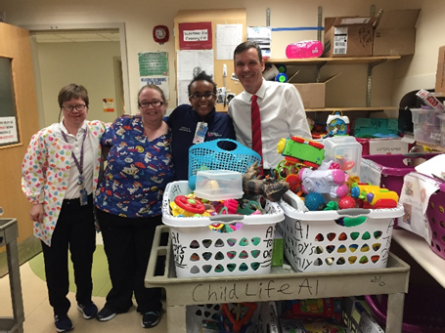
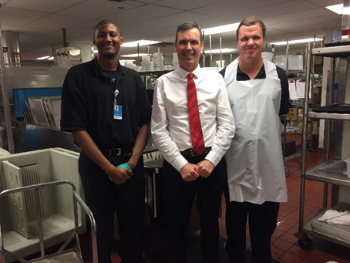

Project SEARCH
Project SEARCH is a transition from school to work program that is delivered to students with disabilities of all levels and is based in a host workplace.
The program is delivered in over 400 sites across America and in several different countries around the world.
The program has enabled 65% -70% of participants to gain employment.

Slide 6
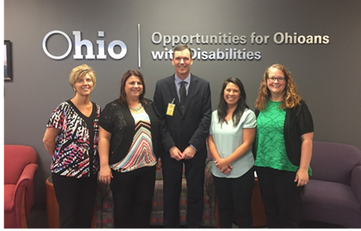
Opportunities for Ohioans with Disability
Opportunities for Ohioans with Disabilities (ODD) is a state agency that works closely with schools and external partners to provide services to students with disability to facilitate a successful transition from school to work.
ODD has transition specific services which are in four components:
Career Development activities
Summer Youth – Career Exploration
Summer Youth – Work Experience
Non – Permanent Job Development

Slide 7

Linworth Alternative School
Is attached to the two local high schools and offers an alternative approach to education.
Students with disability are included in the school’s cohort and find the school’s environment accepting and engaging.
Linworth delivers three main programs that support the development of employment related skills and life skills. These are:
  The schools mandatory Community Service Program
  The Interim program
  Walkabout

Slide 8
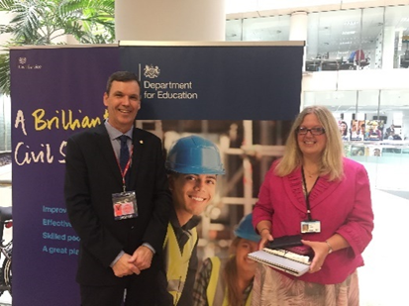
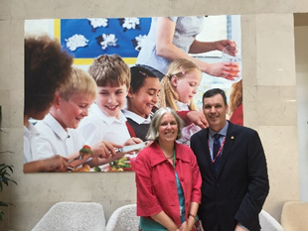

Department of Education UK
Alternative Provision and Attendance Unit, Education Standards Directorate and
Technical Education Implementation Division
Supported internships- are aimed at young people aged between 16 and 24 who want to gain employment. These structured study programs are based at a host employer and are heavily supported by intensive preparation, off the job training and job coaching.

Slide 9

Global Disability Innovation Hub
Launched in 2016 and has a focus on developing global partnerships and collaborations to ‘lead new thinking about disability especially in areas where exclusion is compounded by poverty’.
GDI Hub are leading or collaborating on the following projects:
  provide at least three million people with access to assistive technology
  partner to develop at least ten new disruptive technologies with potential for life-changing impact

Slide 10
Global Disability Innovation Hub
  develop at least six innovative service delivery models
  facilitate at least 30 new start-ups
  develop and test new methodologies for market shaping on assistive technologies
  establish an East Africa AT Innovation Hub
  developing a sustainable ongoing income model
  leverage resources from other stakeholders.

Slide 11
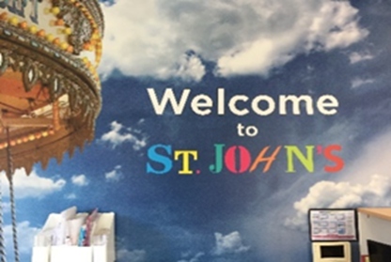
St John’s College, Brighton
Operated as a school for students with disability since 1957 when it was known as St John’s Residential Special School. St John’s state that their core mission is to enable learners to achieve their goals and aspirations; to reach out and achieve the possible and to live their life to the full.
The school links all activities to five outcome areas:
  Wellbeing
  Communication
  Skills
  Independence
  Employability

Slide 12
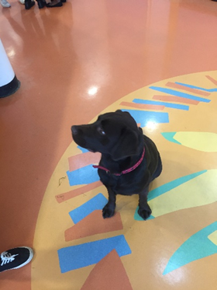
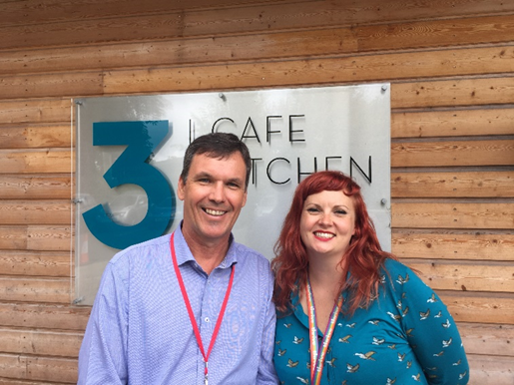

Three Ways School, Bath
Three Ways School in Bath was absolutely amazing. There are 220 students attending with a wide range of special education needs.
Specialises in the sensory and physical areas.
Students are able to access catering and coffee shop work experience in the purpose built on site coffee shop and function space.

Slide 13

Trinity College Dublin
Located in Dublin, Ireland and is recognised for educational excellence and the beauty of its historical campus.
The team at Trinity are passionate in their support of students with disability and champion inclusive participation and inclusiveness for all students, staff and where relevant college visitors.
The numbers of students with disability attending the college is increasing dramatically with mental health accounting for almost 40% of their case load.
Issues include, work placement requirements of courses and disclosure.

Slide 14
St Augustine's School, Dublin
Co-educational day and boarding school providing educational, social, recreational and vocational training programmes.
Student’s involved in workplace learning programs go to their work areas in the morning. Work areas include car valeting, office and retail, horticulture, catering, social skills and personal development. They then attend class in the afternoons.
Students rotate through all skill areas and have the opportunity to engage in work experience programs.
As St Augustine's is in a high socio-economic area parents and relatives are managers, business owners or have a broad network of friends who can provide work place learning opportunities.

Slide 15
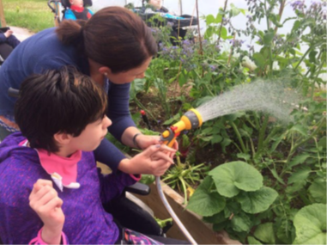
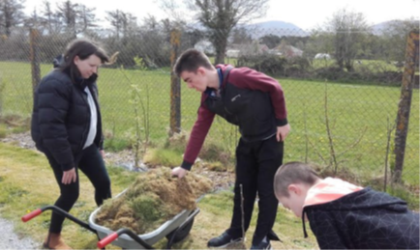
St Francis Special School, Killarney
For young persons with high levels of disability with the many students having multiple disabilities.
When I first arrived I was taken to the mural in the foyer with the school motto of Enable, Encourage, Enrich.
Students are supported to engage in work related activities such as horticulture, catering, construction and car valet services.

Slide 16
Common Themes
The importance of partnerships.
Career education and work related skills are imbedded in curriculum.
The importance of learning and practicing skills in a simulated workplace environment.
A clear pathway of learning, practicing and preparation leading into work experiences.
The value of internships

Slide 17
Thank You
Meaningful employment fosters a sense of worth, dignity, life satisfaction and is a fundamental right of all individuals including persons with disability.

