Slide 1
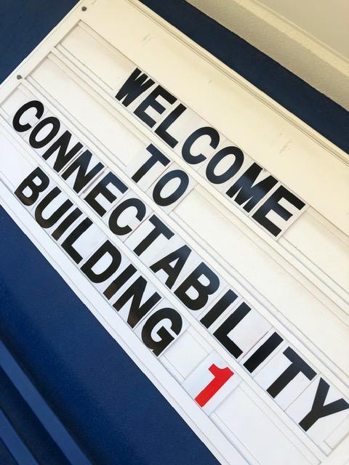
ConnectAbility: connecting high school students with disability to future pathways in tertiary education and training
Nat Vonthien
Acting Coordinator, Inclusion & Accessibility
Student Life & Wellbeing Centre

Slide 2
CQUni Mackay
CQUniversity is the first dual sector uni in Queensland, merged with CQ TAFE in 2014
Mackay has 3 campuses
Located 4 hours south of Townsville & 970km north of Brisbane
7 state high schools, 5 catholic high schools, 1 special school
Issues for young people include transport, employment, access to information and opportunities
Population: 127, 790 (June 2018)
Main industries: sugar, mining &
engineering feeder industry, tourism, services

Slide 3
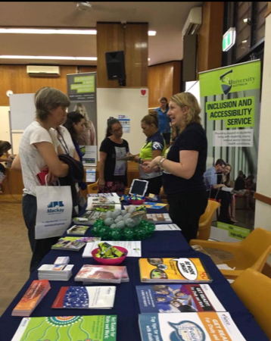
Background to project development
In 2017 Mackay Regional Transition Network was established by the Heads of Special Education Services, supported by NDCO. MRTN delivered Transitions Pathway Expo event: a great opportunity for school students with disability to learn more about post school options…
…but the enrolment of some of these students
highlighted that planning for course options
and support was needed earlier for a
smooth transition

Slide 4
The Idea
ConnectAbility, will actively engage with Grade 11 and Grade 12 students with disability and deliver an inclusive on-campus experience that aims to:
Connect high school students to their strengths, abilities and future possibilities
Raise awareness about training & education pathways
Build links to relevant support services
Deliver inclusive taster sessions
Introduce prospective students and their families to current CQUni students to hear more about lived experiences of post-school education and training

Slide 5
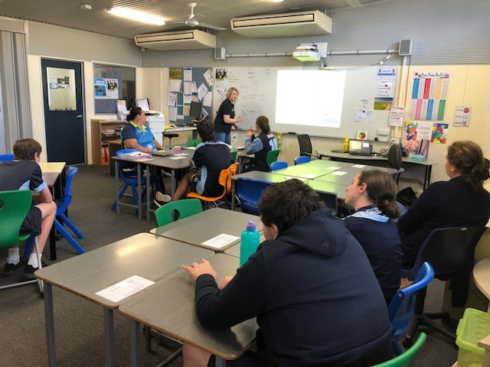
The Plan
CQU Inclusion & Accessibility Service and CQUni Connect worked closely with HoSES engaged with Mackay’s Regional Transition Network (MRTN) and NDCO
Student engagement visits
at schools August 2018
Student participation
shaped the scheduled program
Scheduled date negotiated with partners
Parents/carers welcomed
Notes:
Internal project team met fortnightly to consider project plan, milestones, budget, marketing, content and approach
Student engagement visits delivered in partnership with CQUni Connect staff. Aimed to build connections with high school students, gather information about their knowledge and awareness of future pathways, explore passions & strengths and seek input and advice about what kind of activities would be appealing. Feedback included FREE food, interactive sessions, opportunities to meet current students and find out what life is really like at CQUni. One student suggested Amazing Race tour. Feedback was mixed about parental involvement. Conversations encouraged ‘getting to know you’ with support staff

Slide 6
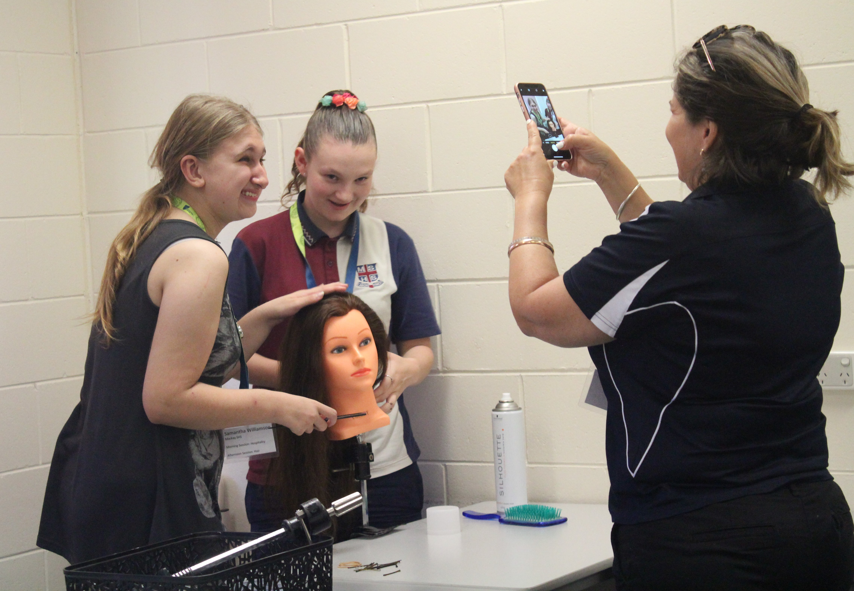
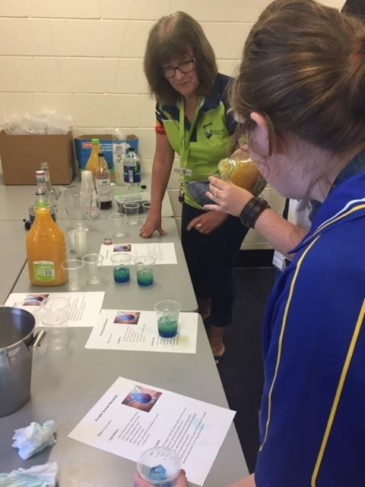
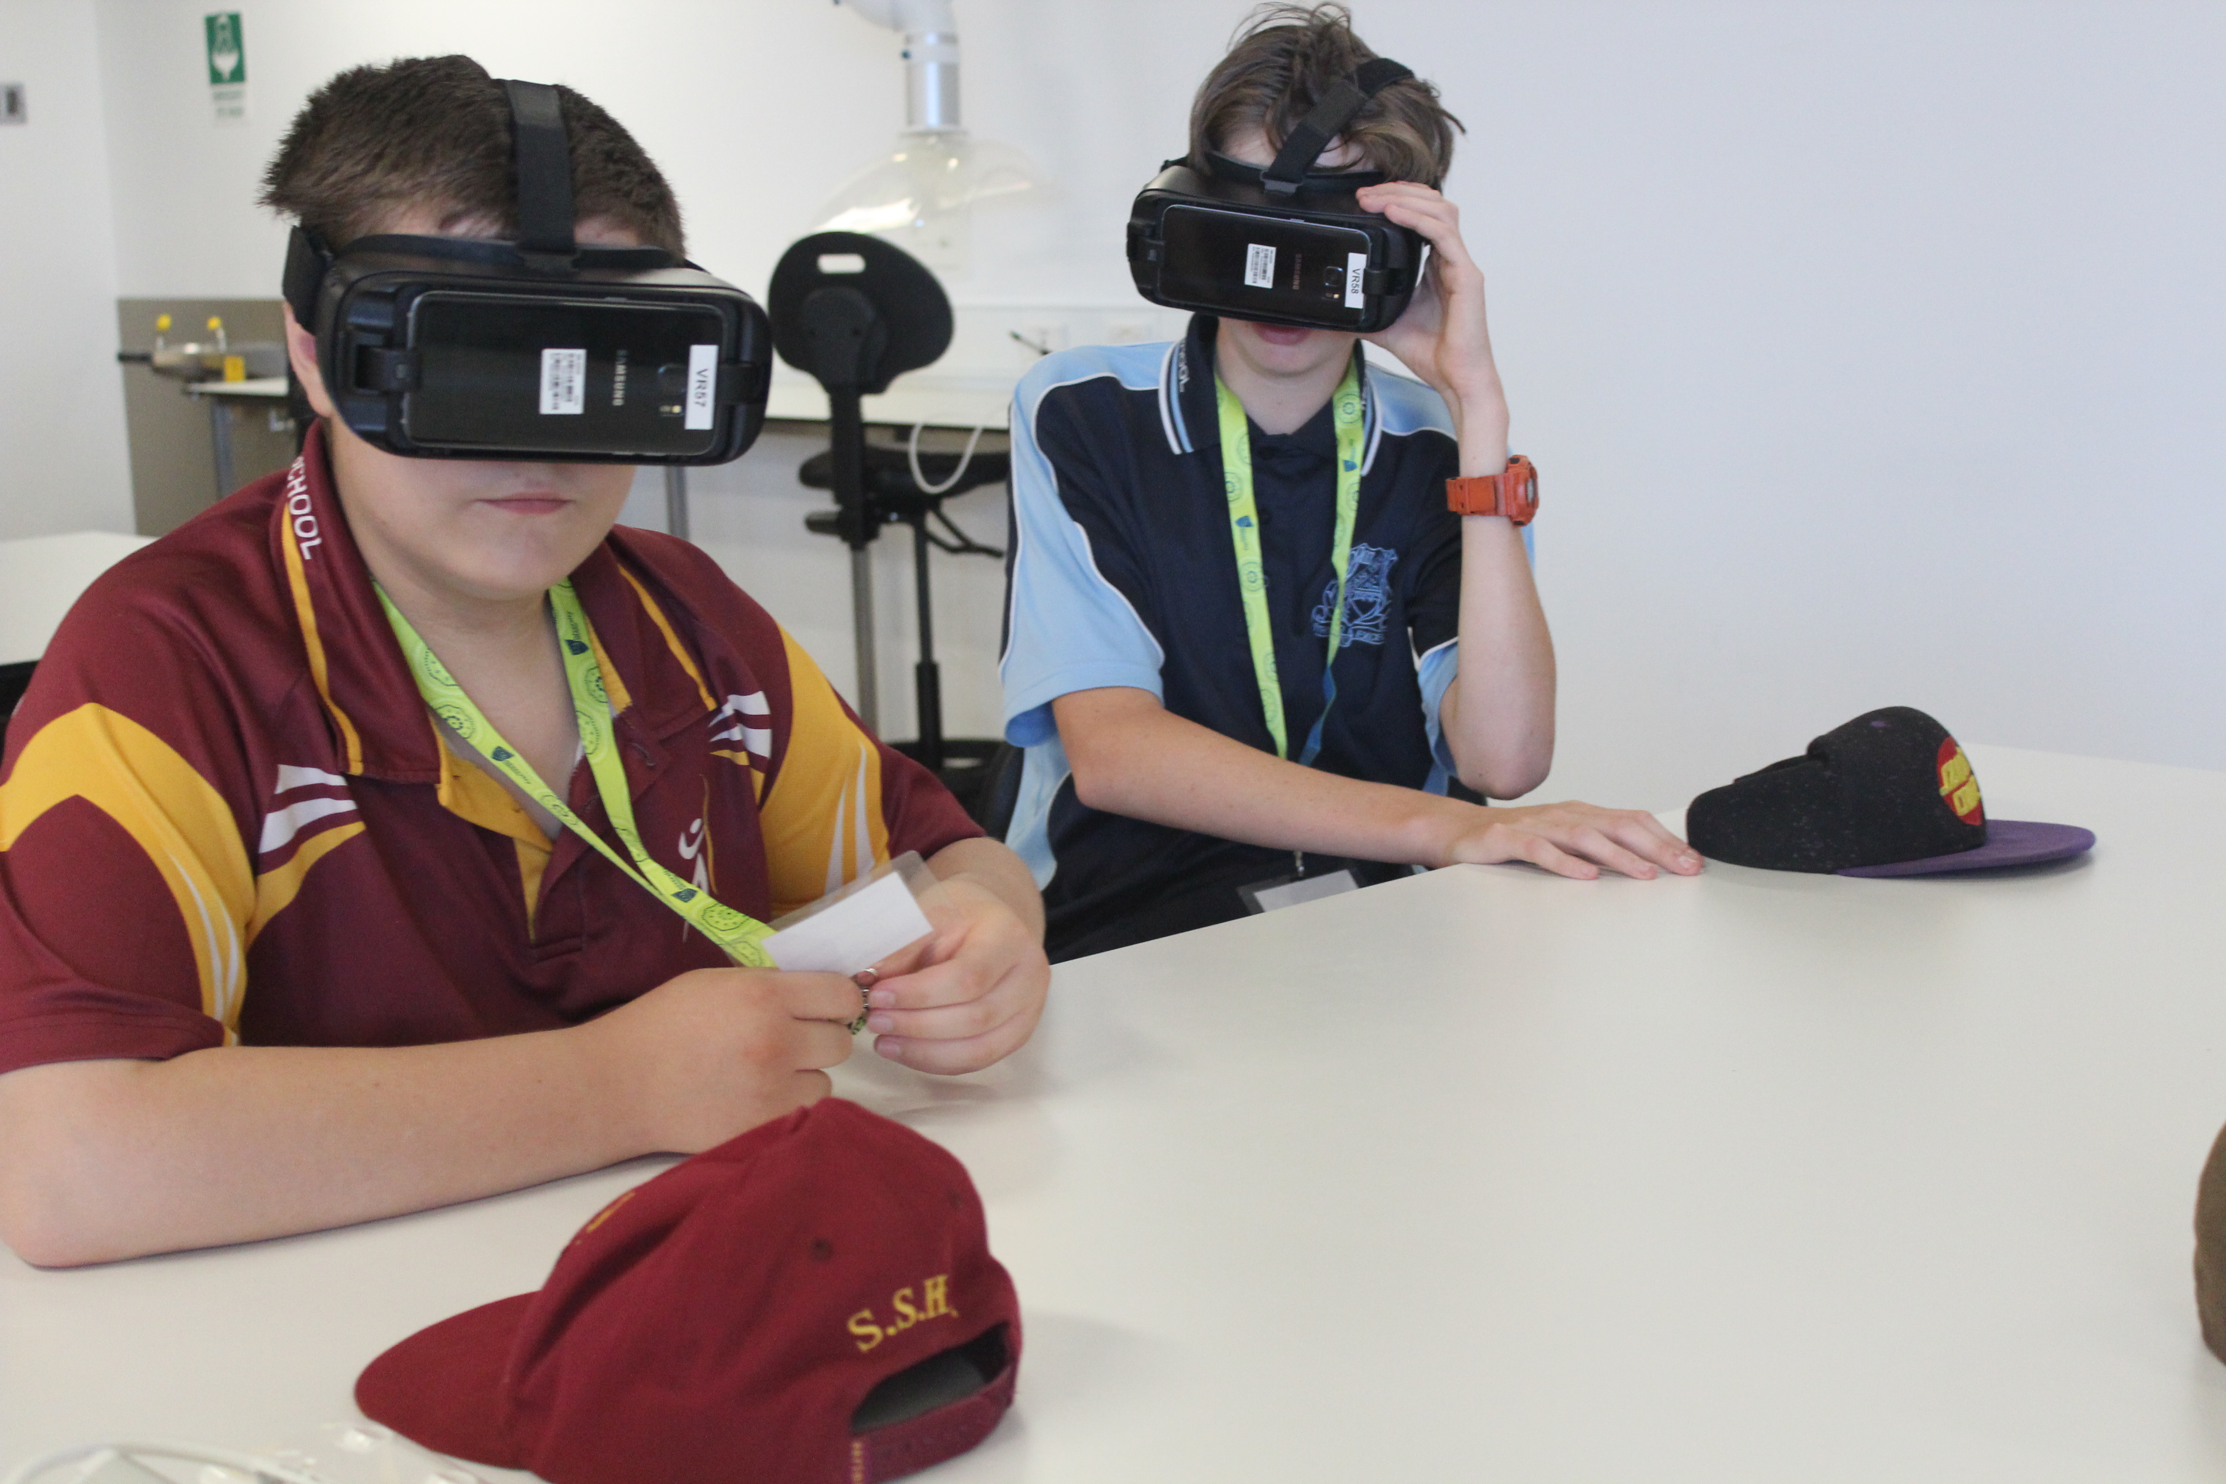
What happened
Welcome to Country
Amazing Race style campus tour
Student panel
Taster skills sessions (AM & PM): Business, Chiropractic, Digital Media, Engineering, Fitness, Hairdressing, Hospitality & Trades
Student Support Services Session
Feedback & evaluations
Notes:
Funding: NDCO funded transport for one school to attend (30 mins away from Mackay)
NDCO set up online registration form that included parental consent and media consent. Gathered data about interest areas
Sought further input from HOSES with taster skills session selections
Successes: picking a day during uni break – campus was quiet, student panel, student photographer, taster skills sessions, opportunities for school staff to connect and see students participate in a different environment
Challenges: teachers not being able to attend at short notice, students with low literacy skills
Atmosphere: relaxed
Budget: catering, cleaning, transport
In-kind: merchandise, prizes, printing
Staff resources: 7

Slide 7
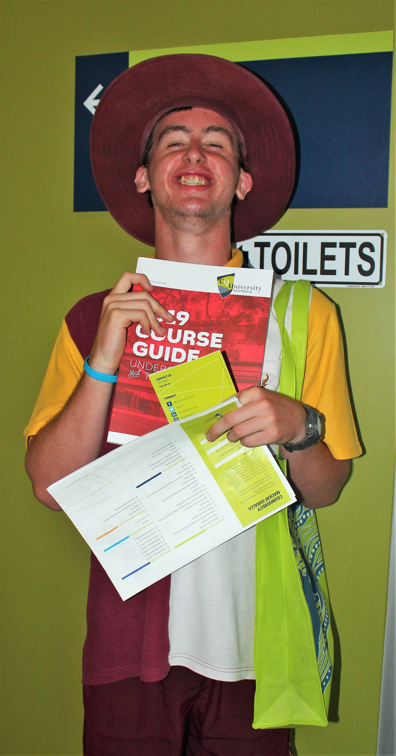
Feedback from students
89% said attendance definitely or probably helped to find out more about their options after school
89% understood support available for CQUni students
78% thought it possible to complete further study or training at some stage in the future
83% would recommend attending ConnectAbility to other young people in a similar situation to themselves
ConnectAbility has made me think differently about..
….“coming here after school”
.....“my future and alternative pathways”
.....“all the different opportunities open to me”
….“after Year 12 learning even though I have a disability I am included”
Other comments:
“I didn’t think I would go to TAFE, but now maybe I will”
“I enjoyed finding out that people like me have help and the LGBTQ community is welcomed and respected”
“it gave me a small sneak peek of the opportunities of studying this course”

Slide 8
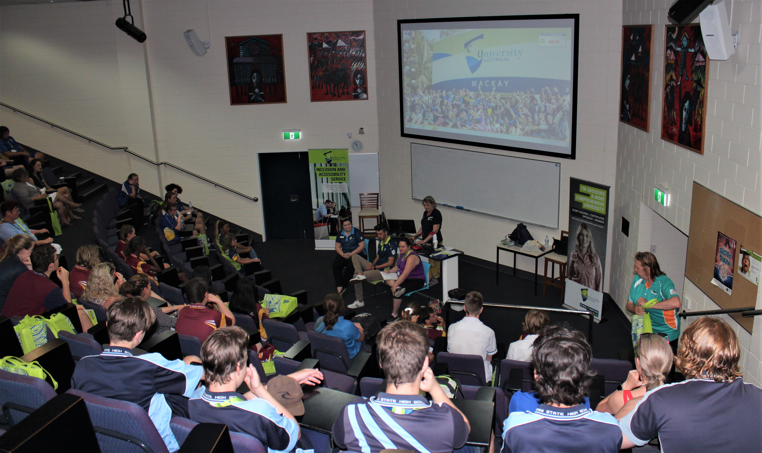
Feedback from school staff
100% adults agreed
ConnectAbility was well
organised, offered enough
opportunities for student
participation, was a positive
experience and
encouragement for similar
events in the future
“Great info for higher level students”
“Awesome presentation. The students felt comfortable and stress-free during the whole process. The presenters were wonderful and language to the students was at their level.”
“When we got back, all of our students had identified their career dream.”

Slide 9
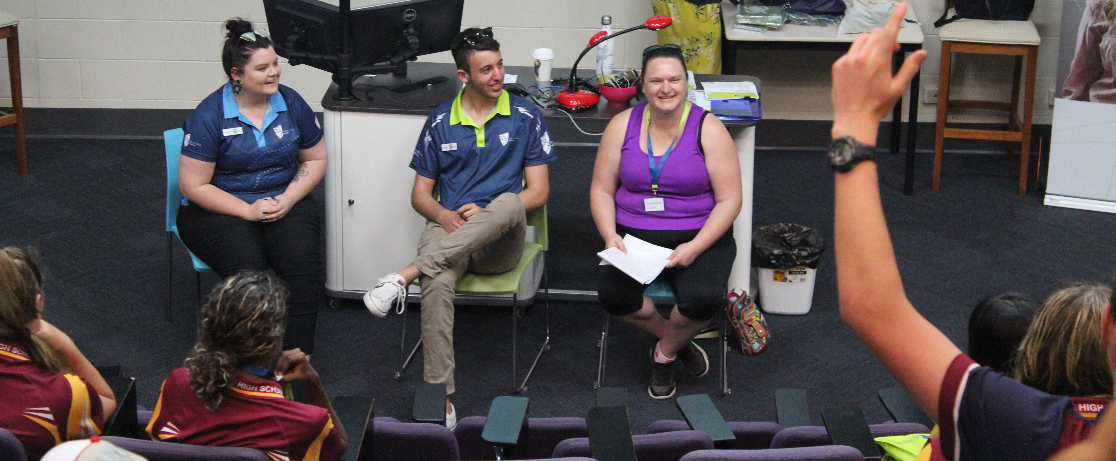
Future ideas for 2019 and beyond
Engage with disability networks in other areas: Bundaberg, Cairns, Rockhampton, Gladstone to build capacity with schools
Consider options for high school juniors (Grades 9 & 10) to assist SET planning and high school seniors (Grades 11 & 12)
Incorporate career planning in school sessions
Community partners would like to be involved
Involve more uni students
as mentors
Move the date (earlier)
Consider literacy needs

Slide 10
Contact us for more information
Nat Vonthien, Acting Coordinator – Inclusion & Accessibility
Email: n.vonthien@cqu.edu.au
Phone: 07 4940 7480
Wes Heberlein, Coordinator – Schools Outreach
Email: w.heberlein@cqu.edu.au
Phone: 07 4930 9542

