Slide 1

Helping them find their Super Power.

Slide 2
GradWISE
A collaboration between WISE Employment and Swinburne University to improve employment outcomes for students living with disability

Slide 3
Issue
Challenges
Opportunities
The future
WISE Employment:
Matthew Lambelle, CEO
Swinburne University:
AccessAbility Services: Genevieve Smith, Stefanie Hansen, Anthony Gartner
Careers and Employability: David Eckstein
Notes:
Collaboration between parties to improve outcomes for students living with disability. Aims to provide:
Internships
Meaningful work on employment
New model of reach in partnership, developing students’ skills for employment
Discuss process, challenges, outcomes to date

Slide 4
Swinburne AccessAbility Services
1100 students registered, vocational and HEd.
1/3 HEd students online
Internships, graduate positions
Challenges of getting a job when CV has gaps
Disclosure
Notes:
AS and Disability standards for education

Slide 5

Matthew Lambelle
Chief Executive Officer | WISE Employment

Slide 6


About GradWISE
GradWISE is a new program, developed by WISE Employment in conjunction with Swinburne University to enhance graduate employability for students identified as living with a disability
Approximately 48,000 (4%) of Australia’s 1.2 million University students identify as having a disability.
Experiencing 15-50% lower graduate employment outcomes than students without disabilities.
Innovative approaches AND, USEP and Dandelion are needed to tackle the scale of the challenge.
GradWISE offers another approach and seeks to add to a growing body of knowledge in a quest for outcome parity.

Slide 7
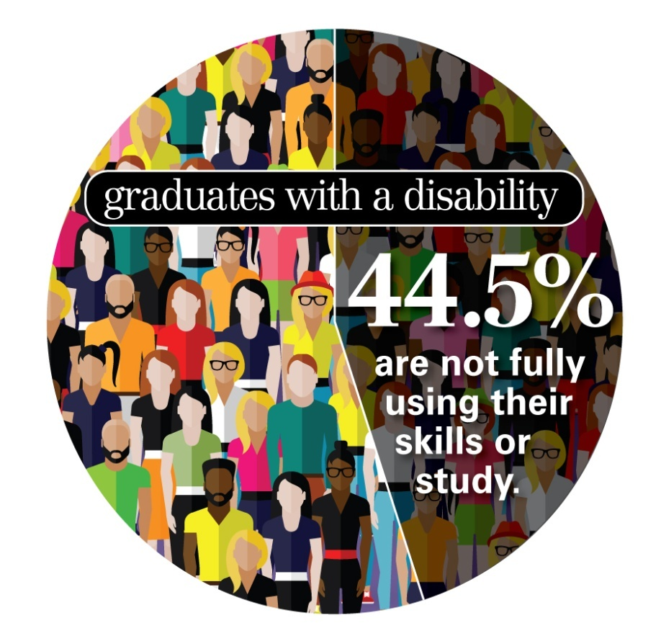
Over 25 years of experience
WISE Employment has over 25 years of experience in disability employment services and over 100,000 employment outcomes.
GradWISE combines WISE Employment’s experience and a new neuroscience approach aiming for enhanced employability for graduates overtime.
GradWISE went live July 1, 2018.
Graduate Outcomes Survey 2017
44.5% of graduates with a disability are not fully using their skills or study.
Notes:
Undergraduates with a reported disability had a full time employment rate of 61.5% four months after graduation. This is 11% lower than their peers.

Slide 8
Challenges
Engagement with students
University buy-in
Student expectations
Notes:
Swinburne’s collaboration with GradWISE the result of chance(?) meeting between Matt and Swinburne VC.
engagement with students. Plan to increase promotion. Is that the right approach? How would audience members reach students. What are the points of engagement with students? Instagram, FB, other social media? LinkedIn? (provide support for professional linkedIn profile, link with CDL)
The need exists but the uptake is nascent because we’re still learning.
When to engage students in their student life cycle. Before or after graduation? Early in student life-cycle ie first year?
2019 new process: student registration with AS’s will auto register students with AACH.
Student expectations. Entitlement vs engagement. How does this affect engagement with students? CDL theory: engage early with students but student perception of CDL and AccessAbility Services mean contact with these supports are not prioritised by students.
USEP acknowledgement (brief outline)
Audience: primarily disability liaison officers. Will want to know difference with USEP program and how GWISE collaboration is different. [Matt will develop this]
How to set up GWISE program? Why was this viable option for GWISE compared to USEP? More collaboration, flexibility.
Unis career services have contracted. Opportunity for USEP model?

Slide 9
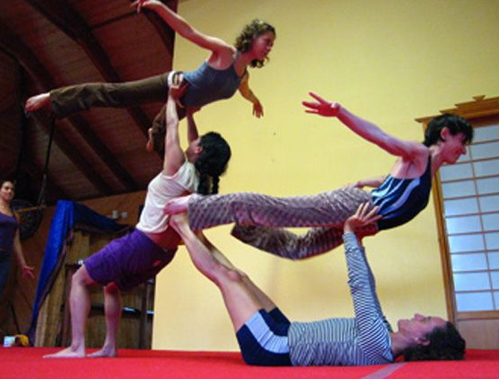
Individual stakeholder frameworks… it takes 4 to tango…
WISE
AccessAbility
Careers & Employability
Students
Notes:
Introduction to the nature of the collaboration effort: different but complementary stakeholder frameworks

Slide 10

Current constraints
Funding model biases fast results (paid work) not well engineered career starts and paths.
Prohibits full time students.
Deters early intervention – Year 1 or Year 2 of study where employability gains can be developed over time.
Stigma and bias still exists – blocking free and open disclosure for fear of discrimination or labelling
Competition is high for graduate entry level employment
Notes:
Despite two decades of economic growth in Australia; 25 years of equal employment opportunity; disability discrimination legislation and the advancement of the diversity agenda, people living with a disability are being left behind.
Nationally, this group experience approximately 30%
lower labour force participation rates and at least 15% lower graduate employment outcomes than those without a disability.

Slide 11

Early learnings
Disclosure
Student engagement
Converting employer interest into action
No quick fixes
The prize of parity is worth the pursuit
Notes:
Despite two decades of economic growth in Australia; 25 years of equal employment opportunity; disability discrimination legislation and the advancement of the diversity agenda, people living with a disability are being left behind.
Nationally, this group experience approximately 30%
lower labour force participation rates and at least 15% lower graduate employment outcomes than those without a disability.

Slide 12
Swinburne University
Careers and Employability
Careers Education perspective
AccessAbility Services
Careers and Employability
AccessAbility Careers Hub
David Eckstein: AccessAbility Careers Hub Coordinator

Slide 13
AccessAbility Careers Hub
Careers and Employability
Career development learning
Tailored student experiences
Makes university employability strategies accessible and beneficial to students
(Watts, 2006)
GradWISE Program + Mentoring, Internships, Placements,
Workshops
Student Community of Practice
E m p l o y m e n t
Nurtures the knowledge, concepts, skills and attitudes
that enable lifelong
independent progression in
learning and work
(Watts, 2006)
Independent career management mindset competencies:
develop strategic approach, resilience, sense of purpose, profession vs job, independence, evidence-based validation, professional development plans, deal with uncertainty, embrace change, planned happenstance
professional self
individual career management capacity
Notes:
Transformative experiences
Self-directed education models
Closing the employability gap for students with disability through planned student-centred experiences that enhance engagement with core disciplines
collaboration with industry, curated by career development learning design
Creates a sense of belonging through engagement with community of learners
_________
planned experiences designed to nurture knowledge, concepts, skills and attitudes which enable independent and lifelong progression in learning and work
strengthens student employability strategies, making them accessible to students
Watts (2006)
________________
Watts, A. G. (2006) : Career Development Learning and Employability. The Higher Education Academy, Learning and Employability Series Two
planned experiences designed to facilitate the development of
CDL: knowledge, concepts, skills and attitudes which will equip them to manage their careers, i.e. their lifelong progression in learning and work
set of meta-skills which enable individuals to develop and use the full range of their other skills.
competence in making and implementing the decisions that determine one’s career.
Career development learning offers an additional dimension to institutional strategies designed to foster the employability of students. It makes the value of such strategies transparent to students; it also strengthens the sustainability of their benefits.

Slide 14
Swinburne University
AccessAbility Services
Genevieve Smith, AccessAbility Adviser
Stefanie Hansen, AccessAbility Adviser
Anthony Gartner, Associate Director

Slide 15
Practitioners' Perspective
Benefits
  Confidence in referral
  Increased job satisfaction
  Professional development
Challenges
  Cross team communication
  Separate physical location
  Students' awareness of service
Notes:
Benefits:
Stefanie and I would like to share with you what it is like as AccessAbility advisers working with the gradwise program.
On the outset, I would like to caveat the following points are from our own experience.
We now feel more comfortable to raise career progression with students knowing that there is an expert specialised service that we can refer our students to who have capacity for 1:1 support.
We also have a degree of tangible confidence in referring to people within our own organisation, we have trust with a known entity.
The gradwise program gives us a greater sense of purpose in our roles.
The reasonable adjustments that are put in place for students translate into more than a university degree.
To use an analogy which I hope is familiar within most peoples vernacular is that ‘We get to see the icing on the cake
Professionally, we are exposed to insights to career development we would otherwise not be privy to.
We have opportunities to be involved into platforms of vital discussions pertaining to students career advancement we would not otherwise come across.
Challenges:
We have found that communication across the teams has been difficult given that we all have a very high workload and staff are mostly part-time. Communicating via emails has proven to be clunky and not clear or efficient at times.
Not being physically located in the same building makes it difficult to have informal conversations and get to know staff members and the project. We miss out on the gold that can occur in water cooler conversations.
At this point in time the GradWise project is very new and we don't have collateral to share with students. Accessability Advisers have had to actively promote the service during consultations with students.
I now hand over to Stefanie, who will discuss our ideas for improvements and the benefits this program have provided to a student registered with AccessAbility services.

Slide 16
Practitioners' Perspective
Ideas for improvements
  Utilising a cloud based program
  Co-locate
  Collateral
Success
  Student outcome
Notes:
Improvement:
We believe that utilising a cloud based program or tool that allows better information sharing and easier communication would enable more streamlined service provision.
Co-location would provide opportunities for informal conversations to share relevant information, facilitate “warm referrals” and increase collaboration and innovation.
Having posters and Marketing material would enable greater awareness of the program amongst the students we support but also those students who are not registered with AccessAbility Services.
Success:
To finish this presentation, I would like to share a success story with you.
Steven came to Swinburne in 2012 and enrolled in a Bachelor of Engineering. At first he seemed quite dependant on his mother and his case worker. The case worker was working with Steven to increase his everyday living skills, especially using public transport. Over time Steven became more confident and independent. He got his driver’s license and wanted to live on his own etc.
He did quite well in his degree with the occasional difficult phase due to stress.
He was very interested in gaining workplace experience whilst being at uni and organised a 6 month industry placement through Swinburne.
Steven completed his degree before the launch of the GradWise program. He was determined to find a job on his own but unfortunately struggled to make it past the initial interview stage.
Students can still access services at Swinburne up to a year past the completion of their course and so Steven used an opportunity that came up through GradWise.
With the support from the program he managed to be successful in gaining a position starting in January.
Steven and I had stayed in contact and his email informing of his success made me very happy. He was very proud and he can now demonstrate to an employer what a skilled, smart and loyal guy he is. To me, it made all my work with him the more worthwhile.

Slide 17


Slide 18

Look forward to connecting
Matthew Lambelle
Chief Executive Officer
Matthew.lambelle@wiseemployment.com.au
Ed Osano
Head of GradWISE
Edward.osano@wiseemployment.com.au
gradwiseenquiries@wiseemployment.com.au
Notes:
Undergraduates with a reported disability had a full time employment rate of 61.5% four months after graduation. This is 11% lower than their peers.

