Slide 1
JobAccess: Enabling workplace inclusivity through innovative solutions
Daniel Valiente-Riedl
General Manager, JobAccess Pathways14 Conference
6 December 2018

Slide 2
Putting facts in perspective
The business case for disability employment

Slide 3
In numbers…

Slide 4
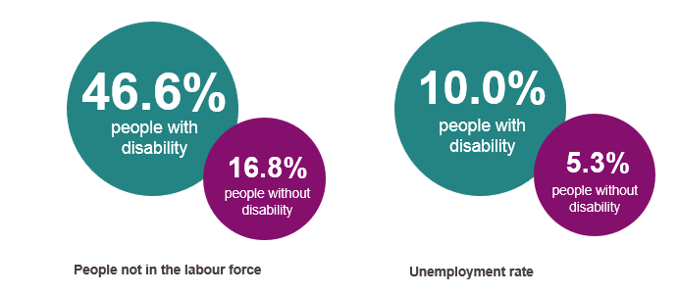
Large talent pool

Slide 5
Sharing the business benefits
Employing people with disability…
Builds diversity
Promotes business
Enhances
employer
brand
Improves customer relations
Diagram: listing reasons why employees with disability are good for business
Creates
goodwill
Boosts
morale

Slide 6
Contributing to the economy
1 million employed people with disability work in all industries and diverse occupations across Australia
32% employees
with disability work as professionals or managers
Over 90%
of employers who had recently employed a person with disability said they would be happy to continue to employ people with disability
Diagram: listing statistics on how employed people with disability are contributing to the economy

Slide 7
Room for improvement
Only 35% employers demonstrate behavioural commitment to hire people with disability
44% employers have concerns about integrating people with disability into the workforce
37% employers see employing a person with disability as ‘a step into the unknown’
Diagram: a list of statistics next to images of a handshake, two arrows in a circle, and two heads

Slide 8
Why are employers shifting the focus to disability employment
Access a broader talent pool with a wide range of skills, talents and qualifications
The best person for the job may be a person with disability
Because they are already doing it! Support for employees with disability can benefit everyone
Picture: man and woman sitting and talking at a table

Slide 9
Strategies to set you on track
Practical advice and tips

Slide 10
Employees with disability are…
Diagram: listing statistics under the headings productive, safe, reliable and affordable

Slide 11
How are employers tapping the talent pool?
Meet Carly Findlay
Access and Inclusion Coordinator at Melbourne Fringe

Slide 13
Language – the power to include
“Lose the ‘us and them’... we are all people. People with disabilities aren’t ‘them’ and people without disabilities aren’t ‘us’.” – Carly
It is important to consider the language you use, and to phrase any questions in terms of any adjustments to the workplace or job design that may be required
Avoid questions seeking details about the nature/origin of a person’s disability, or those with negative assumptions or connotations

Slide 14
How universities are taking the lead
UTS Sydney – first Australian university to host an educational seminar on disability employment
Building accessible spaces through workplace modifications
Embedding disability employment in curriculum delivery
MBA program
Masterclasses

Slide 15
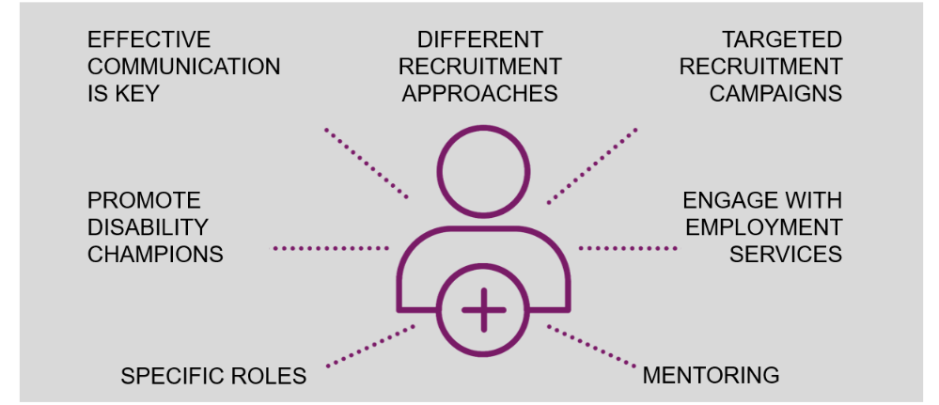
Proven strategies for employers
Diagram: listing different recruitment strategies for employers
Open for business: the benefits of an inclusive workplace and the support to get you there

Slide 16
Support you can count on
Expert advice and resources delivered by JobAccess

Slide 17
JobAccess: we’re here to help
Expert advice via phone and website
Employment Assistance Fund
Employer engagement services
Complaints Resolution and Referral Service
National Disability Abuse and Neglect Hotline
Diagram: a list of services under images of a computer, dollar sign, two heads, a handshake and binoculars

Slide 18
Expert advice via phone and website
1800 464 800
www.jobaccess.gov.au
Picture: a man (amputee) and woman talking

Slide 19
Employment Assistance Fund
Free workplace assessments
Modifications, support and training
Picture: man and woman (both in wheelchairs) in a cafe

Slide 20
A dedicated employer engagement team
A free disability recruitment advisor to employers
12-month partnerships
Focus on building disability confidence and capability
Picture: woman working on a laptop

Slide 21
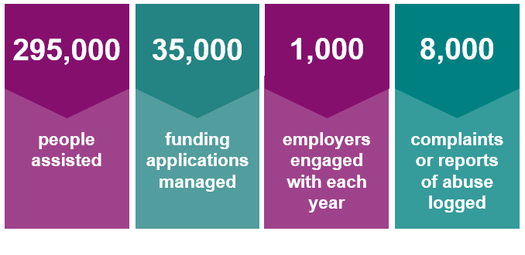
A valued support
Diagram: listing support delivered by JobAccess since July 2006

Slide 22
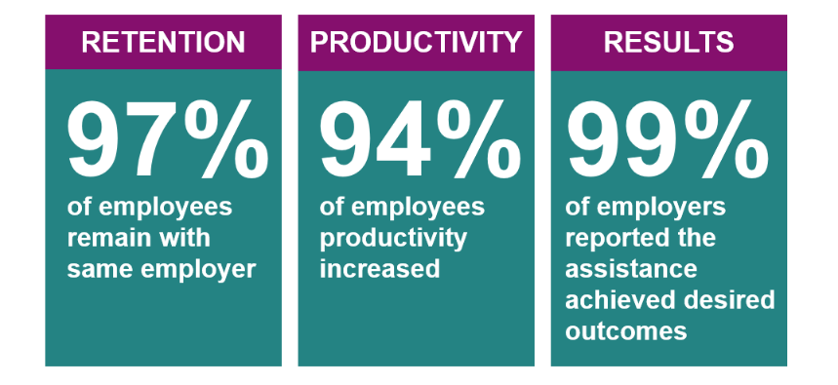
Driving disability employment
Diagram: listing feedback received from employers
JobAccess: Enabling workplace inclusivity through innovative solutions

Slide 23
Join the conversation
Share your views and ideas with us. #EmployTheirAbility
Follow JobAccess on LinkedIn: www.linkedin.com/company/ jobaccessau
Picture: icon of two heads

Slide 24
Thank you
Contact us 1800 464 800
Visit www.jobaccess.gov.au

