Slide 1
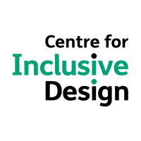
Pathways14 Conference
Progressive Partnerships
Inclusive, Innovative, Ingenuity
New and Emerging Trends in Recruitment and D&I considerations:
Technology, online assessments and artificial intelligence
Presenters:
Dr Crissa Sumner
Manisha Amin
Thursday 7th December, 2018
Notes:
5 mins
Welcome and thanks for joining us in this session.
Introduce self and handover to Manisha to introduce herself.
Provide a high level outline of the session, and invite questions along the way; there will also be at least 5 mins for final questions towards the end of the session.

Slide 2
Employment challenges for people with a disability
Notes:
5 mins - MANISHA

Slide 3

Mary’s Story
Why every step matters
Notes:
Mary (not her real name) is a person I met recently. She is legally blind. She got through university and a law degree. We know how hard that can be for any student let alone one who had to rely on screen reader technology. But she was an excellent student, with family support.
When it came time to look for a job, like other graduates she looked at roles targeting graduates. She told us of her fist experience. Not only didn’t she have to first find the role, the form to upload her resume were not accessible. She needed someone else to upload them.
Then when she got to the next round the test she needed to complete as in accessible. Now Mary is tenacious so she found a phone number and spoke to a human. This is something most graduated wouldn’t have done. She eventually got to the hiring officer, and on explaining her challenge, the officer said she could skip the first few steps of the interview and go straight to the face to face. That’s great you may say –but Mary’s view was that she wasn’t to be on a level playing field with everyone else.
And Mary is one of the luck ones.

Slide 4
Employment statistics for people with a disability
Graduates with disability take 56.2 % longer to gain fulltime employment than other graduates.
People with disability aged 15-24 years are 10 times more likely to experience discrimination than those aged 65 years and over. The source of discrimination is an employer in almost half of those instances.
Unequal participation in employment has high social costs - 45% of people with disability live on or near the poverty line, 2.5 times the rate of poverty experienced by the general population.
Source
[6] 'Grad Stats', 2015, Graduate Careers Australia, viewed 24 February 2017.
[7] 'Benefits to business: The evidence for investing in health and wellbeing' 2011, ComCare, viewed 15 March 2017.
Notes:
While Mary got a job the story doesn’t’ normally end there. In today’s job market it’s harder for graduates to find jobs and the job market is changing rapidly. But for people with disability if even harder. I know that most of you have seen the stats so I’ll only show you a couple that really resonated for me.
*******
Improving employment outcomes for people with disability will provide significant benefits to workplaces, the economy, the community and individuals themselves.
Employment can provide people with disability with increased income, and with this, higher living standards and financial independence. Employment can contribute to a sense of identity and self-worth and have positive health impacts for some people with disability. Improved employment outcomes for people with disability can also reduce demand on welfare systems.

Slide 5
The business benefits of D&I
Notes:
5 mins - MANISHA
Let’s zoom into the business benefits of D&I in more detail.

Slide 6

The diversity advantage
Notes:
We know that diversity isn’t just a nice to have, it’s actually good for business.
When we have a diverse group of people we get different perspectives, rich insight and also more robust ways of working.
However there is a real connection here between diversity and inclusion. Diversity from our perspective is about the numbers and types of people as well as the diverse opinions that these people have.
Inclusion is different, it’s about being able to bring your whole self to work. To fully participate. Not everyone does things the same way but do they have the ability and opportunity to participate at work in a full and rich way.

Slide 7
Diversity + Inclusion = Improved business outcomes
Companies with greater diversity outperform their peers on a number of key economic indicators
35
%
Financial returns with
cultural diversity
46
%
Return on equity with sustained gender diversity
$50
in GDP could be added to Australia’s economy if Australia moved into the top eight OECD countries in employment of people with disability
billion
Sources: McKinsey & Company, 2013; National Bureau of Economic Research, 2013; Catalyst, 2011; PricewaterhouseCoopers, Disability expectations: Investing in a better life, a stronger Australia, 2011.
Notes:
Globally, Australia ranks 21 out of 29 Organisation for Economic Co-operation and Development countries in employment/participation of people with disability, so there is still room for improvement.
More specific business benefits of hiring PWD include the following:
Reliable – People with disability take fewer days off, take less sick leave and stay in jobs longer than other workers.
Productive – Once in the right job, people with disability perform as well as other employees.
Safe – Australian and overseas studies have found that workers with disability are no more likely to be injured at work than other employees.
Good for business – People with disability build strong connections with customers. They boost staff morale and loyalty by helping to create a diverse workforce. Teamwork is enhanced.
Its an important time for this conversation, as not only is there increasing focus on the area of recruitment of PWD, with many state govts increasing focus and targets in this area, (ranging from 3- 8 percent), but also because recruitment is increasingly using technology to find the “right” employee (which presents both opportunities and challenges for PWD).

Slide 8
New and emerging trends in recruitment:
Technology, online assessments and artificial intelligence (AI)
Notes:
10 mins - CRISSA

Slide 9
Insert
Technology takes precedent
59% of recruitment agencies
anticipate an increase in tech
spending in 2018

Slide 10
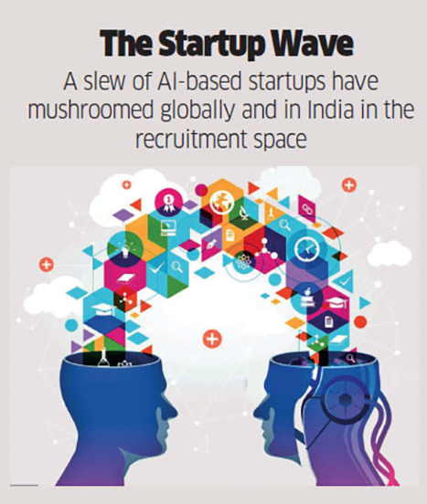
New and emerging trends in recruitment
Social media
Online company reviews
Video interviews
Online assessments & exercises
Gamification
AI candidate screening
Virtual reality
Augmented reality
People and talent analytics
Notes:
Social media: In 2018, the role of social media will continue to grow in importance as more recruiters recognise how invaluable it is as a platform to attract talent and segment talent pools more easily. For example, the technology exists to target job adverts at very specific online audiences, such as those attending a professional conference who live in a certain geographical area.
Company reviews: Previously, good and bad recruiters were largely known about via word of mouth. Now, online reviews on sites such as Glassdoor are increasingly used to identify the agencies that have satisfied their clients and candidates.
Video interviews: The world is becoming increasingly global and interconnected. Whether you are a startup or a multinational, you can tap on the global talent pool. And about 60% of organizations are turning to video interviews for their recruitment exercise. Video interviews are killing the resumes, and ushering in a new way of screening candidates for face-to-face interviews.
Online assessments: Increasingly organisations are using online assessment tools to support selection processes – this may include cognitive ability tests, personality profiles, motivational drive questions, electronic simulation exercises.
Gamification: Some new and emerging assessment tools are based on the notion of gamification - the application of typical elements of game playing (e.g. point scoring, competition with others, rules of play) to other areas of activity, such as selection tools to encourage candidate engagement
AI candidate screening: Automated and machine-learning algorithms will be used to screen CVs and communicate with candidates. While this is a complex AI challenge, in 2018 organisations will work on ‘training’ ontology to convert the semi-structured data of CVs and job descriptions into a consistent format for processing which, once implemented, will significantly accelerate the shortlisting process
Virtual reality (VR) to enhance a jobseeker’s profile: While some organisations (PwC for example) provide VR tours that give jobseekers an indication of the workplace and culture, jobseekers too could start to embrace the technology to showcase skills and competencies to enhance their online profiles. For example, hiring managers could virtually explore an architect’s completed projects, an IT project manager’s applications development projects or a marketing manager’s marketing campaigns.
Augmented reality (AR): As AR becomes more mainstream, organisations will experiment with interactive candidate experiences. For example, AR could allow a candidate to walk through the workplace, participate in a mock client meeting or another relevant activity, and sit with an employee who talks about their typical day.

Slide 11
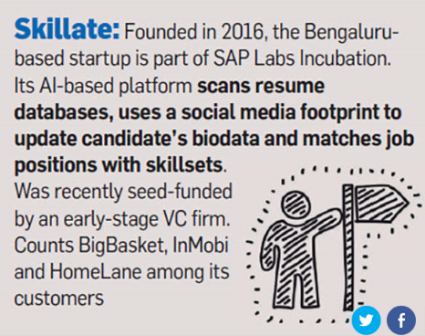
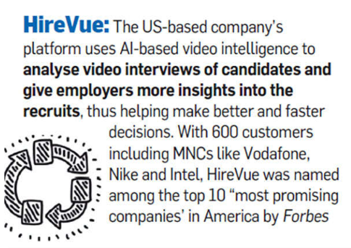
Notes:
Skillate: This AI platform scans resume databases, uses a social media footprint to update candidates biodata and matches job positions with skill sets.
HireVue: HireVue’s AI-based platform analyses interviews on the basis of facial expressions, words being used, voice inflection and micro gestures to assess a candidate. For example, it draws inferences from candidates’ usage of active verbs such as ‘can’ and ‘will’ or negative words like ‘can’t’

Slide 12
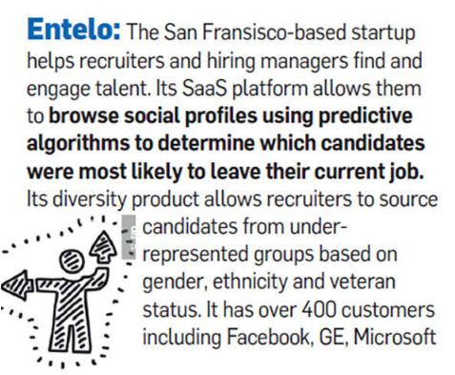
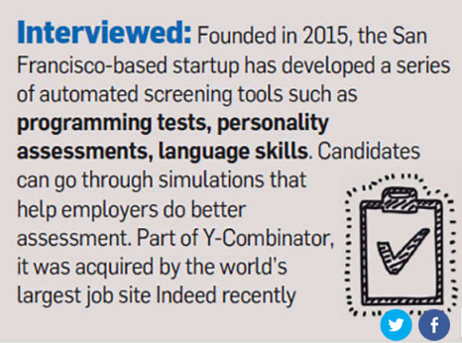
Notes:
Entelo: Another startup Entelo mines data and social media presence to predict which applicants are likely to switch jobs.
Interviewed: In August, job platform Indeed — which claims to be the world’s No 1 jobs site — acquired a 12-employee startup called ‘Interviewed’, which helps companies with its AI-based candidate assessment tool. For example, its automated phone screening, machine learning and natural language-processing capabilities help construct a psychological profile of the candidate and judge cultural fitment. It claims to whittle down a database of 4,000 candidates within days to shortlist the top 2-3%
Read more at:
//economictimes.indiatimes.com/articleshow/60985946.cms?utm_source=contentofinterest&utm_medium=text&utm_campaign=cppst

Slide 13
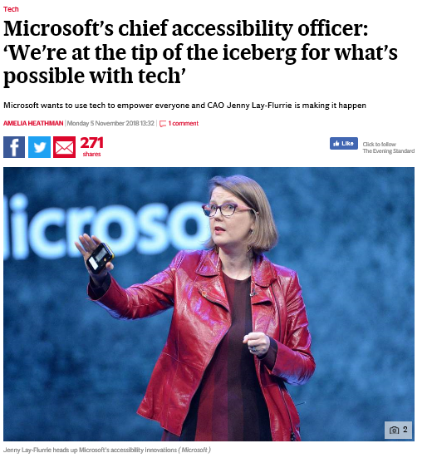
Notes:
There are many pros and cons of technological advancements in the workplace for PWD.
(Refer to article on slide focusing on the pros)
AI advances in areas such as predictive text, speech-to-text transcription, and voice and visual recognition can assist employees or potential employees with disabilities.
However, there are also a number of cons or challenges to be aware of…

Slide 14
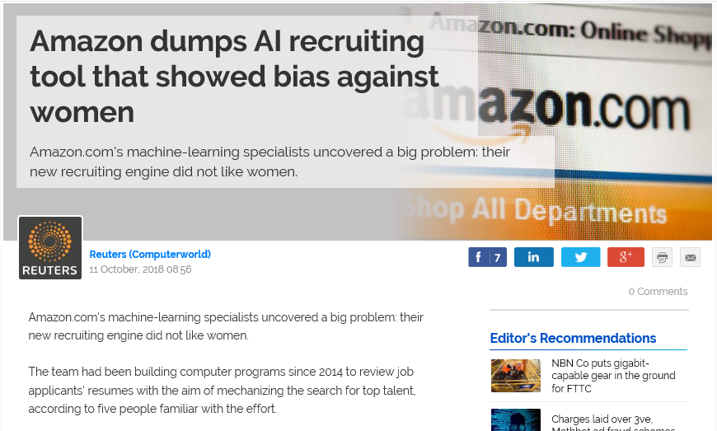
Notes:
As more and more companies use AI in recruitment (especially in the screening stages), there is a danger that the negatives in the normal recruitment process will be normalised in AI-assisted recruitment with certain demographics unable to proceed to face-to-face interview stage and, ultimately, employment.
This is because machine learning and AI environments need to be trained, often with pre-existing data, in order for them to develop the necessary insights as to which candidates have the potential to be most successful. What’s more, that pre-existing real world data will potentially have embedded within it patterns that exhibit existing biases, which the machine learning or AI environments could then mimic, or even potentially accentuate.
*********
Amazon.com's machine-learning specialists uncovered a big problem: their new recruiting engine did not like women.
The team had been building computer programs since 2014 to review job applicants' resumes with the aim of mechanizing the search for top talent, according to five people familiar with the effort.
Automation has been key to Amazon's e-commerce dominance, be it inside warehouses or driving pricing decisions. The company's experimental hiring tool used artificial intelligence to give job candidates scores ranging from one to five stars - much like shoppers rate products on Amazon, some of the people said.
"Everyone wanted this holy grail," one of the people said. "They literally wanted it to be an engine where I'm going to give you 100 resumes, it will spit out the top five, and we'll hire those.“
But by 2015, the company realized its new system was not rating candidates for software developer jobs and other technical posts in a gender-neutral way.
That is because Amazon's computer models were trained to vet applicants by observing patterns in resumes submitted to the company over a 10-year period. Most came from men, a reflection of male dominance across the tech industry. In effect, Amazon's system taught itself that male candidates were preferable. It penalized resumes that included the word "women's," as in "women's chess club captain." And it downgraded graduates of two all-women's colleges, according to people familiar with the matter. They did not specify the names of the schools.
Amazon edited the programs to make them neutral to these particular terms. But that was no guarantee that the machines would not devise other ways of sorting candidates that could prove discriminatory, the people said. The Seattle company ultimately disbanded the team by the start of last year because executives lost hope for the project.

Slide 15
Practical strategies to increase inclusion:
Traditional and contemporary approaches
Notes:
10 mins - CRISSA
There is widespread awareness that decisions made in the recruitment process can discriminate against certain population groups, meaning that proportionately less candidates get through in terms of gender, ethnicity, age and other characteristics. Whilst many processes are ‘fair enough’ to be within the legal burden of proof, this is still quite a distance from achieving 100% fairness and inclusivity.
There are essentially two main causes of adverse impact in assessment:
Firstly, systematic bias in screening tests, for example cognitive testing, and
Secondly, unconscious bias in interview and assessment exercise decisions.
We would like to wrap up our session by exploring practical strategies to increase inclusion – starting with some more traditional methods, and finishing with more contemporary approaches.

Slide 16
Reasonable adjustments
Reasonable Adjustment refers to the administrative, environmental, or procedural alterations required to enable a person with disability to work effectively and enjoy equal opportunity with others (Australia Government, 2008).
Adjust environmental factors (lighting, other noises) to make the candidate more comfortable
Offer access to a controlled environment to complete assessments
Adjust or remove timings for assessments where the candidate is likely to require more time than others
Administration of paper and pen version of assessments
Offer the opportunity to have a support person attend the interview/assessment centre with them
Reach out to the foundation associated with the disability to enquire about other specific adjustments or support available (e.g. provision of resources like a screen reader)
Notes:
Hudson regularly provides assessment services for participants with special needs such as a disability and has clear guidelines for an extensive range of situations. Whilst we treat each instance is unique, and would always seek to find out about a person’s specific disability so that we can tailor the approach, Hudson has compiled an internal Procedures Manual for Assessing People with Disabilities. The manual is comprehensive in its guidelines and covers standard procedures when assessing a candidate with a disability such as: hearing, visual, motor, dyslexia, etc. In addition, where required, we also work with specialist disability advisors to determine a suitable solution that allows the individual to fully participate in the assessment process.
Key guiding principles when determining reasonable adjustments:
Avoid assumptions – Even the same form of disabilities may impact individuals differently, work with each candidate to ascertain their needs
Show empathy – Listen to your candidates and show interest in knowing more about their circumstances
Tailored but consistent – While adjustments should be tailored to each candidate, be mindful of the other adjustments that are granted in the same selection process to ensure equality
Flexible and adaptive – Acknowledge that circumstances may change on the day of the assessment process where further review on the adjustments provided is required

Slide 17

Technology accessibility
Media Access Australia - accessibility and inclusion through technology.
Dedicated to increasing access to websites, digital media and technology for people with vision, hearing and cognitive disabilities, as well as older Australians, those from non-English-speaking backgrounds, and people with varying levels of education and literacy.
Fixing a mistake or failure
Focus on meeting guidelines and regulations around accessibility
Notes:
Crissa to open ad then hand over to Manisha to describe what Media Access did in more detail, and explain that the organisation has recently transformed into CFID.

Slide 18
Inclusive design
Inclusive Design is human-centred design that considers the full range of human diversity –ability, language, culture, gender, age and other forms of human difference – as part of the design process.
Three principles of inclusive design:
Recognise diversity and uniqueness
Inclusive process and tools – ‘nothing about us without us
Broader beneficial impact
Notes:
More contemporary approaches are less backward looking, trying to adapt recruitment processes for PWD and other diversity groups; instead they focus on designing systems and processes that are inclusive from the start!
This is particularly important in the design of new technologies and AI in the recruitment process- to avoid issues like we saw Amazon had with a new AI tool they built to support screening.
The CFID is a leading expert in this space, and Hudson recently partnered with them to ensure that all new tools and technologies that we design are accessible and inclusive – this builds on a lot of previous work we have done focusing on Indigenous recruitment and gender diversity; we see disability as space that still needs a lot of focus.
Ask Manisha to comment further of the work CFID does in this space.
Recognise diversity and uniqueness: Inclusive design keeps the diversity and uniqueness of each individual in mind. As individuals spread out from the hypothetical average, the needs of individuals that are outliers, or at the margins, become ever more diverse. Most individuals stray from the average in some facet of their needs or goals. This means that a mass solution does not work well.
Inclusive process and tools – ‘nothing about us without us’: The process of design and the tools used in design are inclusive. Groups that include diverse perspectives, especially perspectives from the margins, trumps a group of the ‘best and brightest,’ in decision-making, accurate prediction and in innovation. Inclusive design teams should be as diverse as possible and include individuals who have a lived experience of the ‘extreme users’ the designs are intended for.
Broader beneficial impact: Inclusive designers are aware of the context and broader impact of any design, and strive to effect a beneficial impact beyond the direct beneficiary of the design. Inclusive design should trigger a virtuous cycle of inclusion, leverage the ‘curb-cut effect’, and recognise the interconnectedness of users and systems.

Slide 19
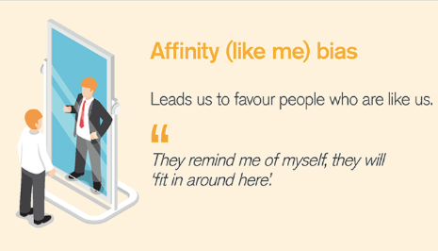
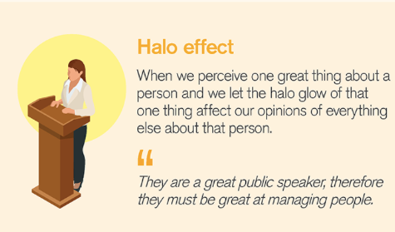
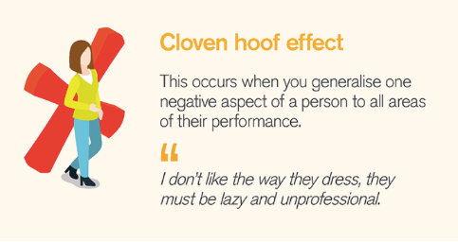
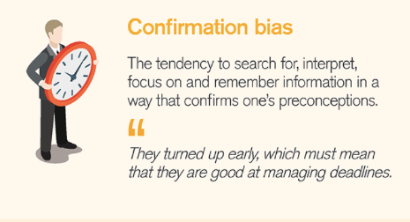
Unconscious bias training
Notes:
While we have been focusing on the accessibility of technology for the majority of this session, we felt it was also important to acknowledge that unconscious bias also impacts fairness and equity, and is being combated more and more through interventions such as unconscious bias training.

Slide 20
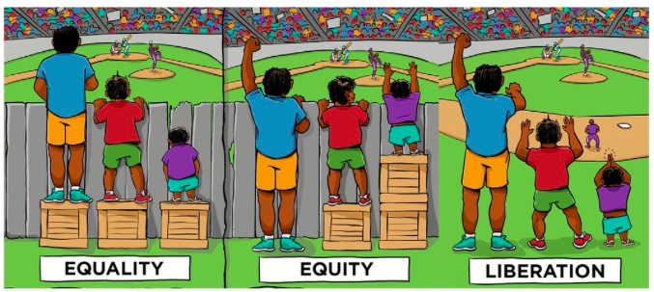
Our vision for an inclusive future
Equality = Sameness
Assumes everyone starts
from the same place
Equity = Fairness
Giving everyone access to same opportunities
Inclusion = Cause of inequity addressed, systematic barrier removed
Image source: Interaction Institute for Social Change | Artist: Angus Maguire, adapted from original by Craig Froehle.

Slide 21

Q&A

Slide 22
Dr Crissa Sumner
Director, Talent Management – NSW & ACT
Level 18, 20 Bond Street, Sydney CBD
0439 074 448
crissa.sumner@hudson.com
Manisha Amin
CEO, Centre for Inclusive Design
Suite 47, 104 Bathurst St, Sydney CBD
0451 371 190
manisha.amin@cfid.org.au

