Slide 1
Promoting learner agency for ALL learners using digital tools.
An essential component for change in education

Slide 2
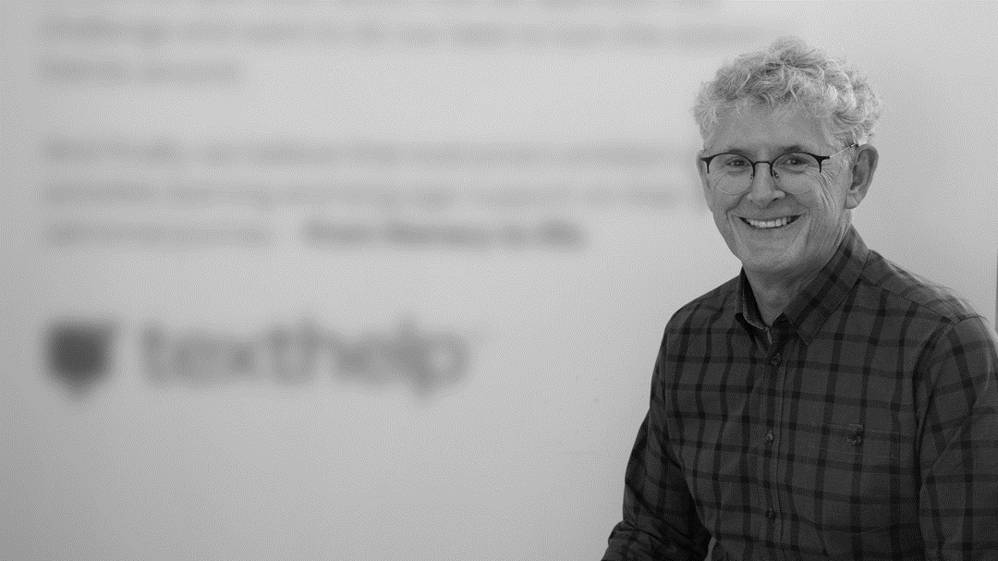
hello,
I’m greg
Greg O’Connor
Asia Pacific EdTech Manager
Texthelp
E: g.oconnor@texthelp.com
@gregoconnor

Slide 3
students with diverse learning needs

Slide 4
1 : 5 ?

Slide 5
ABC News: Illustration/Jarrod Fankhauser

Slide 6
access reading
demonstrate writing

Slide 7
technology

Slide 9
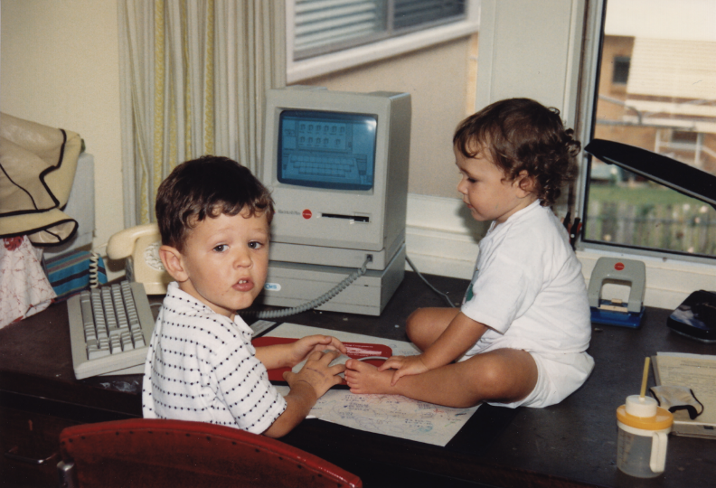

Slide 10
repair
assistive technology

Slide 11
passive

Slide 13
let me Google that for you

Slide 14
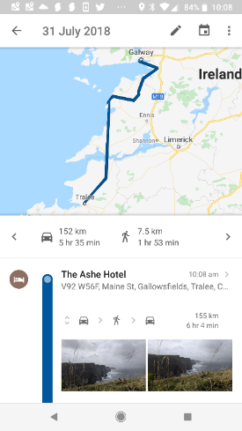

Slide 15
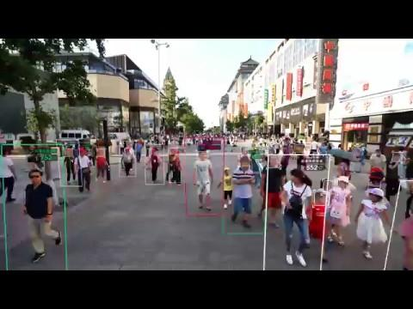

Slide 16
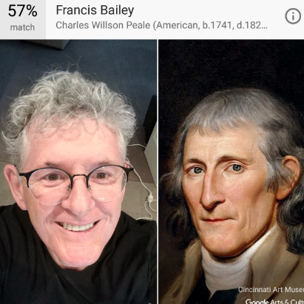
Francis Bailey (1741 - 1827)
A journalist and editor, Bailey was the official printer and publisher for the US Congress. He patented a new form of type that was difficult to counterfeit.

Slide 17
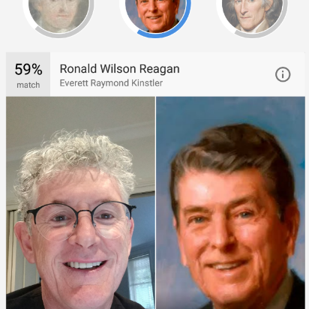
Ronald Reagan
40th President of the United States from 1981 to 1989

Slide 18
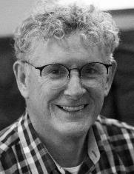
David Astle is a Melbourne-based writer of non-fiction, fiction and plays, and the crossword maker for a national Australian newspaper syndicate.

Slide 19
Notes:
Current changes impacting on literacy in schools:
Movement to student agency
Changing role of the teacher and access to content
Technology

Slide 21
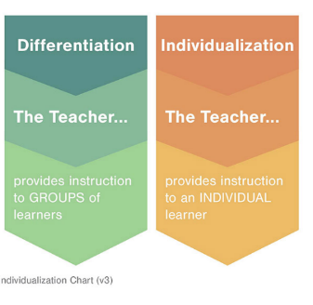

Slide 22
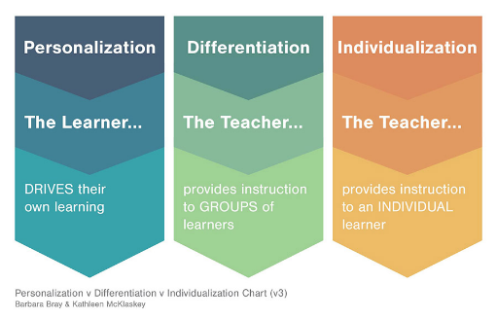
http://kathleenmcclaskey.com

Slide 23
learner agency
giving our learners the power to act
Notes:
http://core-ed.org/legacy/thought-leadership/ten-trends/ten-trends-2014/learning-agency
Agency is when learning involves the activity and the initiative of the learner, more than the inputs that are transmitted to the learner from the teacher, from the curriculum, the resources and so forth. In the past our schools have catered mostly for groups of learners, for classes of kids, with a one size fits all approach. Arguably, many students felt disenfranchised in the midst of that, as they just had to sit and do what they were told. Lessons were delivered to students who were passive in the way that they received that. When learners move from being passive recipients to being much more active in the learning process, actively involved in the decisions about the learning, then they have greater agency.

Slide 24
active

Slide 25
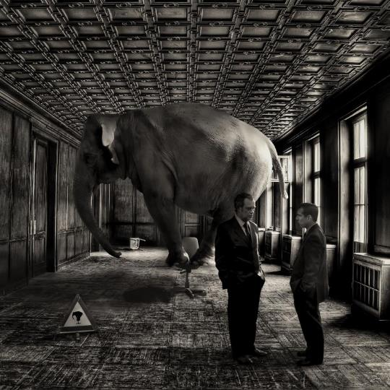
I C T
Chris Harte
http://blog.scootle.edu.au/2016/05/18/educational-technologies/

Slide 26
For many students access to learning looks like this.
Notes:
Years ago accessibility was just not great.
Before CAST, and Bobby & Nimas lots of kids were excluded from content.
At Texthelp we believe that access to literacy and STEM is life changing

Slide 27
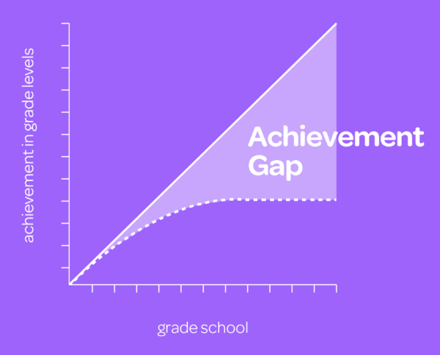

Slide 28
they should experience something that is more like this.
Notes:
These steps are a beautiful example of universal design.
The steps are usable by strollers, skateboards,wheelchairs, suitcases.
Technology needs to mimic this ramp by feeling built in - pre-concieved.

Slide 29
multiple options for
access to learning & expression, and engagement
learning
Notes:
Giving the learner voice and choice in how they access, engage and express

Slide 30
Universal Design for Learning
Multiple Means of Engagement
Provide options for:
engaging with content and learning in different ways
Multiple Means of Representation
Provide options for:
transforming information into useable information
Multiple Means of Expression
Provide options for:
action, expression and demonstrating understanding

Slide 31
Engage
Express
Access

Slide 32
prepare
not repair
Notes:
Text to speech

Slide 34
reading with tech matters
Notes:
Why writing with technology matters:

Slide 35
Text-to-Speech
Notes:
Text-to-Speech can be a game changer for students who struggle with reading. No matter what the struggle, a good text-to-speech tool can give students the help they need.
Text-to-speech also relieves the burden of decoding for struggling readers, allowing them to focus on comprehension and improving their endurance in completing reading assignments. Research has also shown that students with learning disabilities identify and correct more errors in their compositions when they use text-to-speech for proofreading.

Slide 36
read upto 200 - 300 wpm
speak 150-170 wpm
comprehension problems
below 100 wpm

Slide 37
you can listen and understand content that is above your reading level

Slide 39
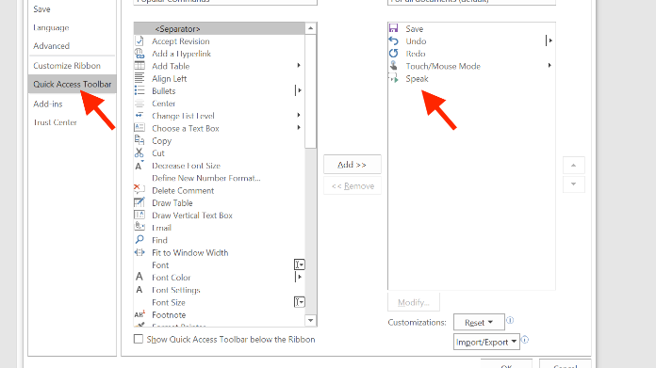
Speak Text in MS Word
Notes:
(Barton & Heidema, 2002)

Slide 40
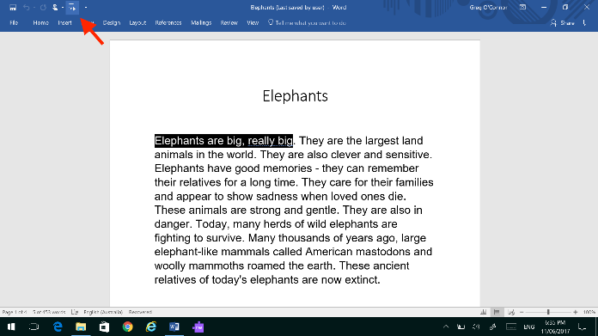
Speak Text in MS Word
Notes:
(Barton & Heidema, 2002)

Slide 41
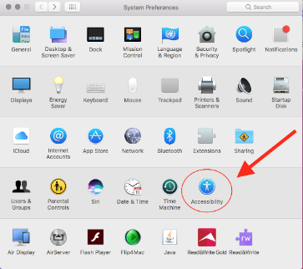
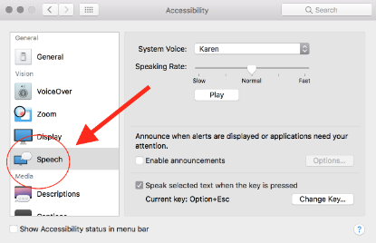
Speak Text on a Mac

Slide 42
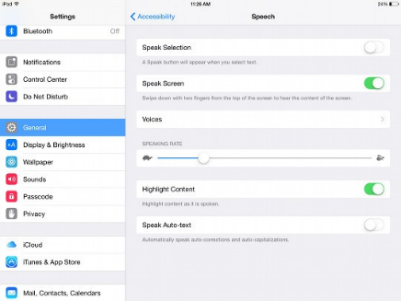
Speech to text - iPad

Slide 44
text.help/freeforteachers

Slide 45
Rewordify.com
Readable.io
Readability Formulas
Readability Analyzer
Microsoft Word - Readability Statistics

Slide 46
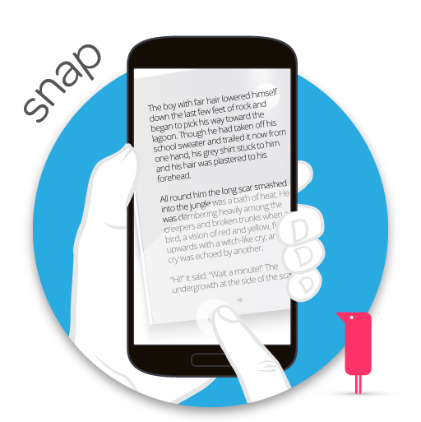
OCR
(optical character
recognition)

Slide 47
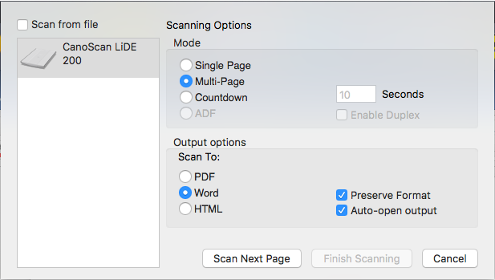
OCR
(optical character
recognition)

Slide 48
EquatIO Screenshot Reader
For websites, PDFs and more.

Slide 49
Writing with Technology Matters.

Slide 50
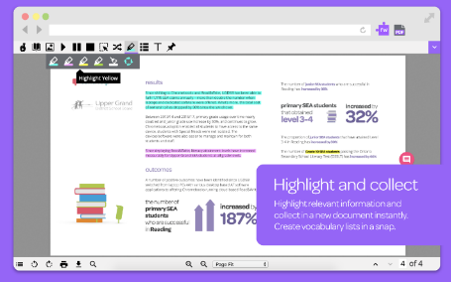
research
Read&Write
Collect highlights
Web Resources
Simple Wikipedia
scholar.google.com
Refseek.com
Ottobib

Slide 51
Text-to-Speech
(proofreading)
Spelling check
Grammar check
writing - technology onramp

Slide 53
“I can hear the difference
in my writing”

Slide 54
Voice Note

Slide 55
alternative pens
Talk & Type

Slide 56
alternative pens
Prediction

Slide 57
Machine Learning & Word Prediction in Read&Write
Every time a student types a letter, we look at the two words before the cursor and compare it to 10 million phrases that we found on the web.
As our 20 million users type and choose their predictions we promote common choices and demote uncommon choices.
When you type, machine learning allows Read & Write to be a real time expert writing coach

Slide 58
#drinkfromafirehose

Slide 59
prepare
learner agency

Slide 60
institutions will try and preserve the problem to which they are the solution
Cathy Davidson (2011)
Notes:
Lean into your discomfort
Subvert the existing paradigm

Slide 61
most
critical factor?
you
Notes:
The future is not only unknown, it is unknowable (George Soros)
Our job is not to prepare our students for something, it is to allow them to be ready for anything………

Slide 62
thanks
@gregoconnor

