Slide 1

Inherent Requirements Again:
From ‘dispositions’ and suppositions
to one simplified guide to
documenting the essential
Marion MacGregor Burgess
Accessability Student Advisor
AccessAbility Services
Notes:
Title slide of Presentation

Slide 2


Today’s discussion on a Guide to documenting
Inherent Requirements :
    Prompts
    Perspectives & Principles
    Package & Process
    Potential
Licensing under creative commons in process.

Slide 3
Provisos
Disclaimers
Acknowledgements
Must be shaped by end-users
- Speaker’s opinion only
- Multiple contributions over years from many across the sector, directly and indirectly
(NB UWS) (Also Catherine Stuckings, Dianne Hodge)
- Many areas implementing at least some of this already
- Some components to be shaped by end-users
- Awaiting broad application
Stepped through from first principles, practical application may be more succinct
University bias but not excluding other uses (NB. ‘Informed Choices’ VET)
‘Course’ and ‘Subject’ terminology used.

Slide 4
Prompts for a Guide to documenting IRs
Terminology
Do we need IRs?
Do varied approaches matter?
Disability Standards for Education 2005 s3.4
… entitled to maintain the academic requirements of the course or program,
and other requirements or components that are inherent in or essential to its nature.

Slide 5


Prompts for a Guide to documenting IRs
Terminology
Do we need IRs?
Do varied approaches matter?
https://www.youtube.com/watch?v=uNXgjnBpxGI

Slide 6


Slide 7
Prompts for a Guide to documenting IRs
Do we need IRs?
Do varied approaches matter?
Medical Deans, Australia and New Zealand:
- Scholarly learning, clinical practice, health advocacy tasks
- Plus Inherent Requirements of the medical student (literacy, verbal communication, hearing, vision, gross and fine motor skills
- “one fully functioning arm and the other capable of providing support” Inherent Requirements for Studying Medicine in Australia & New Zealand, 2017
Dispositions :
- assessment of dispositions towards Teaching required (NCATE, USA) (Welsh et al, 2010)
- “those internal conditions (attitudes, values, beliefs, thoughts etc) that influence our external behavior
(actions and interactions with students and others).” (Choi, Benson & Shudak, 2016, p. 72).
- don’t correlate to effective teaching performance (Choi, Benson & Shudak, 2016, p. 84).
Report - 2012 Review of Disability Standards for Education
… tension between maintaining academic requirements and designing a course or program without participation discrimination.
…calls for the tertiary ed sector to be required to develop and publish inherent course requirements
Final Report - 2015 Review of the Disability Standards for Education 2005 Stakeholders Perspectives
…[concerns that] the exclusionary nature of ‘inherent requirements’….inherently discriminates
against some people with disabilities. P22

Slide 8
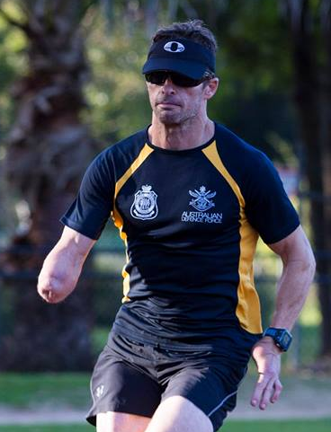
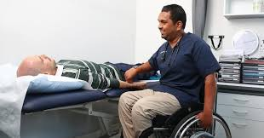
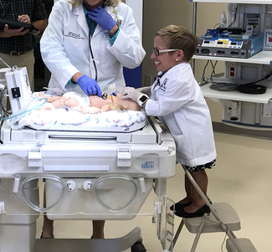

Prompts for a Guide to documenting IRs
Do we need IRs?
Do varied approaches matter?
Michael Lyddiard B. Occ Thy
Dr Jennifer Arnold
Dr Dinesh Palipana

Slide 9
IR Perspectives
Working definition and approach for the Guide
Developing terminology/language for Tasks
The task, not the person.
From variations on:
“Inherent requirements are the fundamental abilities, attributes, skills and behaviours necessary
to complete the learning outcomes of a course while preserving the academic integrity
of the learning, assessment and accreditation processes.”
To variations on:
“Inherent Requirements are the essential and core tasks of the course” .
(“….the essential and core tasks necessary to be identified as a graduate of the course”)

Slide 10
IR Perspectives
Working definition and approach for the Guide
Developing terminology/language for Tasks
Tasks are: tangible, visible, evident, assessable, have a fundamental purpose, intent, goals, meaning
‘IR tasks’ appropriate also
Distinctive/Key Tasks & Inherent Requirement/Essential Tasks
Competency: attained,
accomplished,
completed,
met,
achieved
performed (level of performance should be defined within the task description)
Unless unmet,
not attained,
not completed,
not achieved etc ….. Not ever? (mismatch)
….. Not yet? (scaffolded learning; reasonable adjustments)

Slide 11
IR Package
1. Collect materials and range of contributors/reviewers
2. Multiple review points
3. Supporting materials in IR document
4. Engagement planning, including embedded use in first year subjects
(positive tool for self-development)
Further explanation, including:
- academic integrity
- difference from learning outcomes, accreditation and Registration requirements
- scaffolded learning opportunities
- access to reasonable adjustments to teaching and learning conditions if indicated
while achieving these tasks
- tasks themselves to be successfully performed as outlined

Slide 12
IR Guide Principles
“Simplify” = Separate the steps & add tools
  1. Identify the distinctive tasks of [university], compared to other types of learning
  2. Identify the distinctive tasks of the course
  - compared to unrelated fields
  - compared to related courses in discipline
  3. Format for the core intention or the fundamental purpose of the task
  4. Identify the essential tasks and other tasks
  Task Identification Table
  Task Classification Table

Slide 13
IR Process: Steps and tools in detail
  1. Identify the distinctive tasks of [university], compared to other types of learning
  2. Identify the distinctive tasks of course
  - compared to unrelated fields
  - compared to related courses in discipline
  3. Format for the core intention or the fundamental purpose of the task
  4. Identify the essential tasks and other tasks
Suggested key university-level tasks:
- Manage a volume of information for learning that is higher than in secondary school, VET sector or pathways to university.
- Produce academic [discussion/analysis/critique] of course-related topics that considers
and formally references academic literature across [6-20] articles.
  Additional, for some areas:
- Produce accurate responses to [novel] course-specific questions from a range
of source information without access to the source material at the time.

Slide 14
IR Process: Steps and tools in detail
  1. Identify the distinctive tasks of [university], compared to other types of learning
  2. Identify the distinctive tasks of course
  - compared to unrelated fields
  - compared to related courses in discipline
Cue [ Processing] Response (= Measurable Task)
Cue categories:
Visual cues (text, diagrams, computer code, charts, equipment);
Visual cues (natural environment, human, animal) ;
Audio cues (machine made; natural) ; Tactile cues ; Other Sensory cues (eg.thermal);
Physical cues (gross motor, fine motor);
Cognitive cues (literacy, numeracy, knowledge, processing, executive functioning);
Temporal cues (adapting across or sustained over time; rapidly changing cues) (NB two-way interactions); Emotional/psychological cues;
Cultural & Inclusion cues;
Ethical cues;
Safety cues.
Cue categories are developed from
Inherent Requirements http://www.westernsydney.edu.au/ir
© University of Western Sydney is licensed under a Creative Commons Attribution-Non Commercial Share Alike
4.0 International licence

Slide 15
IR Process: Steps and tools in detail
Cue Categories | Key Cues | Responses as tasks (produce/perform/interact) | Level of performance (passing graduate) | Fundamental Purpose / Core Task
Visual cues (text, diagrams, code, charts, equipment)
Visual cues (natural environment, human, animal)
Audio cues (machine made; natural)
Tactile cues
Other Sensory cues (Eg thermal)
Physical cues (gross motor, fine motor)
Cognitive cues (literacy, numeracy, knowledge, processing, executive functioning)
Temporal cues (adapting across or sustained over time; rapidly changing cues) (NB interactions)
Emotional/psychological cues
Cultural & inclusion cues
Ethical cues
Safety cues

Slide 16
IR Process: Steps and tools in detail
  1. Identify the distinctive tasks of [university], compared to other types of learning
  2. Identify the distinctive tasks of course
  - compared to unrelated fields
  - compared to related courses in discipline
  3. Format the tasks for the core intention or the fundamental purpose of the task
Cue [Processing] [Response Mechanism] Response Intention/Purpose
(Core Task)
  When Ways What’s important
  - Review the verbs Task verbs: see/hear , write, speak………………….. create, produce, interact
  Verbs for core task: respond to, record, communicate………… create, produce, interact
  - Consider what you really want from the student
  ie. Processing + response mechanism AND THEN….. (eg. Response to fire alarm cue)
  NB. Is the response mechanism also a core task?
  - includes elements that cannot be substituted, and
  - are linked to the identity of the course. Eg. Using TENS machines in physiotherapy for treatment.

Slide 17
IR Process: Steps and tools in detail
Task Identification Table
Cue Categories | Key Cues | Responses as tasks (produce/perform/interact) | Level of performance (passing graduate) | Fundamental Purpose / Core Task
Visual cues (text, diagrams, code, charts, equipment)
Visual cues (natural environment, human, animal)
Audio cues (machine made; natural)
Tactile cues
Other Sensory cues (Eg thermal)
Physical cues (gross motor, fine motor)
Cognitive cues (literacy, numeracy, knowledge, processing, executive functioning)
Temporal cues (adapting across or sustained over time; rapidly changing cues) (NB interactions)
Emotional/psychological cues
Cultural & inclusion cues
Ethical cues
Safety cues
Useful information for students: Prompts consideration of reasonable adjustment needs.
Distinctive Tasks, written as core tasks: can then be assessed to see if essential/inherent tasks or not.
Cue categories are developed from Inherent Requirements http://www.westernsydney.edu.au/ir
© University of Western Sydney is licensed under a Creative Commons Attribution-Non Commercial Share Alike
4.0 International licence

Slide 18
TASK LIKELIHOOD | Descriptions
Almost Certain | The task will almost certainly be assessed and will need to be successfully performed to be able to pass overall (assessed directly in one or more subjects and pass very unlikely without completion).
Probable | The task will probably be assessed and need to be successfully attained to be able to pass overall (assessed directly in one or more subjects and pass difficult without completion).
Possible | The task could be assessed in the course (assessed for less than 25% of the cohort) and will contribute to significantly to ability to pass.
Unlikely | The task is unlikely to be assessed (assessed for less than 10% of the cohort) and will not be necessary to pass.
Rare | The task is not assessed or assessment is engaged in by less than 5% of the cohort and will not be necessary to pass..
IR Process: Steps and tools in detail
  1. Identify the key tasks of [university], compared to other types of learning
  2. Identify the key tasks of course
  - compared to unrelated fields
  - compared to related courses in discipline
  3. Format the key tasks for
      - the core intention or the fundamental purpose of the task
  4. Distinguish between the essential tasks and the other tasks
Essential course components: Important to the course and Important to the assessment
1. Level of consequences if the task is NOT included in the course
2. Likelihood the task will need to be completed successfully to be able to pass
Essential Task = High Consequence if not part of course X High Likelihood is required for pass

Slide 19
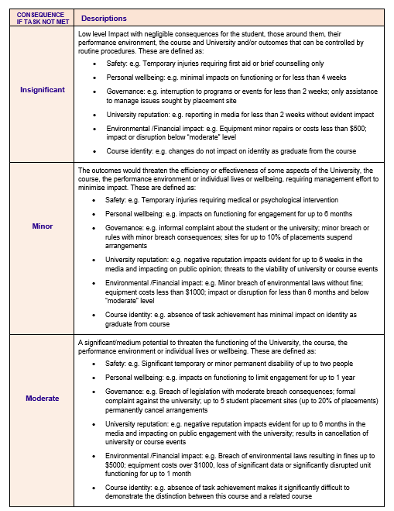
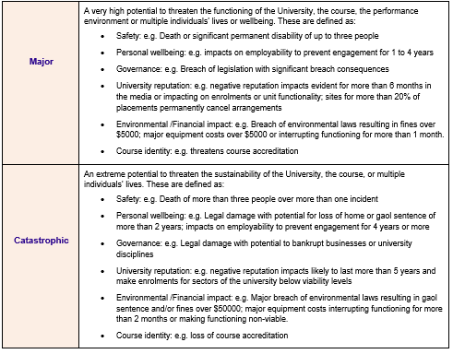
Process: Identify the Essential
Task Consequence Table*
CONSEQUENCE IF TASK NOT INCLUDED IN THE COURSE | Descriptions
Moderate | A significant/medium impacts on the functioning of the University, the course, the performance environment or individual lives or wellbeing. These are defined as: Safety: e.g. Significant temporary or minor permanent disability of up to two people Personal wellbeing: e.g. impacts on functioning to limit engagement for up to 1 year Governance: e.g. Breach of legislation with moderate breach consequences; formal complaint against the university; up to 5 student placement sites (up to 20% of placements) permanently cancel arrangements University reputation: e.g. negative reputation impacts evident for up to 6 months in the media and impacting on public engagement with the university; results in cancellation of university or course events Environmental /Financial impact: e.g. Breach of environmental laws resulting in fines up to $5000; equipment costs over $1000, loss of significant data or significantly disrupted unit functioning for up to 1 month Course identity: e.g. absence of task achievement makes it significantly difficult to demonstrate the distinction between this course and a related course * For review
Developed from Girl Guides Queensland Risk Analysis materials

Slide 20
Process: Identify the Essential
TASK LIKELIHOOD | Descriptions
Almost Certain | The task will almost certainly be assessed and will need to be successfully performed to be able to pass overall (assessed directly in one or more subjects and pass very unlikely without completion).
Probable | The task will probably be assessed and need to be successfully attained to be able to pass overall (assessed directly in one or more subjects and pass difficult without completion).
Possible | The task could be assessed in the course (assessed for less than 50% of the cohort) and will contribute to significantly to ability to pass.
Unlikely | The task is unlikely to be assessed (assessed for less than 20% of the cohort) and will not be necessary to pass.
Rare | The task is not assessed or assessment is engaged in by less than 10% of the cohort and will not be necessary to pass..
Task Likelihood Table
“ At entry non-verbal communication can be assessed during selection interviews (if used) or by other measures.
During the course a student’s non-verbal communication will be assessed during assessments
and teaching episodes.” Inherent Requirements for Studying Medicine in Australia and New Zealand, Medical Deans Australian and New Zealand, 2017

Slide 21
Process: Identify the Essential
Task Classification Table
Ie. Importance of the task to the course, and importance of the task to the assessment.

Slide 22
Potential:
Transparent, verifiable
Guide both new and experienced IR-documenters
Easy conversion of existing inherent requirements documents
Simplified and accurate IR lists
Expand IR document usefulness by including other/key tasks and cue lists as relevant information, clearly classified
Reduce false positives and false negatives in stakeholder perceptions of course matches
Triggers a closer consideration of assessment if needed
Prioritise and focus student learning and reasonable adjustments

Slide 23
Summary:
1. Focus on tasks not personal attributes
2. List the important cues for performance
3. identify the distinctive course tasks, written for their core purpose
4. Identify the essential course tasks separate from recommended, useful and incidental tasks.
5. Specify use for inclusion and proactive decision making, then perhaps risk management.

Slide 24

Probing & Pondering?

