Slide 1
Disability Dialogues: from medical models to empowering students for the challenges ahead.
Cathy Easte, Disabilities Service Officer
Griffith University

Slide 2
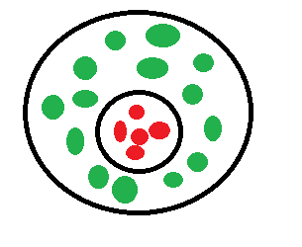
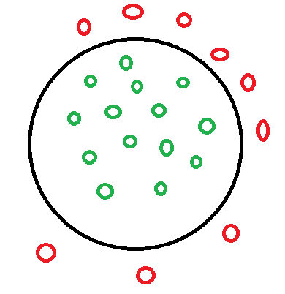
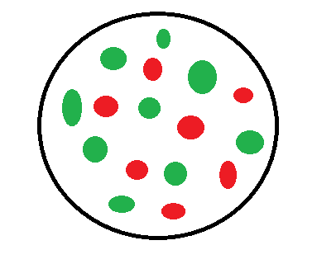
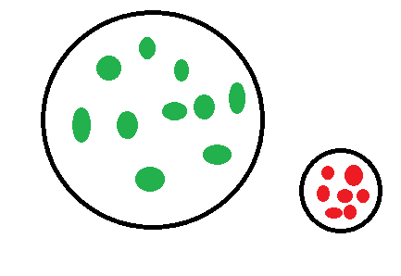
Education of people with disabilities through time….
Exclusion Segregation Integration Inclusion

Slide 3
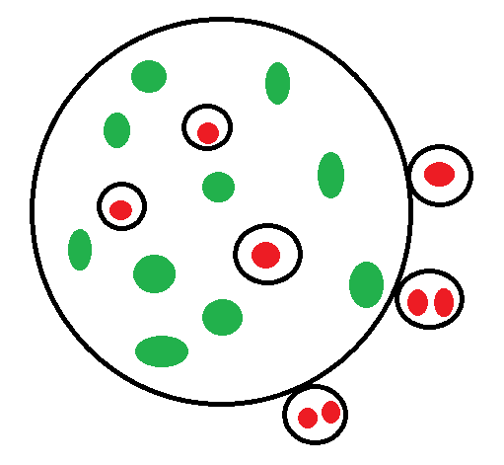
A Closer look at the Inclusion circle

Slide 4
“a weakened strain of inclusionism”

Slide 5
Participation Rates
    5% student cohort has a disability
    16% - Australian Bureau of Statistics (15 to 64)
    8% - Target participation rate

Slide 6
A Fair Chance for All
    The overall objective for equity in higher education is to ensure all Australians from all groups in society have the opportunity to participate successfully in higher education. This will be achieved by changing the balance of the student population to reflect more closely the composition of the society as a whole.
                NBEET, 1990.

Slide 7
How we currently operate
    Individualistic and highly medical mode of operation
    Segregated service
    Tweaking and retrofitting of educational delivery
    Curriculums do not change
    Students with disabilities have to conform/ assimilate

Slide 8
Whole process is not inclusive
    We are retrofitting a curriculum to allow access
    Individual does not fit
    Should be curriculum does not fit
    Students with disabilities have to “submerge their disability experiences in order to pass as non-disabled” students.
    (Mitchell, Synder & Ware , 2014)

Slide 9
Are we playing lip-service to inclusion?
    Australian Gov’t funding – HEDSP
    Targets participation rates
    No ‘incentive’ to invest in inclusive design of curriculums
    Where is the voice of the student?

Slide 10
Terminology is negative
    ‘Reasonable adjustments’ – there must be unreasonable ones?
    ‘as far as possible’ or ‘as far as practicable’ – must not always be possible or practicable!
    Disability Standards for Education 2005

Slide 11
Individual approaches
Not Systemic – not changing system
Individually tailored solutions rarely become systemic
Based on negative imagery of the individual

Slide 12
What is a ‘normal’ student?
Students with disabilities achieve better when they are comfortable disclosing their disabilities.
Concealing differences and following ‘normal’ curriculums is exhausting
19.5% students with disabilities withdraw due to social isolation (AIHW, 2014)
Further 40% withdraw due to disability management, home life and study balancing demands

Slide 13
What is Success?
    High unemployment for people with disabilities
    Have we provided the tools to challenge the continued oppression?
    Government push to reduce welfare and debt
    NDIS – are our students prepared?

Slide 14
If what occurs now is so wrong, what needs to happen?
    Inclusive educational discourse (is not just for dominant normative expectations).
    Cripistemologies – curriculums that allow people with disabilities to recognise their existence as another way of experiencing and knowing
    Epistemological equity – we all have different ways of knowing

Slide 15
Empowering Students
    Opportunities for Social connections
    Peer mentors – students with disabilities
    Lunch and learn Sessions
    Leadership programs
    Tertiary Educational Experiences

Slide 16
Student made resources
    MeetingPOINT Peer Mentoring Group
    Resources,
    online hub for
    giving practical advice
    linking students to Griffith resources.
Notes:
This project is being School of Humanities, and co-ordinated and run by a Griffith OUA students (or recent graduates). The mentors prepare and present student resources and create an online hub for students to meet and form support networks within a safe and inclusive environment, giving practical advice and linking students to Griffith resources.

Slide 17
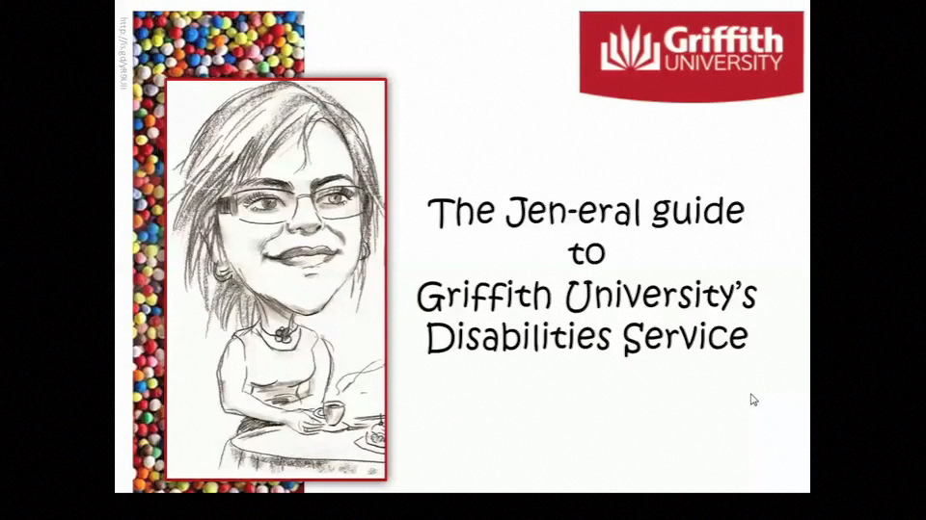
Pathways 12 3 – 5th Dec 2014

Slide 18


Slide 19
Policy change is only a small component
“BE the change you wish to see in the world”
Gandhi

Slide 20
Perhaps it is time to rethink the ‘inclusion’ approach for students with disabilities in Australian Universities.
Notes:
Structural and systemic exclusion / discrimination will only be marginally dismantled through tweaking the policy architecture. Staff have to engage in a sustained and deeper conversation to BE the change.

Slide 21
Cathy Easte
c.easte@griffith.edu.au
07 3735 9282
Notes:
Structural and systemic exclusion / discrimination will only be marginally dismantled through tweaking the policy architecture. Staff have to engage in a sustained and deeper conversation to BE the change.

