Slide 1

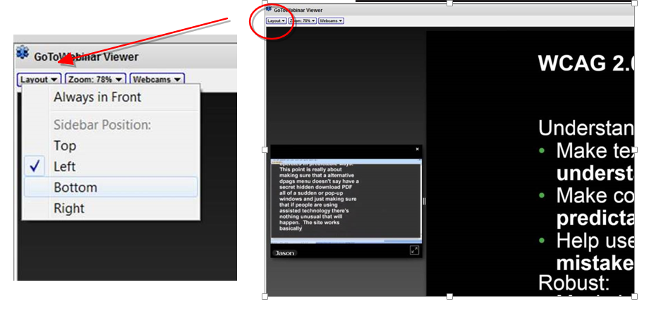
Welcome to today’s webinar.
We will be with you shortly…..
Your microphone has been muted, but we still want to hear from you, so, please add questions/ comments into the question pod throughout the presentation.
The presentation will be live captioned and recorded so you can watch the presentation later on ADCET.
If you require live captions check that this function is working. Images to the right indicate Layout options. If you have any problems please email jane.Hawkeswood@utas.edu.au

Slide 2


Slide 3

Increasing numbers of students with Autism Spectrum Disorders (ASD) at university and TAFE

Slide 4
These learning environments are ‘unpredictable, illogical, noisy and populated with people who communicate unclearly and are unreliable’
Beardon, Martin & Woolsey, 2009

Slide 5

Many students with ASD experience a number of challenges transitioning to the tertiary learning environment
These often include:
Understanding the contexts of the new environment
Time management
Social relationships
Communication
Asking for additional assistance
Getting ‘stuck’ and unable to raise concerns
Fleischer, 2011; Knott & Taylor, 2014

Slide 6

There can be a tendency for students with ASD to:
be reluctant to seek additional support for their studies
have difficulties articulating their needs
decline initial offers of support
Fleischer, 2011; Macleod & Green 2009

Slide 7

“By the time a student is struggling, damage has often already been done in terms of academic development, mental health and general wellbeing”
MacLeod & Green, 2009

Slide 8

But we know …..
When students are given appropriate and timely support they are more likely to succeed in their studies
Many individuals, support staff and teaching staff have developed effective strategies
AND
We wanted to capture and share some
of what works well
Assist students develop good strategies and
identify when to seek additional
assistance

Slide 9

NDCO Special Project Funding
Established an Advisory Committee from around Australia to inform the project
Gained feedback from a number of individuals with ASD
We thank them for generously sharing their expertise and helping make the project a reality
  Mary Brake - Autism Consultant with the Tasmanian Department of Education
  Shaun Corcoran –Disability Liaison Coordinator in Victorian TAFE
  Marita Falkmer - Postdoctoral Fellow with the Autism CRC
  Sue Hancock - Disability Advisor with ANU
  Julie Harrison - Disability Services Centre Manager with ANU
  Colleen Hooper - National Disability Coordination Officer in Southern Tasmania
  Berinda Karp - Teacher /Consultant for Students with Disability in NSW TAFE
  Amanda Richdale - Principal Research Fellow at the Olga Tennison Autism Research Centre, La Trobe University.

Slide 10
Notes:
Provide helpful hints and strategies on making the transition to tertiary studies.
Provide advice on how to succeed in tertiary studies
Help students identify ‘early warning signs’ that things are not going well, and when they may need to seek additional advice and support
Provide information about the support services and learning support at university and TAFE

Slide 11

This booklet aims to increase self-determination by assisting students
better understand their context
identify when and what supports could be helpful
and encouraging them to seek additional support when necessary.

Slide 12

Both editions include:
Characteristics of people with and without ASD
Identifying and using strengths, skills and talents
Information about the learning context
Advice on organising studies
Communication tips
Information on disclosure
Advice on managing stress and anxiety
Handy checklists
Practical worksheets

Slide 13
Long Edition | Short Edition
66 pages | 22 pages
Details of where to get more information at end of each chapter, bibliography and list of other useful resources | Not included
Question & Answers at the end of each chapter | No Q&A and use of more direct concise language throughout
Case studies throughout | No case studies
Checklist after the final chapter | Useful checklists at the end of each chapter
Chapter for Parents - providing advice on supporting adult child | No chapter for parents
Full bibliography | no
Interactive exercises and activities | Some interactive exercises
Easy flip style layout | Each chapter on a page for ease of copying
Notes:
Feedback mixed. Resource would be so useful but so much information. Could be overwhelming. Too much ‘fluff’
Stretched the budget and the project officer to an additional version – now have long and short versions

Slide 14








Slide 15

Table developed to compare characteristics of people with and without ASD
Mindful to respect the individuality and differences of people
‘To know one person with autism is to simply know one person with autism’
Talent, skills, character strengths, and challenges
Encourage resilience and mental well-being
In context of tertiary study

Slide 16

Campus Context
Highlighting key areas on a map
Visit beforehand
Take photos
De-stress area
Travelling to and from the campus
Orientation sessions
Uni Accommodation
Notes:
Being forewarned about what to expect can assist in new environments
Use phone to take photos in the new areas

Slide 17
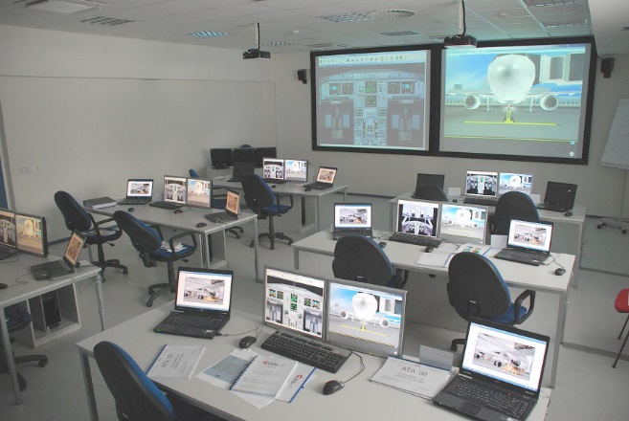
Gillian’s story…

Slide 19
Studying at University or TAFE
Differences between Studying at High School and Uni or TAFE
‘My ideal study space’
Online systems
Library
Assessments
Online discussions or blogs
Group assessments
Full-time or part-time study load

Slide 21

Students who are well organised and have good study techniques are more likely to succeed in their studies
Provide practical tools – semester and weekly planners
Assessment task activities stages
To-do lists
Effective studying
Preparing for exams

Slide 22
Week Number: …………………………………………………….. Date Range: ……………..
 | Monday | Tuesday | Wednesday | Thursday | Friday | Saturday | Sunday
9 am | Prepare for computer online assessment. |  | Computer lecture. |  | Computer lecture. |  | Family and friends time.
10 am | Prepare for computer online assessment. | Biology lecture. | Read history tutorial readings. | Geography lecture. | History research. | Write history assignment. | Family and friends time.
11 am | History lecture. | Biology lecture. | History lecture. |  | Geography research. | Write history assignment. | Family and friends time.
12 pm |  |  | History tutorial. | Society club. |  |  | Family and friends time.
1 pm |  |  |  |  |  | Free time. | Family and friends time.
2 pm | Geography lecture. | Biology prac. | History assignment. start writing | Geography group project meeting. | Geography research. | Free time. | Family and friends time.
3 pm |  | Write up biology prac. | Proof read biology prac report. | Geography prac. | Society club get-together. | Start writing geography assignment. | Family and friends time.
4 pm | Computer prac. | Write up biology prac. | Geography assignment
Research. |  |  | Review biology text book.
5 pm | Gym. |  |  | Gym.
6 pm |  |  | Free night.
7 pm | Read history tutorial readings. | Read history tutorial readings. |  |  |  |  | Check Semester Assessment planner.
Do ‘To-do list’.
Do new weekly planner.
8 pm |  | Geography online discussion.

Slide 23
Week | Geography | History
1
2 | Research for assignment 1. | Research for assignment 1.
 | Research and write up assignment 1draft. | Research assignment.
4 | Review, edit and submit assignment 1. Due Monday. 1000 words. Worth 10%. | Research and write up assignment 1 draft.
 | Research for assignment 2. | Review, edit and submit assignment 1. Due Wed. 1000 words. Worth 15%
6 | Research and write up assignment 2 draft. Check online discussion.
7 | Review, edit and submit assignment 2. Due Monday. 2000 words. Worth 20%. Participate in online discussion. | Research for assignment 2.
8 | Meet with group to plan presentation. Participate in online discussion. | Research for assignment 2.
9 | Online discussion due. Total 1000 words. Worth 10%. | Commence writing assignment 2 draft.
10 | Meet with group. | Review and edit assignment 2.
 | Meet with group to finalise presentation. | Submit assignment 2. Due Wed. 3000 words. Worth 45%.
12 | Group presentation and paper. Due Tuesday. Worth 20%.
13 | Start exam revision. | Start exam revision.

Slide 24

Support Services
DDA and Education Standards
Inherent course requirements
Benefits of disclosure
Support for study
Notes:
Assistance provided table is more positive than just outlining deficets or challenges.

Slide 25
Question & Answer
Question: I am enrolled at university full-time doing 4 subjects. I am feeling overwhelmed and stressed by the workload. Someone has suggested that I withdraw from one subject and only study 3 subjects. Is this advisable?
Answer: If you find that studying 4 subjects is overwhelming, it is advisable to study 3 subjects. You will still be regarded as a full-time student. Studying 3 subjects will give you more time to become familiar with the requirements of tertiary study. It therefore can be a good idea for the first one or two semesters. You can always decide to increase your enrolment to four subjects in subsequent semesters. However, it is important to know that if you drop a subject after the university Census dates there will be academic penalties and a financial cost for the subject.

Slide 26

Find one or two ‘go to’ people on campus
Disability
Transition Support
Counselling
Learning support
Student mentors
Notes:
Titles and roles change – said this
Find one or 2wo go to people

Slide 27

Communication Tips
Lectures and lecturers
Small classes and tutors or teachers
  When do I start talking?
  How long do I talk for?
  When do I stop talking?
  What topics are okay for discussion in the group?
  How and when do I ask questions?
Peers
Notes:
Aware this is a big big big area. Gave information for context and useful tips

Slide 28
Rachel’s story…
Rachel had a question about an assignment that she was having trouble with. She could not do any more work on that part of the assignment until she had clarification on what to do. Each time she went to the lecturer’s office, the door was closed. The deadline for the assignment was coming up soon so she was getting worried.
There was a timetable on the lecturer’s door showing two time slots for student consultations, but unfortunately these both clashed with other lectures that Rachel had to attend. She sent the lecturer an email outlining her question. The lecturer replied the next day with a short answer to the question and offered to make a time to meet later in the week if more information was required.
Rachel started work on the assignment and then took it to the lecturer at the agreed time to get some feedback and make sure she was on the right track. She was then able to finish the assignment on time.

Slide 29

Managing stress and anxiety
Identifying physical symptoms
Stressed - feel overwhelmed or uncertain about how to cope
Anxious – feel concern about possible threats or dangers
Panic attacks – feel in immense danger and fearful for life
Healthy and unhealthy levels

Slide 30

Find 2-3 techniques to manage stress and anxiety
Relaxation techniques
Training your thoughts
Fabic Behavioural Scales
Caring for self
Getting additional help

Slide 31

Information for Parents chapter (long version only)
Recognition that parents can have a significant positive part to play in transition
Parenting role will change as child becomes adult
Early planning
Respecting the need for required consent

Slide 32

But - we acknowledge this resource is only part of the picture….
Also need:
More understanding , respect and valuing the ASD perspective
Proactive support services that are flexible and responsive to needs of individual
Responsive learning and teaching environments

Slide 33
Available at
Hard copies from NDCOs
Download from
www.adcet.edu.au/autism-transition
A huge thanks to Darlene McLennan and Jane Hawkeswood for their work on uploading this.

Slide 34


Slide 35
References
Beardon, Martin & Woolsey, (2009). What do students with Asperger Syndrome or high-functioning autism want at college and university? (in their own words), GAP, 10,(2), 35-42.
Fleischer, (2011). Alienation and struggle: everyday student-life of three male students
with Asperger Syndrome, Scandinavian Journal of Disability Research, 14, (2), 177-194.
Knott & Taylor, (2014). Life at university with Asperger syndrome: a comparison of student and staff perspectives, International Journal of Inclusive Education, 18, (4), 411–426.
Macleod & Green (2009). Beyond the books: case study of a collaborative and holistic support model for university students with Asperger syndrome, Studies in Higher Education, 34, (6), 631–646.

