Slide 1
Research and Practice in Australia
Closing the Loop between Equity Policy,
Professor Sue Trinidad, NCSEHE Director
5/12/2014

Slide 2
What I will cover
National Centre for Student Equity in Higher Education
and the centre’s three core programs
Australia widening participation – to, through and beyond HE (statistics)
How we might work together
Notes:
My aim is to update delegates on the National Centre’s progress to date; to advise on the role it has in supporting research and advocating for student equity in higher education; detail plans for the Centre's future activities; and begin a dialogue as to how we might all work together to further access and participation opportunities for equity students in higher education. I will highlight the current higher education statistics and how the National Centre can assist in research being undertaken in the disability area.

Slide 3
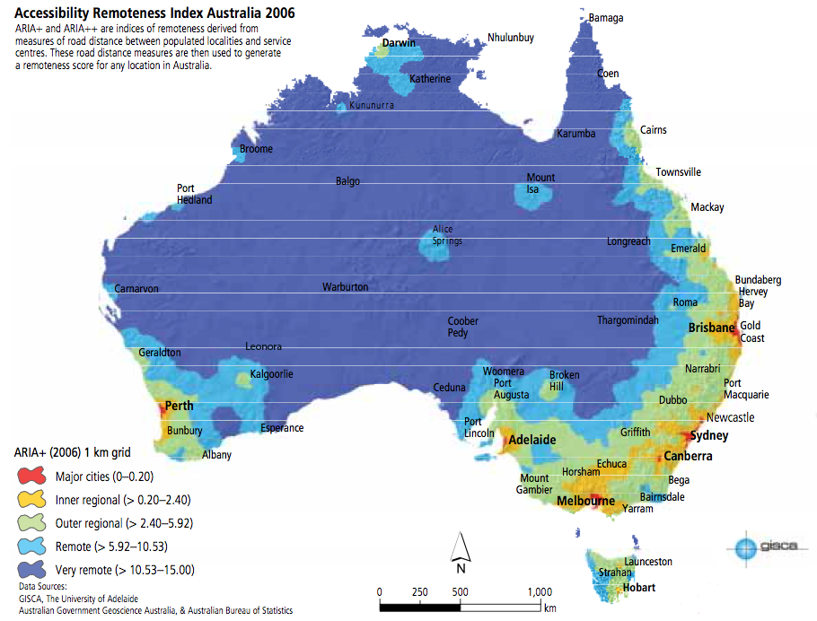
Background
Notes:
Thank you for this opportunity. I wanted to start with the story about me – I was born and education in an inland regional town in Western Australia. I loved school and had a very supportive mother who, I know wanted me to do the best as she had not finished Year 10 and my father did not finish Year 7.
I did not realise that in today’s terms I would be classified as an ‘equity student or a student from a disadvantaged background’ as I came from a family that would be classified as LSES and living in a town that is considered remote. I also had a learning disability which meant that I needed to work twice as hard as other students to learn but I had the passion and motivation to learn. Although I count myself as lucky at the time as unlike some of my peers who had to leave to attend university and live in the city with at university or with friends without parents; my mum and dad shifted to Perth in the late 70’s as regions were in one of its downturn periods. My Dad was retrenched so my parents made the very big decision to sell their house and shift to Perth. They felt that this was a good time to make the move to the city as they would be able to support me as well. I studied hard and obtained my degree and then went to teach in an even more remote location working with aboriginal students. I returned to Perth when I had my children as I wanted them to have opportunities that I did not. In the late 1980’s early 1990’s when I was working on my Doctorate again at university part time and working, by that time I was really starting to understand the differences between having a city education compared to a regional education and how important it is to provide all students no matter where they live equal opportunities.

Slide 4
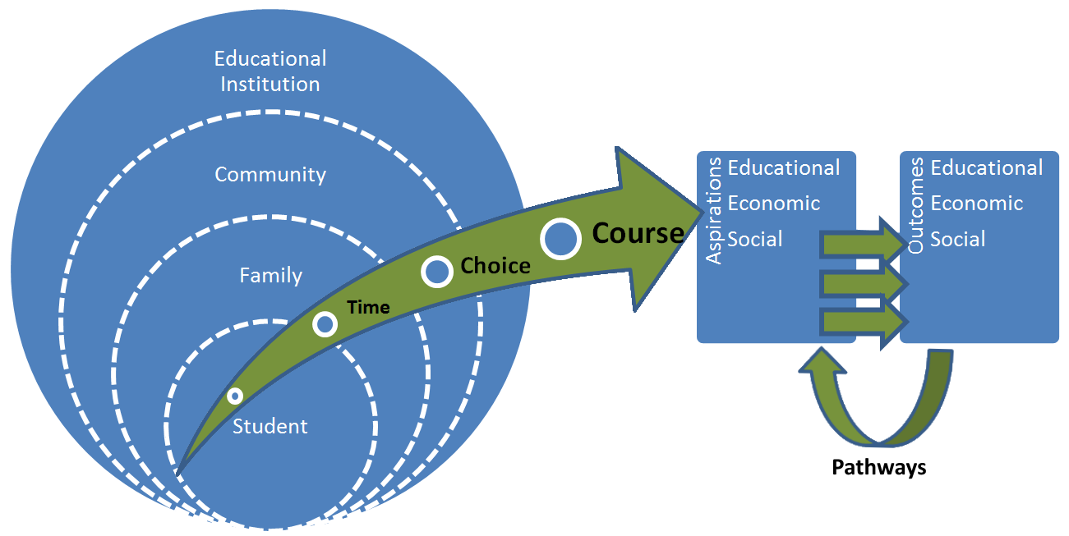
Student Progression via Multiple Pathways
Source: Student progression via multiple pathways (adapted from A.B.S. 2010, 22).
Notes:
We do know from research that student progression is via a multiple pathways and concerns many factors.
It is understood that many causes of disadvantage in higher education occur much earlier in life.
Australian universities have long demonstrated a strong commitment to student equity and to increasing the participation of people from disadvantaged backgrounds. This was also a key recommendation from the Bradley Review (2008). The Higher Education Participation and Partnerships Program (HEPPP) was set up to fund a range of university participation and partnership initiatives. Through HEPPP funding, Australian universities have been able to provide opportunities to students from under-represented backgrounds who have the ability to study at university, to actually do so. Australian universities’ commitment to improving the access, participation and success in higher education of students from equity groups is evident in the current practice used by universities to reach prospective university students (outreach), help get them into university (access), and provide the support once the students commence, improving the retention and completion rates of those students. Such initiatives have been targeted at low SES and regional and remote students, in order to inform and expose school students and other prospective university students to the opportunities that higher education can offer. A variety of entry pathways enables those equity students who desire to participate to have the capacity to apply for and successfully enter undergraduate study at university. A range of support services, such as mentoring and tutoring programs, ensure all students have the best chance of succeeding in their studies.

Slide 5
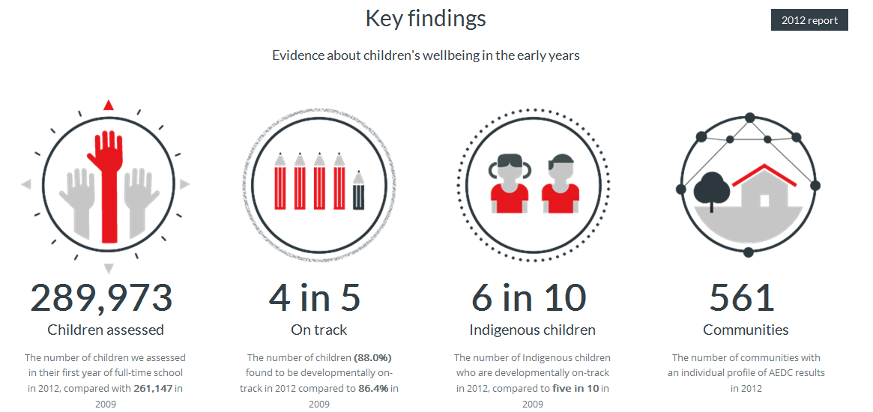
Australian Early Development Census
Notes:
The data are collected within the various State and Territory jurisdictions and overseen and aggregated by the AEDC (Australian Early Development Census), working within the Australian Government Department of Education. In the 2012 data collection, information was collected on 289,973 Australian children representing 96.5 per cent of children in their first year of formal full-time schooling (Australian Early Developmental Index, 2013). AEDC data are collected for individual children and reported at a group level (national, State/Territory or community). For each area, children are reported as being ‘on track,’ ‘developmentally at risk,’ or ‘developmentally vulnerable.’
Demographic information collected makes the AEDC ideal for meaningful comparisons can be made with all higher education equity groups. For example, in the latest collection it was established that:
• females were less likely to be developmentally vulnerable in one or more areas compared with males;
• Indigenous children were more than twice as likely to be developmentally vulnerable than non-Indigenous children;
• children not proficient in English were more likely to be developmentally vulnerable on all the AEDC areas;
• children who reside in very remote parts of Australia are more likely to be developmentally vulnerable; and
• children living in the most socio-economically disadvantaged Australian communities are more likely to be developmentally vulnerable on each of the AEDC areas (Australian Early Developmental Index, 2013).

Slide 6

Equity Groups in Australia
Low socio-economic status (LSES) students
Indigenous students
Students from regional and remote areas
Students with a disability
Women in non-traditional areas of study, and
Students from non-English speaking backgrounds (NESB students)
Notes:
It is interesting when you look at the research and the classification of what constitutes ‘disadvantaged’ today. The Federal Government defines and reports on the number of domestic undergraduates between 2007 and 2013 in the 38 ‘Table A providers’ in Australian higher education and enrolments for 6 equity groups. The six equity groups are derived from the equity performance indicators identified by Lin Martin (1994). Since then, the Federal Government has been regularly reporting on various aspects of the performance of the higher education sector in respect of access, progression and completion of these six equity groups. In Australian higher education policy, six groups of under-represented students have been specifically identified, namely:
Low socio-economic status (LSES) students;
Students with a disability;
Indigenous students;
Students from regional and remote areas;
Women in non-traditional areas of study; and
Students from non-English Speaking backgrounds (NESB students).
It is important to state from the outset that membership of one of these groups does not, in and of itself, constitute disadvantage at the individual level. Further, being identified as a member of one of these groups in no way represents an attempt to disempower persons. We understand some individuals within one or more of the aforementioned equity groups might not consider themselves disadvantaged and might resent being labelled as such. However, explication of these groups is acknowledgement, by and through public policy, that in many cases, under-representation in higher education among members of the identified equity groups leads to future socio-economic disadvantage, such as:
higher levels of unemployment (ABS, 2013a);
lower levels of lifetime earnings (National Centre for Social and Economic Modelling, 2012; Norton, 2012); and
worse health outcomes (ABS, 2013b)

Slide 7

ncsehe.edu.au
Notes:
The National Centre for Student Equity in Higher Education (NCSEHE) – a centre for equity policy, research and practice.
The NCSEHE began operation in 2008, hosted by the University of South Australia. In May 2013, Curtin University won the bid to host the centre until December 2015.
We welcome you to come and explore our website and join our subscriber list

Slide 8
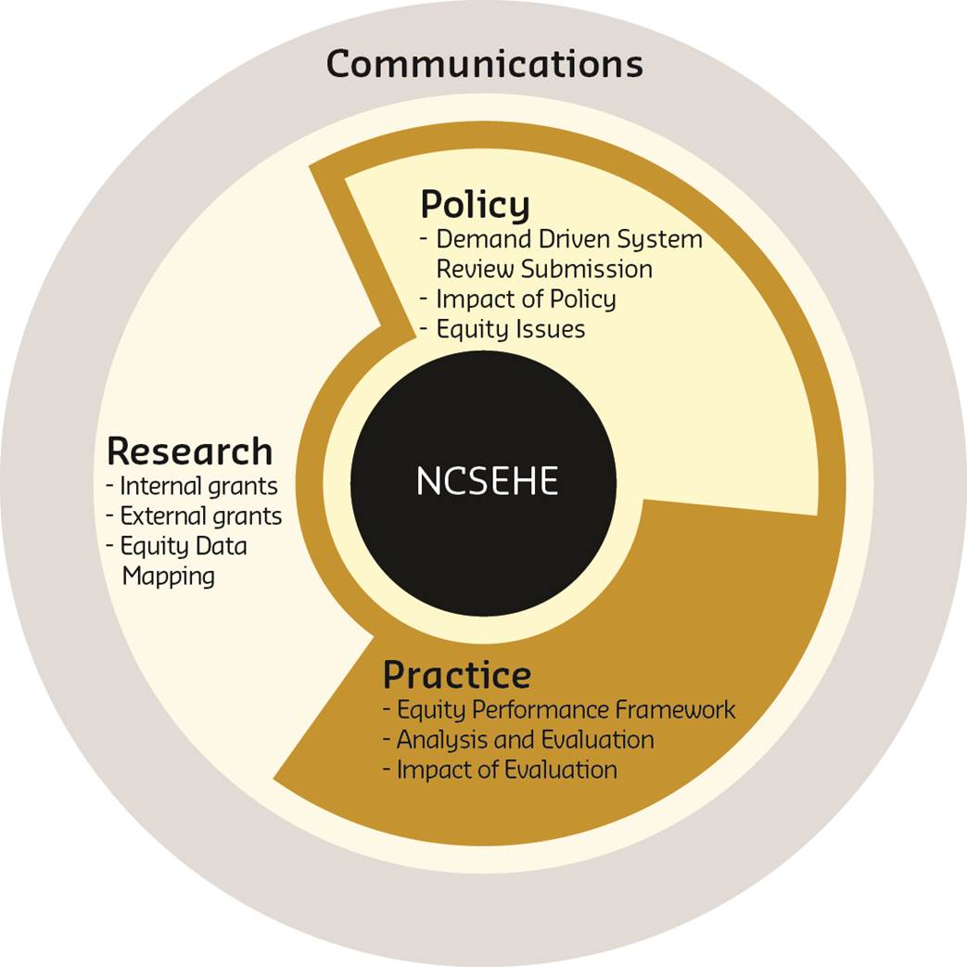
National Centre for Student Equity in Higher Education (NCSEHE)
Closing the loop between Equity Policy, Research & Practice
Notes:
NCSEHE aims:
to be at the centre of public policy dialogue about equity in higher education
to ‘close the gap’ between equity policy, research and practice by:
supporting and informing evaluation of current equity practice, with a particular focus on identifying good practice
identifying innovative approaches to equity through existing research and the development of a forward research program to fill gaps in knowledge
translating these learnings into practical advice for decision-makers and practitioners alike.
Program 1 - Equity Policy and Program Evaluation
- Leadership and support
Program 2 - Equity Policy and Planning Research
- Analysis of student equity groups
- Produce and disseminate publications
- Engagement activities
Program 3 - Student Equity Data
- Collect and analyse data
- Mapping
- Provide access to sources for data and data-driven research

Slide 9


PROGRAM 1
  EVALUATION
Notes:
Program 1 - Equity Policy and Program Evaluation (Evaluation Program) – providing leadership and support in developing a national approach and resources to evaluate the impact of initiatives to increase participation of people from low-SES backgrounds and other equity groups in higher education.

Slide 10

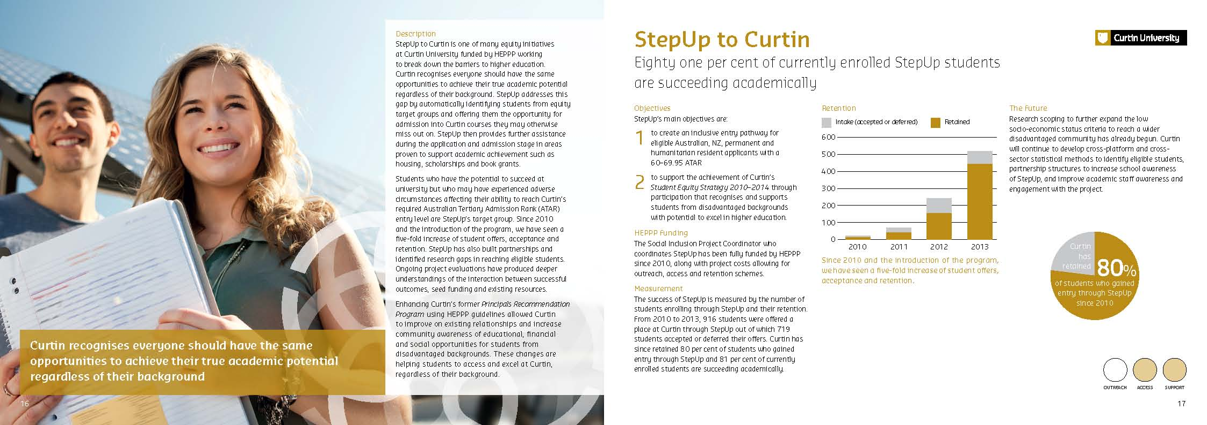
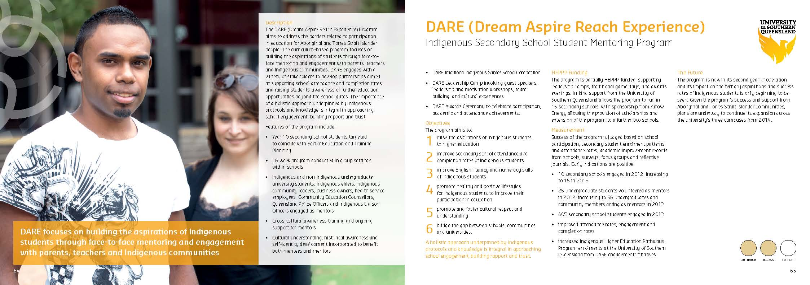
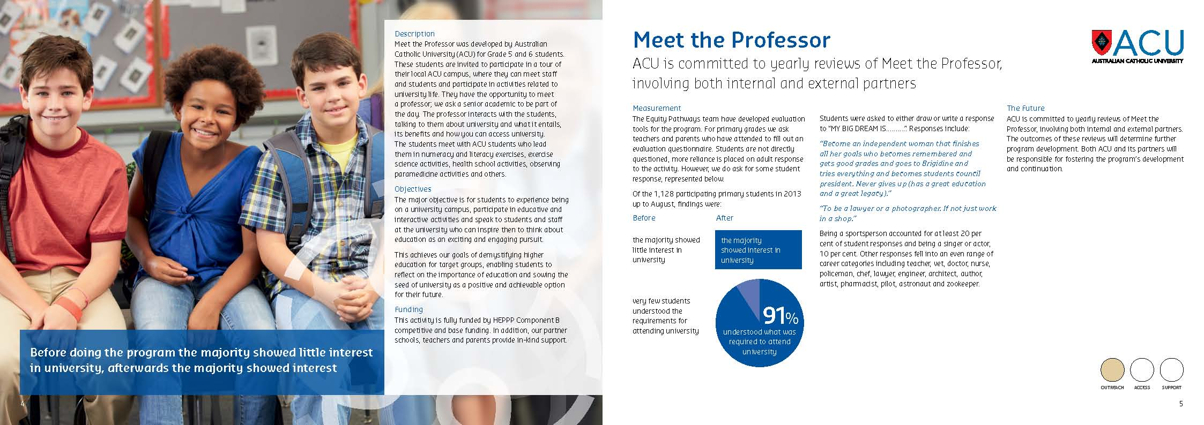

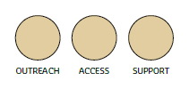
Access and Participation in Higher Education:
Outreach | Access | Support
Notes:
The case study publication was distributed to all universities, government and industry stakeholders, and brought together a sample of the current practice of the 37 public universities across Australia. The universities’ self-selected case studies spanned activities used to reach prospective university students (outreach), helping students progress into university (access) and providing support once students commence, improving the retention and completion rates of those students.
Since December 2013 the NCSEHE website (ncsehe.edu.au) has featured a new case study publication on the front page every three days.

Slide 11

Partnerships in Higher Education
Notes:
https://www.ncsehe.edu.au/wp-content/uploads/2014/11/NCSEHE_Partnership-Publication-13Nov2014v13.pdf
We are just about to release our new publication, which looks at important partnerships that universities have with community and other institutions to assist and support students from disadvantaged backgrounds.

Slide 12
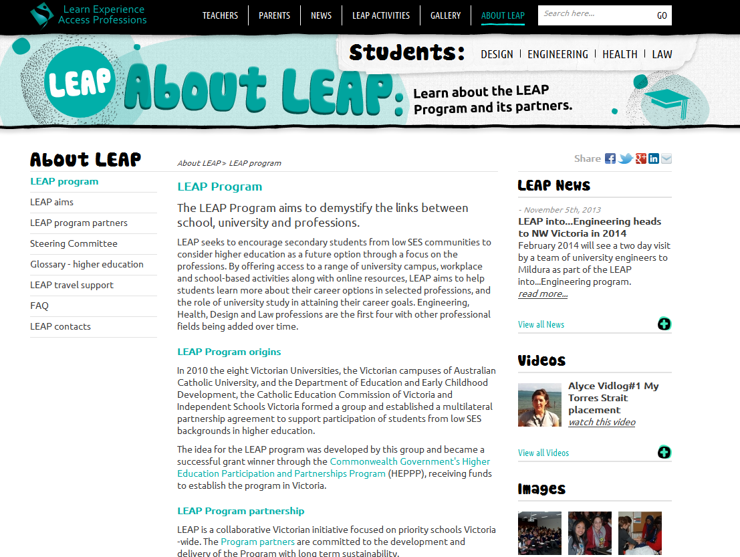
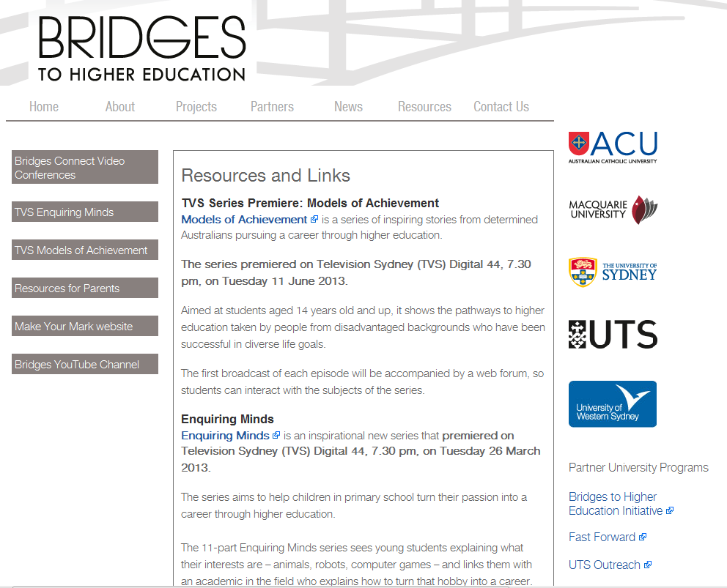
Supporting developing a national approach - monitoring and evaluating projects
Notes:
Evaluating projects such as LEAP in Victoria and BRIDGES in HE in NSW

Slide 13
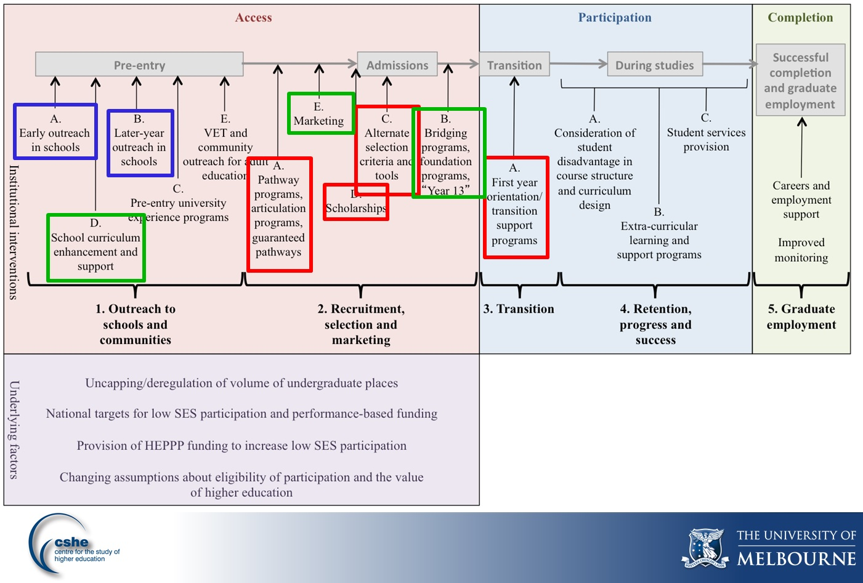
Critical Interventions Framework findings (2012)
Key
Red: strong evidence
Green: some evidence
Blue: may be impossible to prove
Notes:
The National Centre has been a part of some key research looking a the importance of support programs by universities across Australia to raise the aspirations and increase the participation of LSES students in HE.
http://www.ncsehe.edu.au/developing-critical-interventions-framework-presentation/

Slide 14
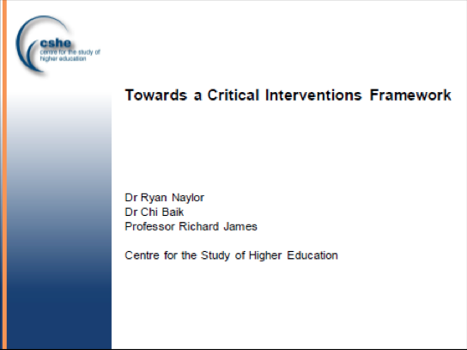



Equity Performance Framework
Notes:
The Australian Government Department of Education has engaged the NCSEHE to develop an Equity Performance Framework for Australian Higher Education’ (“the Framework”). The primary purpose of the Framework is to provide a mechanism, to identify relevant data and statistics for analysis, by which student equity in the higher education system can be monitored in Australia.
This project will:
Identify a set of tested indicators within domains and tiers of which the Framework will comprise, that will allow the measurement of achievement against the Government’s commitments, targets and goals in relation to equity.
Engage with stakeholders:
To test the policy relevance, technical validity and reliability, and flexibility of the Framework and its components;
Regarding the implementation of the Framework; and
Regarding how the analyses and findings should be reported on/published.
Provide the following set of products:
Framework Publication;
Analysis and Reporting Guide;
Implementation Plan; and
A Forward Plan for data and statistics identification and enhancement.

Slide 15
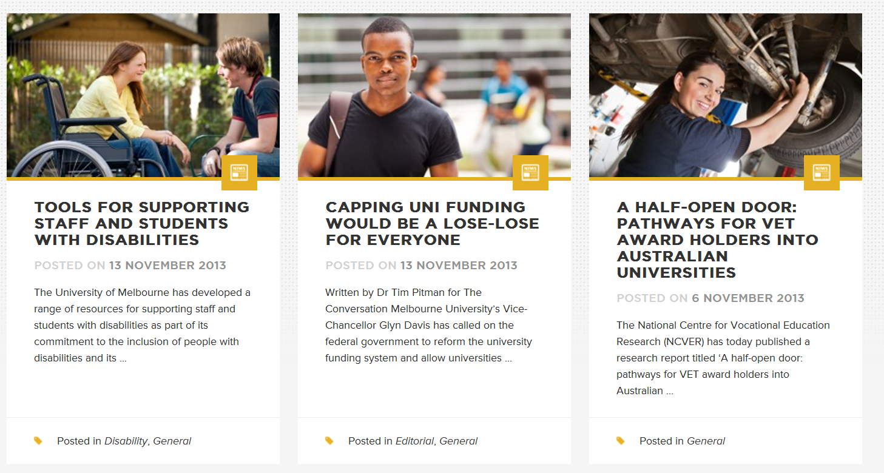
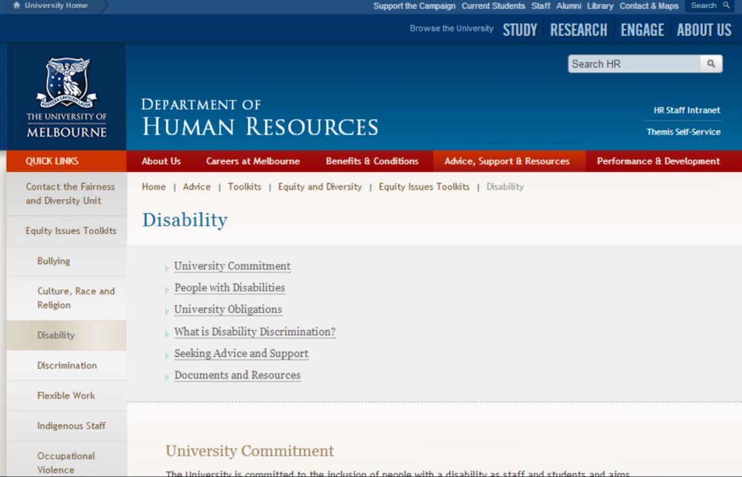
Sharing Resources

Slide 16

PROGRAM 2
  EQUITY POLICY AND RESEARCH
Notes:
Equity Policy and Planning Research (Research Program) – furthering equity policy and planning in Australia, share knowledge and capabilities developed in Australia, and providing evidence on the impact of policy on equity outcomes in the system.

Slide 17

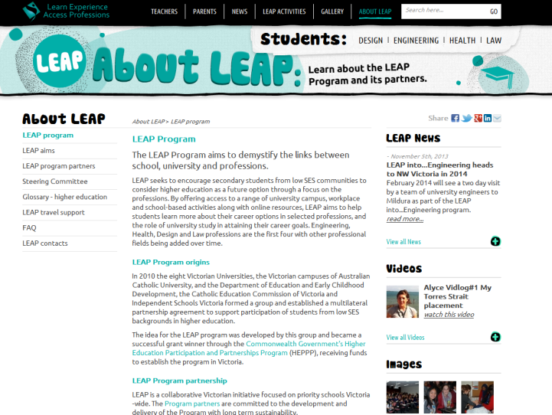
Equity Policy and Planning Research
Notes:
The Research Roundtable Forum held at ANU brought together 29 equity researchers from across Australia and resulted in 12 competitive grants being allocated in 2014 as a part of the NCSEHE research grants program.
The Research Program draws on the resources of the Evaluation Program and the Data Program, as well as informing activities in both those areas. It recognises, as a National Centre, the need to involve and partner with researchers from around the country to ensure that the Centre can tap into relevant research excellence that exists across Australian universities and related research institutions.
As a result, the Research Program involves three elements:
-in-house research by Centre staff
-specially commissioned research projects.
-a competitive research grants program of which 12 grants were funded for 2014 and there is a new round with calls for applications just about to be sent out to all universities. We do hope that you look at applying for funding for research projects – a key area that was lacking in the 2014 round was disabilities, we only received one application so invite you to go back to your institutions and talk to your colleagues about applying.

Slide 18

PROGRAM 3
  STUDENT EQUITY DATA & ANALYSIS
Notes:
Student Equity Data Clearinghouse and Analysis (Data Program) – providing a central location for the analysis of national datasets on student equity in higher education.

Slide 19
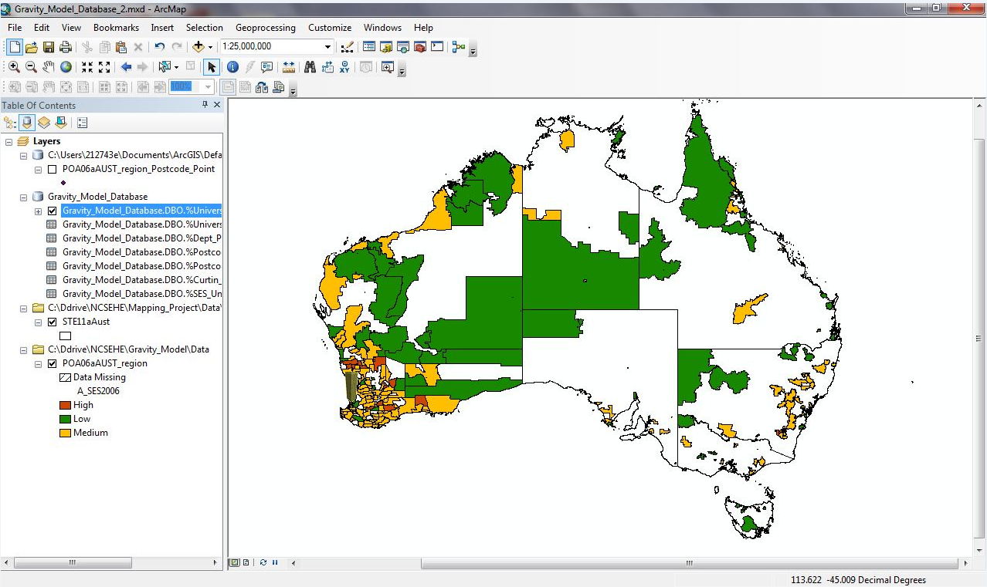
Student Equity Data Mapping Project
Notes:
Interrogating national data sets. There has been a substantial increase in the availability of data on student equity in Australian higher education in recent years. A core mission for us at the National Centre for Student Equity in Higher Education (NCSEHE) is to act as a data hub for student equity data, pointing to official data sources, but also presenting data in formats which support discussion and analysis of equity issues in Australia. In addition, there will be the graphical presentation of student equity data through the NCSEHE’s data visualisation project. Stage 1 is nearly complete so if you have gone to our website and joined the email list when the Beta version is released you will be notified.

Slide 20
Growth By Institutional Grouping
 | 2007 | 2008 | 2009 | 2010 | 2011 | 2012 | 2013 | Growth (07-13) | Growth (07-13) %
National | 528,844 | 532,527 | 553,374 | 580,372 | 600,412 | 634,434 | 668,665 | 139,821 | 26.4%
Group of Eight | 147,609 | 148,484 | 152,718 | 157,289 | 159,749 | 163,643 | 168,682 | 21,073 | 14.3%
ATN Group | 94,486 | 95,520 | 97,467 | 99,423 | 102,097 | 109,302 | 115,712 | 21,226 | 22.5%
IRU Group | 88,632 | 89,480 | 93,518 | 98,191 | 100,849 | 106,050 | 110,622 | 21,990 | 24.8%
Regional Universities Network | 47,650 | 47,782 | 49,716 | 51,627 | 54,072 | 57,295 | 60,188 | 12,538 | 26.3%
Unaligned Group | 150,467 | 151,261 | 159,955 | 173,842 | 183,645 | 198,144 | 213,461 | 62,994 | 41.9%
Regionally Headquartered | 89,761 | 88,873 | 92,109 | 97,115 | 99,752 | 105,739 | 110,879 | 21,118 | 23.5%
Metro Institutions with Regional Campuses | 306,688 | 309,942 | 320,711 | 333,902 | 345,675 | 363,823 | 381,355 | 74,667 | 24.3%
No Regional Campuses | 132,395 | 133,712 | 140,554 | 149,355 | 154,985 | 164,872 | 176,431 | 44,036 | 33.3%
Source: Australian Government Department of Education (2014).
Notes:
Enrolment, as measured by the number of students, in Table A providers increased from 528,844 in 2007 to 668,665 in 2013. This represents an increase of 139,821 undergraduate students, or around 26.4% growth in this six year period. Growth was concentrated in the ‘Unaligned Group’ of universities, with the Group of Eight seeing a slightly reduced share (Koshy and Seymour 2014, 3).
The Federal Government’s Review of the Demand Driven System report (released 13 April 2014), has strongly endorsed the current demand-driven funding system that enables students from diverse and low socio-economic backgrounds to access higher education, a result welcomed by the National Centre for Student Equity in Higher Education (NCSEHE).
Around 82.5% of growth in enrolment took place after 2009, in the lead up to and eventual introduction of the demand driven system (DDS) in higher education and the removal of caps on undergraduate student places. Growth was unevenly distributed across the sector, with the ‘Unaligned Group’ of generally newer universities witnessing a 41.9% expansion in places, raising their share of undergraduates from 28.5% in 2007 to 31.9% in 2013, with the Group of Eight seeing a reduced share from 27.9% to 25.2%. Regionally based universities grew less quickly than those based in metropolitan areas. New South Wales and Queensland recorded growth just under the national average. Victoria saw growth in line with the nation, while Western Australia (31.4%) and the Northern Territory (37.3%) saw faster growth to 2013.
The current funding system is delivering high quality education to more students from diverse backgrounds.
It is important of ensuring that access to higher education is not artificially limited and that there is a place for every person with the desire and ability to participate. That for some students, pathway programs provide the best preparation for university study and extending access to these places will help increase their chances of success, rather than enrolling directly into a bachelor degree.
The report’s recommendation to remove caps on postgraduate courses that offer community benefit.
The important work still to be done from a student equity perspective, and the need for all universities to be held accountable to their social contracts.
The benefits of adopting the report’s recommendations –
providing alternative pathways for students with the required skills but who are under-prepared, due to circumstances beyond their control.
maintaining the already high quality of our higher education system, by further improving the student attrition and success rates.
There are still certain groups of students still experience barriers to participation despite efforts taken by universities to remove these barriers.

Slide 21
Domestic Undergraduate Enrolments, Higher Education, Table A Providers, 2007-2013
 | 2007 | 2008 | 2009 | 2010 | 2011 | 2012 | 2013 | Growth (07-13) | Growth %
National | 528,844 | 532,527 | 553,374 | 580,372 | 600,412 | 634,434 | 668,665 | 139,821 | 26.4%
Low SES | 85,873 | 86,581 | 90,447 | 96,706 | 102,163 | 109,788 | 118,003 | 32,130 | 37.4%
Students with Disabilities | 23,148 | 23,447 | 24,948 | 28,057 | 30,094 | 33,220 | 36,486 | 13,338 | 57.6%
Indigenous | 6,828 | 6,820 | 7,296 | 7,943 | 8,445 | 9,005 | 9,939 | 3,111 | 45.6%
Regional | 100,826 | 101,339 | 104,266 | 110,646 | 115,250 | 121,476 | 127,070 | 26,244 | 26.0%
Remote | 5,428 | 5,240 | 5,368 | 5,532 | 5,572 | 5,804 | 6,069 | 641 | 11.8%
CALD/NESB | 16,702 | 17,222 | 17,649 | 18,227 | 19,226 | 21,289 | 22,863 | 6,161 | 36.9%
Source: Australian Government Department of Education (2014).
Notes:
For Domestic UG Enrolments in Higher Education in Australia there has been a 26.4% growth in headcount since 2007
With most growth post 2009 in the lead up to and eventual introduction of the demand driven system (DDS)
This level of growth is unprecedented in Australian HE.
Overall, faster rates of growth in enrolments for all key equity groups can be seen in this period. Koshy and Seymour (2014, 4) report numbers of students with a disability have increased 57.6% from 2007 – 2013. Strudents must self-identify.
For more information go to Briefing Paper on our website http://www.ncsehe.edu.au/publications/student-equity-performance-australian-he-2007-2012/

Slide 22
Students with Disabilities Equity Ratio, By Groupings and State and Territory, Table A Providers, 2007-2013
 | 2007 | 2008 | 2009 | 2010 | 2011 | 2012 | 2013
National –Disabilities | 4.4% | 4.4% | 4.5% | 4.8% | 5.0% | 5.2% | 5.5%
Group of Eight | 3.6% | 3.6% | 3.8% | 4.3% | 4.4% | 4.5% | 4.7%
ATN Group | 4.5% | 4.5% | 4.6% | 4.7% | 4.7% | 4.7% | 4.6%
IRU Group | 5.3% | 5.3% | 4.9% | 5.4% | 5.6% | 5.9% | 6.2%
Regional Universities Network | 5.0% | 5.2% | 5.4% | 5.5% | 5.7% | 6.0% | 6.8%
Unaligned Group | 4.3% | 4.3% | 4.7% | 4.9% | 5.2% | 5.5% | 5.8%
Regionally Headquartered | 5.1% | 5.2% | 5.4% | 5.5% | 5.7% | 5.9% | 6.5%
Metro Institutions with Regional Campuses | 4.4% | 4.5% | 4.6% | 5.1% | 5.3% | 5.5% | 5.6%
No Regional Campuses | 3.9% | 3.7% | 3.7% | 3.8% | 4.0% | 4.3% | 4.4%
New South Wales | 4.3% | 4.2% | 4.2% | 4.6% | 4.7% | 4.8% | 5.1%
Victoria | 3.8% | 3.9% | 4.0% | 4.3% | 4.7% | 5.1% | 5.3%
Queensland | 4.2% | 4.1% | 4.0% | 3.9% | 3.9% | 4.1% | 4.4%
Western Australia | 3.4% | 3.5% | 4.4% | 4.9% | 5.3% | 5.7% | 5.8%
South Australia | 7.0% | 7.0% | 7.0% | 7.6% | 7.8% | 7.9% | 7.9%
Tasmania | 6.9% | 6.7% | 7.4% | 8.4% | 9.1% | 8.7% | 9.0%
Northern Territory | 5.1% | 5.6% | 5.4% | 5.8% | 6.0% | 5.6% | 5.5%
Australian Capital Territory | 6.0% | 6.1% | 6.3% | 6.4% | 6.5% | 6.3% | 6.5%
Multi-State | 4.0% | 5.6% | 6.3% | 6.0% | 5.8% | 6.7% | 6.6%
Source: Australian Department of Education (2014).
Notes:
Students with Disabilities Equity Ratio Outcomes: 2007 to 2013
The enrolment share of students with disabilities among domestic undergraduates has been steadily increasing since 2008 and stood at 5.5% in 2013, reflecting the growth in this equity group over that period (57.6% since 2007; see previous slide). Rates of enrolment differ somewhat among the various university groupings, ranging from 4.7% for the Group of Eight to 6.8% for institutions in the Regional Universities Network. The ATN Group is alone in seeing a stabilisation of enrolment shares among students with disabilities and now has a lower share that the Group of Eight (4.6%).
Regional institutions continue to report higher levels of enrolment among students with disabilities than metropolitan institutions, with Regionally Headquartered institutions seeing a combined share of 6.5% compared with Metropolitan institutions with no regional campuses who have a share of 4.4%. It is also noticeable that the regional share continues to grow in comparison with static shares in metropolitan regions.
Enrolment shares differ markedly across the states and territories, ranging from 4.4% in Queensland to 9.0% in Tasmania, and generally increased everywhere except South Australia, where they remained flat, and in the Northern Territory where the enrolment share has declined from 6% in 2011 to 5.5% in 2013.

Slide 23

Access and Participation in Higher Education
With increasing diversity in education and training, over 1 in 20 students has a disability that impacts on their study. Significant progress has been made in recent years to "level the playing field" and reduce discrimination however for students with disability completion rates and employment outcomes are still significantly lower than for their peers.
Source: http://www.adcet.edu.au/Key_Issues.chpx
Notes:
Widening Participation of Students with disabilities in Higher Education
This has been taken from the adcet website…
With increasing diversity in education and training, over 1 in 20 students has a disability that impacts on their study. Significant progress has been made in recent years to "level the playing field" and reduce discrimination however for students with disability completion rates and employment outcomes are still significantly lower than for their peers.
Source: http://www.adcet.edu.au/Key_Issues.chpx

Slide 24
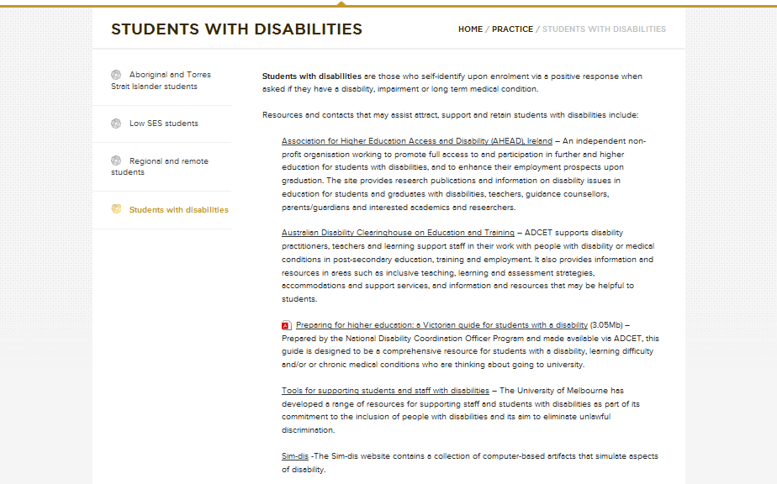
ncsehe.edu.au
Notes:
So I invite you to join us at our website and contribute to the expanding our section on this important area – we have been able to repost links to resources and we have an eNews letter that goes out to stakeholders and we would love to promote some of the great work that has been presented here at this conference and the great work that is occurring in your institutions.

Slide 25

Thank you and Questions
Notes:
Thank you again for this opportunity to talk about the activities of the NCSEHE and we invite you to join us and share your stories.

