Slide 1
An Emerging Model of Community-Based Support for Students with Disabilities
From Inclusive Communities to Inclusive Careers
Michael Millington Ph.D., CRC
Course Director
Rehabilitation Counseling
Notes:
An Emerging Model of Community-Based Support for Students with Disabilities: From Inclusive Communities to Inclusive Careers
(From the program summary)
A value-driven community-based counseling model will be considered on its merits as a vehicle for promoting ATEND’s core objectives. Starting with a reconciliation of values, the argument will be made that community exclusion is best addressed through community action, at all systemic levels. The model posits that: (a) community as an ideal is based on a benchmark set of values; (b) that community is operationalised in the expression of these values through human relations; (c) that these community relations become relationships in the ongoing transactions of identity, power, and capital; and (d) where change is desired for the advancement of full community inclusion for people with disabilities, these transactions are the contexts for community development that must be addressed. The model has been articulated in counseling theory and practice specifically in service to persons with disabilities and their families. Here, we explore its potential applications within the ATEND framework, specifically in relationship to student’s with disabilities and their full participation in education and consequent careers.

Slide 2
Bridging Professions
Origins in Rehabilitation Counselling
  “Families in Rehabilitation Counseling: A Community-Based Rehabilitation Approach”
The Family Model:
  “Community Care & Support”
Broader Applications...
  All caring relationships that unite people and professions in community inclusion
Notes:
Bridging Professions
The model in this book began as a response to a professional conundrum: Despite an appreciation of family centrality to the rehabilitation counselling process and a 25 year-commitment to family inclusion, essentially no progress has been made in research, service models, management, or policy.
What we had was a problem of models. The foundation of the profession was loosely based on ideology and tradition with no fundamental commitment to the scientist practitioner and no deep understanding of the importance of a bedrock moral philosophy.
Having posed this conundrum to my publisher, she invited me to author a book that would provide the model that would make the proper case for families in rehabilitation counselling. Today’s keynote is based on the product of that research.
In the book “families in Rehabilitation Counseling: A Community-Based Rehabilitation Approach” (Millington & Marini, 2015), the first five chapters build a reasoned argument that posits:
families have not had a voice historically because the profession embraced the medical model in their early efforts at professionalisation – there is no social language in the medical model that allows families (or other communities) to be recognized, heard, or heeded;
integrating social models (and values) into rehabilitation counseling (RC) aligns both our science and practice to the contexts of community; and
family is the first of a series of nested and networked communities that provide the context for serving full community inclusion.
Chapter 5 resolves the reasoned argument in a new model of “Community Support & Care”. Although I had not planned it, the process of building this reasoned argument for families meant that the whole of the profession had to reinvent itself in the context of community...that Rehabilitation Counselling, properly understood, was a specialised variant of Community Health Counselling.
It also became apparent, as I shared this model that the Community Care & Support model has potential for framing knowledge and practice across caring & support professions that serve persons with disabilities and their families.
There has been some early popular support for this expanded view of the model. It will be featured in the upcoming counselor’s desk reference (Millington, in press). It has found a forum within the faculty of health science where it is being integrated into participatory action research projects (designing and implementing respite care, community support for facilitating employment among youth with mental health issues); and posited in discussion on integrated care and complexity.
The purpose of my presentation today is to explore the potential utility of the “Care & Support” mode within the ATEND community. To this end, I will link our professions though our shared values, and reconstruct the model with ATEND’s mission and goals in mind. Hopefully, today’s key note will open a bridge for continued discussion and possible collaboration...because we share one fundamental thing: We all identify with the community of students with disabilities in post secondary education and advocate for their full participation in professional careers.
Millington, M. (in press). Community Based Rehabilitation: Context for Counseling. In I. Marini & M. Stebnicki (Eds.), The professional counselor's desk reference. New York: Springer.
Millington, M. & Marini, I. (2015). Families in rehabilitation counseling: A community-based rehabilitation approach. New York: Springer.
http://www.springerpub.com/counseling/families-in-rehabilitation-counseling.html

Slide 3
ATEND Values in Action
Access & Participation served through:
Advocacy Identity in a Social System
Instrumentality of Education
Citizen Empowerment
Best & Evidence Based Practice & Policy
Community Networks & Collaboration
Notes:
Shared Values with ATEND
Building bridges between professions is a global occupation these days. In the Allied Health Professions, the “Professional Silos” and the preoccupation with turf is understood to be a major systemic barrier to best practice, and a problematic one. Regardless of our desire for collaboration, it is very difficult to reach across professional boundaries and make sense of the connection when we start with technical knowledge and skill. These, by nature are the things that differentiate us. Finding the connection, or bridge, between professional concerns is easier if you start at the level of unifying values. For the purposes of this keynote, I visited the ATEND website and extracted value themes that define the professional community. As an outsider with an agenda, this is what I see, and for openers I want to see if there is consensus on these findings.
Advocacy Identity: ATEND sees it’s membership as both professional and consumer voice in advocating social change in existing systems that (a) tend to deny students with disabilities full access and participation in post secondary education & training. As such, it claims community across traditional boundaries of support and student. That is to say ATEND membership embraces the expertise of lived experience of disability and of service provision as indivisible characteristics of its organisational identity.
The Instrumentality of Education: Tertiary education is the point of intervention, but not an end in itself. The purpose of full access and participation in postsecondary education and training is primarily to open up the rest of society to full access and participation for or students. Employment is specifically identified as graduation’s proximal outcome. We can infer that a successful career is the long term goal, supported by accessible education/training opportunities across the life span.
Citizen Professionals and Citizen Empowerment: As a model inclusive community, the members of ATEND advance participation through student-centred service that provides professional resources “on tap” rather than “on top”; where students collaborate in service planning, influence policy within the service structure, and have representation in broader policy arenas through disability advocacy organizations, including ATEND, which self-identifies as a consumer-led community.
ATEND Self Advocates through Continuous, Systems Improvement: ATEND creates and promotes the highest standards of quality in policy and practice, to advance the cause of full community inclusion and legitimate the role of its members in service. ATEND encourages innovation, the disciplined evaluation of its effects through participatory research, and the continuous uptake of best practice by the membership.
Community Development Within, Community Engagement Beyond: Knowledge translation into practice requires a rich and reflexive interconnectivity between members willing to trade in information freely. ATEND recognizes that there is a web of formal and informal support for students with disabilities beyond it’s boundaries. Best practice is founded on mutually supportive collaboration between all stakeholder groups in research, practice, and policy.
ATEND Mission:
To act as an independent professional and consumer voice in advocating for improved standards of access and participation in post-secondary education and subsequent employment for people with disabilities.
Objectives (slightly restated; not verbatim):
1. Act as a peak organisation for affiliated bodies seeking to improve access to post secondary education, training and employment for people with disabilities.
2. Develop and promote informed public and professional debate on policies and practices that lead to access and successful participation in both post secondary education and training, and subsequent employment for people with disabilities.
3. Promote a coordinated national effort directed at government, educational and training institutions and providers, and employer groups to secure the adoption of quality standards and practices that affirm the inclusive education, training and employment for people with disabilities.
4. Promote the sharing of initiatives by state networks and those working in the field more widely within national and international forums.
5. Disseminate information, increase knowledge and promote awareness of issues throughout the community concerning post secondary education and training for people with disabilities.
6. Consult on matters of policy and share information with people with disabilities and their organisations.
7. Promote proper and adequate representation ensure that of people with disabilities in post secondary education and training have proper and adequate representation on bodies and organisations which make decisions that affect their lives.
8. Make presentations and submissions to government and other decision-making bodies concerning federal initiatives, plans, projects and legislation within the purview of the ATEND's objects.

Slide 4
Value Driven Profession
Fundamental Mission: Full Community Inclusion
Agents of Social Justice
Roots in Advocacy
Science of Social Change
Value-Driven Practice within Systems
Notes:
We are Value Driven Professions
I like to believe that there is a Fundamental Mission uniting all stakeholder groups in our service world, i.e.: Full Community Inclusion. Everything else that you might add to that mission is specialisation or commentary. Unpacking the term is a major philosophical undertaking, but it is important to do so, because it reveals some important aspects of our professional Ethos (or character emerging from deeply held values and world view), what we share amongst professions, and how we should organize our science and practice.
Here, I will relate how I chased down the professional ethos for the rehabilitation counselling field as a value-driven practice and a social science. When you go back to the roots of the profession you tend to find common ancestry in education, philosophy, and psychology.
Agents of Social Justice: Drilling down to the core of our values, we find that our professions do not exist outside of the moral philosophy of Democracy. Rehabilitation Counselling was legislated into being after World War I because disabled veterans were not reintegrating into society. Their plight was a violation of the social contract and thus shamed society into action. Providing care and support for veterans was an obligation placed upon society by its values as a democracy.
Democracy is operationally defined by values that describe the relationship between peoples. Equality (or justice), Liberty, and Fraternity are demonstrable “values in action” in society. John Dewey (educational philosopher) pointed out that big “D” democracy is a relative abstraction that is only supported in as much as local communities, made of local people, are engaged in real acts that exercise these values in real community development (small “d” democracy).
When people are denied access to the democracy in their daily lives, justice, liberty, and fraternity are denied them. The individuals suffer of course, but so does the community in which they live, and so does the society that holds itself to the metric of Democracy. Thus rehabilitation counselling serves in the gap between the ideal democracy and its less-than-perfect implementation by working locally to improve the lives of people with disabilities AND to the improve the communities in which they live.
We aspire to build a community so engaged in its values and universally accessible that our services are no longer necessary (as they are presently understood).
Advocates: What gets missed in the medical model is the revolutionary history of the social movement (that included the growth and development of rehabilitation counselling) that kept sharpening its vision of how to include marginalised people, and broadening its scope. People with disabilities created their own civil rights movement, and as they came together, they began to form a collective identity, and through collective power they put that identity out into society and created a new discipline (disability studies). Our collaborative services have to work within this social justice context…and become redefined within it. “Never about us without us” and “professionals on tap, not on top” are not empty catch phrases; they point to our roles as citizen professionals and advocates in the Disability community.
Science of Advocacy: The social model advances on a social science. Humans are social creatures, remove them from community, and you remove their humanity, remove them from humanity and all manner of hell can be visited upon them. Kurt Lewin created social psychology as a response to the holocaust of World War II (note: the strategy of extermination that was the holocaust was first practiced and refined on people with disabilities living in German institutions). Lewin’s pioneer work led the way to understanding the interconnectedness of human beings and their social milieu; how disenfranchised groups can resist oppression; how communities form; and how social change can be directed through participatory action research.
Lewin’s early work was the foundation for rehabilitation psychology, which looked specifically at the phenomenon of disability and based its science of change on 20 value-laden principles set down by Beatrice Wright in the 1970’s. It is here that we see disability as a complex social phenomenon linking biological, psychological, and sociological dynamics in complex systems of family, neighborhood, state, and nation.

Slide 5
Sensing Community*
Membership (Identity)
  Who am I? Who are we?
Influence (Power)
  What do I (we) direct? What directs me (us)?
Trade (Capital)
  What do I (we) have? What do I (we) need?
*McMillan & Chavis (1986)
Notes:
From Democracy to Community
Liberty, Equality, and Fraternity are broad philosophical values. They are not tooled for practical use in describing the experience of community inclusion at the social level. They do translate to three “senses” of community that are qualititative dimension of the experience of participating in community. The Sense of Community Theory (McMillan & Chavis, 1986) linked the values of democracy to three transactional community processes, which in turn provide the contexts for understanding how inclusion (and exclusion) are experienced at the personal level.
Membership becomes Identity: Membership delineates the boundary between in- and out-groups, between us and them. Membership becomes identity, our sense of self, and thus has great value. To be denied membership, to be rejected through shame or humiliation, is stigmatisation and alienation.
Influence becomes Power: Communities manage complexity and diversity through the parsing of authority and responsibility, always pairing the two, balancing the distribution of power, and sustaining a consensus on the rules - rewards of compliance and the consequences of violation. To be denied one’s rights and responsibilities within a community is oppression and disenfranchisement.
Trade becomes Capital: The engine of community is the profit of collaboration and trade. Diversity within community is valued as people trade in information, time, emotions, money, and things. In trade, the members are drawn together, interdependent and valued. To be denied access to the marketplace as both consumer and vendor is exploitation and impoverishment.
The three processes are at work in any act of community, it is possible to describe the essential qualities of the transaction in terms of these processes, to evaluate the experience of community inclusion or exclusion in terms of these processes, and to imagine interventions that would encourage more inclusive transactions in the future.
Each process will be expanded upon in turn…
McMillan, D. W., & Chavis, D. M. (1986). Sense of community: A definition and theory. Journal of Community Psychology, 14(1), 6-23.

Slide 6
Disability & Identity Part I
Personal Identity
  Multiple evolving roles & contexts
Social Identity
  Personally shared within community
Collective Identity
  Solidarity in Action
Notes:
Identity & Self Concept
Inclusion in communities creates the context in which we establish our sense of self; that is to say, a healthy sense of self is dependent upon community. Self-concept is overwhelming social. It constantly develops out of our experiences with other human beings.
Personal Identity: Self is a constellation of identities that shift and change over time. Identities are based on roles (child, student, mother, friend, employee) that imply relationships with others, vary in their centrality in our lives, and are found across a variety of “community settings” (school, work, home, etc.). Disability can impact access and participation in these roles, and in doing so impact ones self concept. “I am a student” is a declaration of a role that gives one standing in the community. If this is a very central role for the student with a disability, self concept is heavily invested in being successful. But the student role is only one of many possible, and understanding what it means to the student is to understand in within the constellation of other roles.
Social Identity: Where personal identity establishes what is meant by “I am”, social identity establishes what is meant by “We are”. Membership brings identity to the space between members and meaning to the bond they share. Again, people belong to a constellation of groups (family, ethnicity, trade), some deeply engrained into our sense of self, and others less so. And again we understand the student within the constellation of these allegiances. If my identity as a member of the disability community is strong, I will seek a community of students who also have disabilities, and I will draw meaning from our shared academic experience.
Collective Identity: Where social identity is the face we show our kin, collective identity is the face we show the world. Coordinated effort among community members with different skills but a common cause results in accomplishments that change the world. The independent living movement began on the University of California – Berkley campus when Ed Roberts and the “Rolling Quads” became a recognized and influential band of activist...and established the Physically Disabled Student's Program.
None of these aspects of identity are available without other people. A Healthy Self-concept is nurtured when the sense of community is strong.

Slide 7
Disability & Identity: Part II
Meaning Making
  Routines/rituals; Stories/myths
Stress & Coping
  Dealing with life
Resilience
  Personal and social growth
Notes:
Identity, Experience, & Growth
Within our communities, in the execution of our roles, we deal with individual and shared challenges. Through these challenges our identities are forged.
Meaning Making: The events of the day become routines that shape our lives and reinforce the roles that we play. Important routines, charged with meaning, become rituals that strengthen the bonds between people. Religious rituals remind us of our faith (social identity), small personal rituals remind us of our love for one another. Routines and rituals help individuals maintain a sense of continuity in challenge and change.
We recall the days events with stories, and important stories become family myths. Stories told and retold, capture the meaning behind the struggles, makes sense of our sense of self within the community. Struggles are met, battles are lost, babies are born, parents die...and the cycle is repeated in every community and yet the community remains... giving a sense of constancy in constant change
Stress & Coping: The events of our lives test our equilibrium and tax our resources. Life is filled with stress and the response comes the roles we play and the resources we bring to bear. We can look at coping from an individual psychology. There is the direct resolution of challenge through problem solving...the cognitive ability to puzzle out a solution and the physical capacity to see it put to action. There is affective coping in reframing loss and other affirmations. There is also the social equivalent of both of these, where support groups share their skill effort and coping strategies to resolve the challenge. The act of simply being there for someone else is in itself a support. Indeed, belonging is often enough to give one the confidence to succeed.
Resilience: Succeed or fail, all experience has the opportunity to teach. We learn what works, and we learn that even if we are knocked down, we can get back up and the world goes on. Resilience is the learned ability to “bounce forward” in the face of challenge, to develop an articulated and deftly used set of coping skills...and to acquire the resources, especially through one’s network of social connections, to minimize loss and leverage success. Resilience also has a social dimension that follows the collective identity.
Families learn to be resilient, sports teams weather losing seasons and come out stronger for it. Student have set backs. Sometimes there is failure. Doubt sets in. Identity is questioned. They turn inward for resolve, and outward to their communities for support.

Slide 8
Disability & Power
Balance
  Authority/responsibility; autonomy/compliance
Oppression
  Systemic, purposeful, and targeted
Resistance
  An empowered response
Notes:
The Second Moment of Community: Power
Power flows through all social groups and is rightfully organized to bring order to dynamic complexity, and fair treatment to all players.
Fairness in Power: Well balanced power matches authority to responsibility, is distributed across stakeholders, is responsive to its charges, and always just in its exercise. But the world is not fair and power is rarely well exercised without conflict.
Oppression: systematic abuse of power. It moves through all political systems, defines much of our shameful history, continues to assert itself in the present, and seeks out minority groups as its preferred targets. It is built into our systems and is reflected in our inaccessible architecture, our cultural attitudes towards disability, our dismissive language, punitive and abasing policies, underfunded and devalued services, and outright bigotry. The student disability experience in university can be a daily stream of micro-aggressions and overt outrages that reminds them that they are not respected, that their needs are not given serious consideration, and they are not heard or heeded in anything of consequence.
Resistance: Oppression, even in its most subtle form, forces the person to taken on an identity that the oppressors are comfortable with. There is no safe place for the student with a disability to be themselves, and so to stay engaged, even on the margins, they must be something other than themselves. Resistance says NO. It is the push back. There is still no safe place for the individual to stand, but they will stand as themselves. They may not be heard but they will speak. Resistance becomes powerful when it is joined in a community of resistance, when the collective voice speaks and is heard.

Slide 9
Disability & Empowerment
Psychological Empowerment
  Affect, Cognition, Behavior, Relational
Social Empowerment
  Community support for personal resilience
Collective Empowerment
  Community Support for community action
Notes:
Disability & Empowerment
There are two approaches to Social Justice. One can resist oppression and fight the system, and one offer a better solution and build community around positive change. Both are exponentially more effective when channeled through community and charged with resources.
Psychological empowerment: There are psychosocial preconditions to empowerment. The affective dimension provides motivation and meaning. Confidence, self-efficacy, self-worth, hope, and optimism are precursors to goals and action. The cognitive dimension provides capacity and intention; the ability of the person to assay the gap between need and goal, and to conceptualise a plan to achieve desired ends. Behavioral dimension provides the physical response and participation; the physical manifestation of affect and cognition in a social environment. It is the presence of a social environment that creates the last, relational dimension. Psychological empowerment is ultimately facilitated by social connections and processes that link the personal to the group. Without it, one can only be as empowered as the unassailable social world will allow.
Social Empowerment: Empowered groups consist of members, empowered in their roles. They share affective strength, knowledge and skill, and provide mutual care and support. Members seek resources and social connections abroad to enrich the membership as a whole and each individual member in turn.
Collective Empowerment: Movements and advocacy groups that form coalitions of families and friends to create societal change at macro system levels, from local self-advocacy initiatives to policy debates in municipal, state, and national forums.

Slide 10
Disability in the Context of Capital
Social Capital
  Trade in any individual or group asset to leverage resources
Capital & Identity
  Trade reinforces identity & community
Trade & Disability
  Diminished access to capital
  Heightened need
Notes:
The Engine of Community: Trade & Social Capital
The purpose of community is transaction…in all things. The individual is enriched by being able to invest of themselves, to exchange work for money, money for possessions, possessions for relationships, time for education…etc. and the community. is strengthened as it can shift and change within to respond to forces without. Exchange is everywhere, in daily routine and in ceremonial rituals. Every domain of civic life is predicated on exchange. School, Employment, Health, Home, and Social settings exchange between members and between groups to form the larger marketplace that is the city, state, and country.
It depends upon two entities, each with something of value to the other, a process of negotiation, and a means of exchange. Moving within a system rife with barriers (many invisible), persons with disabilities may be challenged in recognising the value they bring to the marketplace, may not have access to the marketplace, may not have the tools to navigate the marketplace and its transactions.

Slide 11
Building Capital
Community Development
  Economic development
  Community education & networking
  Culture & political development
Case Management
  Counseling, planning, decision making
  Knowledge and skill acquisition
  Referral & networking
  Advocacy
Notes:
Building Capital
There are two basic ways to assist people in enriching themselves in the marketplace. (a) Develop the marketplace its self, and (b) facilitate the individual’s exchange within it.
Community development: The key to community development id for the community to decide what needs developed and facilitate the collective vision. Bring in cash that leverages projects; activist students raising awareness and staging events that bring players together that bridge school, business, science, politics. Consider again the case of Ed Roberts (berkley student), who saw a need and built buildings, policy, and a movement.
Case Management: Or perhaps “Support Coordination” is a more accurate descriptor. Whether in a professional, peer, or support group format, providing the individuals in your community with all of the knowledge, skill, and support resources needed to choose ones direction, plan one’s path, monitor one’s progress, and adjust along the path to success.

Slide 12
Community Contexts
Family as First Community
  Health
  Education
  Livelihood
  Social
  Empowerment
E
Work
Education
Health
Social
Empowerment
Notes:
Nested and Networked Communities
The three community transactions that negotiate the character of our participation and inclusion (identity, power, capital) are at work in every context where community transpires. These communities are nested…with the family at the core represented by the closest and most powerful social/emotional bonds, moving outward to more distal relationships (friends, neighborhoods, towns, regions)
These communities are networked and interdependent. The WHO (World Health Organization) model of Community-Based Rehabilitation, which has been an inspiration for this “Care & Support” Model, recognizes four domains where community development and services are targeted…these are clearly community spaces as well. The WHO also identifies empowerment as a domain for interventions that transcends function and becomes a consideration within each of the other domains.
Full community inclusion requires that participation, as it transacts in identity, power, and capital, be evaluated and addressed in each domain…because in a system they all effect one another. At the center od

Slide 13
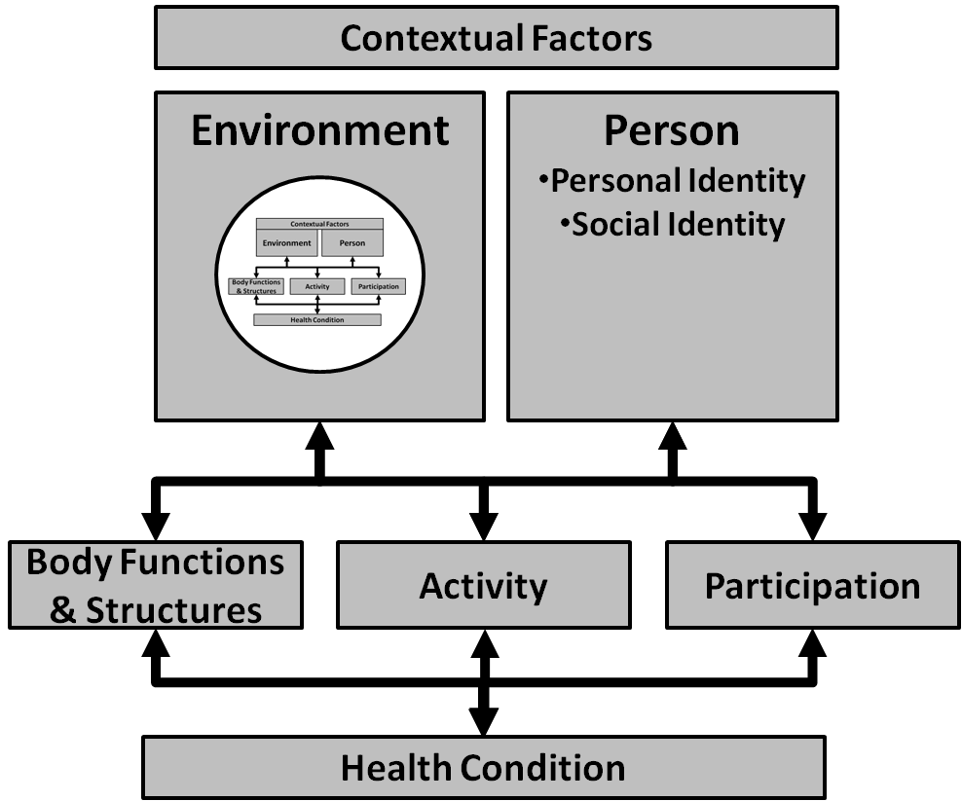
International Classification of Function (ICF)a
Notes:
International Classification of Function (ICF) as Revolution
When does advocacy become science? The World Health Organisation is the closest thing human civilisation has to a global voice for health science, and it has rejected the medical model of disability for the bio-psycho-social one portrayed in this diagram.
In this diagram, Environment X Person represent the contextual factors that transact to create the experiences of our daily lives. This experience puts body structures and functions into play in the execution of daily activities (individual, solitary action) and our participation (social transactions) in community. All of these components are interactive so the history of our activity and participation effect our body functions and vice versa, our personal characteristics effect our environment and vice versa. Similarly, health conditions impact body function & structures, that echo through the activities and participation a person engages in, and ultimately impacts the environments they inhabit, and even their personal and social identities.
Disability is not a thing, or a diagnosis, it is a process that is manifested in all of these processes and structures. It is not contained within the person, but it does becomes part of their identity. It is contained within the social sphere, or community and it becomes part of all of our identities.
If you will note, I embedded the ICF model inside of the ICF model, within the Environmental factor. This is crucial for understanding the community identity of disability. The environment factor in the ICF includes all of the people who interact with the person. The closest and most connected of these are family and friends. When the health conditions of a family member effect that person’s body functions & Structures, leading to an impact upon activities (bathing, toileting) and participation (getting an education), these effects then reverberates in the environment of every person who cares for that person or supports them. Through caring activities and support in participation, the experience of disability becomes part of the family identity, the social identity of friends, and their personal identities they assume in caring roles.
Inasmuch as caring is an important trait in a community, we find that the experience of disability in a community actually creates an opportunity for the community to exercise its values, and provides a growing experience for its members. By leaving the medical model behind, we quit seeing disability as illness and tragedy, and give it the space it deserves as an accdepted part of the human experience, and in being accepted, intrinsically valued.

Slide 14
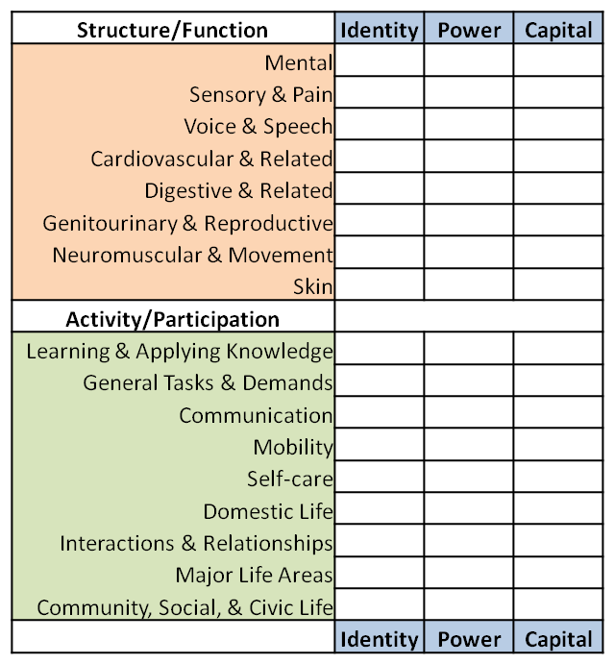
I
C
F
Notes:
International Classification of Function (ICF) as the Scientific Foundation for Care & Support
(World Health Organisation)
Here is a chart of the most basic categories of the ICF “Structure/Function” and “Activity/Participation factors. Each of these subdivides into a taxonomy of descriptors that go to the granular level. Under Activity/Particiption, the major headings are: (a) Learning & Applying Knowledge; (b) General Tasks & Demands; (c) Communication; (d) Mobility; (e) Self-Care; (f) Domestic Life; (g) Interactions & Relationships; (h) Major Life Areas; (i) Community, Social, & Civic Life. The ICF has created tools to evaluate the impact of disability on these subdomains. What we have done here is follow that evaluation with the implied need for some sort of social intervention, i.e., care or support.
Returning to McMillan “Sense of Community” Theory for a moment. There was a fourth sense of community identified, and it referred to the other three in the experience of community over time. That is to say, transactions in identity, power and capital, over time, create products or artifacts that reinforce the culture of the community. We create rituals of inclusion, and build accessible buildings in which to have them, we pass laws, and tell stories of our history of our heros (Ed Roberts), and remember them in our arts. This last sense of community is reflected in the structures of support and care that we build into our society, and all the way down to the plan set forth for an individual.
The rows suggest need for care or support, the columns address the quality of the care and support provided. When a person with a disability is receiving care, there is a carer. What does ritual of care mean to them? Who controls the process, or how is control shared? And what passes between them…what is acquired and given away in the transaction? These are the questions we need answered to see how well the system is working.

Slide 15
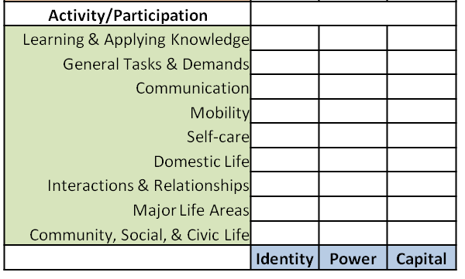
Community-Based
Care & Support
Teachers
Colleagues
Friends
Extended
Siblings
Parents
Notes:
Community-Based Care & Support
In this illustration, we can imagine the total care and support that would be optimal for any student…and the systems response to it. As I said before, (a) the ICF activity/participation categories map the individual’s need for care and support; (b) Identity, Power, and Capital describe the important community aspects of the care or support transaction.
What we see here is a series of sequential charts, each representing the person engaing in the caring or supporting act. The yellow cards up front represent proximal carers. These are people with strong emotional bonds with the student, engaged in long term, developmental, and rather global relationships. That is to say Parents, Siblings, Extended Family, Family Friends. In the traditional literature, these people and their transactions have been referred to as “Informal Care” by medical model experts. I believe “Proximal Care” is a more empowering term.
The Pink cards represent distal care (formal) and people who tend to have weak emotional bonds, engaged in short term and specialized relationship. These tend to be experts called in to perform a service. One could imagine medical and psychological support professionals in this list as well as many others. We could imagine ourselves in this stack of helping service providers.
If maximizing the educational experience is the goal, the entire system needs to be evaluated and served. Learinig & Applying Knowledge is ging to be a direct causal concern in most cases, but so will “Major Life Areas” as this refers directly to the school experience (as well as work down the road). And so we get a clearly picture of the type of interventions as we consider communication, mobility…etc. But then we ask a different set of resource questions:
Who should be engaged doing what, when, and in collaboration with who?
What is the best role for the teacher? The students colleagues, how can they help? Where are the parents, are they influencing this in anyway? We look at balance across the net. Exploring all potnetial resources, and we notice that the most powerful are not the professionals, but those who can contribute time freely as a natural part of their community.

Slide 16
Implications & Discussion
Partnership / Oversight from Peak Body PWD.
Report to the highest level of governance
Staffed by workers with disabilities, trained in RC
Encourage Student Activist/Support/Self Advocacy groups
Research stream: best and evidence-based practice in:
  Ecological Assessment
  Plan Development
  Implementation
  Monitoring
  Evaluation
  Systems Change
Notes:
Implications & Discussion
I do not have your experience and so my ideas are not a good place to start. But as a very invested ally I can offer some thoughts to get the discussion going forward. Your mission enjoins you to seek out partners to help you in your cause and to be a part of your community of practice. I cannot think of a better partner than a profession and academic discipline who shares your dedication to the fundamental mission of full community inclusion.

Slide 17
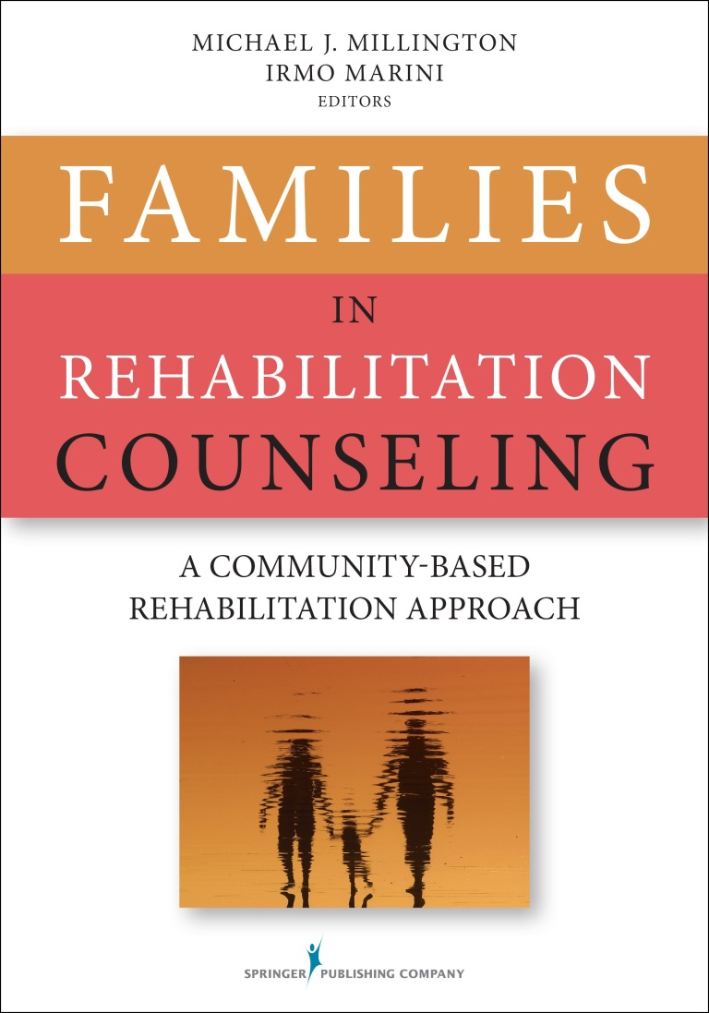
Thank
You
Notes:
Thank you for inviting me to speak. I have enjoyed the challenge of retooling my thoughts on family into the student frame. I hope that we continue a productive discussion on this topic and look forward to hearing from anyone who wishes to make contact me at: Michael.millington@sydney.edu.au
This is the book that details the concepts discussed today. It is available on line at
http://www.springerpub.com/counseling/families-in-rehabilitation-counseling.html
It’s worth a read, and my publisher would appreciate your business.
-Mike

