Slide 1
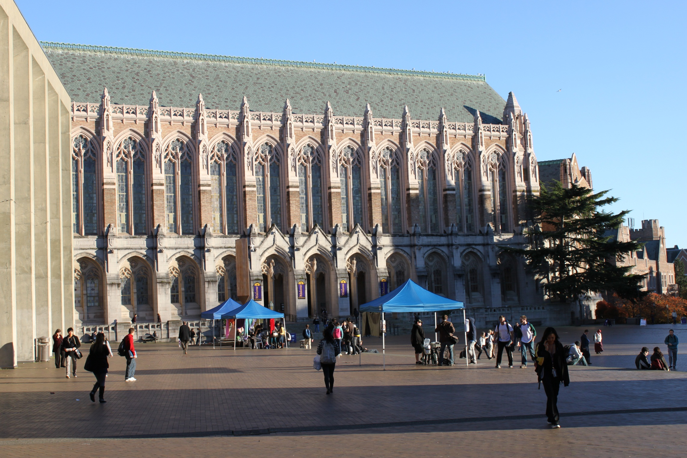
Universal Design—How Do Students with Learning Disabilities Benefit?
@ Pathways Conference, 2014
Sheryl Burgstahler, Ph.D.
University of
Washington
Seattle
U.S.A.

Slide 2
Two UW Centers
Access Technology Center (ATC)
1984-
Funded by UW
DO-IT Center
1992-
Supported with federal (e.g., NSF AccessSTEM, AccessComputing), state, corporate, private funds
Expanded to DO-IT Japan, 2007

Slide 3
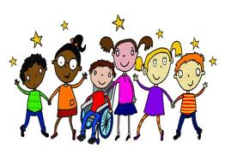
Topics of Presentation
Access Approaches
How to Make Educational Products & Environments Welcoming & Accessible Through Universal Design
Benefits of UD to Students
with LD
Resources

Slide 4
Reference: Universal Design in Higher Education: From Principles to Practice
U.S. Department of Education, NSF
42 authors/co-authors
Peer reviewed
Harvard Education Press
20% off coupon on DO-IT website
Email to join our UDHE CoP

Slide 5
Diversity Types Include:
Cultural
Linguistic
Sensory
Physical
Neurological
Cognitive

Slide 6
Ability on a Continuum
see
hear
walk
manage physical/mental health
read print
write with pen or pencil
communicate verbally
tune out distraction
learn

Slide 7
Some Relevant Symptoms of LD:
Short attention span
Poor memory
Difficulty following directions
Inability to discriminate between between/among letters, numerals, sounds
Poor reading &/or writing ability
Difficulties with sequencing/organizing

Slide 8
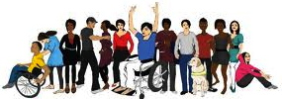
Views of Access Disability Approaches • Outcasts, • Exclude, shame offer charity • Medical • Cure, diagnosis rehabilitate • Mainstream • Accommodate • Social justice/ • Apply universal design diversity + accommodate

Slide 9
Accommodations:
An accommodation adjusts a product or environment to provide access to a specific person.

Slide 10
Examples of Accommodations for Students Who Disclose LD
Extra time on tests
Proctored exams
Materials in alternative format
Alternative assignments
Note taker
However, often students with disabilities do not disclose.

Slide 11
But sometimes it is the design of the product or environment that should be reconsidered…

Slide 12
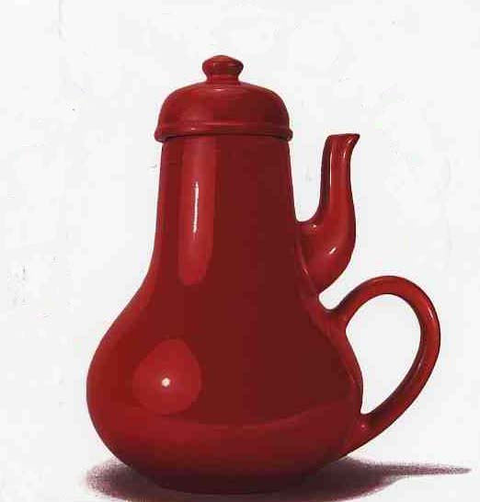
“Coffeepot for Masochists”, Catalog of Unfindable Objects by Jacques Carelman; in Donald Norman’s The Psychology of Everyday Things, 1988

Slide 13
Universal Design =
“the design of products & environments to be usable by all people, to the greatest extent possible, without the need for adaptation or specialized design.” The Center for Universal Design
www.design.ncsu.edu/cut

Slide 14
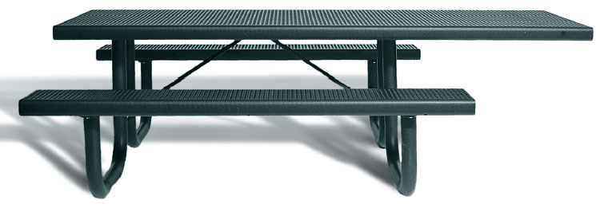
Apply UD to:
instruction
student services
technology
physical spaces

Slide 15
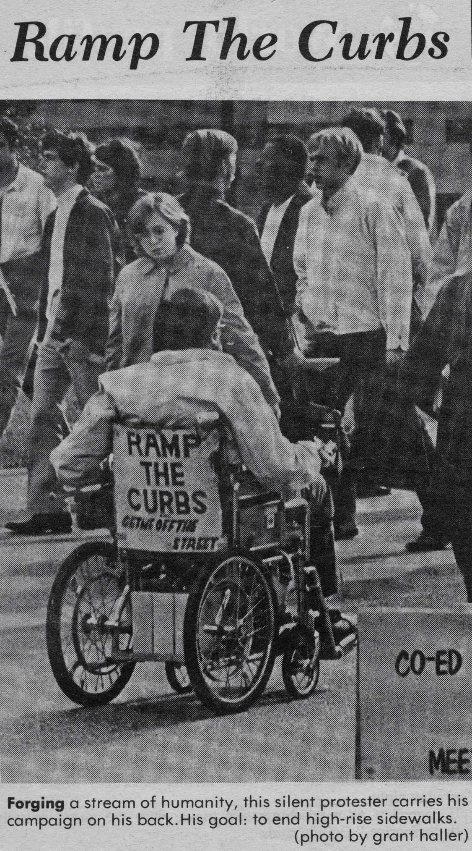
The Daily University of Washington 1970

Slide 16
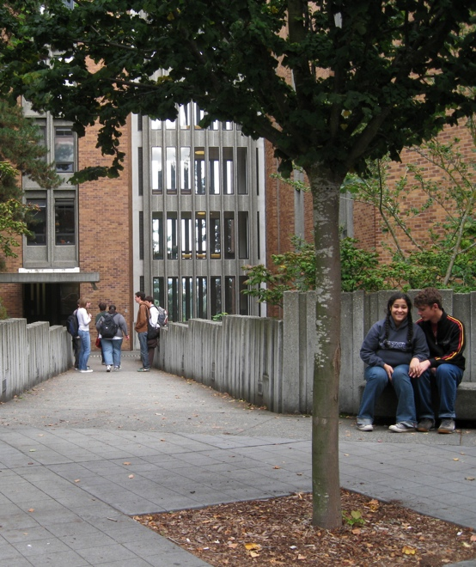
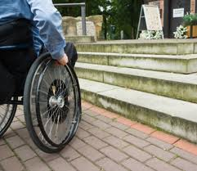
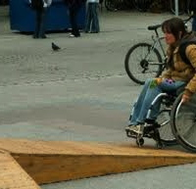
Inaccessible Accommodation UD
Uncaptioned video
Captioned video
Interpreter for student who is deaf

Slide 17
Universally-designed Video
Address multiple audiences in design
Film with captions in mind
Large, clear captions
Searchable captions
Design so that key content is spoken & visually presented
Audio-described version available

Slide 18
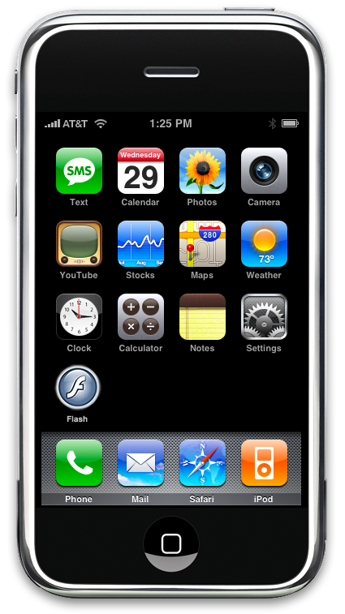
Approaches to the Provision of Assistive IT Features
As an accommodation for students with disabilities
As a universal design feature for the purpose of ensuring access to everyone

Slide 19
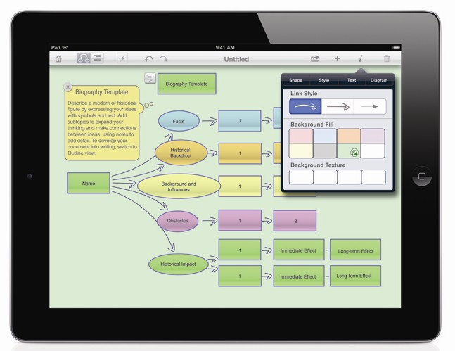
IT That Benefits Students with LDs
reading, writing, math development
scanning/OCR, text-to-speech, reading systems, e-books
large print, highlighting, color options
word prediction, abbreviation expansion
speech input
spell/grammar checkers
idea organizers
other writing/math tools

Slide 20
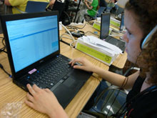
Flexible, Multi-feature Software Example: Read & Write GOLD
Toolbar with collection of literacy support tools for reading, writing, studying, research
OCR, scanning, speech output, voice recognition
Use with Word & other software

Slide 21
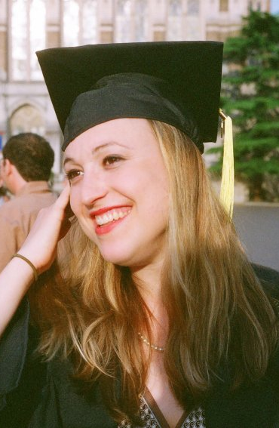
Jessie
BA, Informatics
Business Analyst Amazon.com
speech output
speech input
grammar/spell checkers

Slide 22
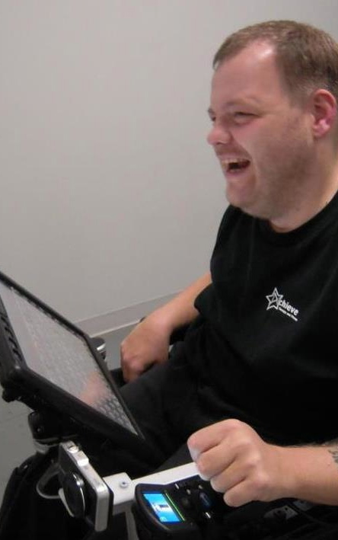
Anthony
AT Specialist
Prentke Romich
grammar/spell checkers
synthesized voice on communication device
touch screen
computer-based environmental control, phone access

Slide 23
UD Features of PDF File
Image
Unstructured text
Structured text
Implications for students with LD

Slide 24
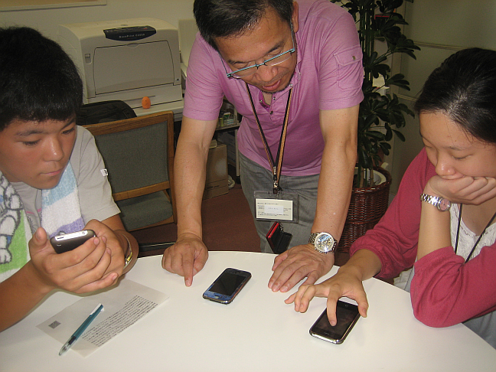
Goals for All IT
Build in accessibility features
Ensure compatibility with AT

Slide 25
UD of Instruction:
Values diversity & inclusion
Is a goal as well as a proactive process
can be implemented incrementally
focuses on benefits to all students
promotes good teaching practices
does not lower academic standards
minimizes the need for accommodations

Slide 26
UD of Learning Promotes Multiple Means of:
representation
expression
engagement
-Center for Applied Special Technology (CAST)

Slide 27
Examples of UD Practices:
Large, bold fonts on uncluttered overhead displays
Speaking aloud all visual content presented
Outlines & other scaffolding tools
Opportunities to practice procedures
Materials in accessible electronic formats
Regular feedback & corrective opportunities
Activities that allow extra time

Slide 28
DO-IT participants say a “good teacher”:
Is a good role model.
Is enthusiastic.
Is approachable.
Is well prepared.
Makes expectations clear.
Is patient.
Encourages students.
Challenges students.
Is open to new ideas.

Slide 29
DO-IT participants say a “good teacher”:
Gets to know students.
Helps students apply knowledge.
Facilitates exchange of ideas between students & between teacher & students.
Respects students
Ensures privacy.
Does not make assumptions about a student’s capabilities.
Adjusts to unique needs of students.

Slide 30
Good teaching
is
good teaching.

Slide 31
UD Benefits Students with LD:
Does not require self-disclosure
Provides format options that use different & multiple senses
Promotes multiple teaching methods & assignment & testing options
Encourages use of scaffolding supports
Builds in adequate time

Slide 32
• an attitude that values diversity, equity, & inclusion. • a goal. • a process. • practices that make learning products & environments welcoming, accessible, & usable for everyone, including those who do not disclose disabilities.
UD is:

Slide 33
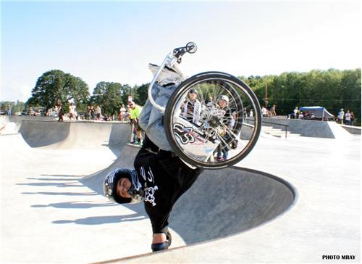
UD – know it when you see it:
…at “skateboard park”

Slide 34
The Center on UD in Education

Slide 35
DO-IT Community of Practice
For Faculty & Staff
udheCoP
To join this or other CoPs, send email to doit@uw.edu

Slide 36
What can you do to promote UD that benefits students with LD?
Embrace diversity, e.g., avoid comparisons with “normal”
Develop a UD perspective: Focus first on changing the product or environment before providing accommodations
Remember people with LD may have other disabilities, too
Develop UD practices inspired by individual needs

Slide 37
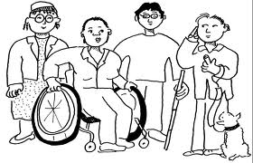
Rather than an individual conforming to a product, UD expects society to conform to diversity

