Slide 1
Bridging the gap between information and application: an online resource for academic staff in evaluating ‘How Inclusive Is My Subject?’
Darren Britten
Senior Advisor, Inclusive Resources Development & Projects
La Trobe University
Wendy Paulusz
Senior Officer, Inclusive Development (Technology and Training)
La Trobe University
Title of presentation
Name of presenter
Title of presenter
School / Faculty / Division
xx Month 201x

Slide 2
About IRD (Inclusive Resources Development)
Background
Began operation in late 2003
Provides alternate formatting service for students referred by the Equality and Diversity Centre
Worked with over 600 academic staff and subjects across 5 campuses
2 Key Goals of IRD
Engage the University and wider community promoting inclusivity and informing discussions, standards and practice
Provide advice on the accessibility of resources and technologies used by the university
Notes:
IRD currently receives around 3000 conversion requests each semester
3 ongoing staff, 2 part-time staff and several casuals

Slide 3
Since 2003
Participation at the University has increased
The range of assistive technologies have increased
Academic workloads have increased
Awareness has increased
Mobile technologies and platforms have increased
Digital content has increased
Information on accessibility, inclusive practice and universal design has increased
Legal requirements and standards have evolved
Teaching and Learning is moving from face-to-face
Old Barriers have reduced
New Barriers have emerged

Slide 4
What have we learnt
Nothing can be made 100% accessible to everyone all the time

Slide 5
The need for HIIMS?
How Inclusive Is My Subject (HIIMS) is an online Professional Development module designed to be undertaken by La Trobe University staff which provides a series of reflective questions across a range of topics including assessment, teaching, accessible learning materials, curriculum design, problem based learning, team/group work and off-campus learning.
Identify Needs Information Practice

Slide 6
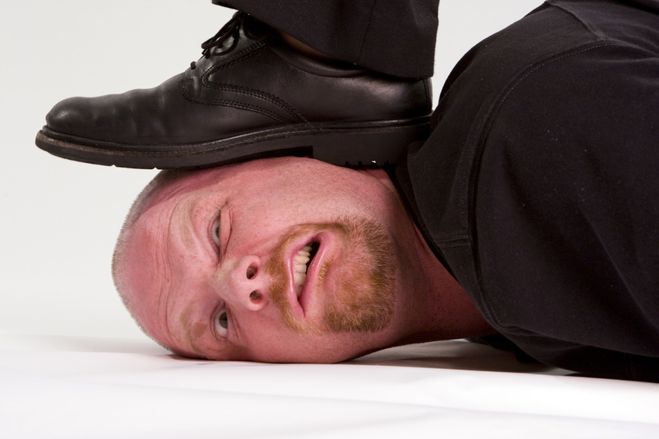
Context of Change: Impact on Learning and Teaching at University
Markets
Widening Access
Funding
Industry Demands
Global Mobility
Digital Technologies

Slide 7
HIIMS Development Cycle
Questions for Reflective Practice
Identifying Training Needs
Building a Community of Practice
Feedback & Support Links
Weighting and Impact of Removing Barriers

Slide 8
HIIMS User Cycle
Questions
Based on role
Feedback
Based on response
Weighting
Based on discipline and historical student demographic
Community of Practice
Based on feedback and best practice resources/links

Slide 9
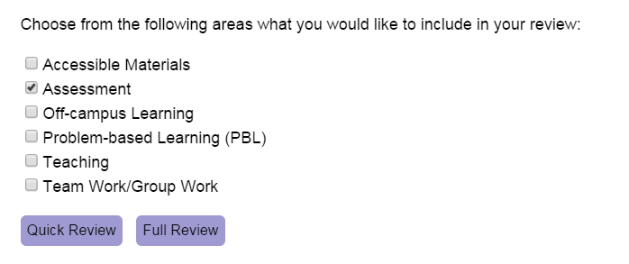

Slide 10
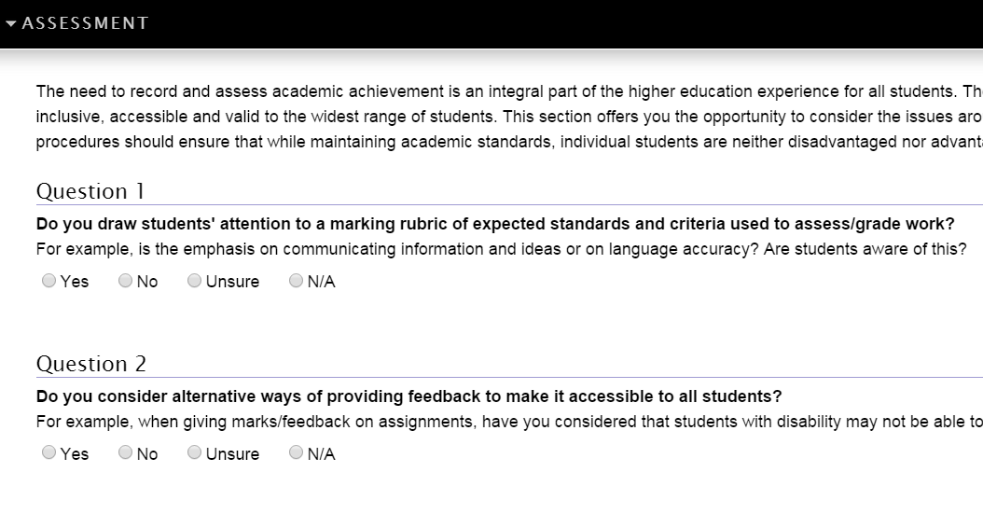
Questions

Slide 11
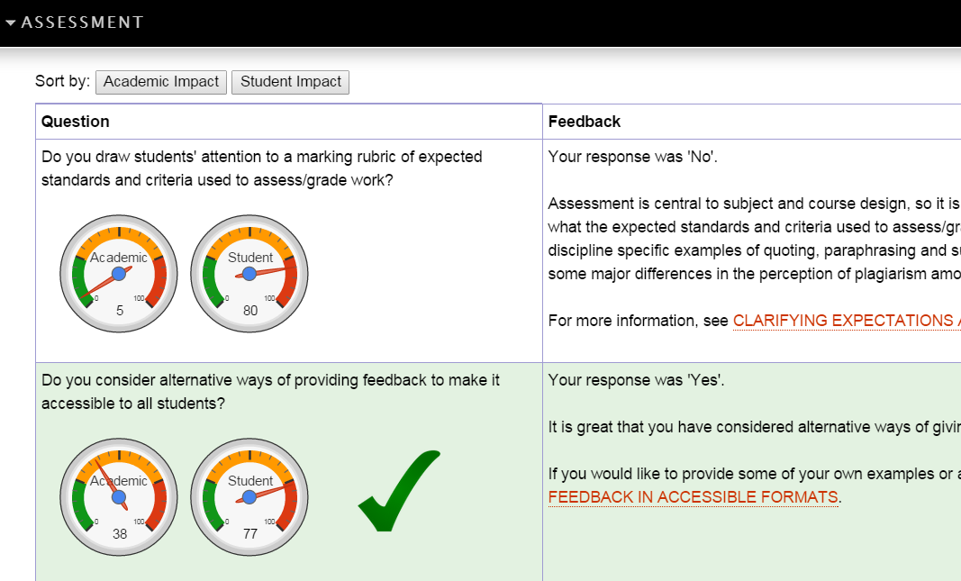
Feedback and Impact

Slide 12
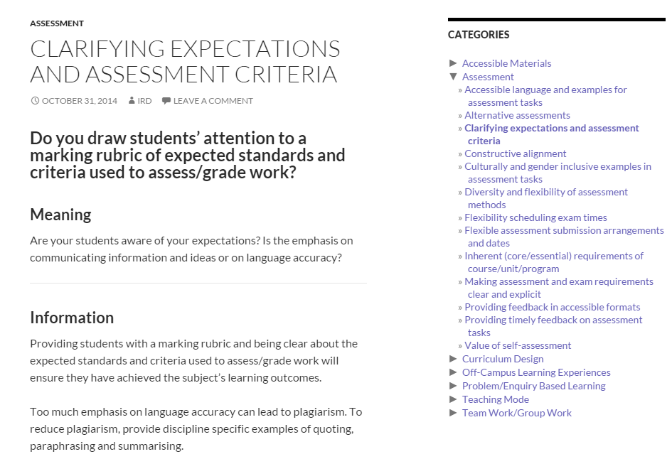
Community of Inclusive Practice

Slide 13
Testing and Feedback
What are your main concerns around implementing inclusive teaching practices?
Time was major issue
Workload
Time to train sessional tutors/facilitators
Ensuring that staff are consistent with their approaches
Nil. Totally support it.
Need for revision of already created resources
Concern about over compensating and "worrying too much about a small number of students"

Slide 14
Testing: and Feedback
What sort of information would you find useful?
Examples of good practice
Finding out what others are doing at La Trobe and other universities
Practical advice and measuring tools
Links to further information/current best practice
Student perspectives
New ideas to enhance accessibility
Technology & inclusivity
Cultural aspects
Strategies for accommodating mental illness

Slide 15
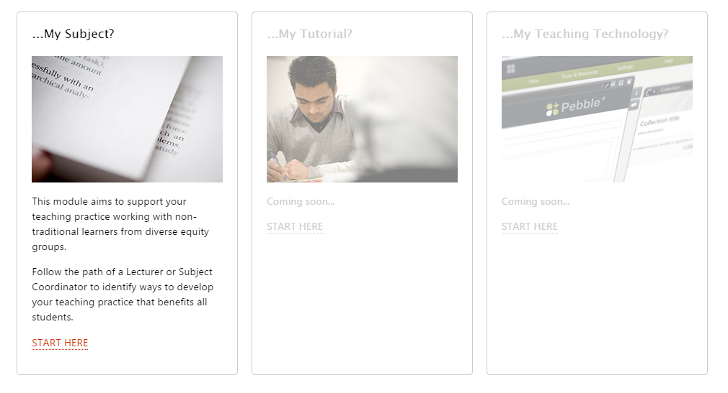
Where to next…..

Slide 16
Questions ?

