Slide 1

  Resilience/Thriving in
  Post-Secondary Students with Disabilities:
  An Exploratory Study
  Dr Rahul Ganguly
  School of Health and Wellbeing
  University of Southern Queensland,
  Toowoomba

Slide 2
  "This material is based upon work supported by the National Centre for Student Equity in Higher Education (NCSEHE), Curtin University under Project No 1005571.
Acknowledgement

Slide 3
  1. Dr. Rahul Ganguly (P.I. Health and Wellbeing)
  2. Dr. Charlotte Brownlow (Psychology)
  3. Dr. Coralie Graham (Nursing)
  4. Dr. Jan Du Preez (Psychology)
Research Team

Slide 4
  Any opinions, findings, and conclusions or recommendations expressed in this material are those of the author(s) and do not necessarily reflect the views of the NCSEHE or USQ.
Disclaimer

Slide 5
Road Map
Need for the study
Conceptual Framework & Study Design
Findings
Where we go from here

Slide 6
Need for this Study
Increasing number of SWD in PSE settings
    Quadrupled between 1994 and 2011 from 11,656 to 42,111 (ABS, 2012)
  Studies by Foreman et al., 2001 & Whelley et al. 2002) indicate PSE-SWD experience difficulty in completing course work & hence poor academic achievement

Slide 7
Need for this Study-II
Scholarship on Equity has largely ignored this population
  Focus of existing research in Australia and across the world has been on identifying systemic barriers (Hutcheon & Wolbring (2012); Barnard-Brak (2010), DaDeppo (2009) Getzel (2008)

Slide 8
Purpose of this Study
From Identifying Barriers to Managing Barriers
    Attitudinal, institutional, environmental, and physical
High Achieving Students with Disabilities – Lived Experiences

Slide 9
Study Design-Exploratory
One University
  Students in Baccalaureate Programs
Mixed Methods
    Survey
    Qualitative Interviews ( N= 30)

Slide 10
Study Design-Instruments used
  Socio Demographic Characteristics
  Engagement with Disability Support Services
  Connor Davidson Resilience Scale (25 Items)
  Rottinghaus Career Futures Inventory (Optimism)
  WHO- 5 index
  Life Satisfaction Scale

Slide 11
Phase I
  Survey sent to 1200 students (closing date 4/12)
    https://pcc.usq.edu.au/ols/?P=RSDP14
  As of 2/12, respondents = 260
  This study 194 students

Slide 12
Preliminary Findings
(N =194)

Slide 13
Key characteristics
Students with disabilities at a regional University

Slide 14
Participants – Socio-Demographics
Predominantly Female (n (F) = 120; 62%,)
Median Age = 38 ( 17 -72 yrs. SD 13)
Predominantly non – Aboriginal or Torres Strait Islander (n = 188, 96%;)
Native English Speakers (n = 186, 95%;)

Slide 15
Socio-Demographics-II
Higher percentage of participants were single ( n = 79, 40%) than married ( n= 75, 38%)
Majority of participants had one or more children (n = 101; 52%)
Majority of the participants were not in gainful employment (60%)
Income of nearly half of the sample earned (49%) < $ 40,000

Slide 16
Participants – Academic
Area of Study
    Education ( n = 37, 19%)
    Psychology ( n = 26, 13%)
    Engineering ( n = 28, 18%)
    Business ( n = 22, 11%)
    Health ( n = 19, 10%)
  Predominantly Baccalaureate deg. (n = 153, 78%)
GPA 33 % < 5, 37% >5 < 6 (Mean 5.06)

Slide 17
Academic-II
Majority of the participants were on online mode than F2F ( n = 100, 51%)
Majority of participants did not take absences for a long period of time ( n =124, 63%)
13% reported not receiving accommodations

Slide 18
Participants – Disability Categories
Most reported psychological disabilities ( n =60, 32%)
Other Disabilities included
    Physical/Medical ( n = 32, 17%)
    Others ( n = 25, 13%)
    Multiple Disabilities ( n = 19, 10%)
    Autism/ADHD ( n = 16, 8%)
  Half of the sample had more than 1 disability ( n =100, 51%)

Slide 19
Participants – Self - Identification
More than two thirds of the sample registered with the Disability Support Services ( n = 128, 65%)
    During Application/Registration ( n = 54)
    Began Struggling/poor grades ( n= 47)
    Difficulty with non-academic issue ( n = 22)
    Faculty indifference ( n= 5)
Of the 128 students registered, 68 (53%) were presently receiving services

Slide 20
Well-Being, Satisfaction, Career Optimism & Resilience

Slide 21
Well-Being and WHO-5 Index
Nearly a fifth of the sample (19%) scored below 13 (Poor wellbeing – Depression risk)
Nearly a third of the sample (32%) score below 15 (indicative of low mood)

Slide 22
Satisfaction
More than two-thirds of the sample ( 67%) indicated low levels of satisfaction their accommodations, financial, friendship and studies situation
Highest levels of satisfaction with Accommodations (80%), Friends (60%), Studies (55%)
Low levels of satisfaction with Finance (56%)

Slide 23
Career Optimism and Academic Satisfaction
Nearly two-thirds of the sample ( 65%) indicated moderate to low levels of career optimism (30/50)
Nearly two thirds of the sample (64%) agreed with their choice of the degree

Slide 24
Resilience
Nearly a three-fifth of the sample (59%) scored below 50 in the Connor Davidson Resilience Scale (25 items 0-4 ratings)
Range of Score from 20 – 83, Mean Score 45
Reported scores of 16% of the sample were above 60 on the CD Resilience Scale.

Slide 25
Preliminary Findings

Slide 26
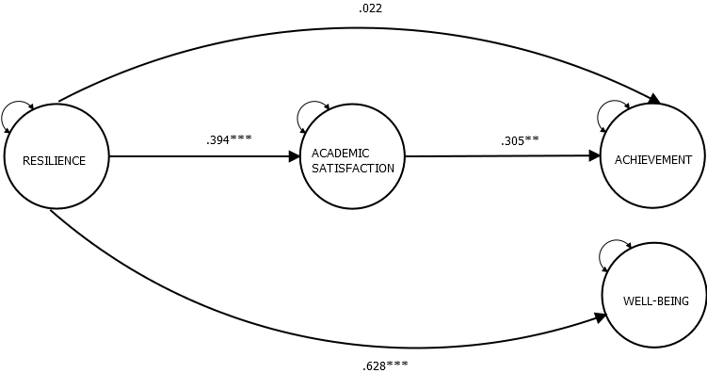
Resilience, Well-being, Academic Satisfaction & GPA
Figure 1. All path coefficient estimates are completely standardized.
** p < .01, *** p <.001.

Slide 27
Interpretation
Resilience was directly and significantly linked with academic satisfaction and well-being, but not directly related to academic achievement.
Resilience was found to be indirectly linked to achievement via academic satisfaction

Slide 28
Next Steps
Complete quantitative analysis
Conduct Interviews
Finalize Report

Slide 29
Where we go from here- Conceptual Framework
University Readiness
Uni-Course Experiences
Peer-Interactions
Persistence
Post-University Success
Career Readiness
Post Baccalaureate
Individual Factors
Family Factors
Others
Faculty Interactions

Slide 30
Strategies
Higher Education Toolkit
    Student Self -Assessment
    Campus Resource Assessment
    Actions and Accommodations in the Classroom
  Faculty Training Modules
  Regional University Symposium

Slide 31
Contact Address
      Rahul Ganguly, PhD
      Lecturer in Special Education (ASD/EBD)
      School of Health and Well Being
      University of Southern Queensland
      Toowoomba | Queensland | 4350 | Australia
      Ph:+ 61 7 4631 1932
      Email: Rahul.Ganguly@usq.edu.au

Slide 32
Questions?
Thank you for listening

