Slide 1
Attention Deficit/Hyperactivity Disorder
ADHD
Invisible and Overlooked

Slide 2


Why should we care?
6% of the adult population has Depression
4.4% adult population has ADHD

Slide 3
Some Myths About ADHD
ADHD isn’t real
ADHD is a childhood condition
ADHD is an excuse for bad behaviour, poor performance, or access to party drugs
ADHD is over-diagnosed
All people with ADHD are hyperactive

Slide 4

Some Myths About ADHD
ADHD isn’t real
    Brain Studies
ADHD is a childhood condition:
    15% full symptoms, 60% partial remission
ADHD is an excuse for ……
    80% due to genetics (familial & molecular)
ADHD is over-diagnosed
    1.2% and 0.5%
All people with ADHD are hyperactive\
    3 Subtypes- Core symptoms

Slide 5
University /TAFE students with ADHD
Take longer to graduate
Lower GPAs
Time poor
Higher dropout levels
(Overwhelm – paralysis – quit)

Slide 6
Executive Function Impairments
Highest level brain processes
Enable us to organise, prioritise, plan time
University and TAFE test EFs

Slide 7
Russell Barkley’s Unifying Theory
ADHD problem with behavioural inhibition
Causes impairments in 4 EFs:
  Non verbal working memory
  Verbal working memory
  Self regulation of affect, motivation and arousal
  Reconstitution (Planning)
Motor control (actions)

Slide 8
Behavioural Inhibition
EF need a pause to operate
Consider options & choose best
Larger future gain for current loss
ADHD struggle to pause – distracted external and internal stimuli – governed by immediate consequences

Slide 9

ADHD Coaches – EF Avatars

Slide 10
Working Memory
Brain’s RAM.
Anything that involves integrating 2 or more pieces of information.
WM dumps info when overloaded
ADHD – WM constantly overloaded

Slide 11
Sense of Time
Time Poor – Slow processing
Difficulty judging passage of time
Difficulty predicting time required
Show up late & miss deadlines

Slide 12
Remembering to Remember
It’s not about knowing – but about doing
Prospective memory – remembering to do right thing at right time.
Behaviours persist despite consequences

Slide 13
Self-Activation - Persistence
Difficulty getting started
ADHD Unfinished tasks common
Tasks within their capability
Lazy, self-indulgent, irresponsible?

Slide 14
ADHD – The Flipside
Often non-linear thinkers
Excellent brainstormers, idea-generators
Energetic and enthusiastic
Quick reactions, intuitive responses
Work well under time pressures
Risk-takers
Hyperfocus when engaged
Spontaneous

Slide 15
Find out how they process information
Kinaesthetic
Verbal
Visual
Conceptual
Intuitive
Auditory
Tactile
(ADDCA Processing Styles)

Slide 16
How Can You Help?
Introduce your students to the following four-letter words:
  Time
  Plan
  List
  Tidy

Slide 17
Make Time Visible
 | Mon | Tues | Wed | Thurs | Fri | Sat | Sun
Date
Due
9am
10am
11am
12
1pm
2pm
3pm
4pm
5pm

Slide 18
Plan
Routines – daily, weekly – plan & follow
Anchor them
Can the student prioritise?
SLEEP

Slide 19
Tidy
“A place for everything…”
The Launch Pad

Slide 20
Getting Started
Dot Point every task
Body Double
Focus Formula
  Plan
  Set Up
  Sprint
  Brain Dump

Slide 21
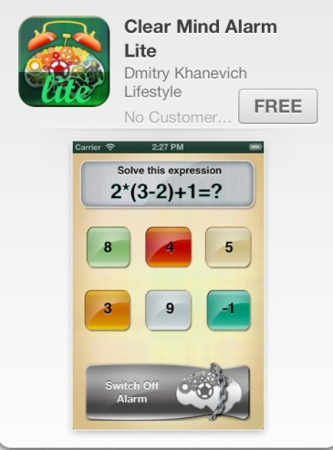
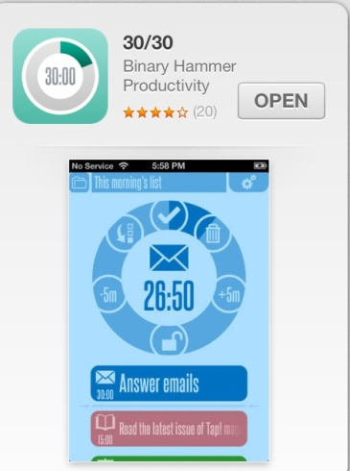
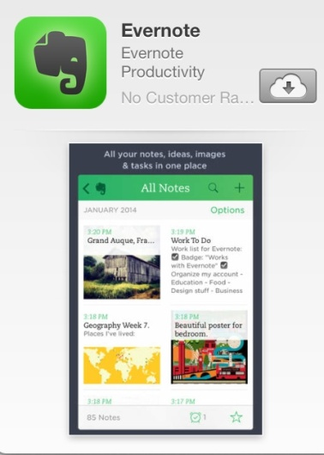
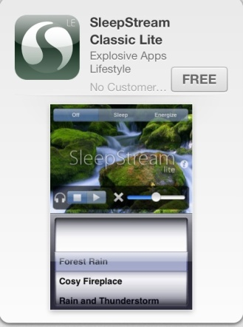
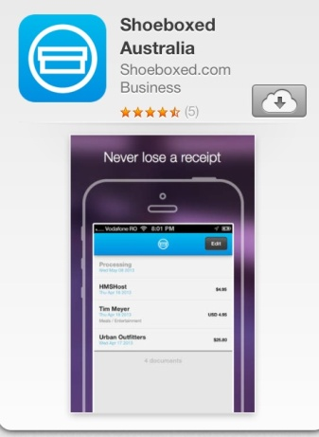
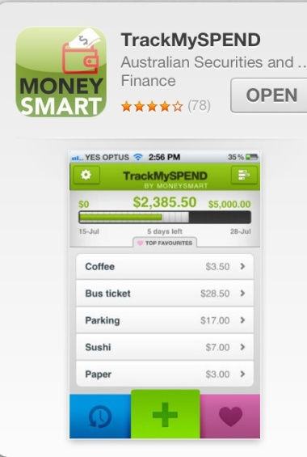
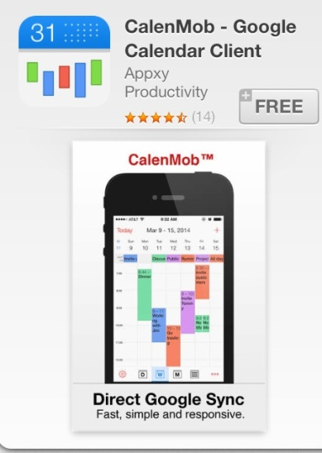
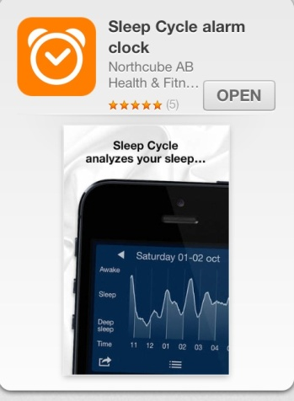
Is there an App for that?

Slide 22
Accommodations
Extra time during assessments
Scribe / Dragon / record lectures
Flexibility around assignment delivery
Dot-pointing sessions with tutors
Support around Overwhelm
Bureaucracy – incl. Centrelink

Slide 23
“If the future is to remain open and free, we need people who can tolerate the unknown, who will not need the support of completely worked-out systems or traditional blueprints from the past.”
-Margaret Mead-

Slide 24
Choosing an ADHD Coach
An ADHD Coach should be credentialled with:
International Coach Federation (ICF)
  www.coachfederation.org
Professional Association of ADHD Coaches (PAAC)
  http://www.paaccoaches.org/

