Slide 1

Document Accessibility Toolbar (DAT)
© Digital Access Vision Australia:
All material contained within this file remains the sole property of Vision Australia. No part can be reproduced, used or copied without the express permission of Vision Australia.

Slide 2
DAT
Digital Access at Vision Australia with the support of Australian Communication Consumer Action Network (ACCAN) have developed the DAT.
Document Accessibility Toolbar is a standard add-in for Microsoft Word
Provides a range of default and automated tools for the implementation of accessibility techniques
Free to download
Notes:
It is the first time ACCAN has funded a piece of software. Out of the 85 organisations that applied for the grant 7 projects were funded.
Once you download the file you simply open it and a dialog opens with an install button. You click install and the template is saved in the STARTUP folder for Windows 7.
The .dotm file extension is used for the macro enabled document template files that are used by Microsoft Word.
How you can download and install it and where its placed in the users operating system.

Slide 3
Research and Testing
Research:
  Task Analysis
  Survey
Testing
  Integration
  User Acceptance
Notes:
Before we developed the DAT we conducted some research, a task analysis and survey. In process of developing the DAT we are conducting testing.

Slide 4
Task Analysis
Learning by observation of a task analysis.
Demographic people that are required to publish accessible documents as part of their current role.
Identified users current skillset for creating accessible documents.
Where skill gaps in accessibility knowledge occurred we resolved the issue by providing a DAT solution.
Notes:
A task analysis is learning about peoples behaviours by observing them in action.
We wanted to understand what users do to create accessible Word documents.
Each participant was presented with a printed copy of a 3 page Word document which contained a title page, headings, lists, paragraph text, an image, a data table and a table of contents. The participant was asked to recreate the print document as a digital Word document optimised for accessibility.

Slide 5
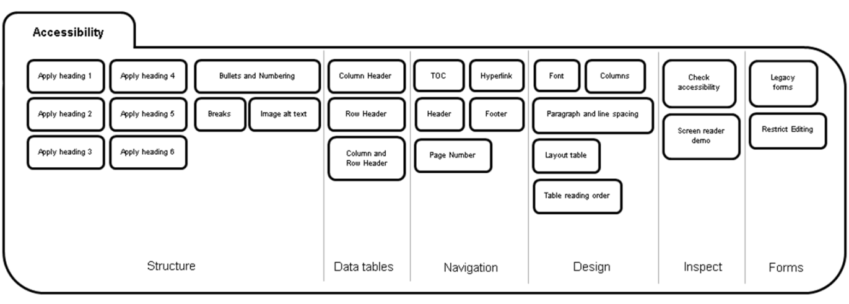
Survey
A survey supported the task analysis component of this study.
Established if the DAT meet user requirements.
The output of the survey was incorporated in the DAT design.
Notes:
100 people who attended our Word and PDF course participated in the survey.
We provided them with a list of automated tools to make accessible document creation more efficient. Such as, a colour contrast analyser, a function for data table optimisation, Word to HTML converter, a built in screen reader etc.
Participants selected which automated tools would aid them in efficiently creating accessible Word documents.
A survey is useful to describe the requirements of a large population.

Slide 6
Integration and UAT
DAT was tested on Microsoft Word 2010 and 2013 in Windows 7.
Testing includes:
  Integration Testing
  User Acceptance Testing (UAT)
Notes:
We are currently fixing the bugs that surfaced from integration testing and will conduct user acceptance testing before the end of the year.
We anticipate the DAT will be available early next year.

Slide 7
DAT and Word Accessibility

Slide 8
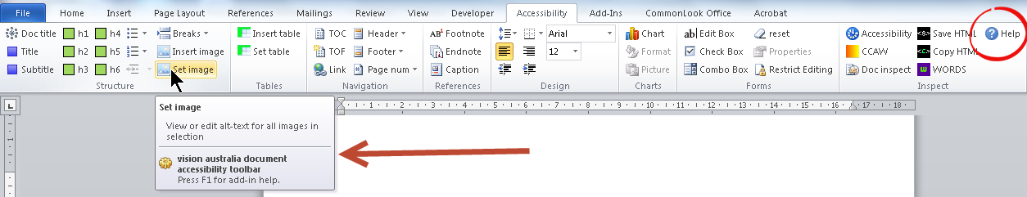
Word Accessibility Standards
There are no global accessibility standards for documents produced in Word.
We envisage that the DAT and its resources will provide authors with guidance on how to create accessible Word documents.
Notes:
In our dealings with people we find that authors have a range of accessibility knowledge. Some people know a lot about Word accessibility and others think its limited to font style, size and spelling out abbreviations or acronyms.
It's difficult to determine what’s required when there is no global standard for Word accessibility.
We envisage that this tool and its resources will arm document authors with the knowledge to create accessible Word documents so that organisations can meet their requirements under the NTS and Disability Discrimination Act.
One of many great things about the DAT is that all functions for accessibility are located in one Ribbon. Each function has a tool tip which provides a brief description of what the function does and how this improves document accessibility. If the author requires something more comprehensive they can select the help button to navigate to a webpage containing more Word accessibility information.
I’m going to demonstrate the fundamental and automated tools of the DAT I’m going to BRIEFLY clarify why we would use that function for Word Accessibility. This is by no means a complete list of techniques for Word accessibility but it will help to provide context for the usefulness of the DAT.

Slide 9
Structure
Notes:
Let’s start with the first section. Structure…

Slide 10
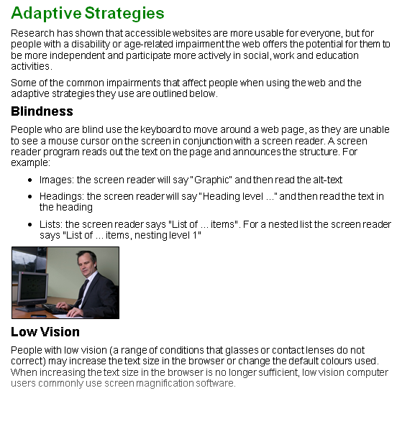
Structure
Notes:
Here is a standard page from a Word document.
By simply gauging how large or small each heading is a sighted person can very quickly work out what is the most important piece of content on the page is, what’s the least important piece of content on the page is, and how the content relates to each other.
They can also assume the list of three items are related to each other but their order is not important.
There is a picture of a man using a screen reader and braille to document information in an authoring tool. The screen of the desktop computer monitor is switched off.

Slide 11
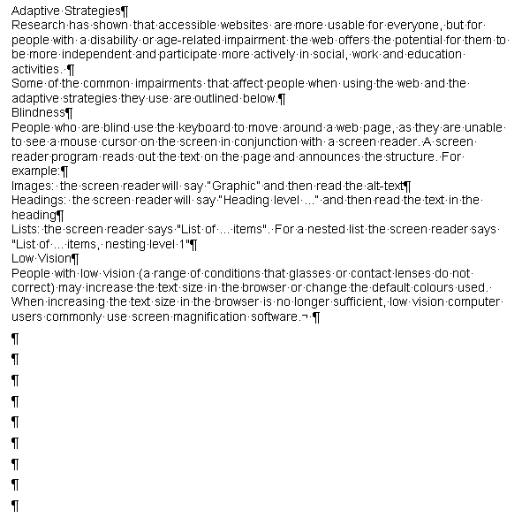
Structure
Notes:
This is how a Word document is interpreted by a person using a screen reader if true headings and lists (the functions built within Microsoft Word) have not been implemented. The structure component of the document is locked away from this user.
If the image has no textual description the information provided by that image is not communicated to the user.
You’ll also notice the author has used the return key to push content on to the next page. This will add a lot of redundant noise to the page for users of screen readers.

Slide 12

Structure
Notes:
In this example the structure section of the DAT comes in handy.
To ensure in-built heading and list styles are used the author simply selects the appropriate heading level button and a bulleted or numbered list icon.
The DAT will inherit the corporate template style or default Word style for the heading or list.
The Breaks function is incorporated within the Structure section of the DAT to prompt users to use an appropriate break rather than hard returns.
Let’s take a look at the efficiency of the Insert image and Set image automated functions…

Slide 13
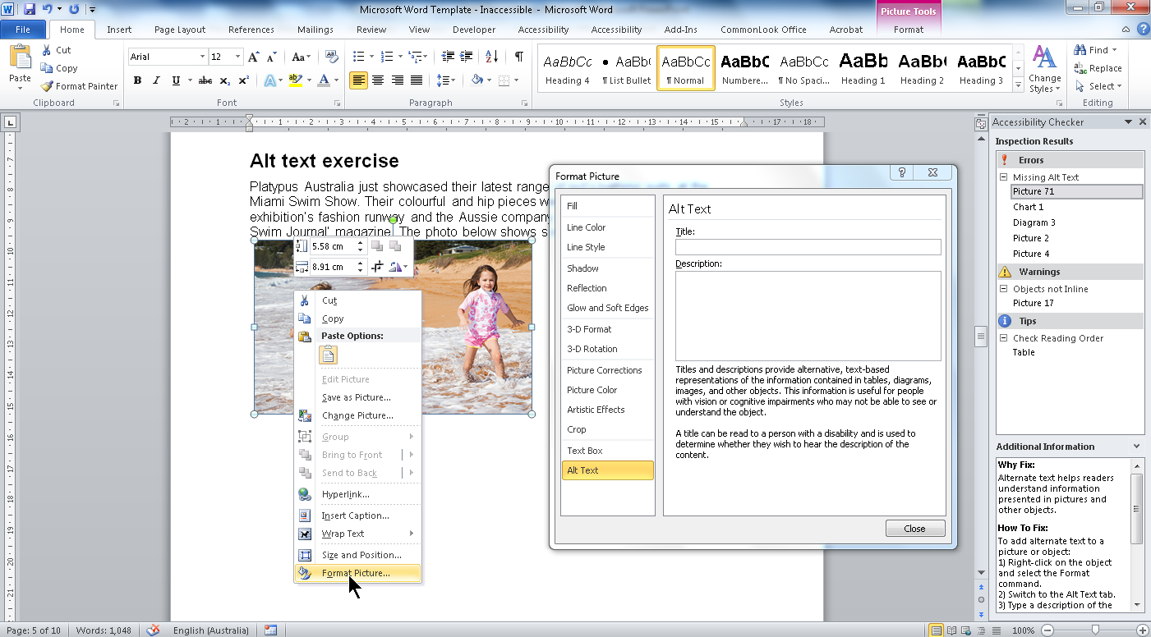
Alternative Text
Using functions in Word
Notes:
We saw that adding textual descriptions to images is important for users of screen readers.
The most efficient way to add alt text to an image (without the DAT) in a Microsoft Word document is to:
Select the image.
Right click and select Format Picture.
Select Alt text in the dialog.
Add a textual description.
Scroll to find the next image.
Select the image.
Right click and select Format Picture.
Select Alt text in the dialog.
Add a textual description.
And so on and so forth until we get to the end of the document.

Slide 14
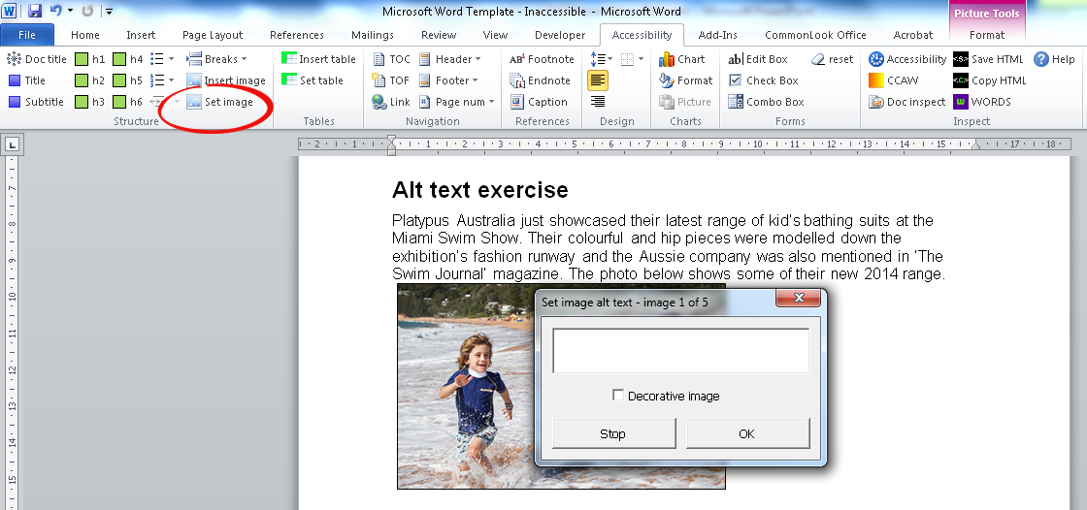
Set Image
In an existing document using the DAT
Notes:
This is the same existing document.
Using the DAT simply use the Control + A keys to select everything in the document and select “Set Image”. A dialog to enter alt text is displayed.
You can select OK to cycle through every image in your document and the DAT will either show you the existing alt text or prompt you to add alt text.
This is a much faster process than what is currently available in Microsoft Word for authors.
All images in Word require alternative text because screen readers will announce the image and its dimensions whether alt text is supplied or not. If some alt text is not provided users may feel that they are missing out on information.
If the image is decorative simply select the “Decorative image” checkbox and the word “Decorative” will populate in the form field.

Slide 15
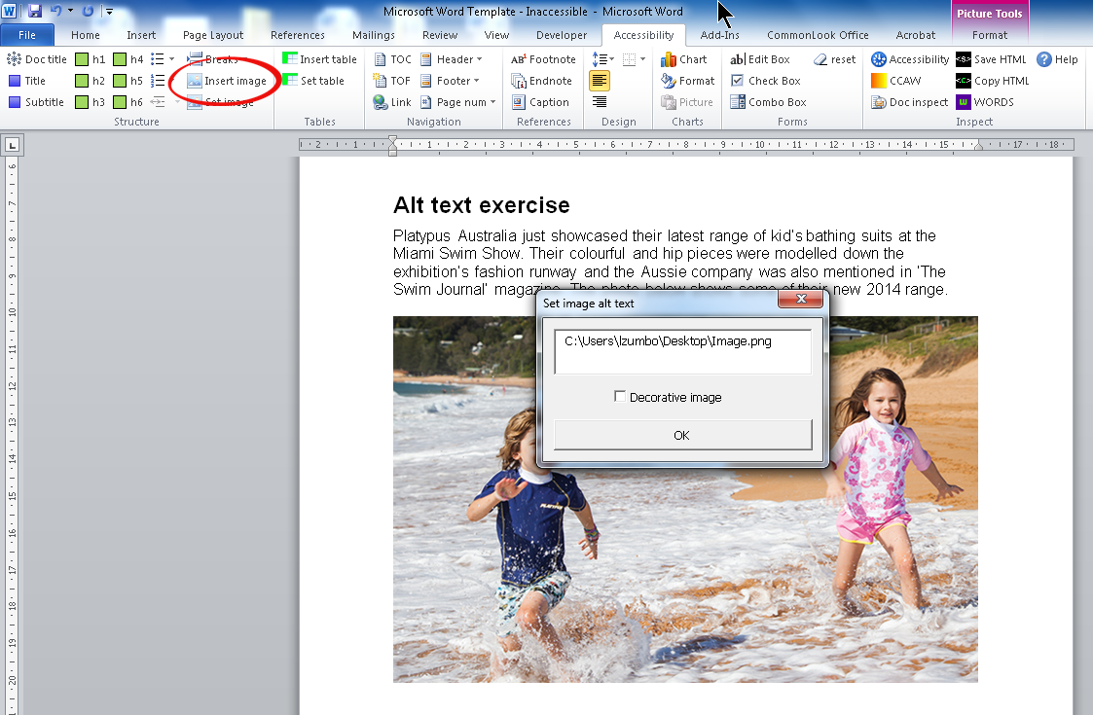
Insert Image
In a new document using the DAT
Notes:
If you are working on a new document you will be inserting images as you go. The DAT will prompt you to add alt text to your image once it has loaded on to the page by automatically displaying the Set image alt text dialog.

Slide 16
Data Tables

Slide 17
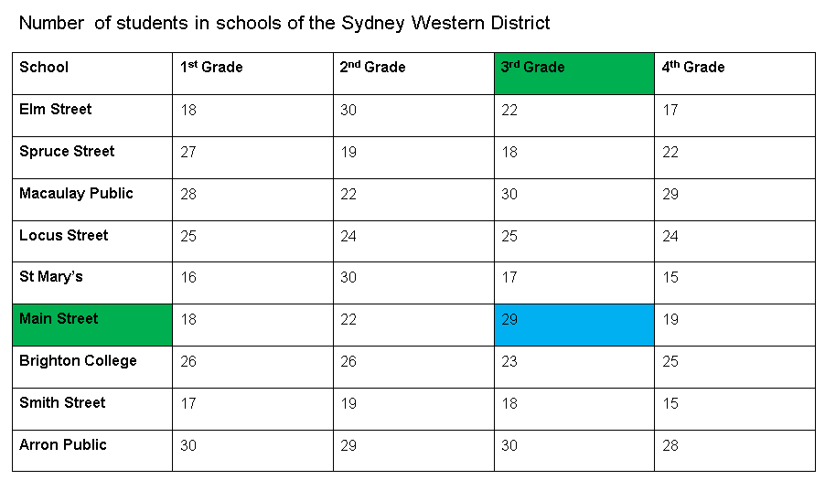
Data Table
Notes:
Sighted users can gain a holistic view of information.
However, if a table is not optimised for accessibility, screen readers cannot announce cell data with its associated headers. On selecting the command Insert + Tab it will only announce “29” not “29, 3rd Grade, Main Street”.

Slide 18

Data Table

Slide 19
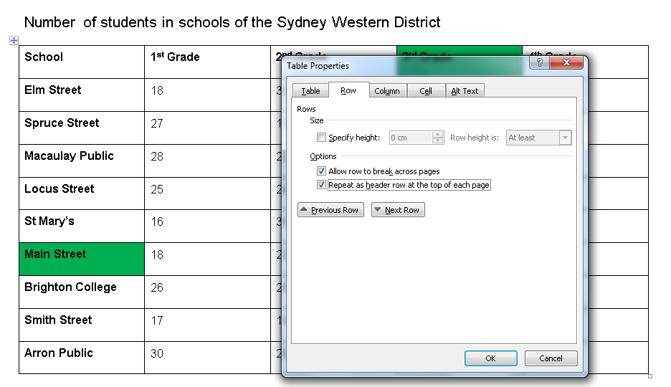
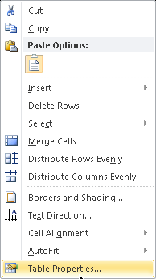
Data Table
Using functions in Word – Step 1
Notes:
To optimise a data table for accessibility in Word the author will need to complete 2 stages.
Stage 1
Select the first row in the table.
Right click and select Table Properties
Select “Repeat header row at the top of each page”.
Then! …

Slide 20
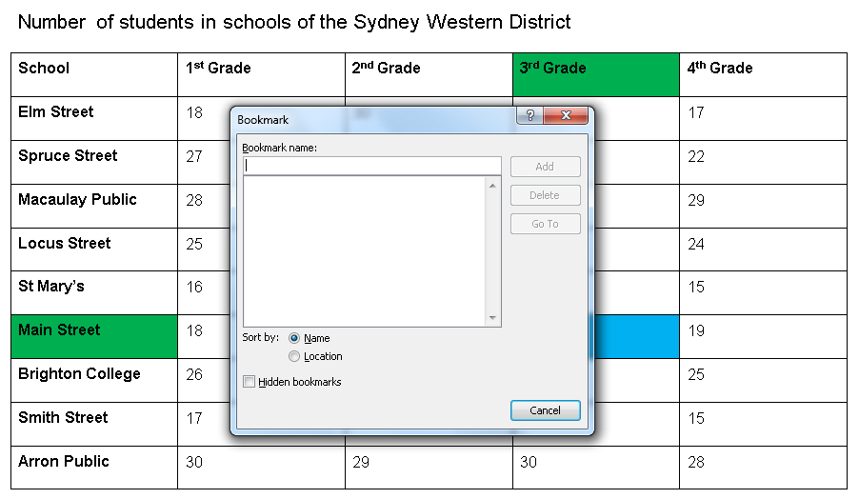
Data Table
Using functions in Word – Step 2
Notes:
Stage 2
The author will have to bookmark the table.
With special code depending on the ‘type’ of data table they are creating. I.e. whether the table has a column, row or combination headers.
And! Each bookmark must be unique.

Slide 21
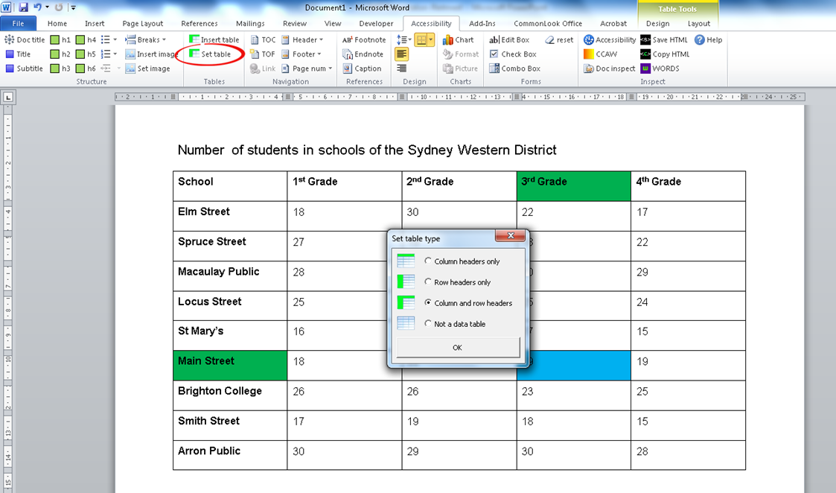
Set Table
Using the DAT in an existing Word document
Notes:
This is the same existing document.
Using the DAT you simply select the Control +A keys and click the Set table button.
The system will select the first table in the document and render the Set table type dialog. Select the table type and OK. The DAT will cycle through all of the tables in the document. Simply select the table type and OK for each table.
Done.

Slide 22
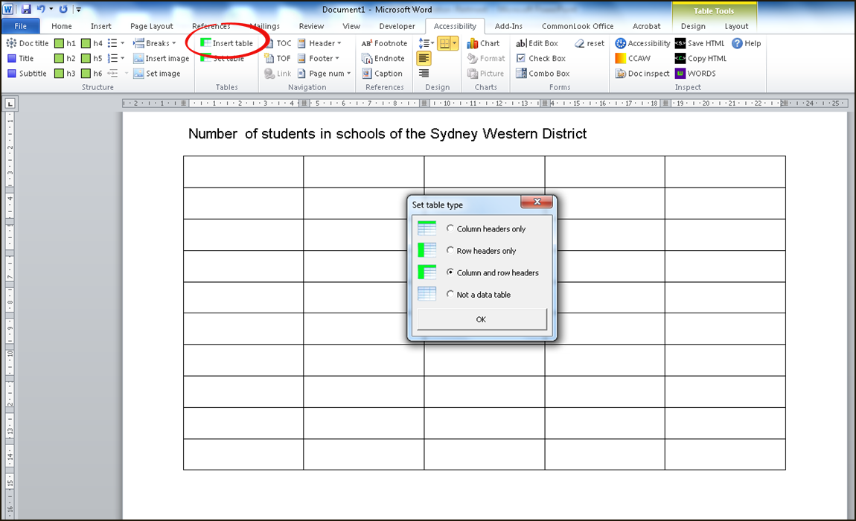
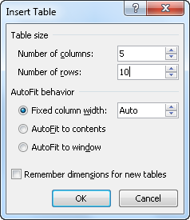
Insert Table
Using the DAT in a new Word document
Notes:
If you are creating a new data table simply select the Insert Table function and select the table size and autofit behaviour. Once the OK button has been selected the Set table type dialog will render. Select the table type and OK.
Populate the table.

Slide 23
Navigation

Slide 24
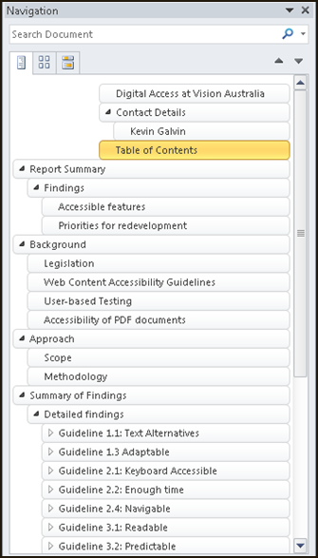
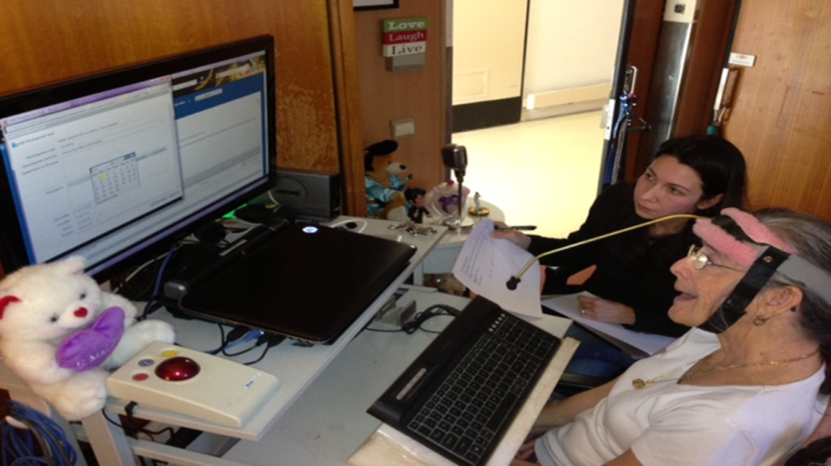
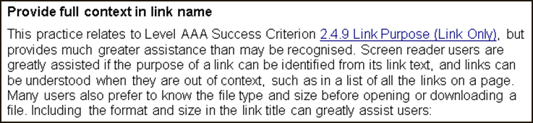
Navigation
Notes:
A person that has a motor disability will use a stylus (a stick that is strapped to their head) to select individual keys on a keyboard.
That’s why it’s so important to provide bookmarks, hyperlinks and a linked table of contents in a long 200 page document.

Slide 25

Navigation
Notes:
The DAT includes the Microsoft Word linked Table of Contents and Table of Figures function. It also includes the Microsoft Word option to hyperlink text.
Adding headers and footers is good usability for everybody so we have included this function within navigation as well.

Slide 26
Design

Slide 27

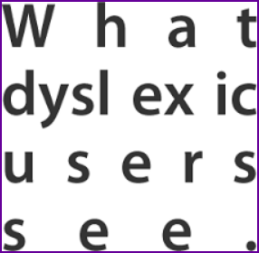

Design
Notes:
People with certain types of dyslexia will transform or flip around letters when they are viewed individually. For example, “p” and “q” and “b” and “d”. So instead of focusing on the individual letters they read by recognising the shape of a word.
Standard Serif and Sans Serif fonts have a distinct shape whereas cursive fonts degenerate the lines of the letters and distort the shape of the word.
At Vision Australia we use San Serif fonts as they are easier to read for people that have certain types of low vision.
Also, text that is justified causes a distracting river of white space for a person that has dyslexia. Use left align instead.
The DAT provides a left and right align but omits the justified function. It’s up to the author to select appropriate font style and size.
---
Reference: http://blogography.com/archives/tag/oscars
An example in case someone asks but not part of the presentation.
Nystagmus eye condition. Sans Serif is a much better typeface for a person that has this type of low vision.

Slide 28
Inspect

Slide 29

Inspect
Notes:
The Inspect section of the DAT is used towards the end of the accessible document creation process.
It includes the Microsoft Word Accessibility checker, Colour contrast analyser, a Metadata scrubber, Word to HTML converter, WORDS Screen reader and the Help function.

Slide 30
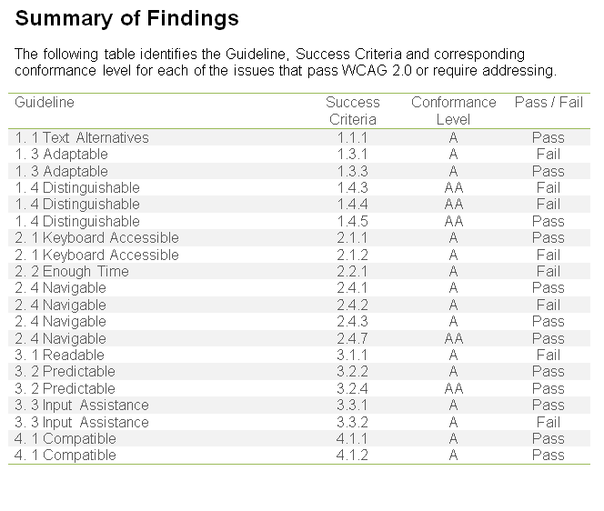
Colour Contrast
Notes:
For a sighted user with 20:20 vision this table is quite easy to digest. The shaded rows make it easy to follow the data associated with each piece of guideline from left to right.

Slide 31
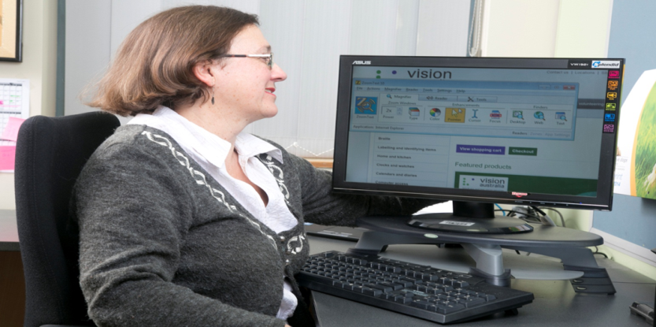
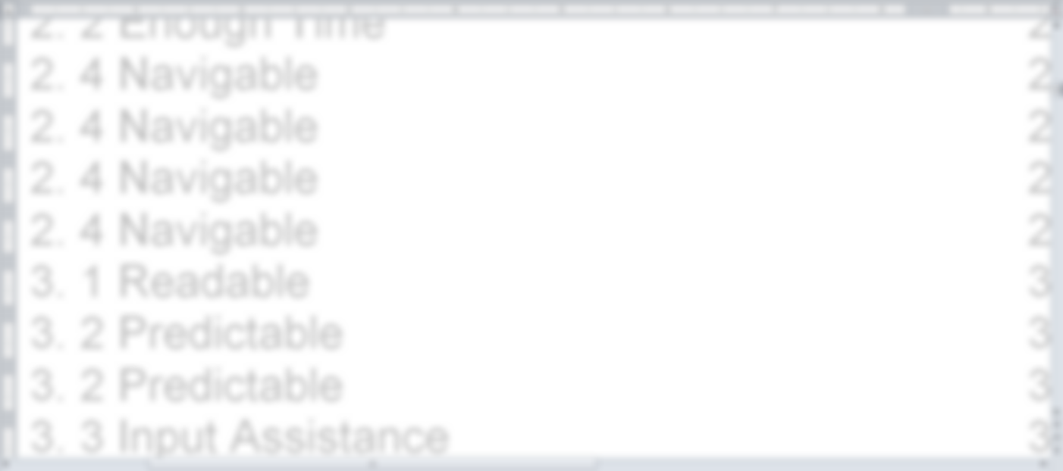
Colour Contrast
Notes:
This is how a person with some types of low vision may view the page. Notice how the pale background shading disappears and light grey text is blurry.
If they zoom in or use a screen magnifier they will only see about 25% of the screen at any one point in time. Look at how difficult it is to line up the guideline data with its associated data without table gridlines.
Here the main issue is that the colour contrast is insufficient.

Slide 32
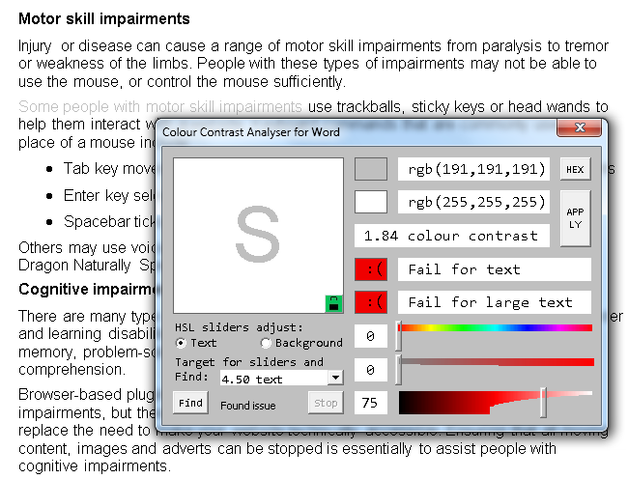
Colour Contrast
Notes:
The DAT includes an insufficient colour contrast “Find” function. It will locate all instances on insufficient contrast between text and background colour within the document. The author can then adjust the text colour to a darker shade and retest the document.

Slide 33
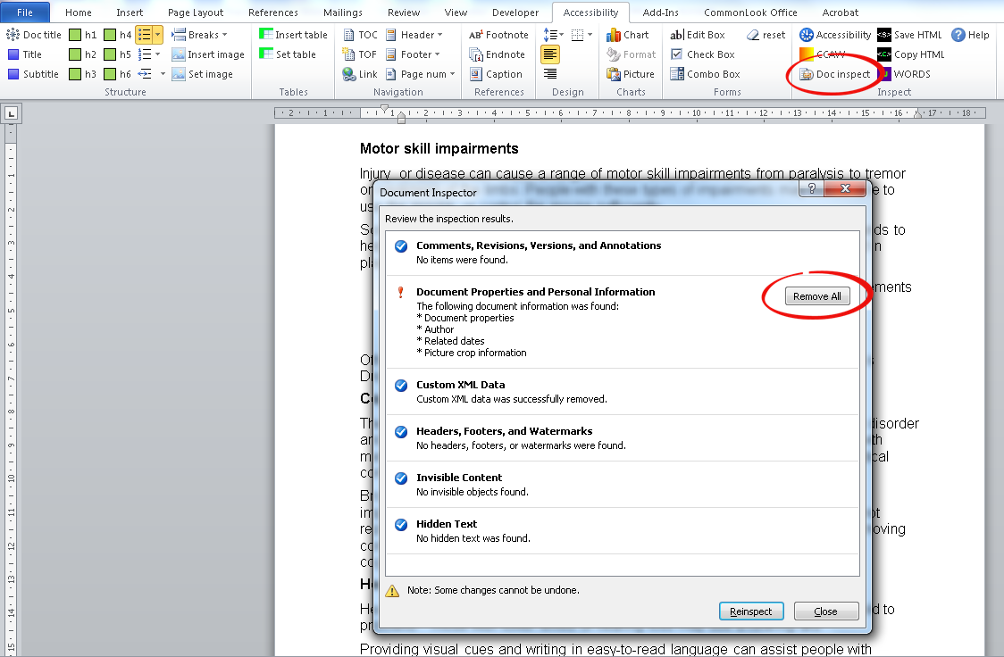
Document Inspect
Notes:
A document title (that is assigned in Properties) in a Word document will be maintained when exported to a PDF. The document title is the first thing a screen reader announces when a PDF document is opened so it’s important that it describes the content available within the document.
Metadata is hidden information can reveal details about your organization or about the document itself that you might not want to share publicly. You might want to remove this hidden information before you share the document with other people.
By selecting “Document inspect” within the DAT and removing all of the “Document properties and personal information” the DAT will delete the hidden data and maintain the document title.
This will save you from having to renter this data.

Slide 34
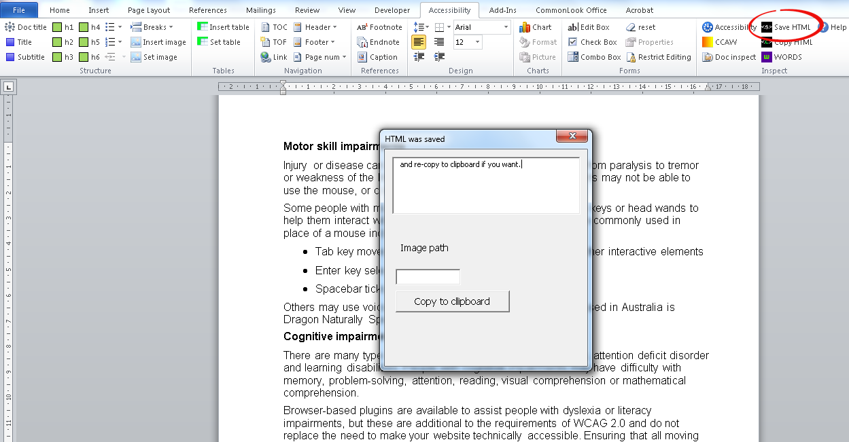
HTML Converter
Save HTML
Notes:
HTML is the most accessible digital format. This is because if it’s coded to WCAG 2.0 standards it is accessible on more devices. For example, if a user reads an accessible PDF document (WCAG 2.0 Level AA compliance) on a Mac using the Preview reader and VoiceOver they will not receive the structure of the document as the technology does not support it. However, if you view the same content as accessible HTML on a browser in a Mac and VoiceOver the structure is communicated.
The DAT includes a “Save HTML” function that allows authors to create an HTML version of the document. The function will automatically save the HTML file in the location as the Word document. i.e. in the same folder. Please note that the Word document will need to be optimised for accessibility for the best results.
To do this simply select the “Save HTML” button.

Slide 35
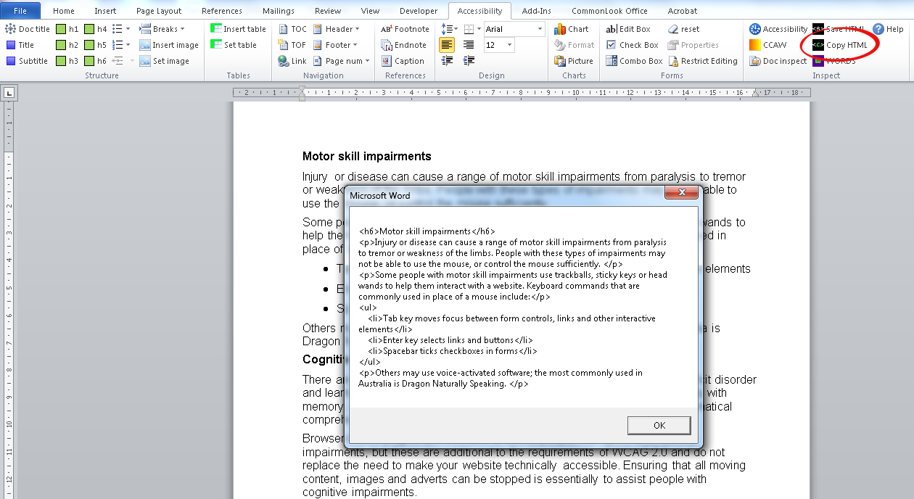
HTML Converter
Paste HTML
Notes:
The DAT will also create HTML from sections of a Word document. The HTML can be pasted into a sourced code editor or content management systems to update webpages.

Slide 36
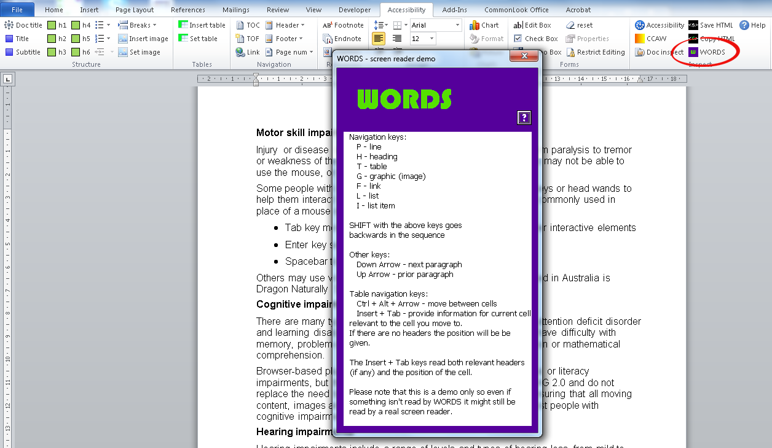
WORDS Screen Reader
Notes:
The DAT has a built in demo screen reader which will allow authors to appreciate the end user experience of those that use screen reader technologies.

Slide 37
DAT Team
Australian Communication Consumer Action Network (ACCAN)
Leona Zumbo - Project Lead
Pierre Frederiksen - Developer
Oliver Senior - Marketing

Slide 38
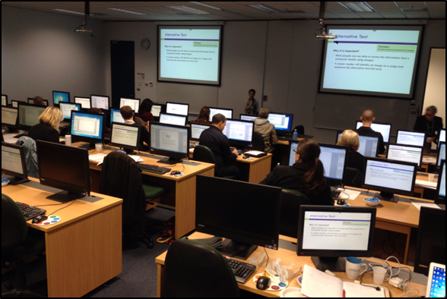
Creating Accessible Documents Workshop
Learn how to create accessible documents in this practical, computer-based training course.
PDF files to WCAG 2.0 Level AA standards
Microsoft Office documents that are fully optimised for accessibility.
Notes:
We are currently working on an eLearning course to support the DAT. If you subscribe to our Digital Access mailing list to find out when this is up and running.

Slide 39
Contact Details
Digital Access:
P: 1300 367 055
E: digitalaccess@visionaustralia.org
W: www.visionaustralia.org/digitalaccess
  4 Mitchell Street, Enfield NSW 2136
  346 Macaulay Road, Kensington Vic 3031
  Brisbane
  Canberra

Slide 40

Questions
Notes:
Invite comments and questions

