Slide 1
Pathways to Implementing Recommendations:
Is there a Best Practice Model?
Julie Kiroluch
Senior Disability & Equity Advisor
Pathways 12 December 2014

Slide 2
Session Overview
Purpose – discuss distribution of plans for reasonable adjustments
Clarify terminology
Survey results
Are there best practice models that ensure:
    students get adjustments they need?
    academics are aware of required adjustments?
    there is good communication between student, DLO & academics?
Notes:
Outline session
Purpose – distribution of LAPS;
Survey Background – to see how others were distributing laps; what works and what doesn’t work
Can we come up with a Best Practice model?
Actual implementation of LAPs is a whole other issue

Slide 3
Terminology
Disability Advisor / Disability Liaison Officer / Equity Officer
Disability Access & Equity Advisor
Learning Access Plan (LAP) / Eligibility letter / ……..
Best practice
Notes:
Terminology –
DLO
LAP - different names but same purpose – record of reasonable adjustments that is used as basis for negotiation
Best practice – need to know what we mean by this so will discuss in more detail soon

Slide 4
Quick Poll
Who has a Client Management System that automatically distributes LAPs to nominated faculty contacts?
Who has to find out who the contacts are and then organise distribution themselves?
Who gets students to distribute the plans?

Slide 5
Quick Poll
Who has problems with staff passing on LAPs?
Who has problems with students disseminating LAPs to their academics?
Who has problems with ……..?

Slide 6

SurveyMonkey
austed
Notes:
Started to reflect on my practice - wondered what others were doing

Slide 7
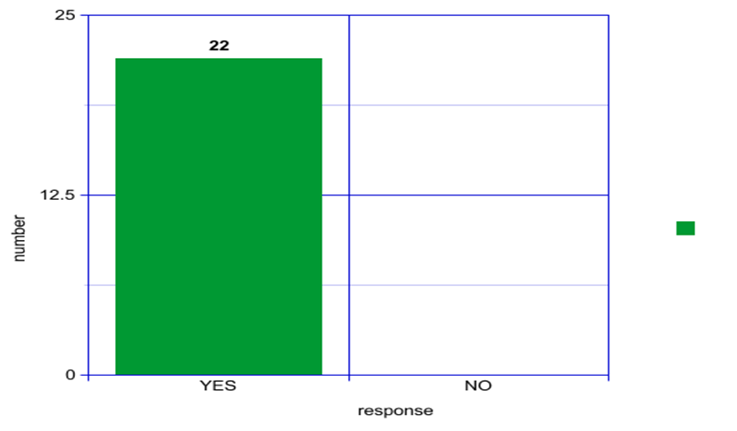
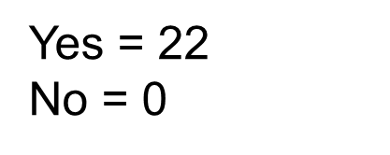
Q1: Do you develop a document that summarises the Reasonable Academic Adjustments and Alternative Exam Arrangements you recommend for your students?

Slide 8
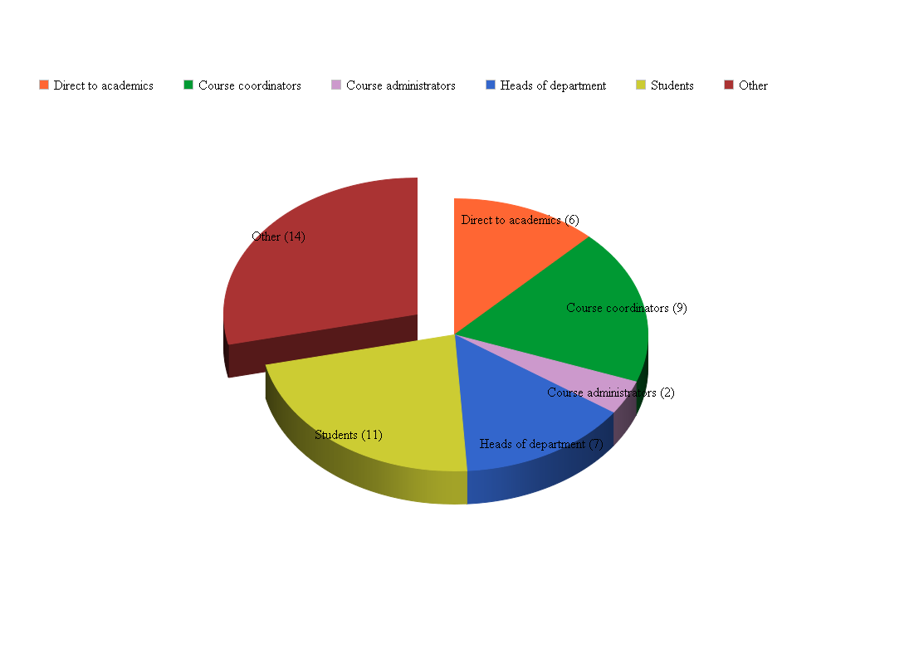
Q2: To whom do you send your plans for actioning?
Academics = 6
Course coords = 9
Course admin = 2
HoD = 7
Students = 11
Other = 14
http://www.onlinecharttool.com/graph

Slide 9
College
Unit coordinators
Directors for clinical/field placements
Heads of Schools
School/Course administrators
Exams Unit
Central database
Faculty Equity Advisors/Disability Coordinators
Parents
Linked in agencies

Slide 10
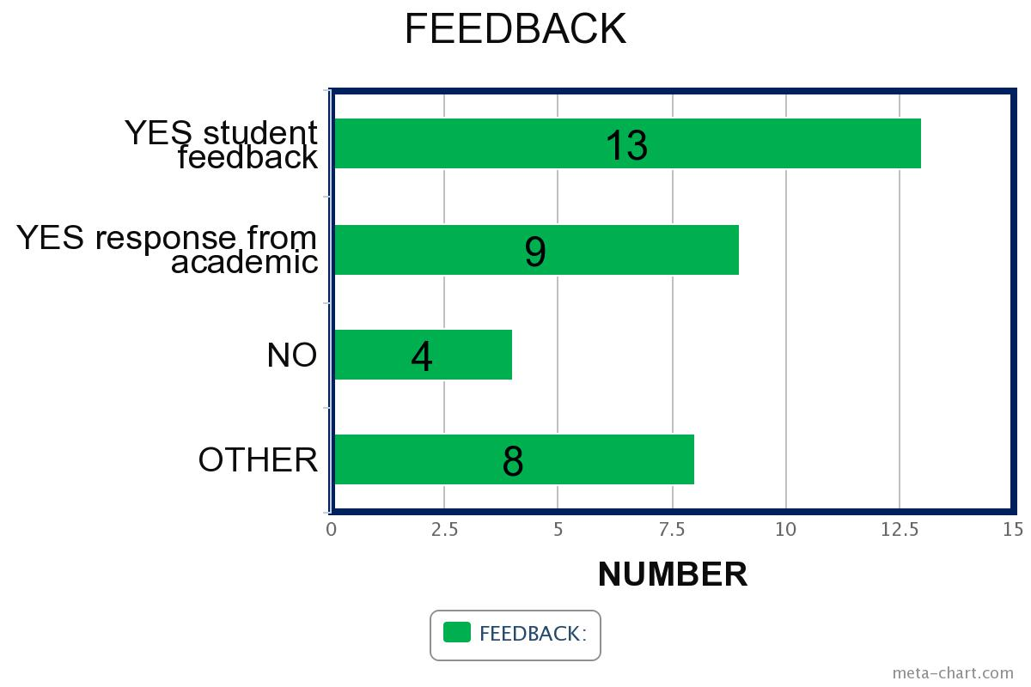
Q3: Do you have a mechanism to ensure that the recommendations have been implemented?
Notes:
Brainstorm around room first

Slide 11
Other
Monitoring by Disability Advisor
Students contact the DA if they have any concerns
University's Disability Policy - all adjustments must be implemented within five days.

Slide 12
Q4: What has been the most effective strategy to ensure distribution and implementation of your plans?
Faculty distribution
Following up with staff - phone call; face to face briefing
Electronic distribution
Automated roll out of plans every semester
Having plans signed off by Course Coordinators/Head of dept.
Ensuring students take responsibility
Notes:
Finish off with some statements from survey around effective strategies:

Slide 13
Q5: What barriers have you experienced in ensuring distribution and implementation of your plans?
Ensuring the Colleges distribute them correctly
Staff changes resulting in delay in sending plans out
Academics forgetting about the reports or not reading them.
IT issues e.g. IT ‘down’; inefficient systems
Students not sending the plans on or not doing so in a timely manner
Notes:
There is one more question which we will cover at the end of the session

Slide 14
Reflecting on our current practice:
Is it based on best practice?
Is it based on policies & procedures?
Did we inherit it?
What drives our current practice?
Needs of students
Needs of academics
System
Notes:
Also consider this…

Slide 15
What is best practice?
Considers all stakeholders
Delivers consistent outcomes
Minimises resource, maximises results
http://bestpracticehub.com/best-practice-definition/
Notes:
Library: Robotics, wound care, wind power, decorative concrete…

Slide 16
Why Adopt Best Practice?
The Best Practice approach is a systematic, professional approach that leads to ….
A proven, quality approach to service delivery
Increased productivity
Increased customer satisfaction
Minimised risk
Reduced costs
Improved communication https://www.itsmf.org.au/best-practice/about-best-practice/

Slide 17
Workshop
Current practice:
Why
Strengths
Weaknesses
Recommendations for Best Practice

Slide 18
Summary
Recommendations for Best Practice
Notes:
Depending on time/number of participants; ask each table to give one point for each aspect or just address one aspect
Collect note paper

Slide 19
Best practice in context
Size of University/TAFE
IT systems
Staff turnover
Workload
Student characteristics
……….
Notes:
Brainstorm what could impact on ability to implement Best Practice

Slide 20
Q6: Do you have any other relevant comments or questions?
You need to find multiple ways to tell students about what their responsibilities are - at interview, support information once a plan is implemented, emails during the semester as a reminder etc.
There needs to be a (state) guideline
Notes:
Finish by referring to last survey question – 2 points that stood out for me

