Slide 1
Supporting Students with Specific Leaning Disabilities
Julie Fry (Wodonga TAFE)
Doctor of Education, Research
La Trobe University

Slide 2
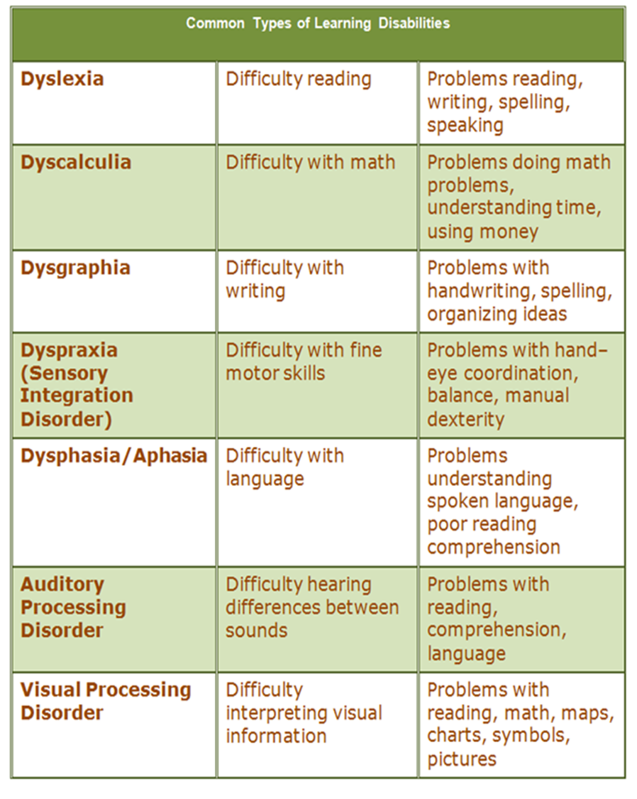
Presentation Overview
80 % of SLD
A bit about me
Why this research
Importance of the findings
The universal model of practice
Where to from here
Notes:
Full cycle – first pathways in Fremantle as novice DLO
Ten years in the DLO role before I moved on to NDCO then Team Leader of Tertiary student support service – now an educator
Through experience and exposure I have become aware of the life changing influence that effective DLOs can have when working with people with a disability
We know enough from research, practice and literature that education is life changing for anyone – but never more so than for people with a disability – my interest area is for people with specific learning disabilities such as dyslexia living the experience in Australia.
SLD - people with specific learning disabilities experience difficulties with one or more of the neurological processes involved in understanding or using spoken or written language. Profiles for individuals differ but they will have neurological differences in one or more areas of the brain focussed on language / processing / decoding / executive functioning

Slide 3
Australian Context
Under study internationally since the 1800’s
One in ten people (internationally)
Recognised in Disability and Equity Legislation & Education Acts:
  US
  UK
  Canada
  Australian Governments have been challenged since the 1960’s by national and international lobby groups and associations to enforce disability legislation across education sectors.
1973 - Schools in Australia (Karmel Report)
1976 - Select Committee on Specific Learning
Difficulties
1992 – Introduction of DDA
2002 - Inquiry into the Education of Students with Disabilities
2004 - National Inquiry into the Teaching of Literacy
2010 - Helping People with Dyslexia: a National Action Agenda
2014 – Round Table Discussion – Minister Pyne
Notes:
The term ‘word blindness’ originated in the 1800s through the works of Adolph Kussmaul (Hallahan & Mercer, 2001). Kussmaul’s focus was on people who he defined as having complete and intact power of sight, intellect and speech but who could not read the written word (Duchan, 2008). Learning disabilities such as dyslexia are not a new phenomenon – there is little to no excuse for Australia’s inability to recognise Dyslexia within their state funded education programs – we are lagging behind the international stage. 80% of people with an SLD have Dyslexia – I often interchange in my language as my focus is primarily dyslexia.
Australia has been challenged at a national and an international level to acknowledge students with specific learning disabilities such as dyslexia – at each lobby point – there has been some political response but at its best the government has defined specific learning disabilities under the umbrella of learning difficulties. In doing this they promote a belief that specific learning disabilities can be remediated through teacher intervention.
This has several ramifications:
For students and teachers alike this has resulted in continued failure – students with SLD who are receiving intensive teaching continue to fail. Teachers who are putting in the best of what they know through their training – are also feeling like they are consistently failing.
If the students presenting with indicators of an SLD are viewed as having learning difficulties that can be remediated – there is no support provided to the student or school for assessment and personalised interventions under disability programs and / or funding.
Recognising and supporting students with an SLD is not the norm in Australia – More times than not these young people exit the school system as failures.

Slide 4
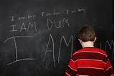
Setting the Scene
The lived experience
Life consequences
Australia’s system
When life goes wrong for a dyslexic at school, it has a knock-on effect to life after school, thus the influence of school is profound. At school there are two curriculums: academic and social, failure in either or both will have lifelong effect on the individual (Alexander-Passe, 2009, p. 267).
Notes:
Without a positive educational intervention and an awareness and understanding of why people with specific learning disabilities learn differently – or don’t learn within a traditional teaching and learning context – people who have SLD are likely to be labelled as ‘the slow learner’ ‘not academically inclined’ ‘lazy and unmotivated’ – they often prescribe their own labels of ‘dumb’ ‘stupid’ ‘useless’.
The lived experience of unrecognised and unsupported learning disability is damaging to self worth and self esteem. Years of failure and shame impacts psychological and physiological well being. As a result people with specific learning disabilities such as dyslexia are over represented in our nations:
Suicide statistics
In our mental health statistics
In our criminal justice systems
In our long term unemployed,
And in our employed but high risk low paid jobs ( I have lost two brothers who were labelled as ‘slow’ in fatal work place accidents – too afraid to speak out or leave because they believed that their learning difficulties would get in the way of gaining another job).

Slide 5
Specific Learning Disabilities
The definition of "disability" in the DDA includes:
Physical
Intellectual
Psychiatric
Sensory
Neurological, and
Learning disabilities, as well as
Physical disfigurement, and
The presence in the body of disease-causing organisms.
Australian Human Rights Commission (2014)
A disorder or malfunction that results in the person learning differently from a person without the disorder or malfunction
Notes:
State governed school systems have not recognised specific learning disabilities such as dyslexia under the special needs section in their Education Acts. NSW is a recent exception and we are just now beginning to see teacher training and awareness programs emerge in certain schools across NSW. I note that the newly elected Victorian Labor Government has stated they will recognise dyslexia in funding and support models within schools for students with disabilities within their platform agenda – lets keep them accountable!
Tertiary Education has stood apart from the compulsory education sectors for more than twenty years - since the introduction of the DDA. In stark contrast to the State funded primary and secondary systems the Tertiary education system at both TAFE and Higher Education level has recognised specific learning disability as defined in the DDA within their disability support programs.
In Australia, this means that often the first real intervention or support focussed on the specific learning disability occurs after the person has exited the secondary education sector. I heard through my research that parents are approaching the TAFE sector for an alternate education based on the supports that can be provided to their child who has learning difficulties.

Slide 6
Why this research focus
20 + years experience across Tertiary Education.
Good practice is occurring and it is having a life changing impact.
This practice has evolved in a difficult and complex context – ambiguous definitions / low levels of acceptance nationally, no educational policy or precedence.
What does it look like – is it universal / can it be taught / can other education sectors learn from the tertiary education experience, knowledge and skills?
Notes:
The seed for my research was planted several years ago – a colleague at RMIT within the NDCO program was hosting focus groups to explore the experiences of students with Specific learning disabilities in tertiary education. I sat in on a couple of these groups.
I heard some very sad and distressing stories about life at school from students in these groups, I also heard some disturbing stories about life at TAFE and Uni – Where students felt that they were still being treated like they are dumb, some students felt they were encouraged or coerced into foundation studies areas – often repeatedly. Disability support practice that mirrored public misconceptions about SLD – either that you can learn if you just tried harder – or you will never succeed on your own in the academic arena without an academic aid.
I also heard some amazing stories – these stories all recognised engagement with Disability support programs that were life changing. Where students both young and mature aged felt heard, felt they were supported to understand exactly why they were having difficulties and believed that through the support from the DLO they now knew what there strengths are, how they learn best and most importantly what tools they need to remove barriers to their learning and to be productive in life.
These students had transitioned far beyond foundation level studies and were studying at Diploma and Bachelor level. They no longer carried the label of ‘dumb’, they believed in themselves, they had a vision of their future that included career focussed aspirations – and they could clearly articulate when their life changed.

Slide 7
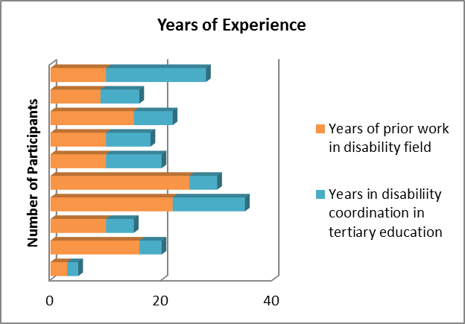
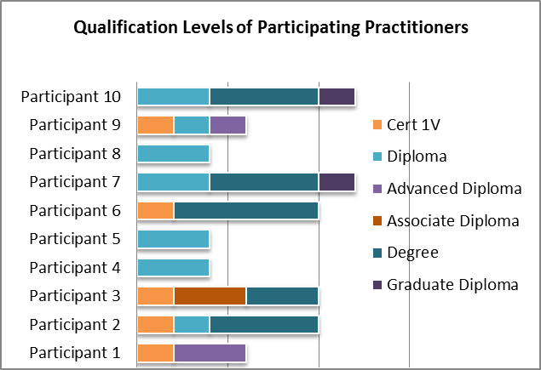
The Research Participants
Notes:
Focussed study to DLOs in TAFEs in Victoria – this provided parameters and similarity in roles and organisational context.
Focus group held in Melbourne
In depth Interviews with individual DLOs
18 TAFEs in Victoria – 10 Participated in the research
Direct request to TAFE Disability Network for participation in the focus group
Snow Ball approach to interviews – DLOs were referred by colleagues based on their professional practice and level of experience working with people with specific learning disabilities – i.e. they were recognised as experienced practitioners who are having good outcomes in their practice models.
The group were in the main very experienced practitioners who had many years professional experience in the disability sector prior to taking on the DLO role.
Even those with the most experience highlighted the complexities of the DLO role and the challenges – especially in the area of SLD where it was often a new learning for them in a context where there was not a lot of local knowledge to draw upon – in the Australian context where we don’t identify SLD as a norm – it is not often a disability category that people had been exposed to in prior work roles.
The group also evidenced qualification levels that are at a higher level than the broader disability service sector – this may have contributed to the higher order skills that were apparent among the group – researching, critical reflection, collaborative practice – professional alignment with recognised good practice models – strength based, future focussed and person centred practice.

Slide 8
Learner at the Centre
Person Centred
Information Technology
Tools of the Trade
Lifelong process
Collaborative
Communities
Strength Based
Solution Focused
Rights Based
Universal Design
Inclusive Practice
Access and Equity
Self Management
Self Advocacy
Professional Growth
Evidence Based
Reflective
Future Focussed
Systemic change
Relational
Life Skills
Personalised
Sustainable Solutions
Transformation
Personalised Learning
Adapted from Abby & Baylis (2012)
Notes:
What fell out of this research was that DLOs were working to a model of personalised learning. Personalised learning is about embracing the learning and development of the ‘whole student’, supporting the learner’s right to all-round personal development - its an alternative to overly standardised, one-size-fits-all models. Within the personalised learning model the Student voice is of pivotal importance.
Research participants did not tell me this is their model of practice, in fact their practice has evolved organically and been nurtured through social equity and human rights principles that align beautifully with the personalised learning model.
Each participant spoke about their commitment to positioning the learner at the centre – valuing the learner as expert of their experiences, recognising the need to develop lifelong learning skills and to find the technological tools that can transfer from the educational context to the workplace and beyond, for students. Each participant stated that they have developed professionally through the relationships formed within the Victorian TAFE Disability network – the practitioners community of practice where collaboration, critical reflection, support and new learning occurs.
They each talked about the strengths they have come to see as inherent in people with SLD – especially those of resilience, coping and adaptation.
Through thematic analysis with the data provided through the in depth interviews and focus group – it was very clear that good practice across this network is universal in nature –same purpose, practice, intent and outcomes. The personalised learning approach across this group of practitioners is quite advanced and has the power to influence good practice across all education sectors. Especially given the current reognition of this model move toward encouraging personalised learning at the primary and secondary levels.

Slide 9

Underpinning Practice Principles
Person at the Centre
Human Rights
Strength Based
Future Focused (goal oriented)
Solution Focused
Sustainable – life beyond education
Universal Design
Transparency - Information
Notes:
Underpinning principles of these practitioners: Human Rights / Strength based / Solution and Future focussed.
Awareness that without learning how to learn strategies life opportunities for people with SLD is limited – human rights
Awareness that people with SLD can achieve but that they have not been provided information and / or developed an understanding of how they will achieve success in education – strength based
Awareness that people with SLD have carried stigma and labelling of dumb for many years and that while not advocates of labelling people – recognition that the dyslexia label was much more empowering than the label of dumb -
An understanding that interventions at the educational level needed to focus on sustainable solutions to enable the individual to move on and apply strategies in further study or education independently
An understanding that educating in the use of technologies etc can not occur in isolation of learning how to learn strategies – people with SLD who have not had diagnosis and support in former education do not have fundamental academic skills – learning to use technological aids needs to occur simultaneously with academic skills.
A belief that wherever possible the solution needs to be one that will benefit all students and wherever possible not become a special accommodation for one person –– universal design – and not fostering the special needs approach – normalising and managing for the diversity that is expected among learner groups - 1:10

Slide 10

Blended Case Study

Slide 11
Written by Benny – Aged 11 years
Only I can understand
how it feels to read in front of my classmates
and be terrified to make a mistake.
Only I can understand
the reason why it takes forever to read a book
when my classmates take a week.
Only I can understand
the words I write on the paper
that no one else can read.
Only I can understand
what it is like to read a question
when the words jump around the page.
Only I can understand
what it is like to work for hours
when other kids work for 30 minutes.
Only I can understand ridiculous puzzles, absurd equations, extreme math, and the meaning of science
because my brain sees things in a different way.
Only I can understand
what it feels like to be judged for needing help.
Kids who need help are not dumb
but only I can understand.
I can understand
because I am Dyslexic.
Because I am dyslexic
I can understand a lot of things
that only I can understand.

