Slide 1
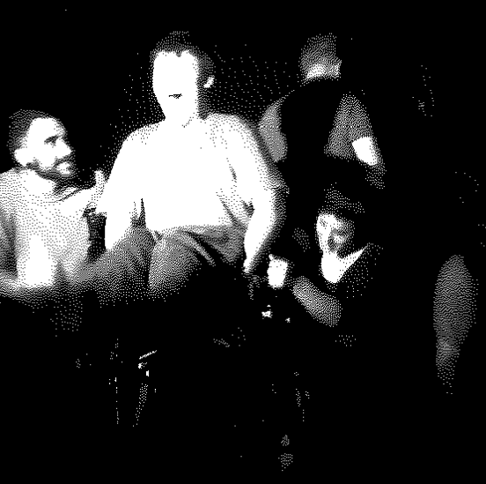
The Inclusive Performance Program (IPP)
December 2014
Notes:
The IPP was a project organised at ECU in Sem one 2012.
It was designed to give both community members an opportunity to experience what university was like and for university students to experience what inclusion looked like at university and within a drama context.

Slide 2
A socially inclusive society is one in which all Australians feel valued and have the opportunity to participate fully.

Slide 3
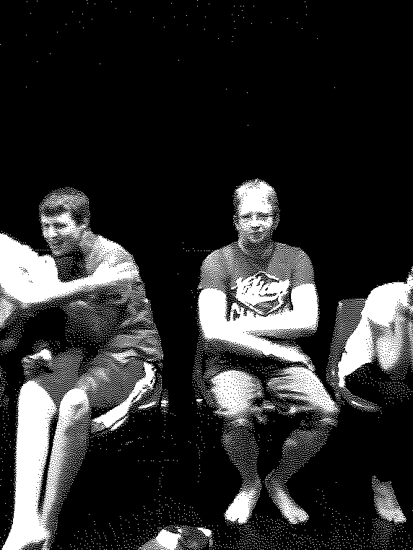
The Inclusive Performance Project (IPP) was sub-group in a 3rd year drama performance unit for pre-service teachers at Edith Cowan University (ECU).
Notes:
The students involved in the IPP were challenged to create performance pieces focussed on meaningful engagement for all. Rather than focus on an end-of-semester production, those involved in the IPP examined process driven activities. Thorough planning and reflection resulted in a series of mini-performances that reflected both a variety of drama techniques and a greater appreciation of inclusion in tertiary settings.
There was ongoing tension as to whether they would create a performance or alternatively let it be process driven….ultimately it became process driven…with weekly planning sessions being focussed on all individuals developing ideas and realising them every Friday afternoon.

Slide 4
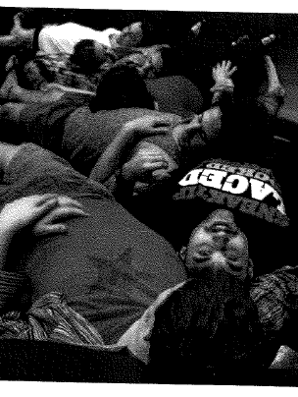
The IPP included nine ECU students and three students with additional needs.
The three students with additional needs had been previously involved in drama projects and had expressed interest in participating in activities at university.
Notes:
Students could have participated with the main group that were developing a semester long drama piece…..students in the IPP volunteered (via an application) to be involved……their applications were reviewed and in the end the nine students plus three community members was seen as a manageable group.

Slide 5
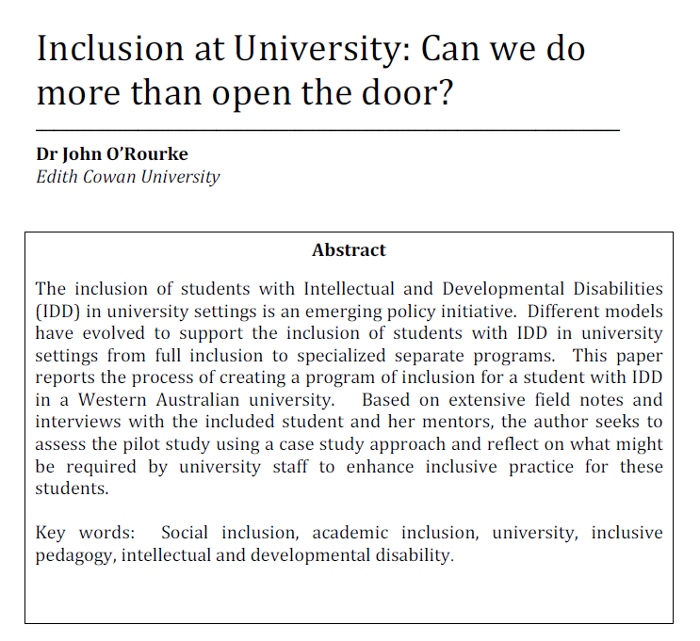
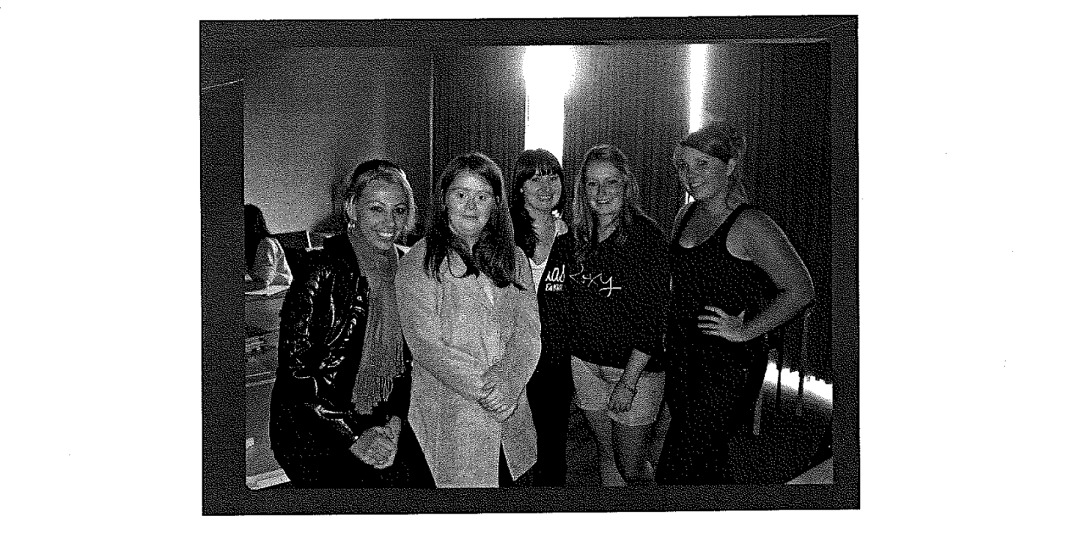
Notes:
This was also brought about by previous experiences….with students with additional needs at university. See article Journal of Social Inclusion.
I had visited Flinders university in SA…..which runs the up the Hill program…..and wanted more than community inclusion….I wanted to fully include ALL students in the learning ….this is challenging.

Slide 6
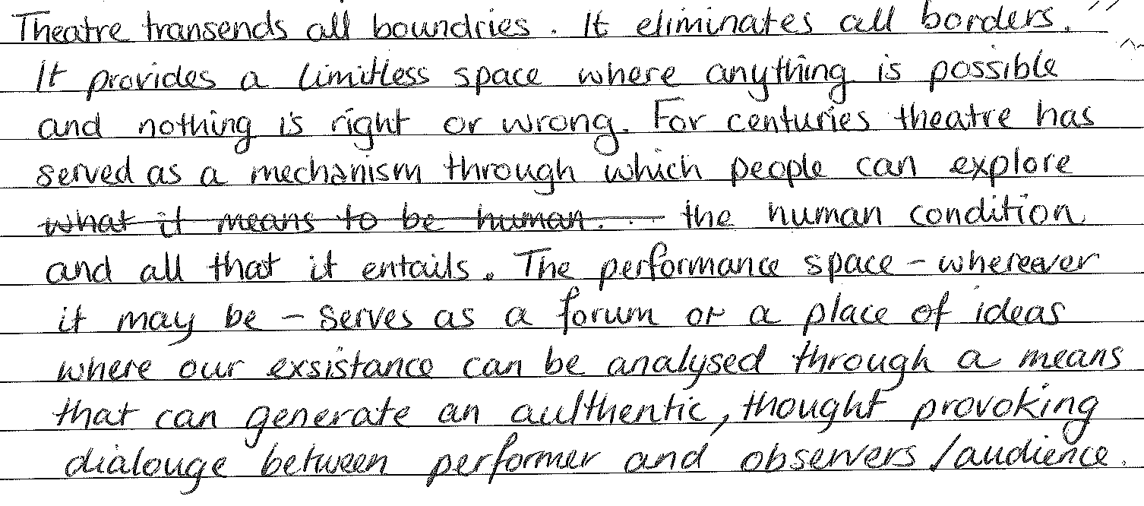
Why Drama?
Notes:
So why drama…….
Students within the drama program who had participated in the core diversity unit ….were always highly engaged in the course ….and the course coordinator was working as a tutor into the diversity course.
The auditing students were also involved in (and are currently involved in the tracksuit theatre company).
Additionally…..drama is considered to be a subject area that has the scope and opportunity to be inclusive..
Here is a description from one of the drama students journals….and it sums it all up nicely…

Slide 7
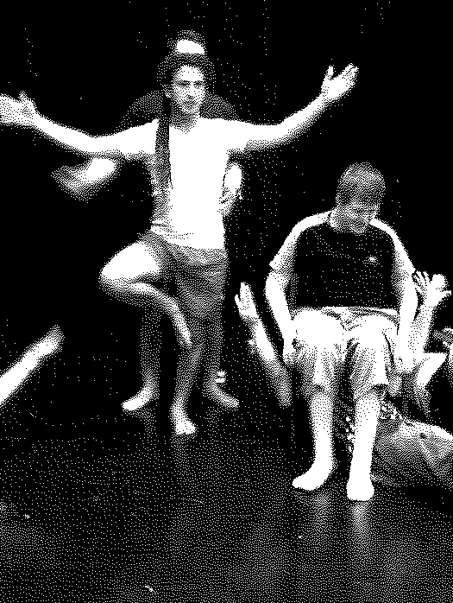
IPP Students were assessed in the following ways:
On their work in rehearsals and in workshops (ECU staff hosted regular meetings with the group to determine progress). Additionally, each meeting and rehearsal was filmed by the students and were to be potentially viewed by the assessing staff as support documentation.
An outside consultant also assisted in the assessment of students (through the lens of their interactions and creative inclusion ideas).
The construction of a reflective IPP journal and accompanying academic research.
Notes:
Students will be required to develop a body of research and analysis of the process/practice during this project. It is recommended that students purchase a hard back A5/A4 plain page book for this purpose.
This is not a description but rather an evaluation/reflection of the sessions. The journal must include ideas for each session.
As well as this all research completed must be included and an analysis made of the outcomes. The journal must be brought to each meeting /rehearsal and may be viewed by the assessing staff at any point.

Slide 8
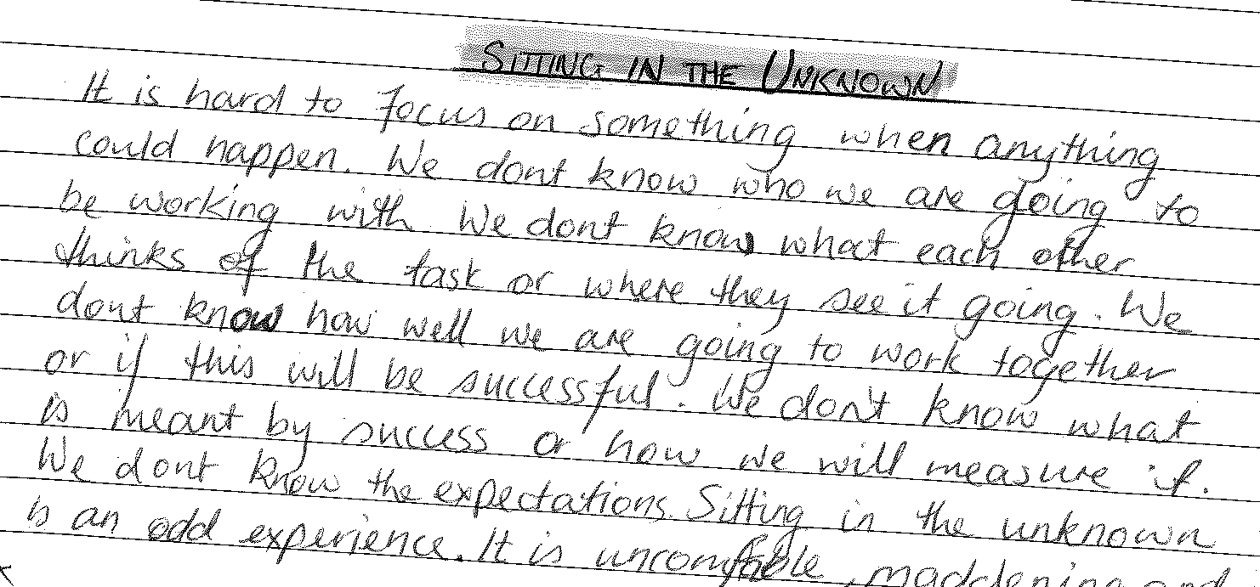

Slide 9

The IPP….a transformative journey into the unknown……
Notes:
The students at all time videoed their planning sessions and their practical sessions.
In the end we had 40 or so hours of video…of which this is just a snippet.
We wanted convey in this video a sense that this was an amazing, transformative, and challenging experience.
For the most we wanted the video to speak for itself. There were many times when I just watched on in amazement at what was happening….at look of those who are practitioners in disability who will recognise techniques …that the student did intuitively…
It was an incredible journey…

Slide 10
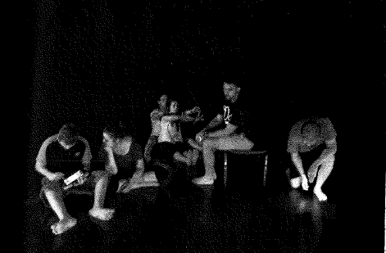
IPP challenges
Approval from the school and faculty.
Trust and ‘buy-in’ from students.
Support to make it happen.
Staff time.
Ethics approval.
Notes:
So all of this takes time…….
Approval to make this sort of thing happen is incredibly time consuming…..meetings, emails…and explaining what is going on …..to the right people….can be tricky.
Getting buy-in from the ECU students was important. They want to be assessed appropriately, they want to ensure that do not miss out on learning…..and they want to be supported. Trust is a key feature to this….
Finding time to make this happen is tricky….we were fortunate that the students involved were highly committed and the time invested could not always be expected of all undergraduate students….
Even seeking ethics approval for this undertaking was exhaustive. We sought to get approval from Eli to use video such as what you have seen…and this took well over 6 months. I think this process was quite unique….but again this is just another constraint within a university setting that exists…

Slide 11
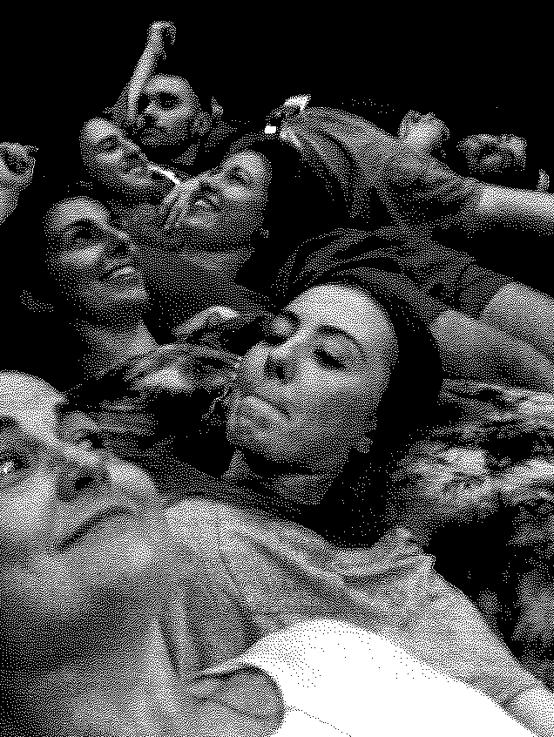
The way forward…..
Convince others this is worthwhile.
Look for the value added..
Keep on believing..
Appreciate that inclusion is about everyone….
Notes:
So where to from here….
I will finish off by saying this experience was one of most amazing to observe in my 10 years at ECU. Many of the things I was seeing…I could hardly find the words to describe what was happening….but it appeared to be transformative learning ….and in reality this is rare to find at university….
The next semester…I had a couple of the students present in a 4th year special education unit on developing relationships with students with complex needs ….and they were incredible. These were individuals with no real theoretical experience…..but a deep sense of the practical….
There was so much value-addedness to this….even including 3rd and 4th year film students in such an meaningful project has been excellent…..
We need much more support and encouragement at university to move forward…..we need time and money to create opportunities….but these are oppportunities that will change lives…and from inclusion point of view….move all of this forward…

Slide 12
