Slide 1
Improving employment outcomes for Grads with Disability
5th December 2014

Slide 2
Introductions
Jenny Watts-Sampson (AND)
Tracey Lopes (Dept. of Agriculture)
Kate Crookes (Stockland)
April McCarrey (student from Edith Cowan uni)
Michelle Hayter-Falconer (Macquarie uni)

Slide 3
Graduates

Slide 4
Stepping Into program evaluation
Evaluation of program between 2006 – 2010
In excess of 170 internships offered in this time
82% of candidates that were surveyed had part-time or full-time work post graduation
Stepping Into is closing the gap
2014
The program is growing with more and more employers taking part and providing multiple internship opportunities to students as pipeline talent.

Slide 5
What interns have said
The work is exactly what I have been yearning for, it wonderfully incorporates and compliments my studies and satisfies my interests
I have been lucky enough to receive guidance and teaching from each of the lawyers in the practice
All of my reasonable adjustments were met and my workload and work schedule were tailored to suit my University commitments.
The program has allowed me to apply the knowledge and skills that I have acquired through tertiary education into real life work experience.
The work is for the most part stimulating, and it's pretty much a dream job.

Slide 6
Stepping Into Perspective
Students:
Find employers who talk about diversity
Focus on skills and abilities
Understand the recruitment process
Confidence in their abilities
Confidence to discuss workplace adjustments in a positive and solutions focussed way

Slide 7
Mentoring
PACE
Positive Actions towards Careers Engagement

Slide 8
Tracey Lopes
Dept. of Agriculture

Slide 9
Kate Crookes
Stockland

Slide 10
April McCarrey
Student from Edith Cowan uni

Slide 11
Michelle Hayter-Falconer
Macquarie uni

Slide 12
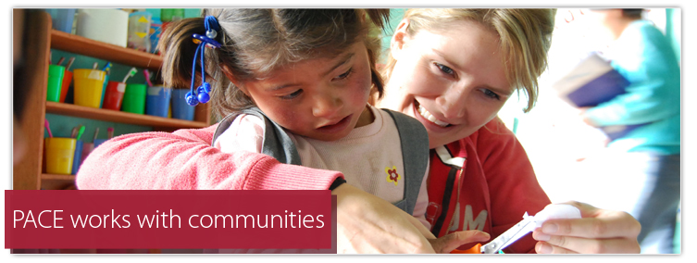
What is PACE?
Macquarie University’s professional and community engagement program providing students practical experience locally, regionally and internationally.

Slide 13
Currently a general requirement for 60% of undergraduate degree
Available as an elective in other undergraduate degrees
Usually happens 2nd – 3rd year
Includes an academic framework, such as:
a range of lectures, workshops and/or tutorials before the PACE activity, and
an outline of assessment requirements for the academic criteria.

Slide 14
Students with disability participating in PACE
2013 PACE developed a local Disability Action Plan, correlating with university-wide DAP
2013/2014 engaged AND to conduct a scoping study to predict the likely costs, and also potential sources of funding
2014 developed detailed procedures on how to make reasonable adjustments within PACE activities, and guidance on encouraging early disclosure
Late 2014 and continuing in 2015, staff participated in a half day Disability Confidence Workshop

