Slide 1
Building Blocks Over Barriers
A peer-facilitated group skills program for students with autism spectrum disorder (SWASD)
Donna-Marie Thompson
Notes:
WELCOME
INTRO SELF – NOT a person with ASD – Don’t presume to speak on the part of a person with ASD
INTRO VIDEO

Slide 2
Building Blocks Over Barriers
In their own words:
http://www.youtube.com/watch?v=ZfzqBCC30as
Notes:
VIDEO

Slide 3
Building Blocks Over Barriers
Background
Student requirement and requests – loneliness, difficulties with university expectations, behavioural issues.
Significant increases in enrolments of SWASD
Needs analysis
79% increase in ASD since 2009
Tertiary enrolments of SWASD increasing across Australia
Poor academic outcomes / increased attrition of SWASD
Notes:
POSITIVES
CHALLENGES WITH TRANSITION
IN SEM 2 2013 - SPRINGFIELD SWASD – LONELY, FRUSTRATED, ILLOGICAL CURRICULUM, DIDN’T UNDERSTAND REQUIREMENTS
ACADEMICS
NEEDS ANALYSIS – SIGNIFICANT INCREASES - AUST BUREAU OF STATS – 79% IN ASD SINCE 2009 / CAMPUS SWD INCREASE IN 2 YEARS – 83 to 130 SWASD (up 64%), CONTACTS UP 93%
RESEARCH – POOR ACADEMIC OUTCOMES AND HIGH ATTRITION

Slide 4
Building Blocks Over Barriers
Issues and Impacts
Difficulties with adaptive skills, change (transitions), social relationships and communication.
“Learned Helplessness” – individual support in earlier schooling and greater guardian advocacy.
Impacts of SWASD Attrition:
Individual - limited employment and earning opportunities, failure to achieve independence, reduced self-worth, loneliness, depression, anxiety, and well-being.
Education Providers – lower enrolments of SWD = lower funding plus financial and reputational risk.
Societal – loss of ‘talent’ and skills.
Notes:
CONSIDERED THE ISSUES OF SWASD?:
WE KNOW THAT PEOPLE WITH ASD PREFER ROUTINE, HAVE DIFFICULTIES WITH CHANGE, SOCIAL COMMUNICATION AND WITH MAINTAINING FRIENDSHIPS
RESEARCH POINTED TO SWASD HAVING:
- POOR ADAPTIVE SKILLS: PLANNING, TIME TABLING AND ORGANISATIONAL SKILLS
ALSO
SWASD were more likely to have received one-on-one support and may have had well-meaning parents who assisted them
developed a dependence or ‘learned helplessness’ on this level of support,
a reliance on external rewards or punishments to motivate,
lost the opportunity to develop a sense of mastery over their environment
resulting in decreased self-efficacy.
far reaching implications when SWASD fail to complete higher education, including:
Individual - limit employment opportunities and earning potential
Failing to achieve independence - financial hardship, loneliness, depression, anxiety and poor overall well-being.
education providers - decreased enrolment has funding implications.
And if we are not providing equitable and inclusive education opportunities, it may also lead to complaints of discrimination with subsequent financial and reputational consequences.
wider community - as many SWASD have areas of interest that they are gifted within, we will also see a loss of talent and skill potential.”

Slide 5
Building Blocks Over Barriers
A Theory … and Solution?
Deci & Ryan’s Self-Determination Theory
Continuum of motivation
Improving sense of self-determination = positive motivation, academic outcomes, and well-being.
Achieved by satisfying three (3) universal basic psychological needs:
Autonomy + Competence + Relatedness
Limitation –individual/environmental factors of complex students
Notes:
DECI AND RYAN’S SELF DETERMINATIONT THEORY
A theory of motivation
Proposes that motivation exists on a continuum from amotivation to extrinsic to intrinsic
Research shows that moving along the continuum towards intrinsically motivated behaviour improves academic outcomes and well-being
3 universal needs - Autonomy (choice), Competence (Mastery / Optimal Challenge), and Relatedness (at least one supportive person)
University may not satisfy
clash
between traditionally structured education (neurotypical students) - Restricts autonomy which limits competence
AND characteristics of ASD (eg sensory overload V loud lecture theatre, or social communication deficit V group assessment)
Limitation of the theory is that the model doesn’t allow for the impact of individual and/or environmental factors of complex students

Slide 6
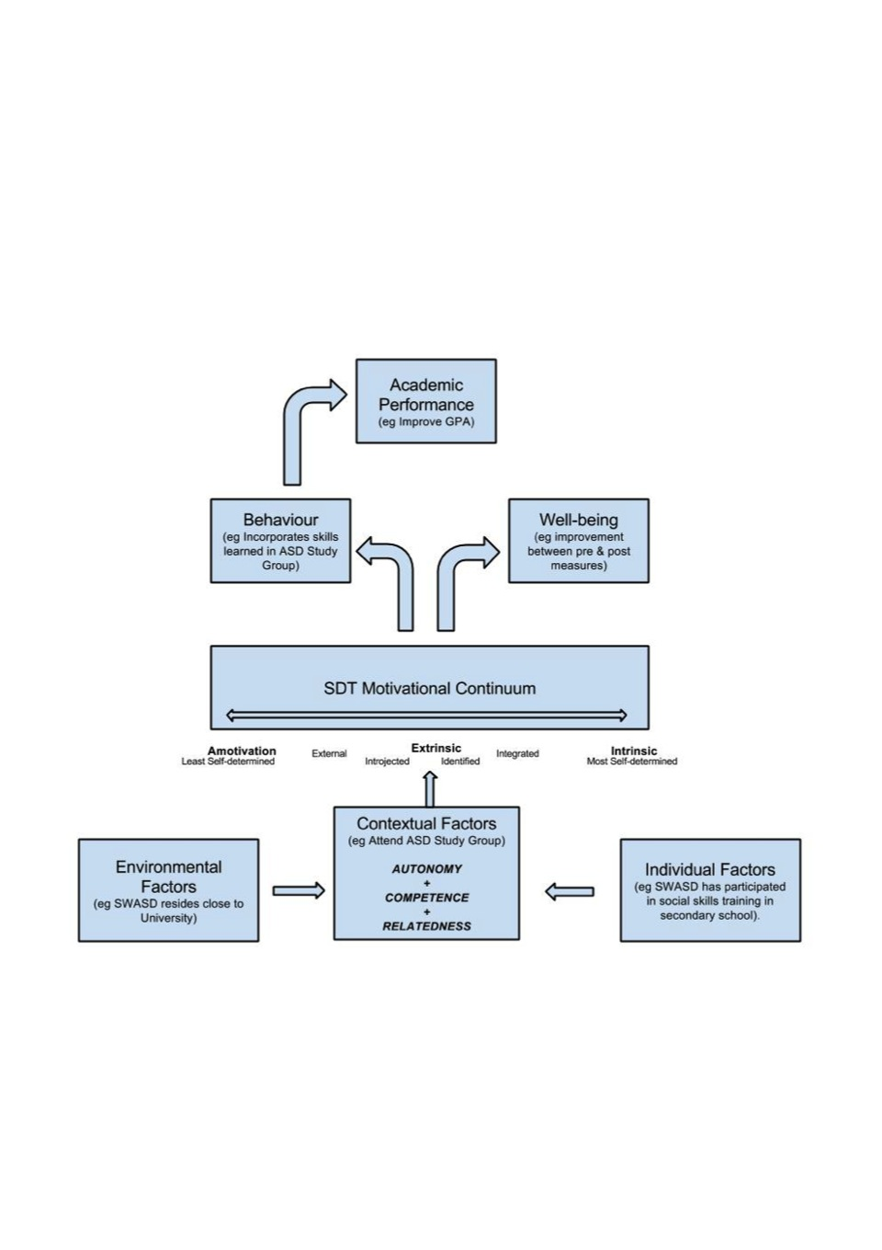
Building Blocks Over Barriers
SWASD Academic Outcomes Model (incorporating Self-determination Theory)
© 2014 D Thompson
Notes:
To address these issues, we proposed an adjusted model of SDT – being the Students with ASD Academic Outcomes Model
EXPLAIN THE MODEL
COPIES AVAILABLE

Slide 7
Building Blocks Over Barriers
First Steps
Tailored a program to SWASD strengths and challenges addressing:
Autonomy + Competence + Relatedness
Peer-facilitator with lived experience or knowledge of ASD
Invitations to SWASD and/or ADHD through Disability Services and wider USQ community (voluntary attendance)
ADHD included due to comorbidity and to increase no’s
Notes:
Incorporating the SDT model with identified needs of SWASD –
We proposed that the 3 universal needs could be satisfied by providing:
opportunity for choice (decision-making/problem-solving/self-advocacy/appropriate assertion communication) = Autonomy
By building on organisational and communication skills in university context (practical exercises and modelling) = Competence
By providing an autonomy-supportive relationship with peer-facilitator, and friendship formation with group members = Relatedness
However sessions would focus on general study skills applicable to tertiary study and anxiety management techniques.
Sought to identify preferred peer-facilitators with either lived experience or knowledge of ASD and
forwarded invitations to students with ASD and/ADHD who had registered with Disability Services.
Attendance at the group was promoted as voluntary and informal.
ADHD diagnosis incorporated due to comorbidity and to increase attendance ‘take-up’.

Slide 8
Building Blocks Over Barriers
Program goals:
Opportunity for choice
Development of study skills
Awareness of ‘campus life’
Social interaction
Stress and anxiety management
Included:
Autonomy supportive facilitation
Behavioural modelling
Interactive activities
Role playing
Guest facilitators (‘experts’)
Notes:
Here is an outline of the goals of the program:
Opportunity for choice
Development of study skills
Awareness of ‘campus life’
Social interaction
Stress and anxiety management
We intended for delivery of the program to include:
Autonomy supportive facilitation
Behavioural modelling
Interactive activities
Role playing
Guest facilitators (‘experts’)

Slide 9
Building Blocks Over Barriers
First Steps (continued)
First semester – Springfield campus
Facilitated and promoted by a SWASD
Weekly sessions attended by 1-3 SWASD
‘Social’ support
Only verbal feedback
Highlight – personal growth of peer-facilitator
Limitations – peer-facilitator’s own social-communication deficits
Notes:
First semester 2014
Peer facilitator - in her last semester of BAM – promoted AND facilitated
A ‘meet up’ style social group throughout entire semester
Had between 1 – 3 each week – attendance fell off
Received verbal feedback sheets – overall did not meet student needs
Had a positive impact on student faciliator
Limitations – unstructured and facilitator’s own inherent social communication deficits – missed the relatedness marker

Slide 10
Building Blocks Over Barriers
First Steps (continued)
Second semester – Springfield campus
Facilitated by a Provisional Psych in 5th year Pre-planned sessions for 8 week program
Students referred to program by SRO’s
3-4 SWASD attended each week
Promising qualitative feedback
Highlight - Facilitator received ‘competency’
Social Connections Group at Toowoomba campus/online provided informal support to SWASD by Psych and DA.
Notes:
Second semester
Facilitator – 5th year psychology student – negotiated a competency with the Faculty
Structured an 8 week session plan in line with SDT
Increased promotion via Student Relationship Officers
Sessions regularly attended by 3 to 4 students each week
Feedback was very encouraging with comments such as “I can be listened to here” and “I would have dropped out of uni this term if it wasn’t for this group”.
Word of mouth – our Toowoomba campus initiated an online and on campus group providing informal support to SWASD
Limitation – Not formally evaluated

Slide 11
Building Blocks Over Barriers
Next Steps…
Next offering
Promote peer-facilitation opportunity to senior/postgrad Psychology and Education students (negotiate competency with faculty)
Induct peer-facilitator/s – autonomy-support skills / program outline
Promote program to all USQ students
Offer as weekly 8 week program with limited places
SWASD to ‘enrol’ into program
Notes:
Next we plan to
Again seek a peer-facilitator from Post grad Psych or Education cohort (competency if possible)
Provide training to PF - autonomy supportive facilitation and program goals/outline
Promote the program more heavily via email, faculty staff and at Open Day and O-Week
Students required to register for the 8 –week program (but not for DS)

Slide 12
Building Blocks Over Barriers
Next Steps…
Evaluate program:
Pre and post measures – qualitative and quantitative
6 & 12 month follow-up (retention)
Should results indicate program efficacy:
Continue and Extend program:
other campuses if appropriate
online offerings (chat room/social media platforms)
Notes:
And while we’ve had encouraging informal feedback, we need to gather evidence around the efficacy of the program.
To do so:
Take pre and post measures
Qualitatively – SWASD’s expectations and experience of support while at university (semi-structured interviews - interpretive phenomenological approach)
Quantitatively – effect on level of perceived autonomy and wellbeing
PLUS checks on enrolment status at 6 and 12 month intervals
If results continue to be promising
Extend program to other campuses
Adapt on line social support offerings to incorporate aspects of program

Slide 13
Building Blocks Over Barriers
References
American Psychiatric Association. (2013). Diagnostic and statistical manual of mental disorders (5th ed.). Arlington, VA: American Psychiatric Publishing.
Australian Bureau of Statistics. (2014). Autism in Australia, 2012. (cat. no. 4428.0). Retrieved from http://www.abs.gov.au
Ackles, L., Fields, H., & Skinner, R. (2013). A collaborative support model for students on the autism spectrum in college and university housing. Journal of College and University Student Housing, 39/40(2/1), 200-212.
Petrina, N., Carter M., & Stephenson, J. (2014). The nature of friendship in children with autism spectrum disorders: A systematic review. Research in Autism Spectrum Disorders, 8, 111-126.
Richdale, A. (2014). Life issues for adults with ASD. Retrieved from the Latrobe University, The Olga Tennison Autism Research Centre website: http://otarc.blogs.latrobe.edu.au/life-issues-for-adults-with-asd/
Ryan, R. M., & Deci, E. L. (2002). Overview of self-determination theory: An organismic dialectical perspective. In E. L. Deci, & R. M. Ryan (Ed.), Handbook of self-determination research (pp. 3-33). Rochester, NY: University of Rochester.
Thompson, D. (2014). Retention of University Students with Autism Spectrum Disorder: Self-determination through group support.. Unpublished manuscript.
VanBergeijk, E., Klin A., & Volkmar, F. (2008). Supporting more able students on the autism spectrum: College and beyond. Journal of Autism & Developmental Disorders, 38(7), 1359-1370. doi:10.1007/s10803-007-0524-8
Notes:
List of References

Slide 14
Building Blocks Over Barriers
Discussion:
Feedback – suggestions?
What supports are other Providers offering to SWASD?
Questions?
Notes:
THANK YOU
Feedback or Questions? What are other universities offering SWASD?

Slide 15
Building Blocks Over Barriers
Contact Details:
Donna-Marie Thompson
Disability Support Coordinator
University of Southern Queensland
(Springfield Campus)
Ph: 07 3470 4279
E: Donna-Marie.Thompson@usq.edu.au
Thank you!
Notes:
Contact details

