Slide 1

Australian Disability Clearinghouse on Education and Training (ADCET)
Redeveloped & Redefined

Slide 2
ADCET is hosted by the University of Tasmania and was officially launched on IDPwD on 3 December 2003.
Funded as a part the Disability Support Program which provides funding to eligible higher education providers to undertake activities that assist in removing barriers to access for students with disability.
There are three components to support universities to do this
Additional Support for Students with Disability (ASSD)
Performance-based Disability Support Funding
ADCET
Notes:
Additional Support for Students with Disability (ASSD)
The objectives of the ASSD component of the program are to: provide funding to eligible higher education providers to assist with the high costs incurred in providing educational support and/or equipment to students with disability to enable them to participate in higher education; and encourage efficient and effective use of equipment and education resources to support students with disability.
Performance-based Disability Support Funding
The objective of the Performance-based Disability Support Funding component of the Disability Support Program is to encourage higher education providers to implement strategies to attract and support students with disability.

Slide 3
ADCET is funded to facilitate equitable access to education and training for people with disability by providing information and resources to support the work of disability practitioners and other staff in the post-secondary education and training sector.
Notes:
$70,000

Slide 4
Our Mission
To promote and contribute to inclusive teaching practices within the post-secondary education sector in order to facilitate successful outcomes and improve the educational experiences of students with disability.

Slide 5
Providing guidelines and information on inclusive teaching, universal design, and best practice for staff and students with disability within the post-secondary education sector
Disseminating up to date information and research which can inform best practice within the sector
Providing information about key issues which may impact on post-secondary students with disability
Encouraging and supporting information-sharing among practitioners and highlighting achievements

Slide 6
2013-2014 review of ADCET made a number of key recommendations
Redesign the website so that it was easier to navigate
Develop specific content for each stakeholder group
More dynamic & responsive design

Slide 7
We received a grant through Department of Education to:
Improve the navigation tools
Embed interactive tools within the website
Revise content and amalgamate the information from a number of websites such as CATS
Create a responsive design to enable access on both computers and mobile devices
Enhance the experience and ease with which
information can be sourced
Notes:
Improve the navigation tools used to effectively search, making it easier for the end user to access the right information quickly
Embed interactive tools within the website to enable forums, professional development and other information sharing options for the sector
Revise content and amalgamate the information from a number of Portals including Creating Accessible Teaching and Support www.cats.edu.au, Opening All Options II http://www.adcet.edu.au/oao/, Mature age study http://www.adcet.edu.au/Mature/ into ADCET. Once completed these portals to be closed
Create a responsive design to enable access on both computers and mobile devices and
Enhance the experience and ease with which information can be sourced by:
Developing content and categories for key areas-which will include Disability Practitioners, Inclusive teaching and student

Slide 8
We are supported by an Advisory Committee
Who's role is to provide:
http://www.adcet.edu.au/advisory-committee-members/
Strategic direction and leadership
Monitor content and work
Provide advice and guidance on issues and key themes that are emerging from across the sector
Participate in working groups, as required, on developing or reviewing resources, facts sheets and other relevant materials
Actively work to increase the profile of ADCET
Provide advice and strategies around ongoing funding
Notes:
To provide strategic direction and leadership to ensure the ongoing development and improvement of the website, resources and projects undertaken by ADCET and that they reflect the current best practise across the sector.
Monitor content and work undertaken by the ADCET project team and to advise around the continued sustainability and ongoing development of the site.
To effectively provide advice and guidance on issues and key themes that are emerging from across the sector
Participate in working groups, as required, on developing or reviewing resources, facts sheets and other relevant materials.
Actively work to increase the profile of ADCET
To provide advice and strategies in seeking ongoing financial support from government and other funding sources.
Darlene McLennan (chair) - ATEND/NDCO, University of Tasmania
Jane Hawkeswood - ADCET Project Coordinator, University of Tasmania
Darren Britten - Senior Advisor, Inclusive Resources Development (IRD) and Projects.| Curriculum, Teaching and Learning Centre (CTLC), LaTrobe University
Hayley Torabi - Disability Advisor, University of Canberra
Max Bini (Dr) - Tertiary Education Consultant, Vision Australia
Shaun Corcoran - Disability Liaison Coordinator, Bendigo TAFE
Stephen Manson - Disability Manager, Learning &Teaching Unit, University of South Australia
Sumon Aye - Assistant Director, Equity Branch, Higher Education, Dept of Education
Natalie Call - Equity Programmes Team Access and Participation Branch Research and Strategy Group, Dept of Education
Alisha Larkin - NDCO, Busy Inc
Judy Hartley - Manager, Student Equity Services, Griffith University
Jodie Hoger - Teacher Consultant (Vision), TAFE NSW - Illawarra
Lauren Shivvan - NDCO | ATEND, University of South Australia
Marion MacGregor Burgess - Team Leader, AccessAbility Services, James Cook University
Vicki Ratliff - Director, Equity Programs, Equity Branch, Higher Education, Dept of Education
Effie Kapsalos - NDCO, Inner Melbourne VET Cluster (IMVC)

Slide 9
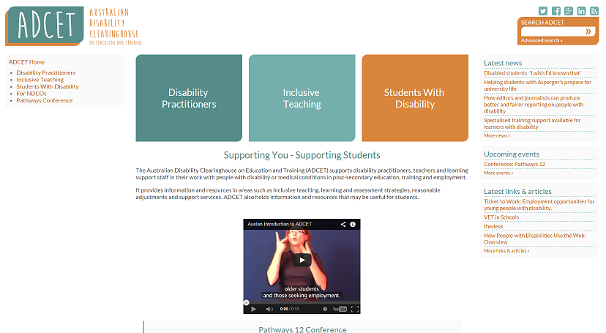
Our new look- Launched 3rd December 2014
Notes:
Disability Practitioner
Your role
Reasonable Adjustments
Universal Design
Inherent Course design
Information and technology
Legislation/guidelines
Disability information
Student Lifecycle
Campus Life
Inclusive Teaching
Understanding Disability
Specific Disabilities
Working with Students
Teaching and assessment
Policy and Assessment
Policy and Administration
Technology & Facilities
Students with Disability
Planning for Post Secondary Education
Entry Pathways
State and Territory information
Disability and Discrimination
Support needs
Resources
Disclosure
Employment-what next
Studetn acc & services

Slide 10
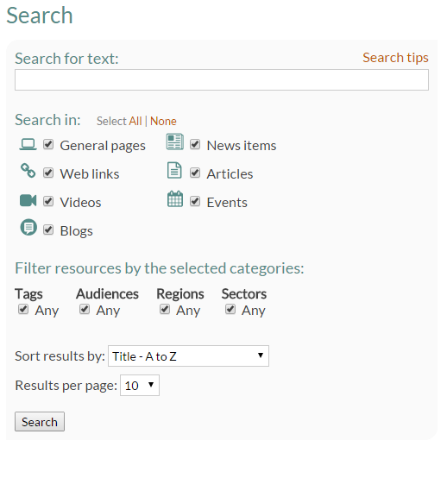
New and improved search capabilities
Notes:
Search tips
If you enter two or more words in the search field, the search results will include matches for any of those words.
To optimise the search results, you can use the following operators in the search field:
Surround a phrase with double quotes (" ") to search for the whole phrase.
Prefix a word with + if all search results must include the word.
Prefix a word with - if the search results must not include the word.
Examples:
one two
Search for either one or two.
"one two"
Search for the whole phrase "one two" rather than the inidividual words one or two.
+one two
All search results must include one, and will rank higher if they also contain two.
+one -two
All search results must include one, but none will include two.

Slide 11
Using the search engine
http://www.adcet.edu.au/search/

Slide 12







Events
Icons that are used throughout the website that depict the resource type
Blogs
Video
Articles
General pages
News item
Web links

Slide 13
Three key areas
http://www.adcet.edu.au/disability-practitioner/
http://www.adcet.edu.au/inclusive-teaching/
http://www.adcet.edu.au/students-with-disability/

Slide 14
What's next
Disability Practitioner in residence
Continue to update key resources
Development of new content from aust-ed discussions
Ongoing funding

Slide 15
Get involved
Send newly developed resources, policies and guidelines to ADCET
Register to receive our newsletter
Follow us on social media
Became a blogger
Join aust-ed

Slide 16
Thank you and any questions?

