Slide 1
Associate Professor Kelly Linden
Dr Sarah Teakel
2025 ACSES Equity Fellowship
Supporting part-time students with disability to succeed at university

Slide 2
Part-time study
Traditional university students study full-time and as such, university processes, support and government funding are skewed towards supporting full-time students (Malm & Weber, 2017).
From 2019 to 2022, part-time students were more than twice as likely to drop out of university as full-time students (O'Kane et al., 2024).
UDL is a pedagogical framework that aims to create flexible, inclusive learning environments that accommodate the diversity of modern students (King-Sears et al., 2023; Rogers-Shaw et al., 2018).
It was initially developed to support students with disability but has since been demonstrated to benefit all students.

Slide 3
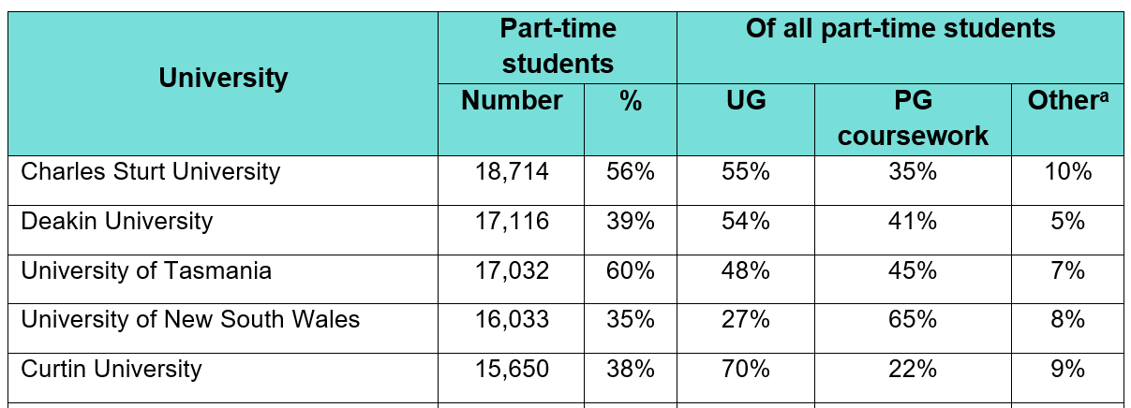
Part-time students in Australia
In 2024, 35% of domestic university students studied part-time (360,125 students)
*Other includes PhD, enabling and micro credentials
70%

Slide 4
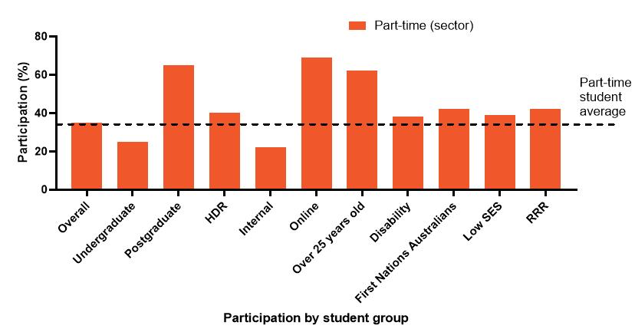
Part-time students in Australia: 2024 sector data
Students from equity cohorts study part-time at a higher rate than average

Slide 5
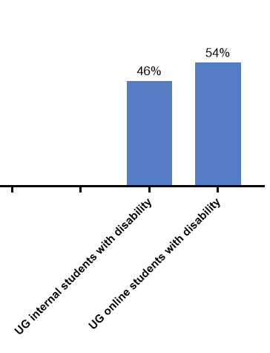
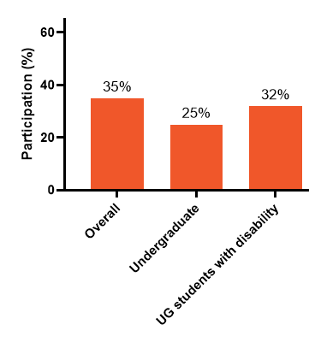
Part-time students in Australia: 2024 sector data

Slide 6
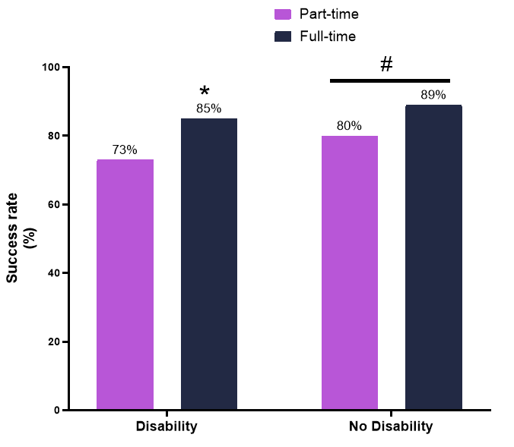
Part-time students in Australia: 4 universities
*, p<0.001 compared to students with disability. #, p<0.001 compared to part-time.

Slide 7
Part-time students in Australia: 4 universities
When adjusting for other factors, studying part-time one of the biggest risk factors for success and retention. Percentages show adjusted odds ratio.
Undergraduate on-campus
Undergraduate online
Postgraduate
Passing
Part-time (49%)
First Nations (60%)
Disability (61%)
Passing
First Nations (57%)
Disability (59%)
Part-time (77%)
Passing
First Nations (50%)
Disability (51%)
Online (61%)
Part-time (70%)

Slide 8
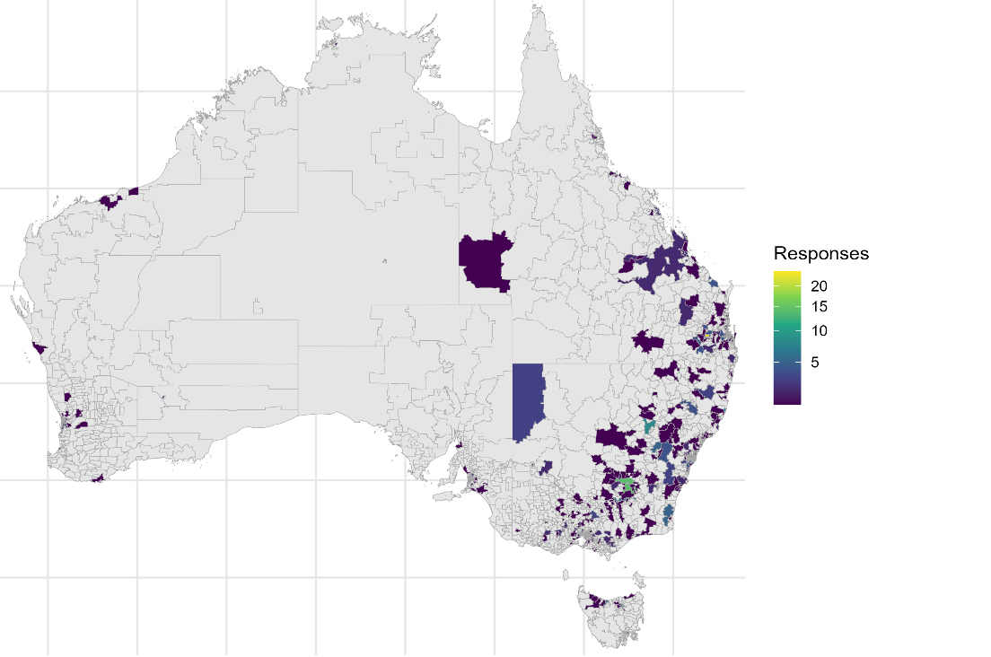
Survey and interview responses
965 part-time students from 35 Australian universities completed the survey, with 80 follow-up interviews from 28 Australian universities from all states and territories

Slide 9

Menti poll: What is the main reason that students with disability study part-time?
Menti poll: What is the main reason that students with disability study part-time?
The need to work
Caring responsibilities
Unavailability of subjects
Not living near campus
Disability
Too busy/other time commitments
Financial reasons
Studying out of interest
Studying for a career change
Easing into study
Other

Slide 10
Survey Findings: Demographics
Demographics, Work and Caring Commitments of Part-time Students
Demographic | % of Survey Responses
Disability, condition or illness that impacts studies: No Yes, and I am registered with my university Yes, and I am not registered with my university | 52% 34% 14%
Average age | 34 years old
Average weekly hours of paid employment | 23 hours
Personal caring responsibilities | 43%

Slide 11
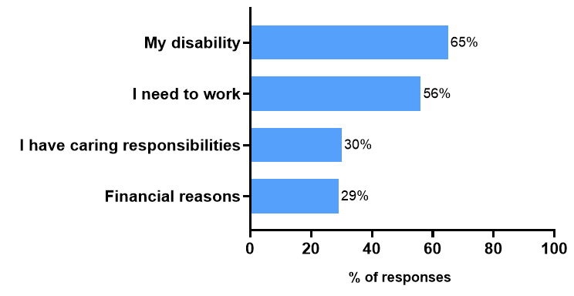
Survey findings: ‘What influenced your decision to study part-time?’
N=383 students with disability

Slide 12
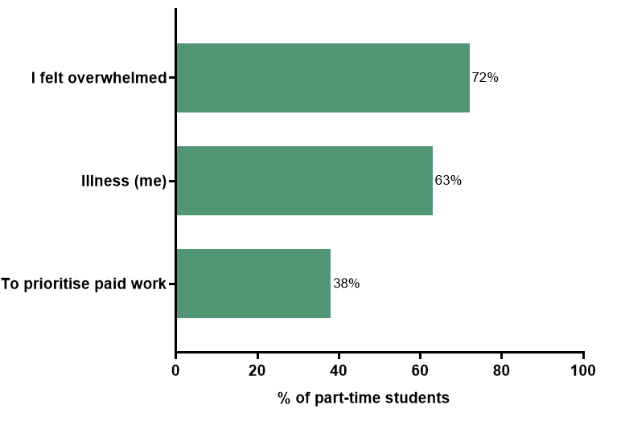
Survey findings: ‘How did failing grades make you feel?’
How did receiving failing grades make you feel?
disappointed in myself
I felt dejected as there was no support afterwards, or opportunity to explain why I failed or opportunity to retake assignment/exam.
Like a failure. It simply did not reflect me as a student. It reflected my life at the time.
Not good at all, very disheartened. Due to a disability and mental health struggles I had to prioritise other subjects, letting the ones that I failed fall to the wayside as I couldn't manage to fully commit to all my subjects. But I wish I could.
Pathetic and worthless, incapable
They made me feel a bit helpless, and it took a toll on my self-confidence.
N=32 students with disability

Slide 13
Challenges: Allocating time to study
“Allocating energy to study, even when the time is available.”
“When coursework is staggered and I cannot juggle with existing commitments”
“Complete absence of consideration of anyone over the age of 25 and is juggling other commitments. Lots of young people are busy too and need to study part time, but uni structures are weighted towards young people and don't cater for people with more life/work experience, more complex life outside uni etc.”
“Being a mum of 4 with medical/additional needs children, I am concerned I won’t be able to complete my degree in 10 years.”
“Find classes that fit in around other commitments eg: school drop off/pick-ups, after school activities, regular medical appointments.”

Slide 14
Challenges: Work Commitments
“Balancing study with a full-time role (career rather than just a job), while still maintaining a healthy life is challenging.”
“Being torn between work and study often”

Slide 15
Challenges: Difficulty connecting with other students
“Not feeling a part of the on-campus culture; missing out on campus events and activities”
“Solely online study can sometime feel a bit isolation from the university and not as acknowledged as on campus students”

Slide 16
Challenges: Poorly delivered subjects
“If a subject is presented poorly it makes it much more difficult. Studying online is hard, poor study material makes it harder.”
“Sometimes feel 'less of a student' compared to on-campus - recordings finish earlier than the lecture, not always available in a timely fashion.”
“Students would ask less simple questions if teachers provided more clear information more often without too much assumed knowledge, when I make time to study I need it to be productive, not time wasted trying to get answers to simple questions, some teachers seem to not help with simple things with anticipated or timely help because they think post-grad students should struggle to avoid making it too easy.”
“Subjects having informal pre-requisites building off a subject I haven’t done.”

Slide 17
Challenges associated with disability
“How my disability is affecting me day to day, as my symptoms fluctuate”
“I appreciate when teaching staff email me at the beginning of a teaching period to say that they have received my [access plan].”
“The Inclusion and Disability Unit has been life-changing for me. The officer who attended to me, she immediately understood my situation without me sharing too much details. She did not doubt me or question me, because she could read the medical reports, doctor's discernments, and me. We need intelligent people like her.”
“I really think the disability plan has been instrumental in helping me pass my courses or give me some confidence that I have extra breathing room time as someone who has struggled a lot with mental illness combined with a full time academic load and then feeling bad that I burned out.”

Slide 18
Menti poll: What can the students’ comments tell us that the demographic data alone cannot?

Slide 19
What are the key elements of unit design to support success of part-time students with disability?

Slide 20
Survey findings
% Agree
Survey findings
Well-spaced out assessments | 96%
Consistent unit site layout | 91%
Having the learning content available early | 90%
Clear distinctions between key and additional content | 89%
Flexible assessment due dates/ simple extensions * | 87%
A weekly announcement clearly stating what needs to be completed in the next week | 85%
A variety of ways to interact with the learning content * (such as tutorials, videos, podcasts, online activities) | 85%
Recorded lectures * | 83%
University support (such as academic writing, referencing or numeracy support) | 72%
Variety of assessment types (such as quizzes, essays, oral presentations) | 71%
* significant p<0.05

Slide 21
Creating predictable learning environments
1. Consistent LMS layout (91% agree)
  “Course formats are consistent, so once familiar, you don't have to re learn for each unit”
2. Having the learning content available early (90% agree)
  “Having all content available at the start of the semester is extremely important for disabled students whose energy levels fluctuate”
  “Give it to me early. I needed to see what hill I am climbing. I need to know how to pace myself because I’ve got other responsibilities. How am I going to pace myself?”

Slide 22
Creating predictable learning environments
3. Key distinctions between key and additional information (89% agree)
  “A clear understanding of the expectations required by lecturers and of assessments without complex words or complicated expectations”
  "what content is key/supposed to be known and what is extra information"
4. Minimise unnecessary changes to teaching and assessment timelines

Slide 23
Embedding flexibility
1. Flexible and simple extensions (87% agree)
  Extensions provide “flexibility with assessment due dates due to caring responsibilities and disabilities”
2. Recorded lectures (83% agree)
  "Remove requirements to attend classes in person where it is clearly not required(lectures, tutorials)… Ensure lectures and tutorials are recorded."
  "Well set out is not rigid class structure, you have the option to watch it later recorded, and you don't get penalised for not being online while the lectures live."
3. A variety of ways to interact with the learning content (85% agree)
4. Variety of assessment types (such as quizzes, essays, oral presentations)
(71% agree)

Slide 24
Embedding flexibility
5. Does it need to be compulsory?
  "I feel compulsory intensive schools are highly discriminatory, as they adversely impact people with caring responsibilities (usually women), those living under the poverty line and people living with disabilities. All of which already cause significant additional barriers to study."
  “Making them only compulsory when they are actually needed"
6. Access to teaching staff, support and information

Slide 25
Clear communication practices
1. A weekly announcement (85% agree)
  "provide announcements on a rundown of what’s is happening in the week"
2. More clarity should be provided at admission regarding compulsory activities
  “as long as the dates are known well in advance to give appropriate time to arrange child-care and work cover”
3. Clear information early on timetabling of classes
  "longer notice on any timetable changes to be able to notify a workplace, and more consistent timetable (not different class times each week) so that work hours can stay the same"

Slide 26
Supporting success
1. Well spaced out assessments (96% agree)
  “It would allow me to do more work when I have the time available instead of falling behind for a couple weeks until I have the time to catch up”
2. Engaging and understanding lecturers
  “Excellent lecturers who are experts in their subjects - who inspire me to keep going and keep me interested and challenged”
3. Student wellbeing & belonging
  “The Inclusion and Disability Unit has been life-changing for me. The officer who attended to me, she immediately understood my situation without me sharing too much details. She did not doubt me or question me... We need intelligent people like her.”
"Really isolating... friendships within class are hard, most people are full time so you are less likely to be in the same class, and they finish years before you do"

Slide 27
Menti poll: What could we do to help students right now?

Slide 28
Recommendations
Accessibility Plans automatically sent to academics
Automatic extensions as part of Accessibility Plans

Slide 29
Recommendations
Quality learning and teaching.
Student load policy.
Equity in work-integrated learning (WIL) placements.
Minimising compulsory activities.
Access to no-questions-asked extensions.
Equitable access to scholarships.
Promotion of success.
Part-time study patterns.
Shared campus facilities.
Public transport discounts.
Access to government financial support.
Tax-free scholarships.

Slide 30

For more information contact Kelly:
klinden@csu.edu.au or Linkedin @Kelly Linden

