Slide 1

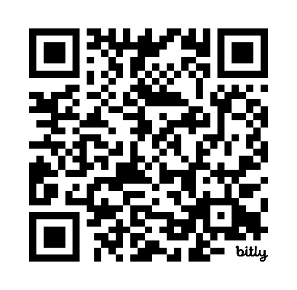
UDL in Higher Education
Campus Implementation Criteria Roadmap
ADCET Webinar
Date: 10/1/2026
Homebase document: https://bit.ly/UDL-CIC

Slide 2
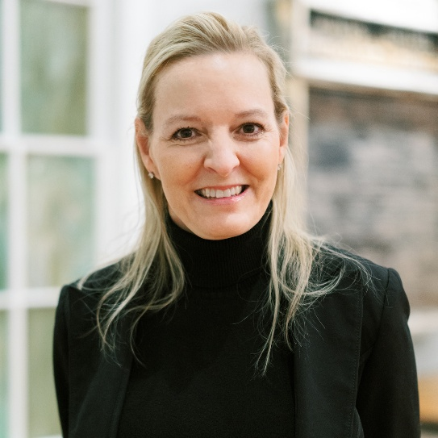
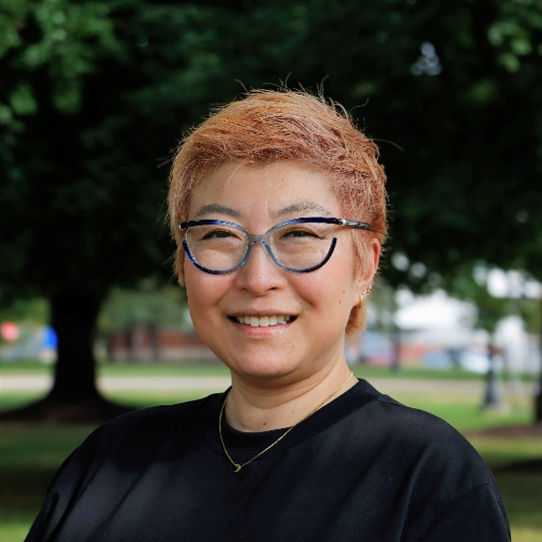
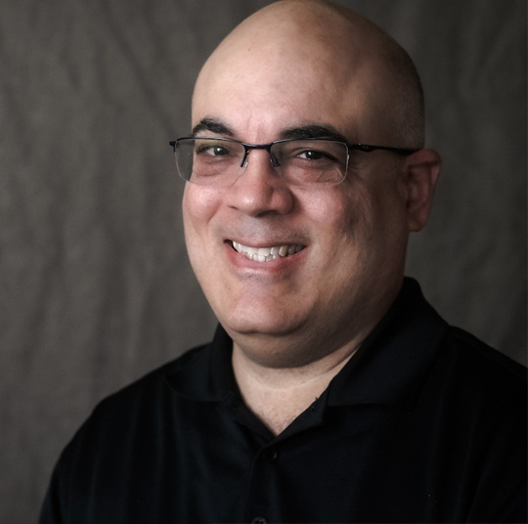
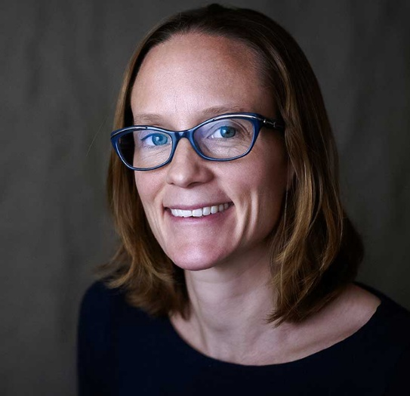
CAST Facilitators
Anne Ristow
Chair/Editor
Natsuko Takemae
Chair/Editor
Luis Pérez
Senior Director of Disability and Accessibility
Sam Johnston
Chief Postsecondary Workforce Development Officer

Slide 3
Layer 1
Four Domains

Slide 4

UDL Across Campus
Four Domains
Culture and Environment
Teaching and Learning
Leadership and Management
Professional Learning

Slide 5

Culture and Environment
Shared values, policies, and practices that advance access and belonging.

Slide 6
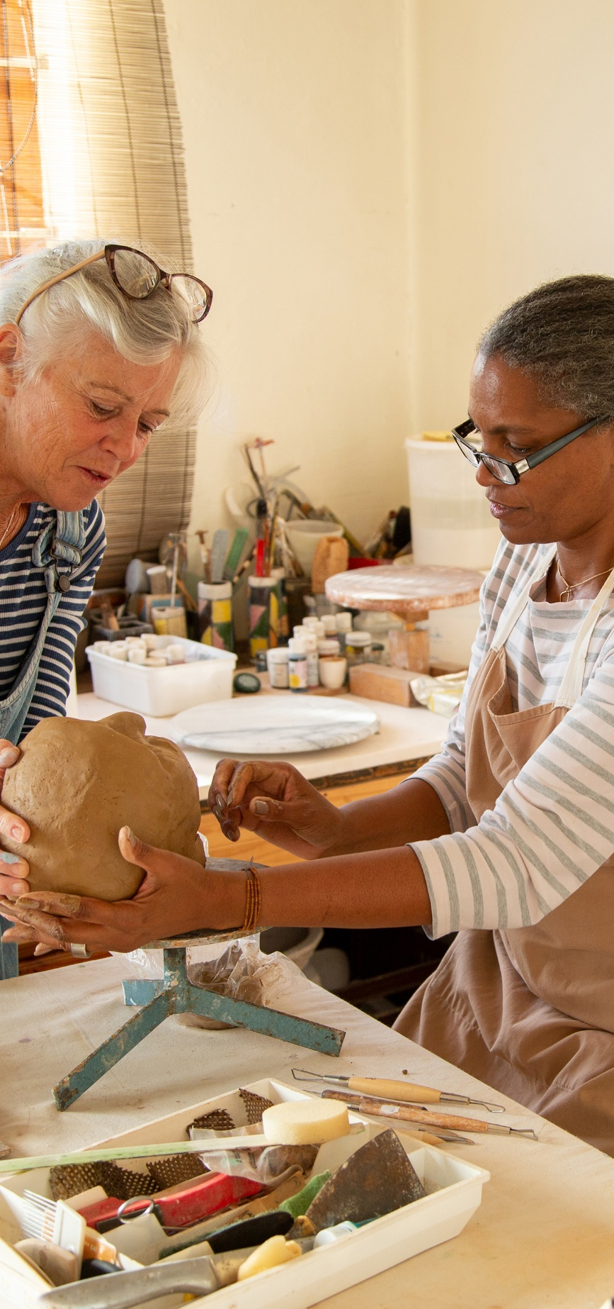
Teaching and Learning
Inclusive, flexible teaching and learning experiences for everyone.

Slide 7

Leadership and Management
Structures, resources, and decision-making that enable UDL across campus

Slide 8

Professional Learning
Ongoing learning and development to build UDL knowledge and practices at all levels.

Slide 9
Layer 2
From Domains to Action

Slide 10
From Domains to Action
Each domain includes specific elements and indicators to guide meaningful, measurable progress.
Shared framework
Multiple entry points
Stronger and more inclusive campus

Slide 11
Elements and Indicators
Each domain includes specific elements and indicators to guide meaningful, measurable progress.

Slide 12
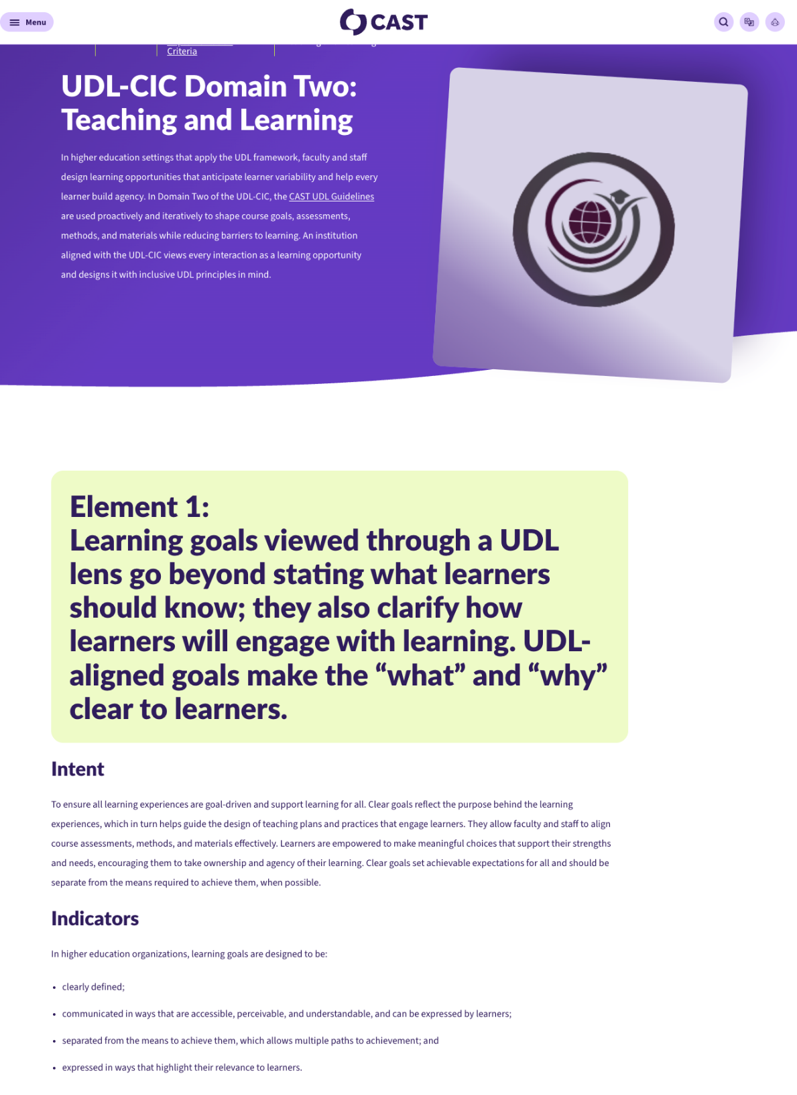
UDL-CIC Domain Two: Teaching and Learning
A link to the online version

Slide 13
Layer 3
Continuum of Practice

Slide 14
Continuum of Practices
Different starting points. Progress builds possibility.
Level 1: Explore
Level 2: Implement
Level 3: Scale up
Level 4: Systems and Culture Change

Slide 15
Level 1: Explore
Build awareness and readiness
  Beginning to learn about UDL
  Identify needs and assets
  Early phase of implementation across spaces
  Support teams begin to assist faculty and staff

Slide 16
Example for Level 1: Explore
"We are building awareness of UDL and exploring how it connects to our teaching and learning goals"
Campus dialogues
Needs and asset mapping
Initial learning opportunities

Slide 17
Level 2: Implement
Initiate and Support
  Collect data to monitor learner progress and spaces
  Make adjustments guided by ongoing learner feedback and data analysis
  Monitors UDL-aligned support plan for faculty and staff

Slide 18
Example for Level 2: Implement
"We are piloting UDL strategies in courses and programs and building faculty confidence."
Professional learning
Course design support
Early evidence of impact

Slide 19
Level 3: Scale up
Broaden implementation
  Frequently share data analyses on learner progress and learning environment
  Use data to inform decisions and increase coherence across systems

Slide 20
Example for Level 3: Scale up
"We are expanding UDL across departments and institutional priorities"
Shared tools and resources
Cross-campus collaboration
Data-informed decision-making

Slide 21
Level 4: Systems and Cultural Change
Sustain and Evolve
  UDL is embedded in structures, policies, and culture, leading to sustained, equitable impact across the institution
  Systematic use of data to iterate and improve support plans for faculty and staff

Slide 22
Example for Level 4: Systems & Culture
"UDL is part of how we design, deliver, and evaluate teaching and learning across the institution"
Embedded in policy and practices
Ongoing data use and reflection
Sustained support structure

Slide 23
Fireside Chat
The Journey Behind the Roadmap

Slide 24
Conversation Prompts
What problems were we trying to solve?
What surprised us along the way?
Where do institutions tend to get stuck?
What does meaningful progress look like?
What advice would you give to institutions starting out?

Slide 25
From Insight to Impact
Putting the Roadmap to Work

Slide 26
Putting the Roadmap to Work
Choose a domain
Examine possible evidence
Locate a possible level
Identify a next action
Engage others

Slide 27
Your Questions, Our conversation
Let’s explore your ideas and next steps

Slide 28
Audience Q&A
Getting Started
Leadership & Alignment
Faculty Engagement
Evidence & Data
Different Contexts

Slide 29
Keep the Momentum Going
Explore
Visit CIC
Apply
Identify next step
Go Deeper
Micro-course
Stay connected
Join community

Slide 30
We can’t wait to hear from you!
Implementation stories, Mini-Course, and more

Slide 31


Contact us
Anne Ristow: AnneMarie316@iCloud.com
Natsuko Takemae: NatsukoTakemae@iCloud.com
Luis Pérez: LPerez@cast.org
Sam Johnston: SJohnston@cast.org

