Slide 1

Addressing hidden curriculum in higher education music:
a UDL approach to accessible music industry pathways
Monique Boggia - Academic Course Manager, Bachelor of Music Industry - Box Hill Institute

Slide 2
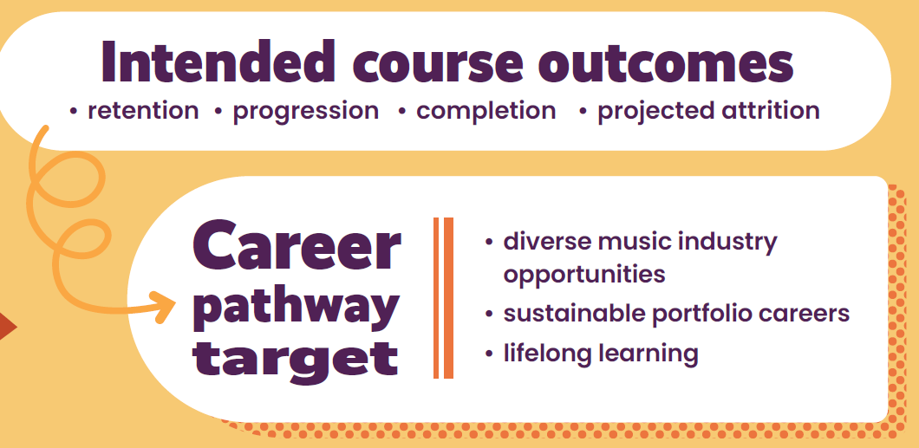
Bachelor of Music Industry

Slide 3
Bachelor of Music Industry

Slide 4
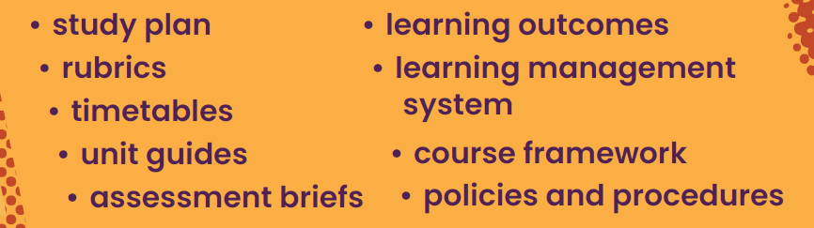
Bachelor of Music Industry

Slide 5
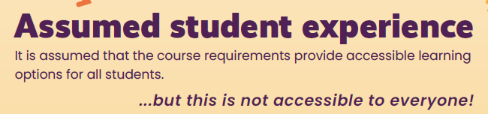
Bachelor of Music Industry
Based on….

Slide 6

Bachelor of Music Industry
Based on….

Slide 7
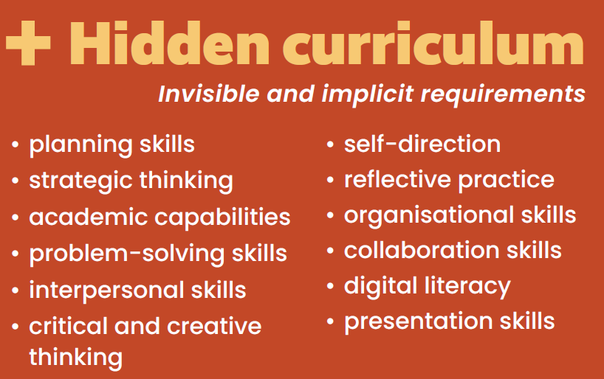
Bachelor of Music Industry

Slide 8

Bachelor of Music Industry

Slide 9

Hidden Curriculum
These hidden expectations create barriers for students with executive function challenges and can result in
inequitable participation
Felt most sharply by students who are:
culturally diverse
neurodivergent
entering via non-traditional pathways

Slide 10
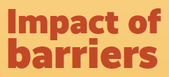


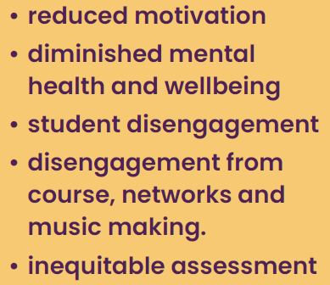
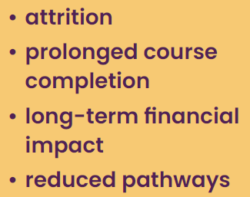
Impact of Barriers
Proposed evidence base: student feedback, progress and retention data, assessment review data, patterns in student support requests, course evaluation insight

Slide 11
Hidden Curriculum – Hidden Barriers

Slide 12

Reduce Barriers

Slide 13

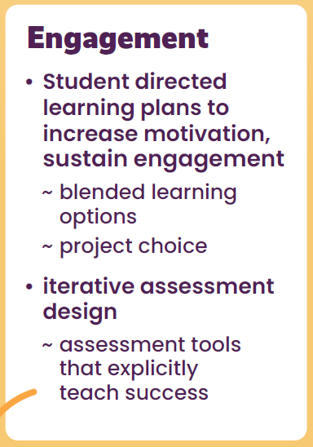
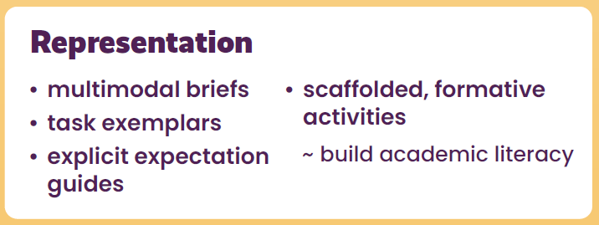
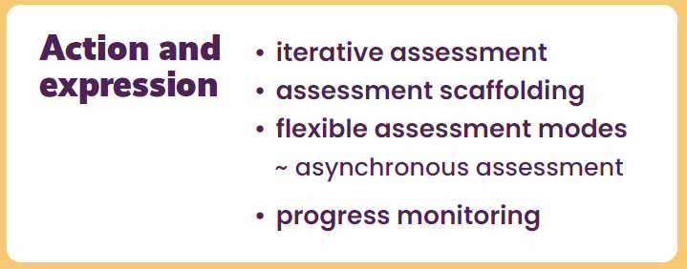
Centring Student Agency
Assessment tools that explicitly teach success | asynchronous assessment | building academic literacy

Slide 14


Where this could lead…
Embedding a UDL-informed course design that makes the implicit explicit could reduce barriers created by unnecessary executive function demands

Slide 15
Addressing hidden curriculum in higher education music:
a UDL approach to accessible music industry pathways
Monique Boggia - Academic Course Manager, Bachelor of Music Industry - Box Hill Institute

