Slide 1


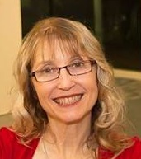

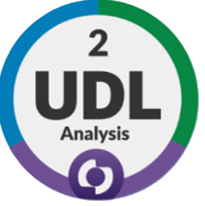

Increasing university learners’ engagement and retention by co-designing resources based on UDL principles.
Dr Christine Krol
C.Krol@westernsydney.edu.au

Slide 2
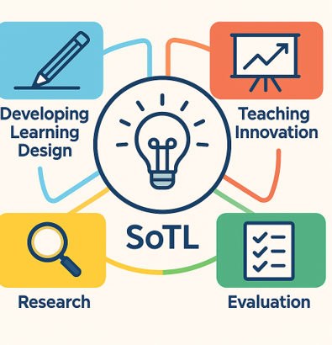
Content
This research was for my Foundations of University Teaching & Learning (FULT) Scholarship of Teaching & Learning (SoTL) project.
Universal Design for Learning (UDL)
Diverse cohort of learners
Research project aims and questions
Project activities
Findings and Evaluations
Future directions
Key takeaways
Image: Generated with Copilot

Slide 3
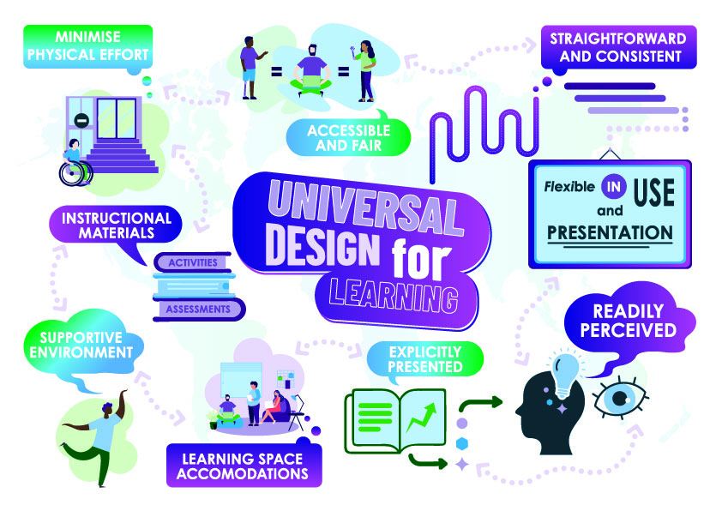
Universal Design for Learning (UDL)
The goal of UDL Guideline 3.0 is learner agency that is purposeful and reflective, resourceful and authentic, strategic and action orientated (CAST, 2024).
  Strategically, subjects can be transformative when they are intentionally designed to be inclusive, accessible, and flexible.
Image: Krol, 2026

Slide 4
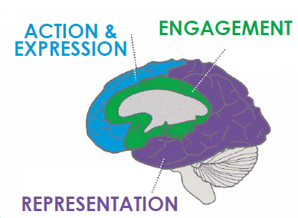
The “Who” of learning
CAST’s Guidelines 3.0 (2024) introduces the “Who” of learning which emphasises learner agency and identity as part of variability.
It emphasises the value of interdependence and collective learning.
The “Who” of learning is a dimension that intersects across all three UDL principles of: the “Why” with (Multiple Means of Engagement), the “What” with (Multiple Means of Representation), and the “How” with (Multiple Means of Action and Expression).
Image: Krol, 2026

Slide 5

Diverse cohort of learners
Australian university learners represent a highly diverse cohort, including those who are first in their family to attend university, mature‑age learners, First Nations peoples, individuals for whom English is an additional language, learners from low‑socio‑economic backgrounds, single parents, carers, and people with disability (DoE, 2024; Krol, 2019).
Many learners can have multiple intersecting identities, e.g., a learner with disability who is first in their family to undertake tertiary studies.
At times, these marginalised groups can struggle to develop their sense of belonging in higher education settings.
It can be costly for people with disability to obtain diagnosis documentation to obtain reasonable adjustment plans, these are affirmative or reactive strategies.
Image: Krol & Galeng, 2024

Slide 6
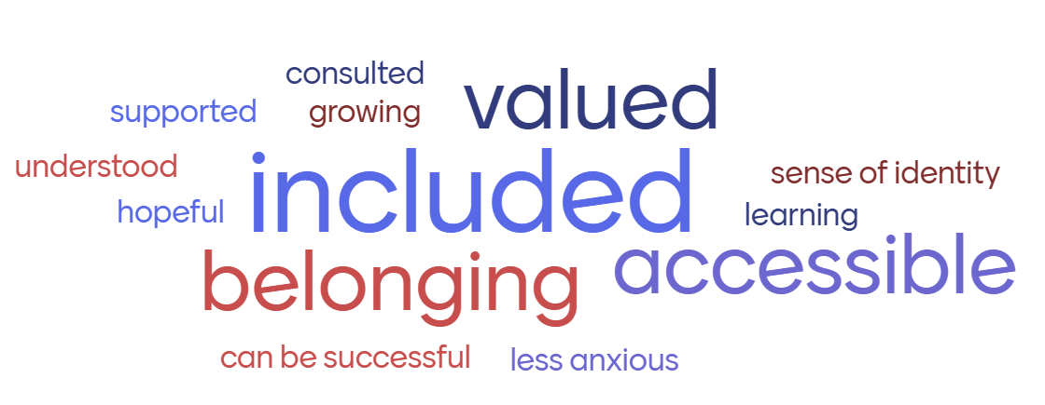
Research project aims and questions
The aims are to increase this diverse cohort of learners’ sense of belonging by co-designing accessible resources which are available to all and help to provide timely and meaningful assessment feedforward by asking:
1) How does applying UDL principles to assessment resources contribute to student retention and engagement?
2) How do these resources benefit the learners and the teaching team?
Image: Mentimeter (2024) Word Cloud created by learners at the end of Module 1 Workshop, 2025

Slide 7

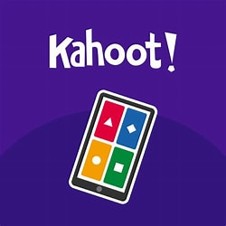



Project activities
Co-design supplementary assessment resources with insight from previous and current learners and teaching teams
Introduce Kahoot (2024) activities to bring fun into understanding the recommended readings
Incorporate Mentimeter (2024) activities towards the end of the workshops. Learners could have a voice anonymously and provide progressive feedback on the workshops
Qualtrics surveys for learners and academics towards the end of semester on the usefulness of the project activities
Encourage working independently, peer-to-peer and collaboratively in small groups
This Photo by Unknown Author is licensed under CC BY-SA

Slide 8
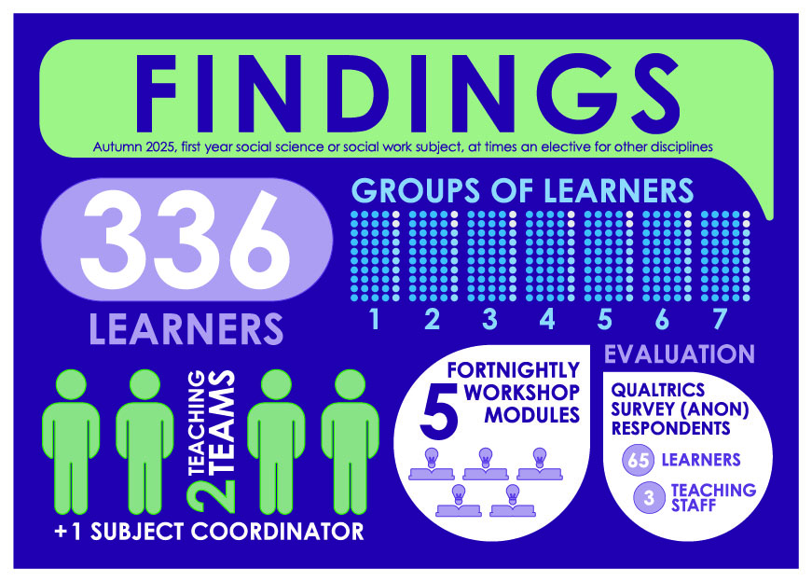
Findings
Participant demographics
Autumn 2025, first year social science or social work subject, at times an elective for other disciplines
336 learners
Teaching teams of 2:
4 sessional tutors with
1 subject coordinator (SC)
7 workshop groups of
48 learners
5 Workshop Modules:
on a fortnightly basis
Evaluation of supplementary assessment resources
Image: Krol, 2026
Feedback gathered via anonymous Qualtrics surveys.
Respondents: 65 learners, 3 teaching staff
Overall findings indicate mixed effectiveness

Slide 9
Learner feedback
Qualtrics survey: Participants needed to be in the final Module 5 workshops to access the survey
What were the most useful aspect(s) of the supplementary assessment resources?
“recapping the assessment questions, detailing what exactly is being asked of you”
“Extra information about answering the assessment questions + sentence starters, proper structure for assessments”
“Breaking down the assessment notice sheet [marking rubric] and providing layouts were the most useful as it reassured [me] that I was doing the assignment correctly”
“Referencing examples, recapping the assessment”
“The tutors. I wouldn’t have been able to do the assessments without them”
“Studiosity, and supplementary slides”
What were the least useful aspect(s) of the supplementary assessment resources?
“There was nothing that I couldn’t use, maybe the referencing as I already had somewhat of a [sic] understanding”
“Idk, I think they were all useful”
“talking about the assignments”
“Writing support”
“N/a”

Slide 10
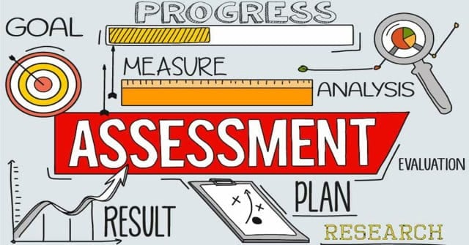
Teaching team feedback
Supplementary assessment resources
Positive:
  “Resources were comprehensive”
  “Great guides for staff and students”
Concern:
  Limited evidence learners revisited resources during task development
This Photo by Unknown Author is licensed under CC BY-SA-NC

Slide 11
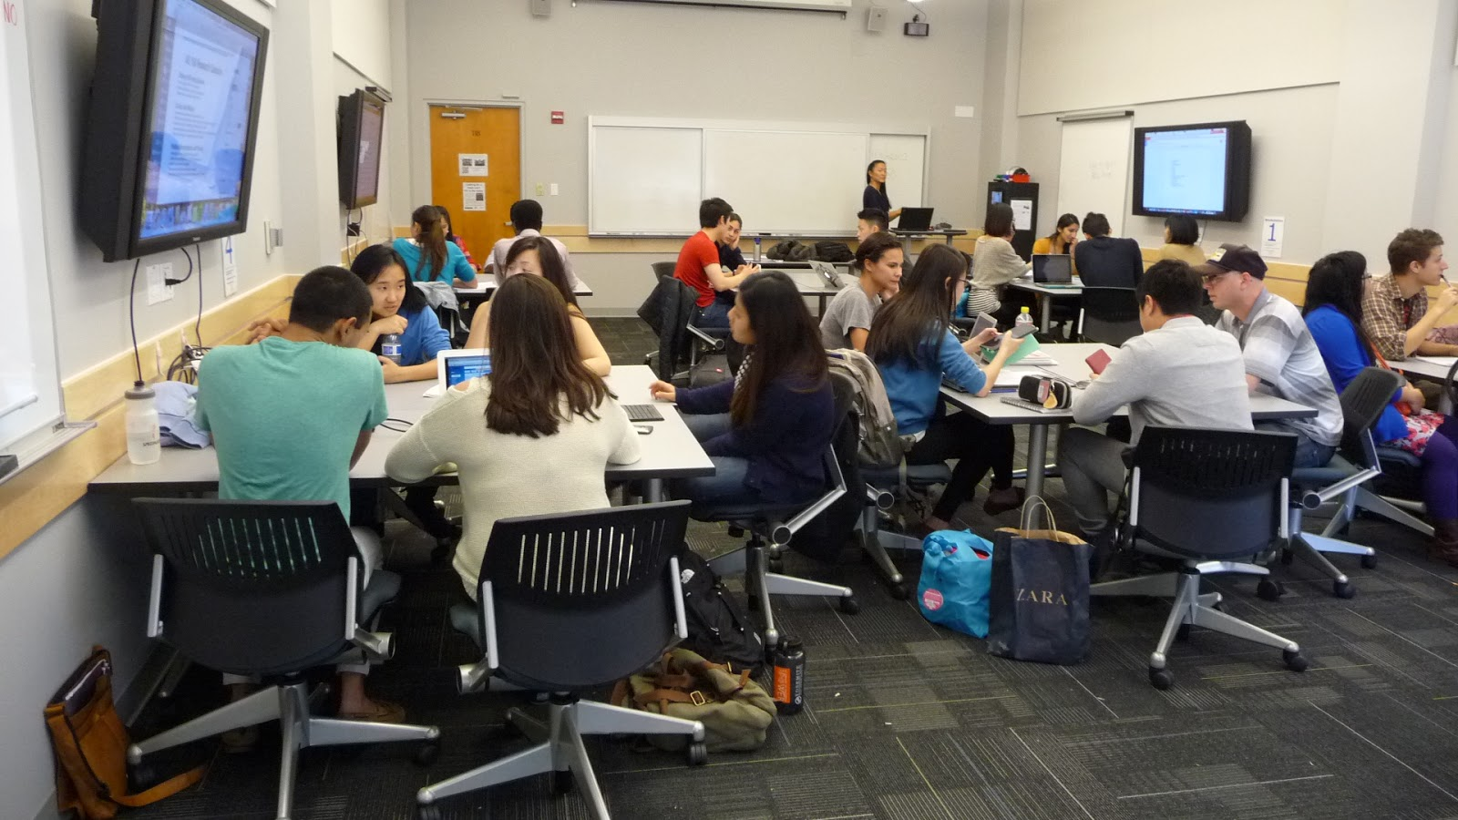
Engagement strategies feedback
Kahoot and Mentimeter activities were well received
“The group work and kahoots [sic] benefit my understanding the most” (learner)
Increased participation and sense of belonging observed
However, limited impact on sustained attendance (2025)
This Photo by Unknown Author is licensed under CC BY-NC

Slide 12

Future directions
Strengthening learner agency (in WELF2002)
Applying more UDL principles:
  Multiple means of engagement
  Representation
  Action and expression
Adding another UDL “+1” strategy (Tobin, 2023)
Image: PowerPoint Stock

Slide 13

Key takeaways
Workshops enhance engagement but not consistently sustained
Resource design and delivery require refinement
Focus for Autumn 2027:
  Improve accessibility and motivation to engage in learning independently
  Working towards co-designing assessment tasks with learners and the teaching team
This Photo by Unknown Author is licensed under CC BY

Slide 14

Thank you for engaging with my FULT project presentation

Slide 15
References
Advance HE. (2023). Professional Standards Framework for teaching and supporting learning in higher education 2023.
https://advance-he.ac.uk/knowledge-hub/professional-standards-framework-teaching-and-supporting-learning-higher-education-0
Centre for Applied Special Technology (CAST). (2024). Universal design for learning (UDL) guidelines 3.0. CAST. Retrieved 27th August from
https://udlguidelines.cast.org/
Department of Education (DoE). (2024). Australian Universities Accord summary of the final report.
https://www.education.gov.au/australian-universities-accord/resources/australian-universities-accord-final-report-summary-report
Kahoot. (2024). About us. Kahoot. Retrieved 6th December from https://kahoot.com/schools/higher-ed/edu/
Krol, C. (2019). A human rights and social justice perspective of disability and participation in higher education [Western Sydney University].
Penrith, NSW.
Krol, C. (2026, 25th June). Increasing university learners’ engagement and retention by co-designing resources based on UDL principles
learners’ engagement and retention by co-designing resources based on UDL principles. [Poster Presentation]. ADCET UDL Symposium,
Hobart. Tas
Mentimeter. (2024). Accessibility statement. Mentimeter. Retrieved 6th December from https://www.mentimeter.com/accessibility
Tobin, T. J. (2023, 20th September). Reach everyone and teach everyone with universal design for learning. ADCET Universal design for learning
(UDL) online symposium 7th September. Retrieved 21st October from https://youtube link to watch Thomas Tobin Plus One

