Slide 1
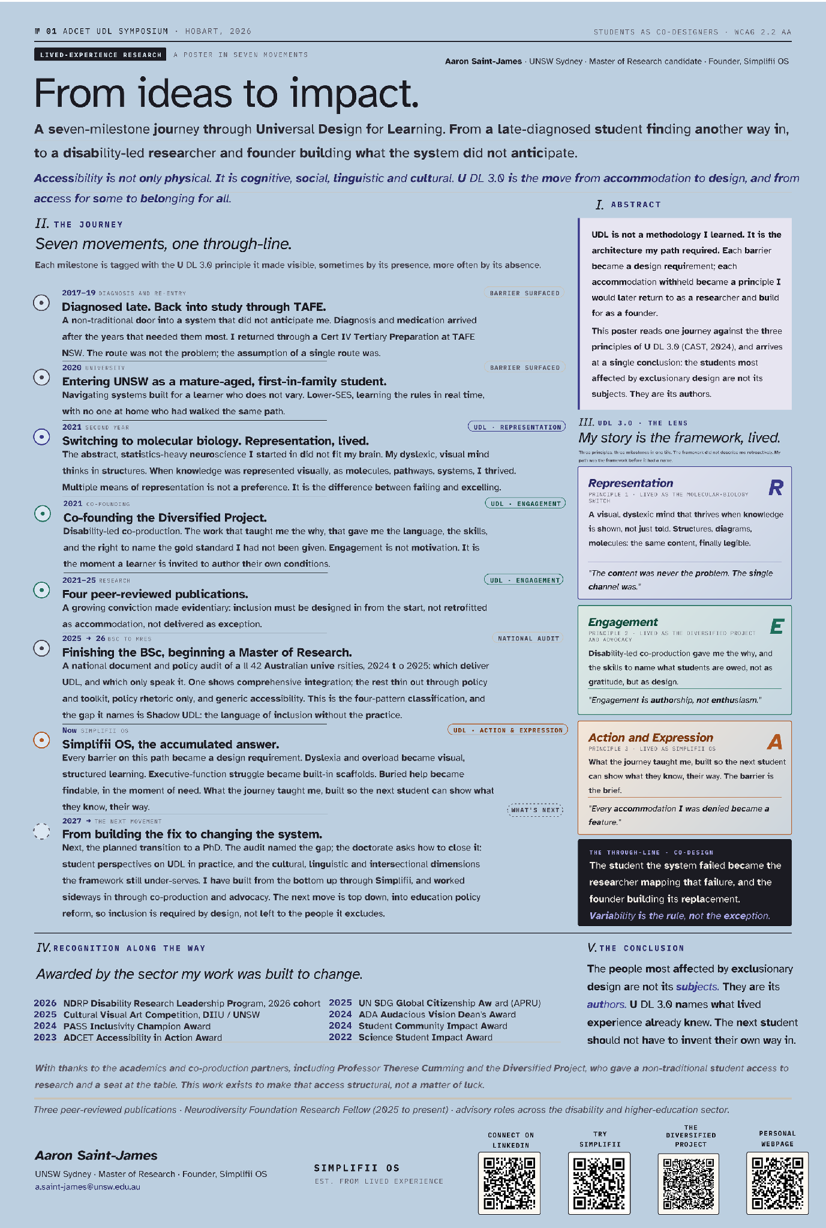
From ideas to impact
A lived-experience journey from
student to UDL researcher and founder
Aaron Saint-James (he/him)
Lived experience researcher
Master of Research candidate, School of Education,
UNSW Sydney
Founder, Simplifii
ADCET Show Me Your Poster. 17 September 2026

Slide 2
Seven movements, one through-line
It is not a CV.
It is one student life, read against Universal Design for Learning.
Poster, whole view

Slide 3
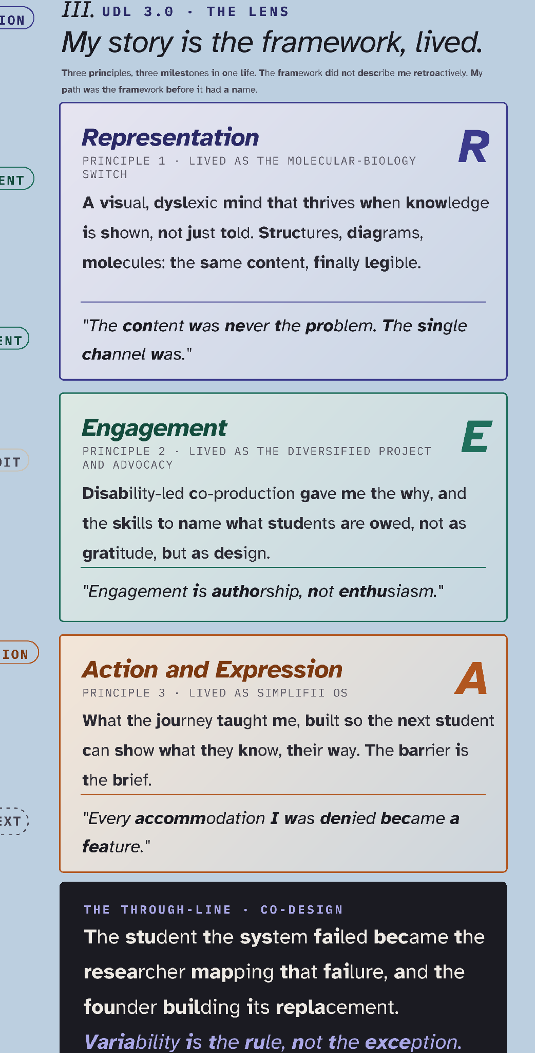
The move: my life, read against the framework
Most UDL work takes the framework and applies it to a classroom.
I took my life and read it against the framework.
Every principle was a moment I had already lived, years before I knew the name for it.
Poster, section III. Right-hand column

Slide 4
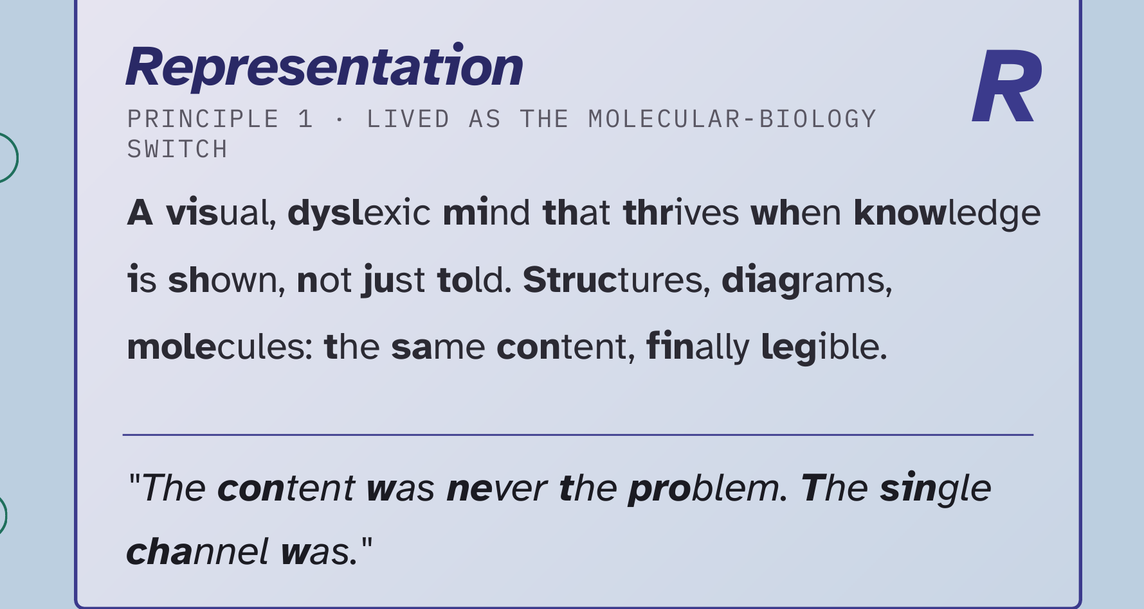
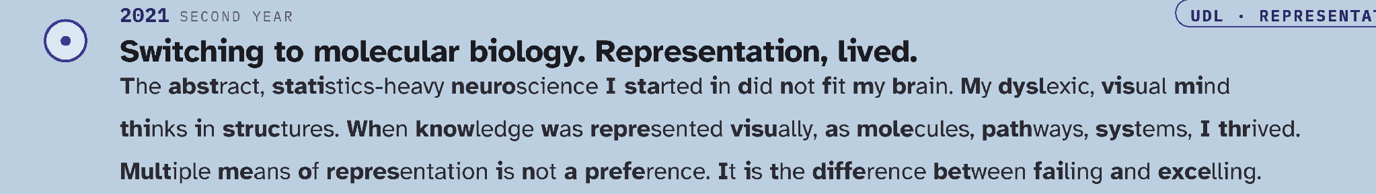
Representation, lived
Molecules are pictures.
Same content as the course I was failing. Finally legible.
Poster, section III card 1 and movement 3

Slide 5
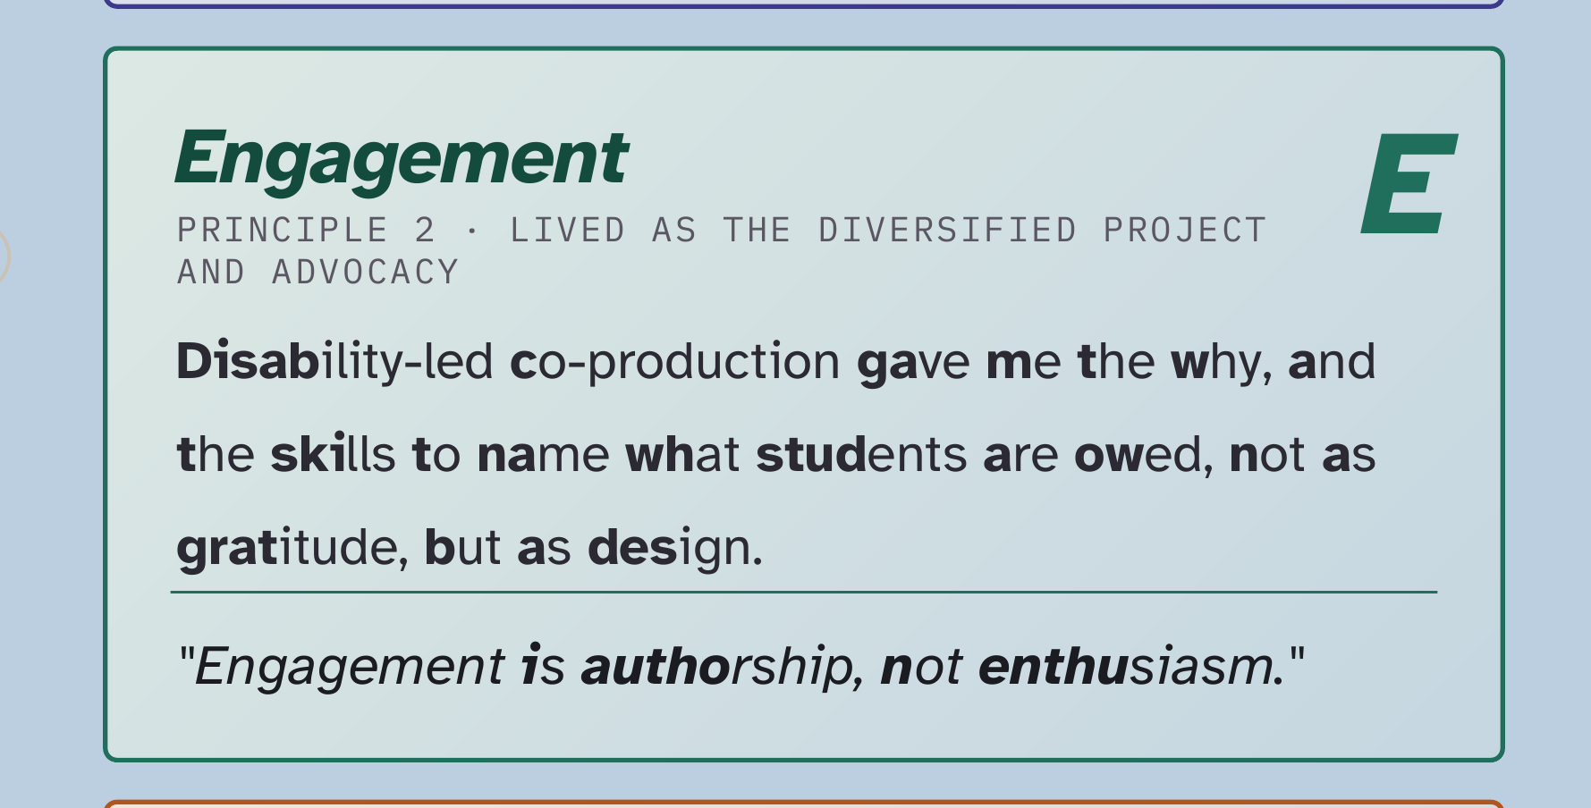
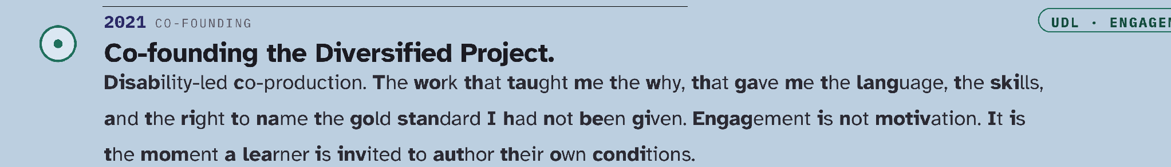
Engagement, lived
Engagement is authorship.
Being handed the pen.
Poster, section III card 2 and movement 4

Slide 6
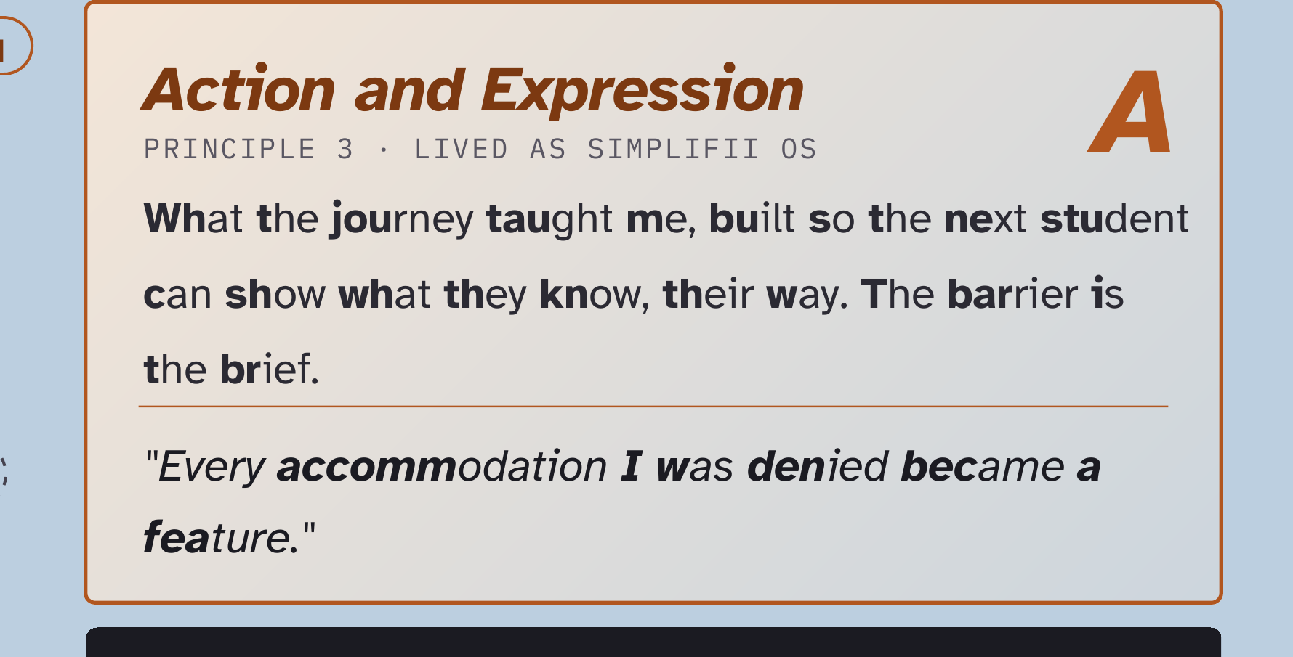
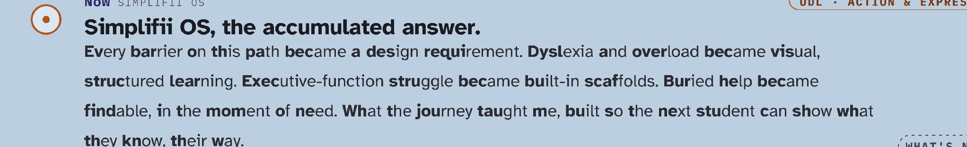
Action and Expression, lived
Every accommodation I was denied became a feature.
Poster, section III card 3 and movement 7

Slide 7
The gap nobody audits
Academics are not students.
Disability practitioners are not students.
Learning designers are not students.
STAFF SEE
Design intent
The course they built.
STUDENTS SEE
Design consequence
What happened when they tried to use it.
Off the poster. The argument

Slide 8
We are auditing the promise and calling it the practice
When the sector measures UDL adoption, what does it actually measure?
Policy documents. Staff surveys. Teaching plans.
All of it sits on the intent side of the line.
You cannot put yourself in the student’s shoes.
because the shoes are the position.
The only way to get the student view is to give the student the pen.
Off the poster. The argument

Slide 9
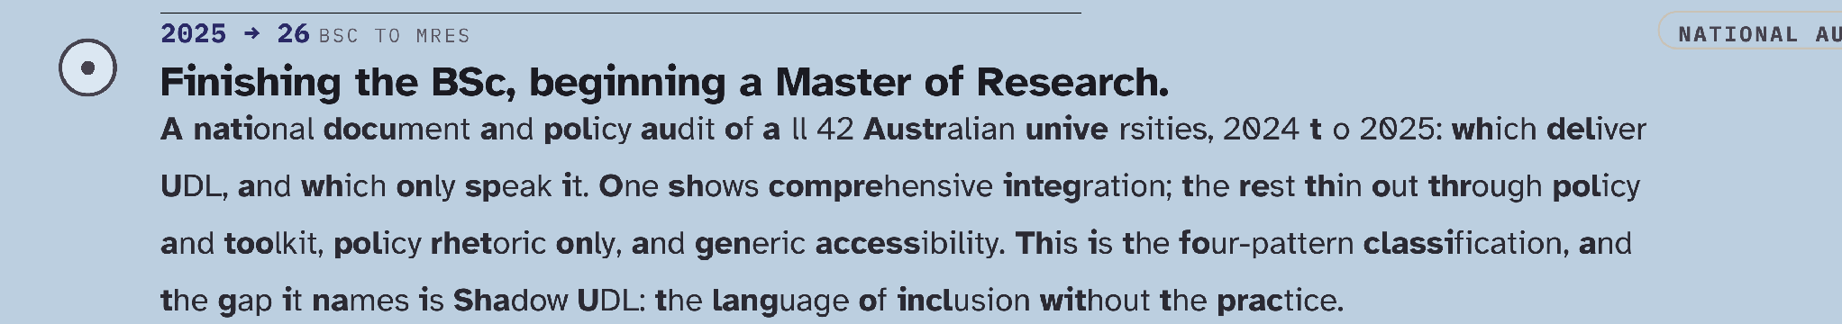
Shadow UDL
The shadow a policy casts when it is never delivered.
Inclusion on the website. UDL in the learning and teaching plan. Then you try to get the support, and it is not there.
First national audit of UDL 3.0
All 42 Australian universities
Fourteen document channels
A gap score. Five patterns of adoption.
Poster, movement 6

Slide 10
Three versions of the same promise
1
What the university promises
Policy, websites, plans. What a document audit can see.
A document audit can only see the promise.
The research is the distance between them.
2
What staff are resourced to deliver
Workload, training, tools. What a staff survey can see.
3
What a student actually experiences
Delivery. Only students can see this.
Off the poster. Research design

Slide 11
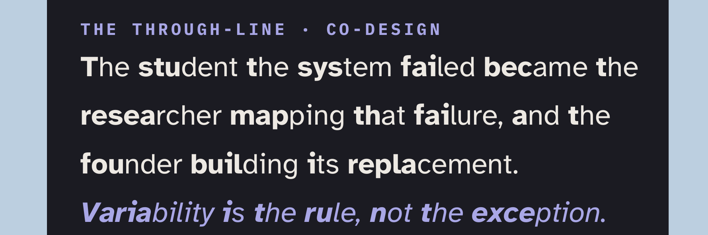
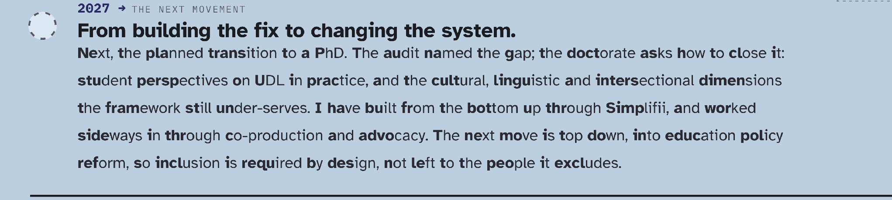
Students as the next UDL 3.0 leaders
You cannot find a margin from the centre.
The margin has to tell you where it is.
Not a focus group at the end. Not a satisfaction score.
Co-authors. In the room when the instrument is built. Names on the output.
Poster, through-line card and movement 8

Slide 12
Top-down keeps producing Shadow UDL
TOP-DOWN
Design for students
Well-meaning. The people who would notice the shadow are never in the room.
BOTTOM-UP
Design with students, led by students
I am one. I am asking you to make more.
If a student has already built a workaround for your course, that workaround is your design brief.
Off the poster. The practical version

Slide 13
The future is now: Simplifii
Today
Sits between the student and the assignment. Plain-language rubric. Draft checked against it before submission, not after the grade.
Built from
Every barrier on my path, turned into a design requirement.
Where it goes next
Layer three. Delivery data, from the student side, at scale, in the moment.
Poster, movement 7. Then the future

Slide 14
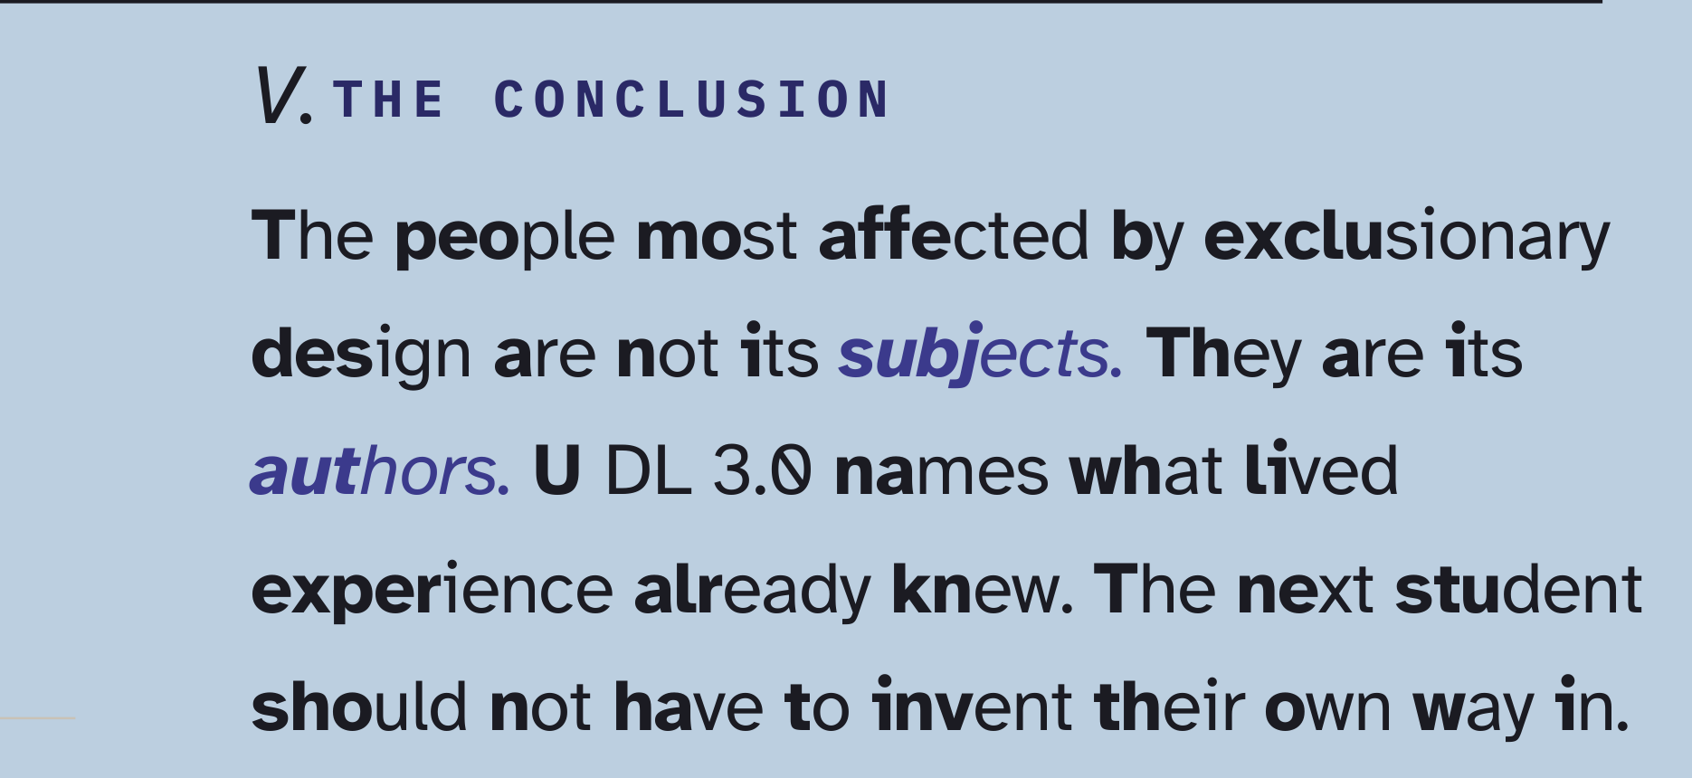
Three ways to work with me
1
Staff
The national survey and interviews are next. I need your side of the promise.
2
Students, or people who work with them
I want them in the room for the co-design phase.
The next student should not have to invent their own way in. Help me make sure they do not have to.
3
Want to see Simplifii
Or put it in front of your students. Come and find me.
Poster, section V. The asks

Slide 15
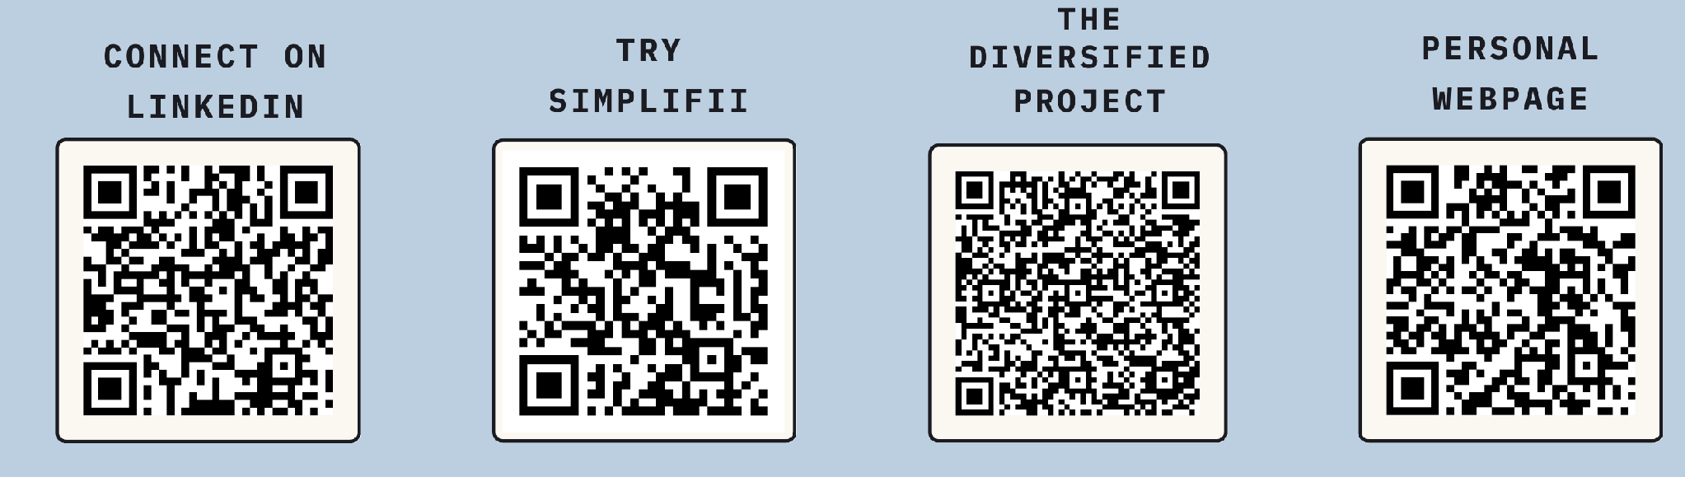
Come and find me
Aaron Saint-James
a.saint-james@unsw.edu.au
linkedin.com/in/aaron-saint-james-b577471a5
simplifii.com.au

