Slide 1


Genio

Slide 2

Genio’s journey towards UDL

Slide 3



Your note-orious host
Jim Sprialis
Australasian Account Manager

Slide 4

Agenda
Introduction
How Genio Notes enables learner agency for all
Demo of key features through a UDL lens
  including new mobile app
Deployment management
  New Admin Insights Dashboard
External evidence of educational impact
Q&A

Slide 5
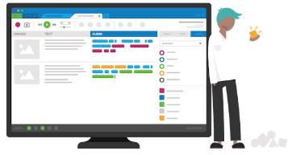




Our beginnings…
We expand into Higher Education institutions
We became Glean
Genio branded products
Audio Notetaker
2007
2012
2021
2025
2016
Pathways 13

Slide 6




Genio’s Learning Principles​
Heart - Confidence, agency and enjoyment build independent learners
Learning is social - we find inspiration and motivation through collaboration and community​
Mind - Learning is a metacognitive process​
Learning to learn can expand your possible - developing learning skills can help everyone become more effective and efficient learners​
Action - Learning happens through doing
The right tools can transform learning - technology can scaffold, accelerate and enhance learning but cannot learn for you

Slide 7

Genio Notes is now UDL certified
CAST have awarded Genio full UDL Product Certification.
Meets CAST’s Accessibility Baseline
Meets alignment to the UDL Framework

Slide 8
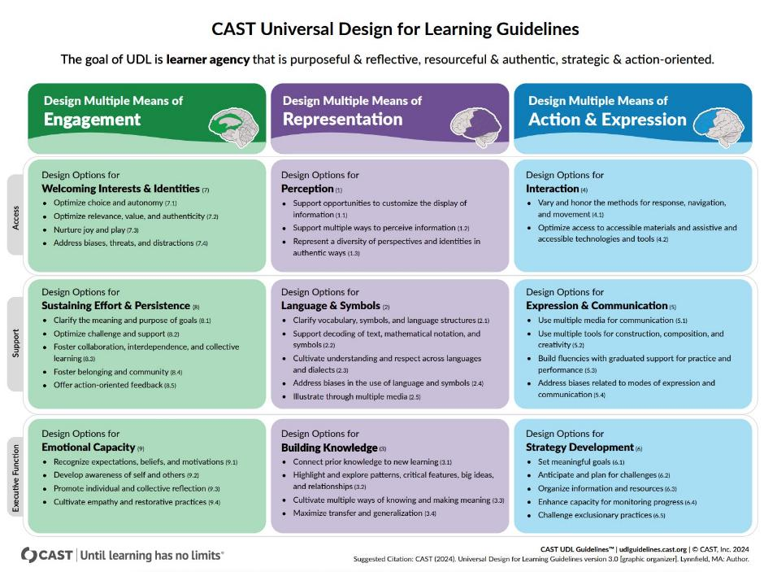
CAST Universal Design for Learning Guidelines

Slide 9


Key Genio Notes features through the UDL lens

Slide 10
The CORA Framework
01 // Capture
02 // Organise
03 // Refine
04 // Apply
Capture is about being able to:
seamlessly record information,
focus on class without missing any information.
Organise is giving learners the tools to manage their time and knowledge to learn effectively.
Refine is about revisiting information, developing understanding.
It’s part of that recursive learning process.
Apply is actively using the knowledge in refined notes.

Slide 11
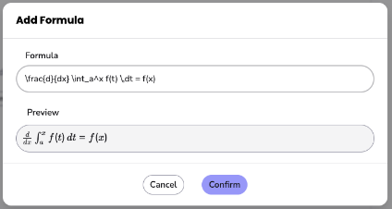
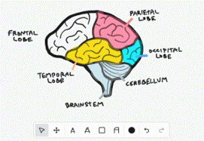
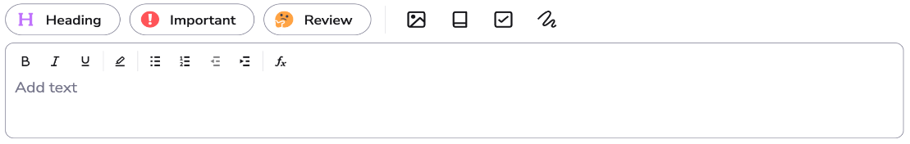
Capture Everything
02
03
04
01 // Capture
While recording classes add time stamped entries into your notes feed:
Text notes (plain text or bulleted/numbered lists)
Latex formulas (Math, Chemistry and Physical Units)
Label key moments
Handwritten notes and drawings
Tasks, images, and definitions
Annotate slides

Slide 12
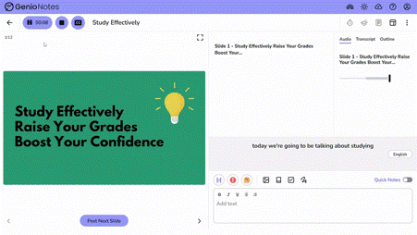
Live Captions
02
03
04
01 // Capture
Live captioning not only makes live classes more accessible for students who are deaf or hard of hearing, but also supports learners who struggle with concentration in class.

Slide 13

Genio Demo
Of the CAPTURE stage

Slide 14
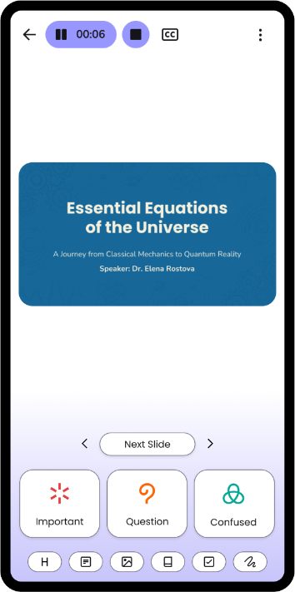
Focus Mode
02
03
04
01 // Capture
For the students who need it most.
Focus Mode is a streamlined recording interface that lets students mark moments as they listen - helping them stay engaged in the lecture, with a clear path back to what mattered.
To better manage the cognitive load burden, labels are front and centre, with features less relevant to capture hidden away.
It’s been built with neurodivergent and underserved students in mind.
Adding Focus Mode provides another option for maintaining deeper engagement that is consistent with UDL principles.

Slide 15
The CORA Framework – Organise and Refine
01 // Capture
02 // Organise
03 // Refine
04 // Apply
Organise is giving learners the tools to manage their time and knowledge to learn effectively.
Refine is about revisiting information, developing understanding.
It’s part of that recursive learning process.

Slide 16
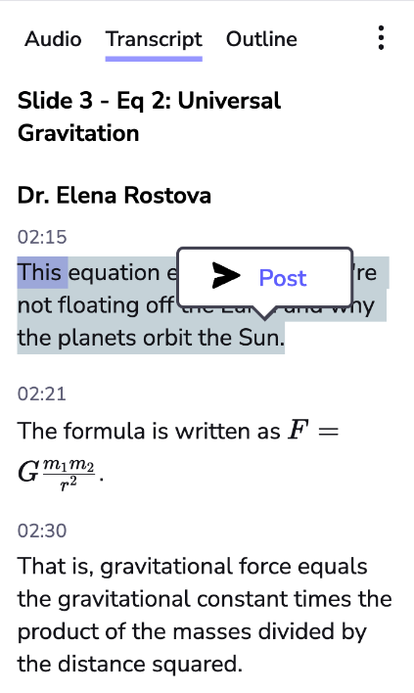
Transcription enhancements
01
03
04
02 // Organise
Includes slide headings and time stamps
  Making it easier to locate snippets of information to post into the notes feed
Speaker diarization
Generate formatted formulas and equations

Slide 17
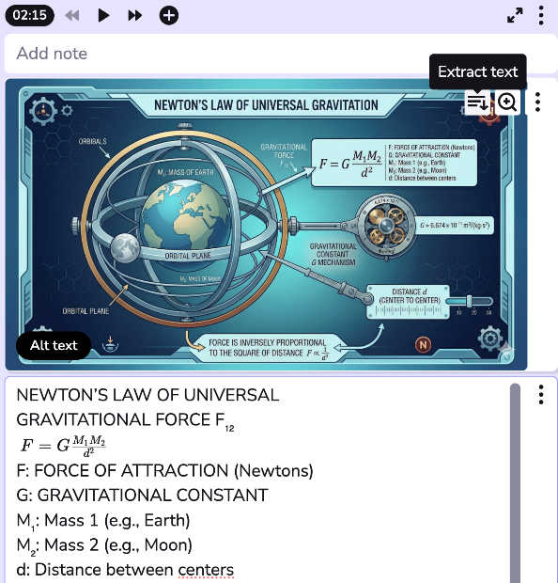
Optical Character Recognition OCR
01
03
04
02 // Organise
Learners can capture anything from their lecture (whiteboards, slides, handwritten notes) and have the text instantly readable and searchable.
The extracted text is added to the notes feed directly underneath the original image, keeping notes organized and streamlined
For learners with vision impairment, this is an essential tool for accessing visual content (e.g. images) independently
This new feature also is also a UDL design option that supports STEM students, with full recognition and formatting of complex formulas and equations. Formulas are editable in the text box.

Slide 18
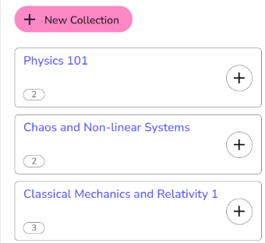
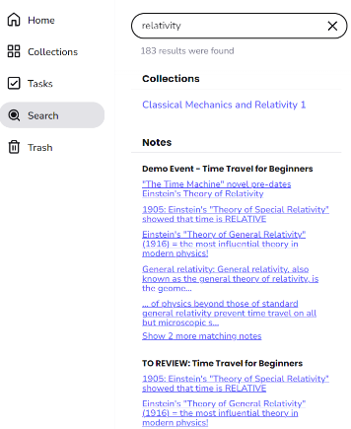
Collections & Search
01
03
04
02 // Organise
Collections provides a simple and straightforward means of organizing Events, ensuring it is easy to navigate to particular class recordings.
Search retrieves content across Collections, Notes and Transcripts - perfect for when you’re not sure which class a particular term was referenced!

Slide 19
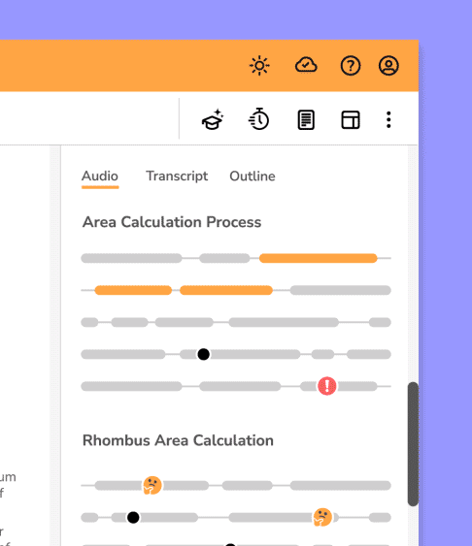
AI Outline
01
02
04
03 // Refine
Outline gives students a structured set of key highlights across a recording, making it easier to prioritise their study sessions and improve the efficiency of their learning.
Formulas and equations are now supported in Outline, ensuring STEM students have an accurate class record to navigate across.

Slide 20
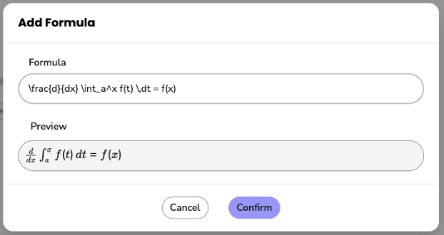
Equation Support in
Notes & Transcripts
01
02
04
03 // Refine
Learners can insert their own LaTeX formatted notes, and view them in transcripts generated after class.
This is part of our ongoing effort to seamlessly integrate equations and formulas into Genio Notes throughout the study process.

Slide 21
Genio Demo
Of the REFINE and ORGANISE stages

Slide 22
The CORA Framework - Apply
01 // Capture
02 // Organise
03 // Refine
04 // Apply
Apply is actively using the knowledge in refined notes.

Slide 23
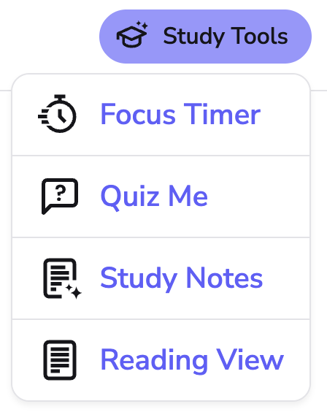
Study Tools
01
02
03
04 // Apply
Focus Timer is based on the Pomodoro technique.

Slide 24
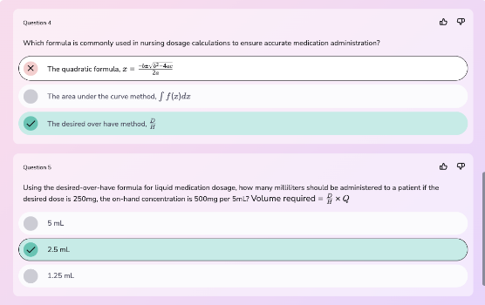
Quiz Me
includes Equation Support
01
02
03
04 // Apply
With Quiz Me users can generate five multiple choice quiz questions using their event transcripts and slide content.
Support for equations has also been added so that STEM students can appropriately test themselves on their class material and engage in retrieval practice to feel more confident and less stressed in their studies.

Slide 25
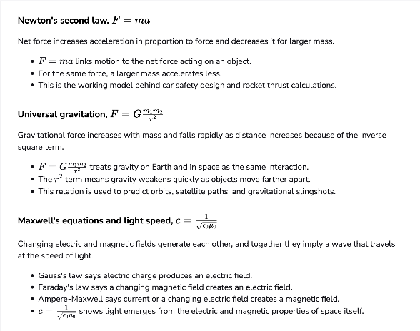
Study Notes
01
02
03
04 // Apply
AI Notes made to be studied from.
Generated from your lecture transcript
Reflects the content covered in class
Helps reduce gaps in your notes
Gives a reliable starting point for revision
Cognitive accessibility tool for students who genuinely can’t take notes - this is a critical scaffold, not a convenience.

Slide 26
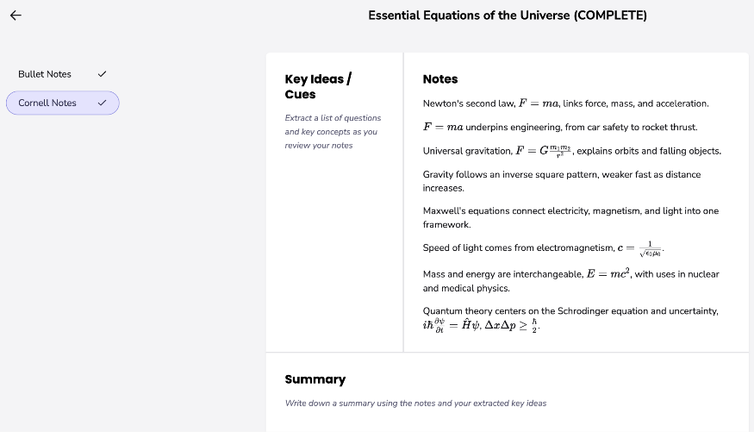
Study Notes templates
01
02
03
04 // Apply
Bullet notes
Cornell notes
More evidence informed templates released soon

Slide 27
Genio Demo
of the APPLY stage

Slide 28
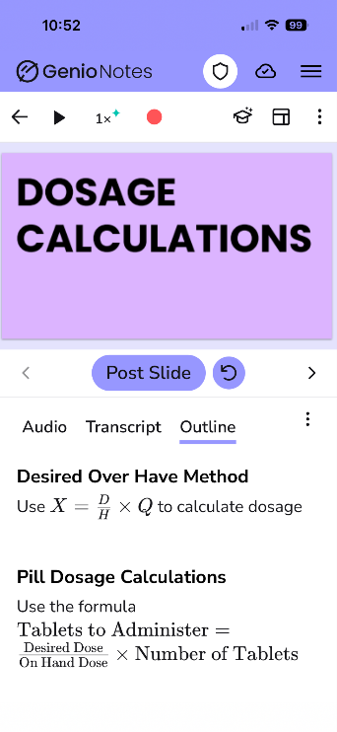
Genio mobile app
Parity with the web platform means that busy students can turn their smartphones into portable study sessions.
Unlike laptops and desktops, which are designed for long, concentrated study sessions, mobiles are perfect for small, impactful bursts of study throughout the day.
It allows all learners to experience Genio Notes in a way that works best for them. Whether it's during commutes or between their classes, this is Universal Design for Learning in action.
More information on the Genio Notes mobile app page.

Slide 29
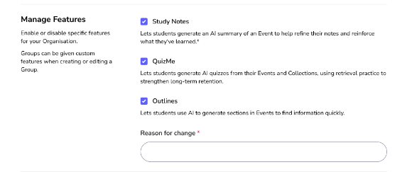
Admin Dashboard - Managed Features
Full control over AI features — right from your admin panel.
Self-service control centre: Toggle AI-powered tools — including Study Notes, Outlines, and Quiz Me — on or off without needing to contact support.
Granular configuration: Apply settings across your entire organisation, or customise per user group to suit different cohorts.
Built for academic integrity: Roll out features at your own pace, accommodate specific student groups, and align with your institution's policies.

Slide 30
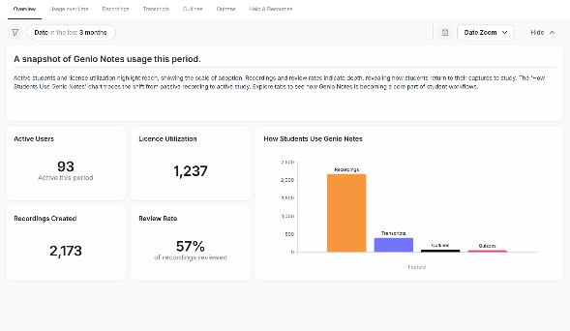
Admin Dashboard - Insights
On-demand usage data — so you can prove impact without waiting for a report.
Self-serve metrics, on demand: Access aggregated usage data across recordings, transcripts, quizzes, outlines, and more — filterable by date range with period-over-period comparison.
Built to prove investment: Download reports as PDF, image, or CSV and share them with leadership — turning real usage evidence into a story that tells itself.
Depth that matters: See how deeply learners are engaging with their learning — transcripts generated, quizzes taken, outlines created.

Slide 31
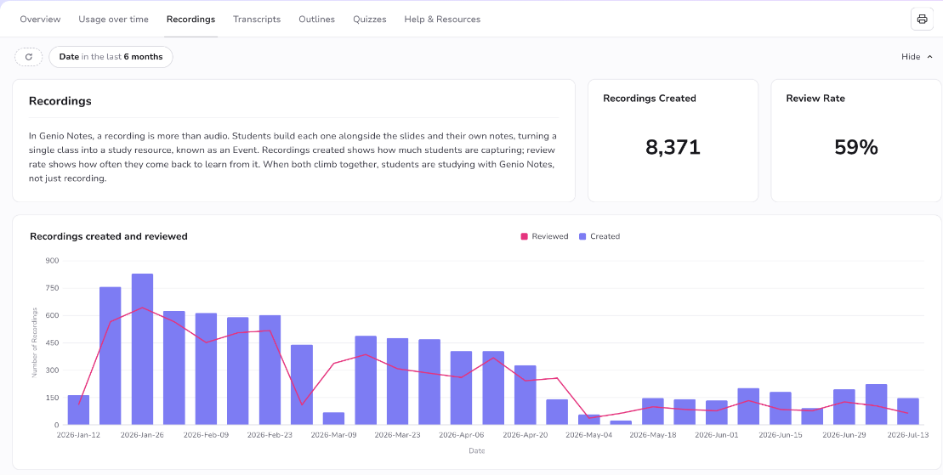
Admin Dashboard - Recordings data
Recordings created shows how much students are capturing; review rate shows how often they come back to learn from it. When both climb together, students are studying with Genio Notes, not just recording.

Slide 32
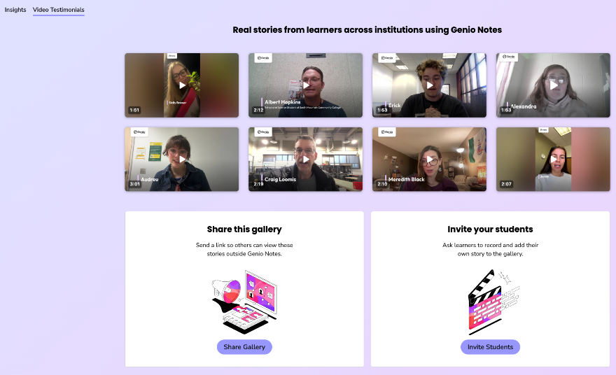
Admin Dashboard - Video Testimonials
Video testimonial enhancement
Helps you see a fuller picture of impact by bringing qualitative learner stories alongside quantitative dashboard data.
Admin Insights now gives you a fuller picture of impact: not just how many learners are engaging with Genio, but what the experience means to them.
Vocal Video has features, including teleprompting a script, to scaffold the recording process.

Slide 33
LMS Integration
Genio Notes can now connect directly with your institution's learning management system, ensuring every learner has access to the support they need from day one.
Frictionless Discoverability: Students find Genio Notes directly within their existing course workflows, removing barriers to entry
Compliant by Design: Integrates institutional recording policies directly into the LMS sign-up flow, securing upfront student consent via a simple checkbox.
Actionable Intelligence: Provides a clearer picture of which courses and classes are utilising Genio and which may require work to encourage adoption.
UDL by default: Genio becomes a universal standard for all students, unlocking better learning for every student.

Slide 34
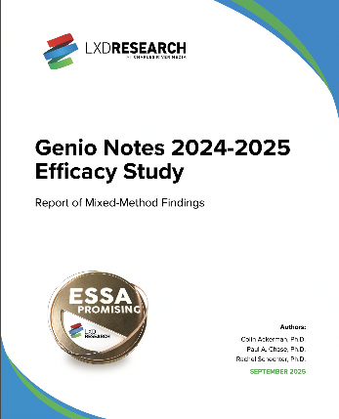
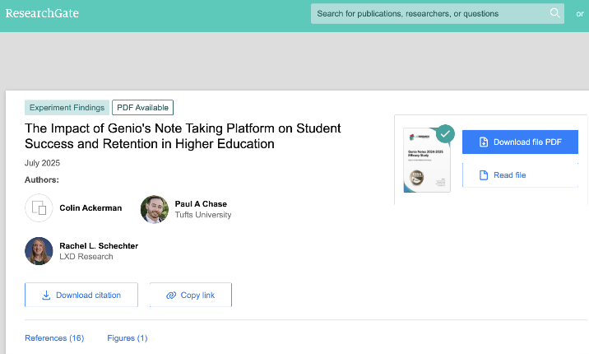

External evidence of impact
Research Accreditation Hub

Slide 35
Independent Efficacy Study in collaboration with LXD Research
“The particularly strong benefits for new majority learners—including first-generation students, working students, and those with learning differences—suggest that the Genio Notes platform addresses systemic barriers to academic success that traditional support services may not adequately address.”
"These measurable outcomes are complemented by qualitative insights revealing how Genio Notes transforms students' cognitive, emotional, and behavioral relationships with learning."
Schechter, R., Chase, P., & Ackerman, C. (2025)

Slide 36

Volunteer State Community College research department
Have been providing our note taking tools to all students on campus.
1,300+ students accessing Genio tools
89% of students feel more confident about their studies after using Genio tools
First year students who use our tools are 11% more likely to persist from first to second semester

Slide 37


Efficacy and Educational Impact Accreditations
EduEvidence - UNESCO
Genio Notes has been awarded Gold certification by EduEvidence under their Science of Learning Certification
Institute of Education Sciences
ESSA Tiers of Evidence
Tier 3 certification

Slide 38


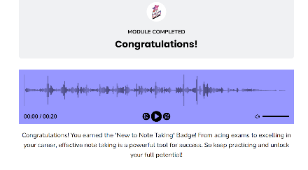
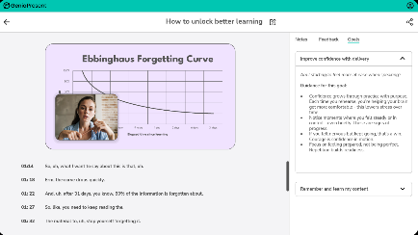
Unlock better learning for all with Genio tools
The Confident Notetaker’s Masterclass
Already available
Already available
In the pipeline!

Slide 39


Questions?

Slide 40

Thank you

