Slide 1

Benefits and cautions when embedding Universal Design for Learning into RTO practice
Supporting learner agency within the realities of competency-based assessment.

Slide 2


Introductions

Slide 3
Scoping the issue

Slide 4
Scoping the issue
UDL 3.0 and ASQA 2025 Standards
Both affect how learning and assessment are designed
Both can involve flexibility, support, access and learner participation
Both influence how learners prepare to demonstrate competence
But they do not overlap in purpose.
UDL is about access and learning design.
VET requirements are about evidence and competency judgement.

Slide 5

Enrolment-Driven Accessibility
Within RTO’s
Revenue is typically proportional to learner enrolment numbers.
There is a structural incentive to maximise participation and completions.
Barriers often reflect system constraints, compliance requirements, resource limits or operational trade-offs.

Slide 6
Do you think implementing UDL in your RTO will affect training standards or assessment integrity?

Slide 7
Flexible assessment design

Slide 8
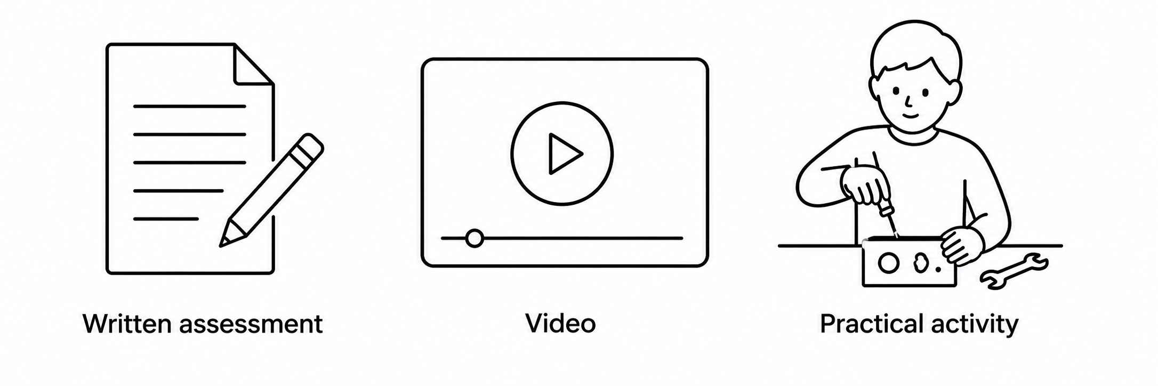

Flexible Assessment Design
Multiple ways to demonstrate knowledge and performance can sound simple in theory.
Create an alternative task.
Map it against the unit requirements?

Slide 9
Flexible Assessment Design
But in practice, RTO systems add further considerations.
Breadth and depth of the assessment
Sufficiency of evidence
Authenticity of evidence
Reliability and consistency
Trainer understanding and implementation
Assessor capability and judgement
Marking guides and rubrics
Evidence recording and storage
LMS/SMS limitations
Version control and administration
Delivery time and support requirements
Assessment time and staff workload
Scalability across cohorts and locations
Moderation processes
Validation processes
Audit and compliance defensibility
Learner clarity and understanding
Impact on cognitive load and decision-making
Impact on skill development
Sustainability of the adjustment
Organisational consistency and quality control
Impact on organisational KPI’s and operations

Slide 10
Trade-offs
UDL in VET involves working through trade-offs between learner access, compliance, workload and organisational viability.
Flexibility
(access, choice, learner agency)
UDL at its best
UDL Implemented poorly
Traditional compliance-heavy RTO delivery
Efficiency
Robustness
(time, cost, workload, scalability)
(validity, consistency, auditability)

Slide 11
Where do your resources sit?

Slide 12
Misconceptions

Slide 13
Flexibility misconception
“more options = more meaningful choices for learners”

Slide 14



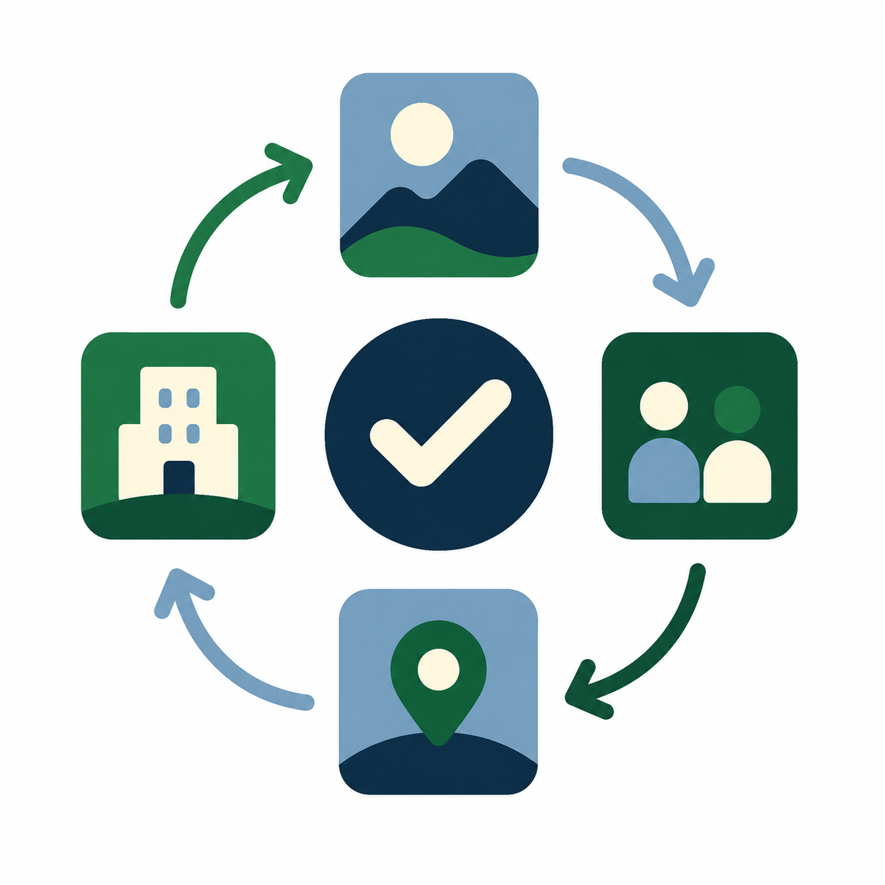
Structured Flexibility
Other forms of flexibility
Processes
Guided practice
Feedback prior to assessment
Discussion
Activities that consolidate the learning
Providing Examples
Modelling tasks
Breaking learning into steps
Scaffolding early attempts
Sequencing tasks
Consistent activities
Group relevant scenarios
Consistent scenarios sequencing learning through different units
Timeframes
Catch-up opportunities
Time between learning and assessment
Pacing
Practice
Context

Slide 15

Boundaries enable Flexibility
Structured Flexibility

Slide 16
Attendance – Assessment Evidence – Timeframes – Class Participation
Structured Flexibility
Boundaries enable Flexibility
Clear and predictable structures allow learners to:
Support their own self-management
Build routines within their environment
Engage with flexibility with less uncertainty
Understand the reasons behind having to do the harder option

Slide 17
Autonomy misconception
“Learners know best”

Slide 18
Autonomy misconception
Learner autonomy needs guidance
Learners may know their preferences, but not the full demands of the course.
They may underestimate the preparation, practice or evidence required.
Choice can increase engagement, but can also enable avoidance.
Flexibility without structure can lead to delay, confusion and disengagement.

Slide 19
Autonomy misconception
Contributors
Learner may not value the task or see its relevance.
Thinking knowing about something equals competence.
Interpreting flexibility as optional or lacking importance.
Learners may prefer less class time, flexible deadlines or different formats, but this can increase disengagement, delay learning and weaken evidence if it is not carefully managed.

Slide 20
Autonomy misconception
Upfront Assessment of Needs (UAN) should look at:
VETiS learners | Adult learners
School structures Attendance Motivation Parent/school expectations Limited workplace context Maturity and life skills | Work commitments Family commitments Confidence & wellbeing Prior experience Time pressure Financial pressure Self-management skills Digital literacy

Slide 21

Summary
Sustainable UDL is a systems issue for RTOs, not just a classroom strategy.
UDL can strengthen RTO practice when it is applied with structure.

Slide 22
Questions?

