Slide 1
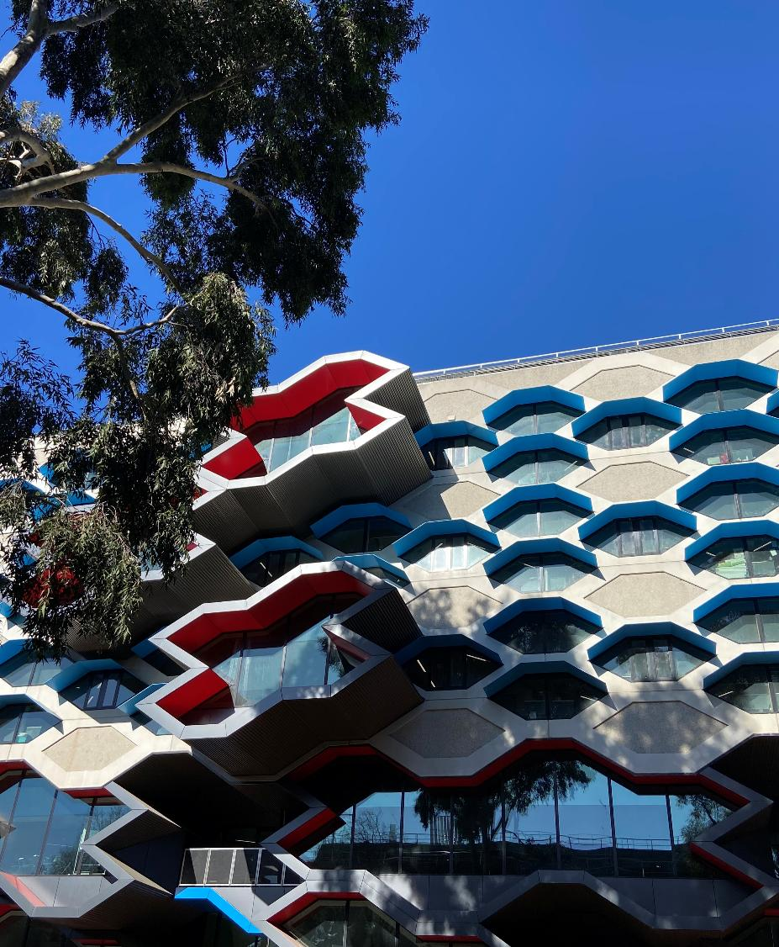
Improving Supervision for Neurodivergent Graduate Researchers
ADCET UDL Symposium
26 June 2026
Lyndel Kennedy
L.Kennedy@latrobe.edu.au
Photo by Lyndel Kennedy

Slide 2
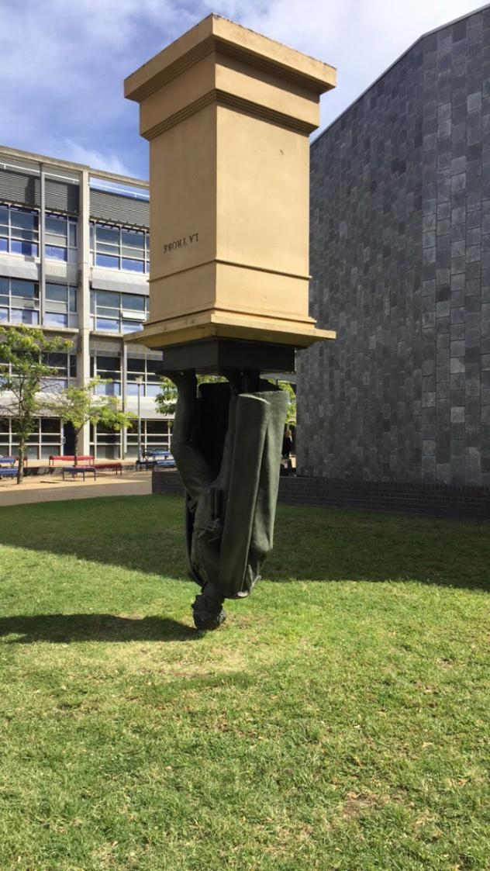
Background & Positionality
PhD - Success in Higher Education for Neurodivergent Students
Graduate Researcher Student Representative
CANDID Peer Support Network Co-founder
Lived experience
Gap in support for neurodivergent graduate researchers
Photo by Lyndel Kennedy

Slide 3

The problem
66,000 graduate researchers
High attrition rates
Non-completion is costly
Liminal space
Supervisory relationship is key

Slide 4
Project Goal & Overview
Develop a neurodiversity-affirming supervision practices training package for supervisors, to improve support for all graduate researchers
Project Phases:
Co-design
Build – online module and workshop
Evaluate – randomised controlled trial (RCT)

Slide 5
Neurodiversity-affirming principles
A commitment to continued learning about neurodivergence
Providing safety to be one’s neurodivergent self
Finding a way to communicate
Authenticity and humility in practice
Validation of neurodivergent experiences
Neurodivergent informed person-centred support
Genuine acceptance and appreciation of neurodiversity
Flower et al. (2025). Defining neurodiversity affirming psychology practice for Autistic adults: A Delphi study integrating psychologist and client perspectives. Autism in Adulthood. https://doi.org/10.1089/aut.2024.0305

Slide 6
Co-design methodology
Centring lived experience
Project led by three current/recent neurodivergent graduate researchers
Governance team combines lived and professional expertise
Institutional ethics approval for all data collection stages
Co-design process
Literature and resources review
Mixed-methods survey of supervisors – attitudes, demographics, qualitative reflections
Focus groups – 4 each with neurodivergent GRs and supervisors at La Trobe University
Underpinning principles
Participatory research methodology
Joint problem identification and solution development
Neurodivergent perspectives as expertise, not deficit

Slide 7

Focus Groups - Participants
Supervisors (N = 26)
Gender – more women
Ages – 30s–60s
Location – more metro
Lived experience – mix of self/family
Candidates (N = 13)
Gender – mostly women
Ages – 20s–50s
Location – more metro
Lived experience – almost all self
Photo by Compagnons on Unsplash

Slide 8
Focus Groups – Key Themes
Supervisors
Understand key traits & challenges
How to help when undisclosed
Making the implicit explicit
Ways of working
Mindset before strategies
Neurodiversity as a culture
Candidates
Safety and power imbalances
Late diagnoses and shame
Small steps when overwhelmed
What works changes over time
Check in often - masking struggle
Neurodiversity as culture

Slide 9
Theme: Bias, masking and shame
“We’re so ready to be told that we’re stupid and that we don’t know what we’re talking about … Supervisors don’t understand that we’re dealing with shame. I have a lot of internalised shit that I have not unpacked yet.” C
“Neurodiversity doesn’t mean that we can’t [do something] … but we do need extra time … to regenerate … to recover afterwards.” Candidate
“Neurodivergent folks tend to be their own toughest critic … There may be some complex emotions around … asking for help and fear of letting supervisors down.” Supervisor
“Despite getting 96% on my master’s and a full-ride scholarship for my PhD, [after I disclosed] she told me I wouldn’t be capable of doing a PhD because I was autistic.” Candidate.

Slide 10
Theme: Curiosity, flexibility and joy
“Keep asking questions and remain curious … remember why you got into academia in the first place … not [just] to find answers, but to explore.” Candidate
“If someone’s not on the same wavelength … you need to switch [it] up … That might be introducing a rule, or a structure, or a metaphor or an example. If they’re not getting one … jump to the next.” Candidate
“Every day can sometimes be a struggle and [also] be joyous. We need society to be strengths-based but still retain why we struggle.” Candidate
“What’s getting in the way here?”
“What’s that like for you?”

Slide 11
Theme: Making the Implicit explicit
“At the commencement of our supervision relationship, we shared three mindset statements to anchor our way of working: 1) Assume capability, not deficit. 2) Normalise different working styles, and 3) Be explicit, not implicit.” Supervisor.
“It’s not knowing the rules … the social things as well. They need to tell me their rules, because when my supervisors do, I can work within them.” Candidate

Slide 12
UDL 3.0 Implications
Emotional capacity (Guideline 9)
Recognise expectations, beliefs and motivations
Develop awareness of self and others
Promote individual and collective reflection
Cultivate empathy and restorative practices
Strategy development (Guideline 6)
Set meaningful goals
Anticipate and plan for challenges
Enhance capacity for monitoring progress
Challenge exclusionary practices

Slide 13
Reflection
Optional activity
My student can’t seem to stay on track. Every meeting we’re back at square one.
They’re clearly passionate about the topic, but they’re hard to supervise – they go off on tangents and can be really intense.
How can we reframe these through a neurodiversity-affirming lens?
My student may benefit from more explicit structure around milestones, drafts and meeting agendas. Making expectations concrete and visible between sessions could reduce the cognitive load of keeping the bigger picture in view.
My student’s hyperfocus and depth of engagement are significant research strengths. My task as supervisor is to channel that intensity through agreed scope boundaries rather than moderate the passion itself.

Slide 14
What neuroaffirming supervision looks like (1)
Starting Well
          Ways of working
          Co-design tracking – what, how and why
Supervision is a team sport
          Managing the system
          Coordinating behind the scenes
Be Explicit
          Hidden curriculum
          Acknowledging uncertainty
Plan your communication
          Agreed structures and tools
          Flexible yet consistent

Slide 15
What neuroaffirming supervision looks like (2)
5. Managing overwhelm
          Overcommitting
          Rejection sensitivity
          Recovery time
6. Managing environments
          Workspaces, meetings and presentations
          Conferences and social events
7. Helping well
          Responding to disclosures
          Connecting with peers
          Let’s do it together

Slide 16

Project Team
Olga Tennison Autism Research Centre, School of Psychology and Public Health (SPPH)
Dr Lauren Lawson
Dr Gilly McKeown
Miki Mackenzie
Dr Simon Bury
A/Professor Jennifer Spoor
Professor Nora Shields
A/Professor Philippe Chouinard - Director Graduate Research, SPPH
Megan Campbell - Manager Wellbeing and Inclusion, Student Experience and Employability
Professor Dan Bendrups - Pro Vice-Chancellor Research Training, Graduate Research School
Australian Centre for Student Equity and Success (ACSES), Curtin University

Slide 17
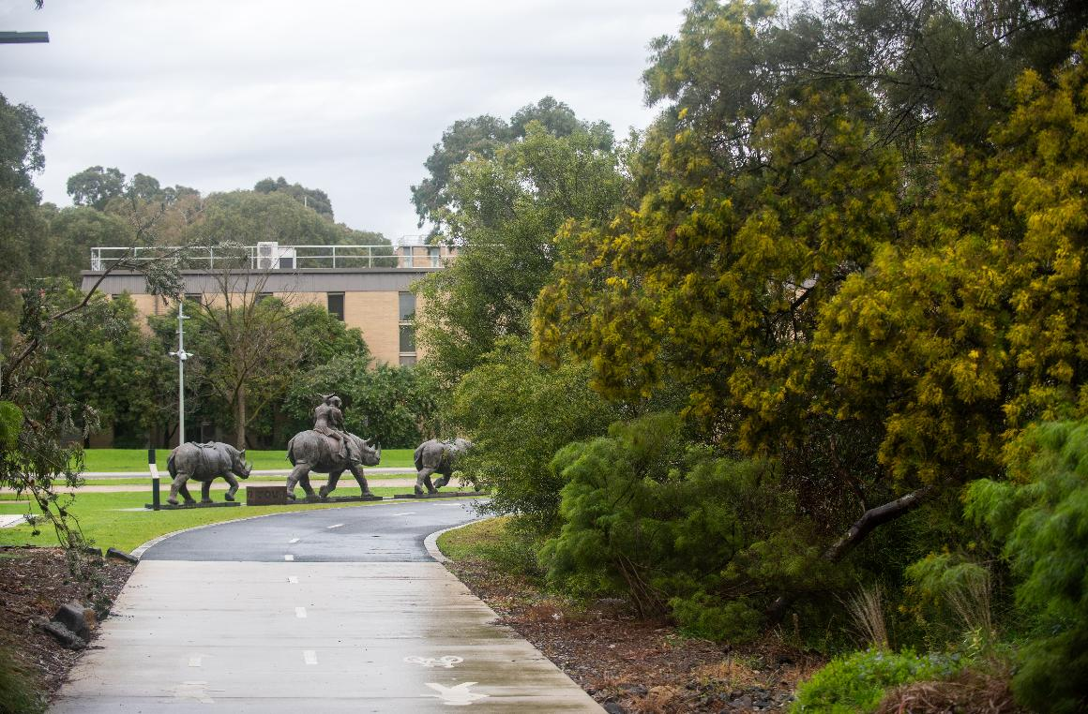
Final thoughts
Neurodivergent strengths
Deep knowledge
Innovative thinking
Persistence
Cultural change
Photo by Jake Mulligan

Slide 18

Thank you
Lyndel Kennedy
L.Kennedy@latrobe.edu.au
www.latrobe.edu.au/otarc

Slide 19
References
Australian Government Department of Education. (2025). Higher Education Statistics. https://www.education.gov.au/higher-education-statistics
Grant, A., & Kara, H. (2021). Considering the Autistic advantage in qualitative research: The strengths of Autistic researchers. Contemporary Social Science, 16(5), 589-603. https://doi.org/10.1080/21582041.2021.1998589
Jones, S. C. (2022). Autistics working in academia: What are the barriers and facilitators? Autism, 27(3), 822-831. https://doi.org/10.1177/13623613221118158
Kennedy, L. J., Richdale, A. L., & Lawson, L. P. (2025). A comparison of neurodivergent and non-neurodivergent students’ characteristics and higher education experiences in Australia and New Zealand. Autism in Adulthood, 0(0), 1-21. https://doi.org/10.1089/aut.2024.0159
Syharat, C. M., Hain, A., Zaghi, A. E., Gabriel, R., & Berdanier, C. G. P. (2023). Experiences of neurodivergent students in graduate STEM programs. Frontiers in Psychology, 14, 1149068. https://doi.org/10.3389/fpsyg.2023.1149068
Szorenyi, A., & Payne, C. (2025). Supporting neurodiversity in higher degree research supervision: A relational approach. Higher Education Research & Development, 1-16. https://doi.org/10.1080/07294360.2025.2493248
Tan, D. W., Edwards, C., Mewburn, I., Simpson, K., Webster, A. A., & Brownlow, C. (2025). Understanding the experiences of neurodivergent research students: A mixed methods systematic review. Studies in Higher Education, 1-17. https://doi.org/10.1080/03075079.2025.2573209

Slide 20
ACGR Good Practice Guidelines
Inclusive Supervision of Neurodivergent HDR Candidates
Foster a neuroaffirming culture
Create accessible systems
Provide accommodations and supports for academic progress and wellbeing
Provide conducive work environments
Enhance supervision capabilities
Minimise the ‘hidden curriculum’
https://www.acgr.edu.au/good-practice/good-practice-guidelines/

