Slide 1


Co-Designing UDL-Aligned
Summative Assessment
UDL Symposium 2026 · ADCET · University of Tasmania · 24-26 June 2026
1 / 26
UDL SYMPOSIUM 2026 · ADCET · HOBART
for Care Sector Training - a case study with CALD adult learners
Salam Alwani
Dr Hang Ngo
Mak Sun
Project Coordinator, CAASSA
ACE Team Leader, Instructional Designer, CAASSA
RTO Trainer & Assessor, ANMEC
CAASSA & the SSS82 grant
Co-design process · Results & feedback
UDL innovation in assessment

Slide 2
Three voices, one project
UDL Symposium 2026 · ADCET · University of Tasmania · 24-26 June 2026
2 / 26
Twenty-five minutes · a Vietnamese-Australian community, an RTO trainer, an ACE team leader.
PART 1
Salam
Why this project exists
CAASSA, the Vietnamese-Australian community in South Australia, and the SSS82 Skills Set Supplement Grant from Skills SA.
PART 2
Hang
Co-designing the supporting package
The seven-step co-design loop · 46 community voices · two parallel supporting packages wrapped around CHCSS00114.
PART 3
Mak
UDL innovation in assessment
Module 3 · CHCCCS015 as case study — quiz, role-play and progress note redesigned · NotebookLM · Gamma.
PART 4
Hang
What learners are telling us
Cohort 1 results, the post-use learner survey (n=11), and what we carry into the next cohort.

Slide 3
CAASSA & the SSS82 grant
UDL Symposium 2026 · ADCET · University of Tasmania · 24-26 June 2026
3 / 26
PART 1 · SALAM ALWANI (CAASSA)
A multicultural ACE provider, a Vietnamese-Australian community, and a state grant for CALD workforce.
Community Access and Services SA (CAASSA)
Community-controlled multicultural organisation
Supporting CALD communities across South Australia
Focus on education, employment, settlement and community participation

Slide 4
Community Access and Services SA · CAASSA
UDL Symposium 2026 · ADCET · University of Tasmania · 24-26 June 2026
4 / 26
A multicultural Adult Community Education provider in South Australia · Athol Park.
CAASSA at a Glance
Connecting • Empowering • Supporting CALD Communities
WHO WE ARE
A community-controlled organisation
Serving Vietnamese, Arabic-speaking and other culturally and linguistically diverse (CALD) communities
Community-controlled multicultural organisation
Based in Athol Park, South Australia
People Reached
24,000+ community members engaged
Communities
Vietnamese, Arabic, Afghan, Bhutanese, African, Farsi and other CALD communities
Education
253 ACE learners completed programs
Learning Hours
7,100+ education contact hours
Activities
862 community activities & events
Recognition
2025 ACE Provider of the Year
WHAT WE DELIVER
Adult Community Education (ACE) programs
Employment and training pathways
Community development projects
Settlement and social inclusion programs
NDIS and wellbeing support
WHO WE WORK WITH
Government: Skills SA • DHS • DSS • APHN
Education & Training
Industry: Aged Care • NDIS • Employers
Communities: Vietnamese • Arabic • Afghan • Bhutanese • African

Slide 5
The SSS82 Skills Set Supplement Grant
UDL Symposium 2026 · ADCET · University of Tasmania · 24-26 June 2026
5 / 26
Skills SA grant supporting CAASSA to build a CALD-Responsive Care Training Toolkit · Jan-May 2026.
WHY
WHAT
HOW
The workforce gap
· Ageing population, persistent care-workforce shortage in SA
· Over half of residential aged-care staff were born overseas
· CALD adults with heritage care experience are locked out by English-first training and assessment
Two parallel outputs
· Accredited delivery of the skill set + First Aid with RTO partner ANMEC
· A co-designed supporting toolkit in two registers — bilingual Việt-English and plain-English CALD
· Published openly for reuse by other communities and RTOs
Co-design with three rings
· Community — 46 survey voices via temples and faith networks
· Learners — weekly observation, reflection surveys, feedback sessions
· Industry — RTO trainer debriefs and aged-care/NDIS employer input
CHCSS00114 · HLTWHS002 · HLTINF006 · CHCCCS015 + HLTAID011 First Aid

Slide 6
Cohort 1 · partners · timeline
UDL Symposium 2026 · ADCET · University of Tasmania · 24-26 June 2026
6 / 26
Twelve CALD learners — ten Vietnamese-Australian, two Arabic-Australian — recruited through community and faith networks · pilot Feb-May 2026.
12
Feb-May
85%
3
CALD learners enrolled
2026 accredited delivery window
attendance target
modules · CHCSS00114 skill set
PARTNERS IN THE LOOP
CAASSA
Lead — design, ACE delivery, community
ANMEC
RTO partner — accredited delivery & assessment
Aged-care & NDIS employers
Workplace evidence & post-training pathway
Vietnamese community & temples
Recruitment, voice, validation
Skills SA · Steering Committee
Funder · oversight · quality assurance

Slide 7
Co-designing the supporting package
UDL Symposium 2026 · ADCET · University of Tasmania · 24-26 June 2026
7 / 26
PART 2 · DR HANG NGO(CAASSA)
Seven steps · forty-six community voices · two parallel registers wrapped around the accredited core.

Slide 8
A seven-step co-design loop
UDL Symposium 2026 · ADCET · University of Tasmania · 24-26 June 2026
8 / 26
Each step feeds the next; later steps loop back to refine earlier outputs.
1
2
3
4
5
6
7
LISTEN
MAP
DESIGN
RUN
REVIEW
ADJUST
EXTEND
Surveys to surface the cultural lens of care
Cultural lens mapped onto the ANMEC Moodle core
Two parallel supporting packages — bilingual VN-EN + CALD English
Supporting sessions during accredited delivery
Skill-set instructor feedback after every session
Iteratively revise the supporting package
Multilingual NotebookLM with multimodal AI elements
The loop cycles · step 6 re-feeds step 3 · step 5 reframes the next round of step 1
Today’s case study: Module 3 · CHCCCS015 — Provide Individualised Support

Slide 9
Step 1 · LISTEN · Voices captured at community sites
UDL Symposium 2026 · ADCET · University of Tasmania · 24-26 June 2026
9 / 26
Forty-six Vietnamese-Australian respondents across three groups, plus weekly observation in classroom.
INSTRUMENT
COHORT
REACH
WHAT THE DATA TOLD US
Community Attitude Survey
Vietnamese-Australian community
n = 33
Vietnamese-Australian voices articulated chăm sóc as a holistic practice integrating material (vật chất) and spiritual-emotional (tinh thần) care. Filial piety (hiếu thảo) anchors the moral weight; trust in cross-cultural carers is conditional on demonstrated cultural competence; care work itself is consistently respected as honourable, skilled labour.
Pre-Learning Survey
Prospective skill-set learners
n = 3
Support Worker Survey
Existing bilingual carers
n = 10
Client Voice Survey
Vietnamese-speaking care clients
ongoing
Instructor Readiness Survey
ANMEC trainers
ongoing
Weekly Observation Notes
CAASSA ACE team in-class
continuous
Vietnamese_Australian_Care_Data_Analysis.docx · March 2026

Slide 10
The cultural lens of care · chăm sóc
UDL Symposium 2026 · ADCET · University of Tasmania · 24-26 June 2026
10 / 26
Care is dual: material AND spiritual. The two are inseparable, not sequential.
VẬT CHẤT · Material care
TINH THẦN · Spiritual / emotional care
· Nutritious food appropriate to preferences and health
· Reliable transport to medical appointments
· Assistance with activities of daily living
· Physical comfort, sanitation, clean environment
· Skilled, safe technique — manual handling, infection control
· Genuine companionship, attentive listening
· Respect (tôn trọng) for life story, faith, family role
· Patience (kiên nhẫn) — gentle, meticulous (tỉ mỉ) presence
· Filial piety (hiếu thảo) honoured in everyday gestures
· Religion / ancestral practice supported, not interrupted
"Care for material needs, daily living, including the life of the soul."
— Survey 22
"Not just health but spirit and emotion — comfort and happiness."
— Survey 12
Implication for design: every care task carries both a 'do' and a 'be with' instruction.

Slide 11
Step 2 · MAP · Friction & assets, named
UDL Symposium 2026 · ADCET · University of Tasmania · 24-26 June 2026
11 / 26
Friction points become curriculum; cultural strengths become professional language.
CULTURAL FRICTION POINTS · must be taught explicitly
CULTURAL ASSETS · already professional competencies
✕
Cross-gender personal care (showering, toileting)
✓
Hiếu thảo · filial piety as care commitment
✕
Discussing death, dying, and advance care planning
✓
Vật chất + tinh thần · whole-person care framework
✕
Mandatory reporting that bypasses family authority
✓
Kiên nhẫn, tỉ mỉ, dịu dàng · patience, meticulousness, gentleness
✕
Documentation that exposes private family matters
✓
Sạch sẽ · cleanliness rituals (asset for infection control)
✕
Speaking up to a supervisor (mất mặt — losing face)
✓
Cạo gió, bấm huyệt · traditional practices as prior learning
✕
Refusing food or rituals offered by client / family
✓
Đồng hương trust · bilingual carer as bridge worker
Mapped onto CHCSS00114 → HLTWHS002 · HLTINF006 · CHCCCS015

Slide 12
Step 3 · DESIGN · Two parallel versions of the supporting package
UDL Symposium 2026 · ADCET · University of Tasmania · 24-26 June 2026
12 / 26
Same module structure · same nine box-types · two cultural registers.
VERSION A
VERSION B
Bilingual Vietnamese-English
CALD plain-English (any cohort)
· Vietnamese as primary register, English as gloss
· Confucian + Buddhist sources named explicitly (hiếu, lễ, từ bi)
· Cầu Nối Văn Hóa boxes at every cultural friction point
· Self-assessment: Chưa / Đang tiến bộ / Được rồi
· Trước / Trong / Sau giờ học three-stage study plan
· Action-based assessments — not English literacy gates
· Plain-English register, learner own-culture invited in
· 'Your culture, your reflection' prompts in every section
· Same nine box-types, neutral colour-coded
· Self-assessment: Not Yet / Getting There / Yes, I Can
· Group-discussion prompts replace bilingual glossaries
· Same action-based assessment design
Both versions sit alongside Moodle — supplementary, not substitutive.

Slide 13
Steps 4 · 5 · 6 · Run, review, adjust
UDL Symposium 2026 · ADCET · University of Tasmania · 24-26 June 2026
14 / 26
How learner and instructor voice loops back into the package — week by week.
BEFORE CLASS
IN SUPPORT SESSION
AFTER CLASS
Pre-session reading
Action-based practice
Reflection & rubric
Vocabulary preview · cultural bridge box · scenario question to think about. Learners arrive into accredited class with the language already in their hands.
Role-plays, decision guides, manual-handling demos, infection-chain walk-through. Bilingual scaffolding by the CAASSA team; observation notes captured in real time.
Three-level self-assessment, module reflection survey, scenario journaling. Cultural friction surfaced privately first, then folded back into design.
FROM REVIEW TO REVISION · v1 and v2
→ Six-element chain of infection misread as three → front-loaded the diagram before Assessment 1
→ Mất mặt reticence around incident reporting → added a 'Speak up' decision tree + bilingual phrases
→ Hesitancy to read aloud → reframed as oral knowledge demonstration; added Presentation Phrases sheet

Slide 14
UDL in summative assessment
UDL Symposium 2026 · ADCET · University of Tasmania · 24-26 June 2026
15 / 26
PART 3 · MAK SUN(ANMEC)
Module 3 · CHCCCS015 Provide Individualised Support — assessment that unlocks competence rather than gatekeeping it.

Slide 15
Module 3 at a glance · the unit we chose
UDL Symposium 2026 · ADCET · University of Tasmania · 24-26 June 2026
16 / 26
CHCCCS015 — the person-centred heart of the skill set, and its deepest cultural friction.
THE UNIT
CHCCCS015 · ACCREDITED CORE
Provide Individualised Support
Four elements: determine support needs · provide support services · monitor support activities · complete reporting and documentation. Delivered on ANMEC’s Moodle with study guides and care videos; our two co-designed supporting packages — bilingual Việt-English and plain-English CALD — wrap around it.
AS INHERITED
TWO OFFICIAL ASSESSMENTS
Quiz + Care-Plan Case Studies
Assessment 1: a 22-question English quiz with a 100% pass mark. Assessment 2: three Australian care plans — Mrs Piermonte, Tom Harris, Mrs Jenkins — role-played in groups, then one written progress note. Competent care can hide behind English reading speed and a blank page.
THE STAKES
WHY THIS MODULE
Paternalism vs Làm Cùng (Do With)
‘I know best’ versus ‘you choose’. For learners raised with family-centred decision-making, consumer-directed care is the deepest cultural shift in the skill set — named by the community survey, the co-designer feedback session, and by the learners themselves.
Sources: ANMEC Moodle Module 3 · CHCCCS015 unit of competency · co-designer feedback session · community survey themes

Slide 16
From English-literacy gates → evidence of competence
UDL Symposium 2026 · ADCET · University of Tasmania · 24-26 June 2026
17 / 26
UDL 3.0 across Module 3’s two assessments — same competency evidence, redesigned access.
BEFORE · the assessment as inherited
AFTER · UDL-aligned redesign
· 22-question English quiz · 100% pass mark
· Three Anglo-Australian care plans, read cold
· Progress note written onto a blank page
· CALD learners assessed out of the workforce despite competent practice
· Preparation booklets in two registers — bilingual Việt-English + plain-English CALD
· Seven Big Ideas concept review — the quiz’s logic taught, not ambushed
· Role-play sentence-starters · progress-note template + worked example
· Cultural Bridge prompts inside the rubric, not bolted on
UDL 3.0 · three principles guiding every redesign decision
ENGAGEMENT
REPRESENTATION
ACTION & EXPRESSION
Multiple ways to mean it
Multiple ways to receive it
Multiple ways to show it
Scenarios learners recognise — Mrs Piermonte’s carer preference sits beside Mrs Piermonte’s care plan.
Bilingual glossary, NotebookLM audio in Vietnamese, care-plan walk-throughs and worked examples.
Say it in role-play, show it in practice, write it with a scaffold — three routes to the same evidence.
Source: M3_Assessment1+2 Supporting booklets — CALD & Vietnamese editions · CAST 2024 — UDL Guidelines 3.0

Slide 17
Two assessments · three UDL pathways
UDL Symposium 2026 · ADCET · University of Tasmania · 24-26 June 2026
18 / 26
Module 3 · CHCCCS015 — what learners do, not just what they write.
ASSESSMENT 1
PREPARED, NOT AMBUSHED
Person-Centred Care Quiz
22 questions, 100% pass mark. The preparation booklet re-teaches the Seven Big Ideas — person-centred care, strength-based approach, human rights, Maslow, paternalism vs client-directed care, equity, cultural safety — in plain English and bilingual Việt-English, with practice questions and explained reasoning. The quiz tests the concept, not the learner’s reading speed.
ASSESSMENT 2
ACTION-BASED ASSESSMENT
Three Care Plans, Lived
Groups role-play Mrs Piermonte’s first shift, Tom Harris’s complaint about rough handling, Mrs Jenkins’s fall recovery. Sentence-starters scaffold spoken English; the Golden Question opens every encounter; the pain report and the supervisor phone call are rehearsed live, not described in writing.
ASSESSMENT 2B
SCAFFOLDED DOCUMENTATION
The Progress Note
One written progress note (Mrs Piermonte) — but the blank page is gone. Learners work from a note template plus a worked ‘strong note’ example, and self-mark against it before the trainer marks. Writing stays in the assessment as a supported skill, not an English gate.
Source: M3_Assessment1_Supporting · M3_Assessment2_Supporting — CALD English and Vietnamese bilingual editions

Slide 18
Multilingual NotebookLM · the package travels with the learner
UDL Symposium 2026 · ADCET · University of Tasmania · 24-26 June 2026
19 / 26
Built from the same supporting package — accessible from any device, any time, in language.
WHAT WE FEED THE NOTEBOOK
AUDIO OVERVIEW
MIND MAP
· Bilingual VN-EN supporting package (M1 · M2 · M3)
· CALD English supporting package
· Module quizzes and answer keys
· Cultural Bridge boxes & the Golden Question
· Lesson observation notes from each session
· Survey themes — cultural lens, friction, assets
Two-host conversation in Vietnamese AND in plain English. Learners listen on the bus before class.
Visual map of the cultural lens and where each module sits — opens the package at a glance.
STUDY GUIDE
DOMAIN CHATBOT
Auto-generated guide per module — vocabulary, key questions, scenario prompts.
'What if I refuse a task on cultural grounds?' — answered with the package + policy in language.
Why it matters under UDL: Representation (audio · visual · text) and Engagement (in-language access on the learner's device).

Slide 19
What learners are telling us
UDL Symposium 2026 · ADCET · University of Tasmania · 24-26 June 2026
21 / 26
PART 4 · DR HANG NGO (CAASSA)
Cohort 1 complete · early indicators, learner and instructor voice, and the post-use survey (n=11).

Slide 20
Early indicators from cohort 1
UDL Symposium 2026 · ADCET · University of Tasmania · 24-26 June 2026
22 / 26
Vietnamese-Australian learners · Module 1 (HLTWHS002) · captured mid-pilot, April 2026.
12 / 12
learners completed Module 1 assessments
100%
passed Assessment 3 (Manual Handling Practical) at first or second attempt
92%
average attendance across weekly support sessions
0
withdrawals across Modules 1–3 and First Aid · Feb–May 2026
READ THESE NUMBERS LIGHTLY
Cohort 1 is ten Vietnamese-Australian and two Arabic-Australian learners in a single pilot. The numbers tell us the redesign is not pushing learners out — they are telling us what to ask next, not what to declare. We pair them with learner voice, instructor voice, and the post-use survey on the slides that follow.
Source: weekly attendance register · Assessment 1-3 marker sheets · ANMEC trainer report · Apr-May 2026.

Slide 21
Learner voice · what the cohort is telling us
UDL Symposium 2026 · ADCET · University of Tasmania · 24-26 June 2026
23 / 26
Captured in weekly support sessions, reflection surveys, and one-to-one chats with the ACE team.
"Khi tôi được nói tiếng Việt rồi mới dịch sang tiếng Anh, tôi mới dám trả lời."
— When I am allowed to discuss in Vietnamese first and then translate, I dare to answer.
"The role-play makes me know what to do. The written quiz only makes me know if I can spell."
Learner D · Week 2
Learner T · Week 4 · Module 1 case study
"I listened to the audio overview on the way to class. I came in already knowing the words."
"Tôi không nghĩ kinh nghiệm chăm sóc mẹ ở nhà của tôi cũng là kỹ năng nghề."
— I never thought my experience caring for my mother at home was also a professional skill.
Learner K · NotebookLM audio · Week 3
Learner H · pre-learning interview
Quotes translated and reproduced with learner consent · pseudonyms used.

Slide 22
Instructor & community voice · what changed
UDL Symposium 2026 · ADCET · University of Tasmania · 24-26 June 2026
24 / 26
Each line is traceable: feedback → design change → where to find it.
TRIGGER · whose voice
WHAT CHANGED
WHERE TO FIND IT
Pre-learning data: low cross-gender care comfort
(Vietnamese community survey)
Added a Boundary Navigation strand · supervisor language · scripted role-plays
Module 3 · Section 4
Mất mặt reticence around speaking up
(weekly observation, week 2)
'Speak up' decision tree + bilingual reporting phrases sheet
Module 2 · Section 11
Six-element chain of infection misread as three
(skill-set instructor feedback)
Front-loaded the six-element infographic before Assessment 1
Module 2 · Quick Reference
Hesitancy to read aloud
(skill-set instructor)
Reframed: oral knowledge demo, not English speed · Presentation Phrases sheet
Module 1 · Assessment 1
Traditional cạo gió, bấm huyệt practices
(community survey)
Recognised as valid prior learning, paired with IPC standards
Module 2 · Section 9
Sources: lesson observation notes (SSw1-4), ANMEC instructor debriefs (Apr 2026), community survey themes.

Slide 23
The post-use learner survey · June 2026
UDL Symposium 2026 · ADCET · University of Tasmania · 24-26 June 2026
25 / 26
Eleven completers · bilingual paper survey · 77 Likert items + open text · read against the January baseline.
11 / 11
agree the materials were useful and the assessment a fair test of learning
10 / 11
say ‘Yes, I Can’ to working the consumer-directed way — Làm Cùng, not Làm Cho
11 / 11
now call their bilingual, bicultural background a professional asset, not a barrier
8 / 8
of those who answered would recommend the course with these materials to family and friends
WHAT THEY ASK FOR NEXT
More spoken-English dialogue practice · more hands-on infection-control and First Aid hours · an Arabic edition of the materials · a continuation course. Every request extends the model; none asks to change it. English remains the honest frontier — seven of eleven still name it the hardest part.
Source: CHCSS00114 Post-Use Learner Survey (n=11) · CHCSS00114_PrePost_Survey_Analysis.xlsx · June 2026.

Slide 24
Five commitments · beyond cohort 1
UDL Symposium 2026 · ADCET · University of Tasmania · 24-26 June 2026
26 / 26
WHAT WE CARRY FORWARD
1
Traceability
Every design change carries a named voice — community, learner, or instructor.
2
Cultural relevance
Cultural lens — vật chất + tinh thần — sits inside every module, not appended.
3
Action over literacy
Action-based and oral assessment as default · written English an option, not a gate.
4
Multilingual AI access
NotebookLM and Gamma open the package in language, on device, any time.
5
Replicability
Another RTO · another community could pick this up and run it without our team.
Cảm ơn · Thank you · questions, online and in the room

Slide 25
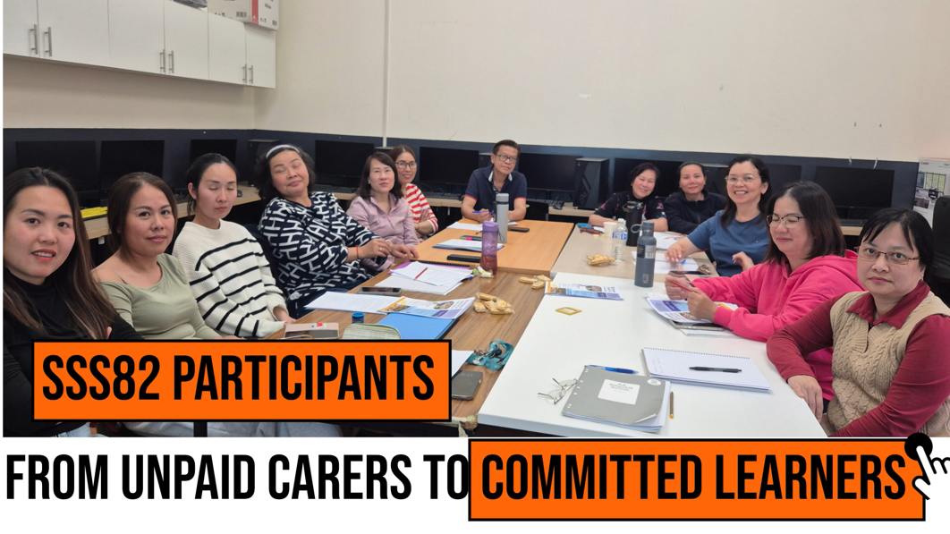
Learning in action . Assessing in action
UDL Symposium 2026 · ADCET · University of Tasmania · 24-26 June 2026
19 / 26
Teaching and learning journey in a nutshell. Video produced with photos provided by learners and recording of classes and interviews with instructors. All consent obtained.

Slide 26
Gamma · learners build their own research deck
UDL Symposium 2026 · ADCET · University of Tasmania · 24-26 June 2026
20 / 26
Action & Expression — the learner is the presenter, not the recipient.
1
2
3
4
Choose a topic
Speak the outline
Add evidence
Present back to the room
From a menu — e.g. 'How I would respond to a fall' or 'PPE in my own kitchen'.
Paste the text into Gamma in Vietnamese or English. Gamma drafts the slides.
Photo of practice, role-play video, or a checklist.
Three-minute talk to peers and trainer — assessed against the same rubric.
WHY GAMMA · what UDL gives back
Multiple means of expression
Recruit interest
Self-regulation
Speak, type, paste an image, drop a video — the deck composes around the learner's strongest channel.
The topic is the learner's — a fall in Bà Lan's home, infection control in their own kitchen, the carer they used to be at home.
The deck becomes a portable artefact of competence the learner takes to the next employer or interview.
→ Hand-back to Hang for the early results from cohort 1

Slide 27
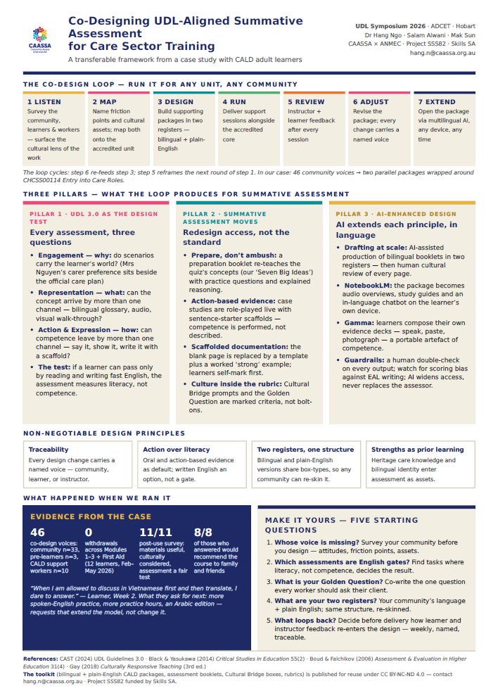
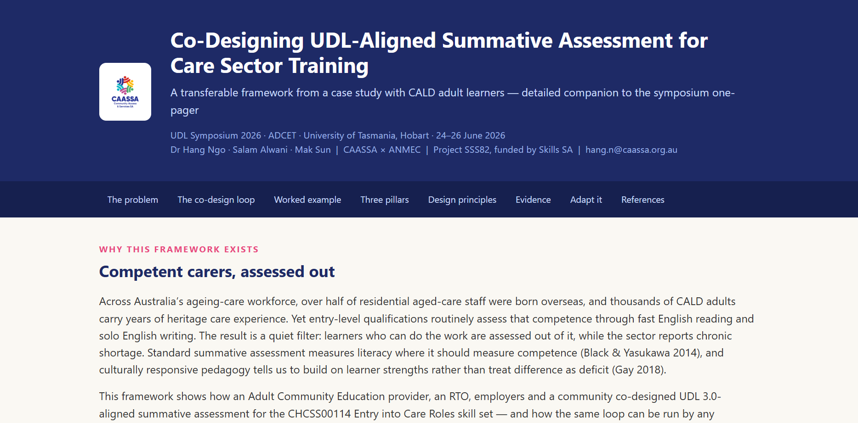
Bring home our gift

