Slide 1



observodon.cloud
Scan the QR code to access a recording
of this session, complete with .

Slide 2

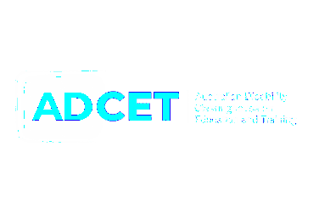


Making practical learning visible with
Cutting-edge video observation within your LMS
UDL Symposium
Hobart, 26 June 2026

Slide 3



Slide 4

N Z
A o t e a r o a

Slide 5

PIED PIPER
michael@thetarngroup.com

Slide 7
How do we help learners show
what they know and can do?

Slide 8



DysCalculator

Slide 9
How do you
currently assess practical competence?

Slide 10

You assess practical skills using some form of written submission.
show of hands

Slide 11
You have had a learner who
could clearly do the task,
but struggled to demonstrate
that competence through writing.
show of hands

Slide 12


But most of the time,
we assess what they can write.
We say we assess
what people can do.

Slide 13

workflow
Learn
Practise
Perform
Write about it

Slide 14
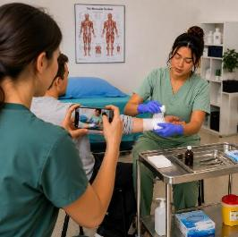
workflow
Learn
Practise
Perform
SHOW IT

Slide 15


meet Mia
wound dressing

Slide 16

Mia learns
through video
1

Slide 17


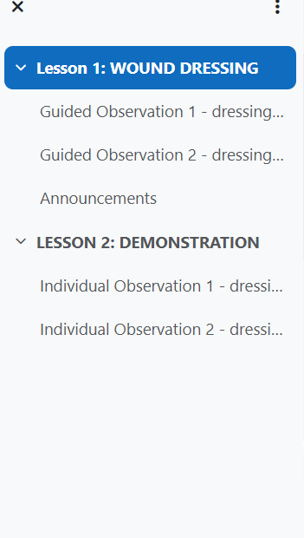



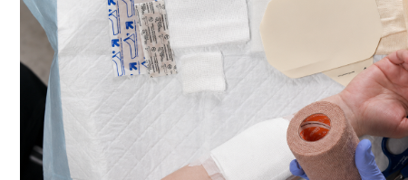





Slide 18
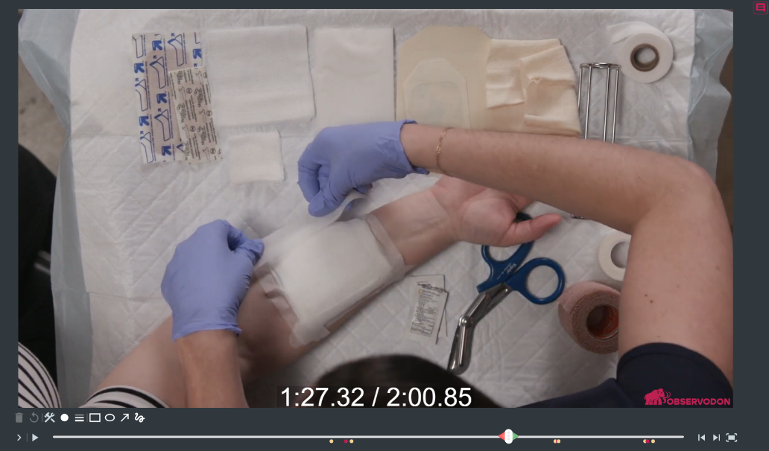
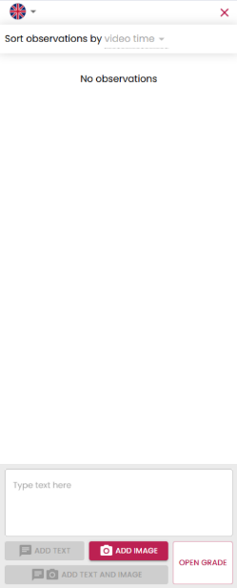


LEARNER VIEW

Slide 19
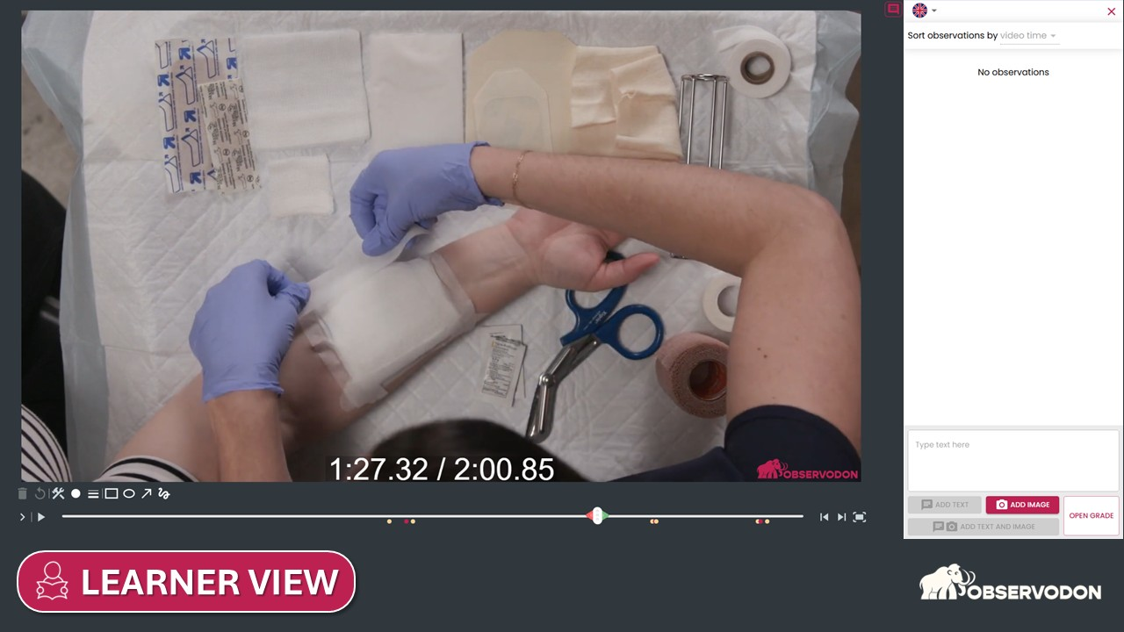


Supporting learner agency and self-regulation.
Mia can engage with the learning at her own pace, rather than relying on a one-off demonstration.

Slide 20
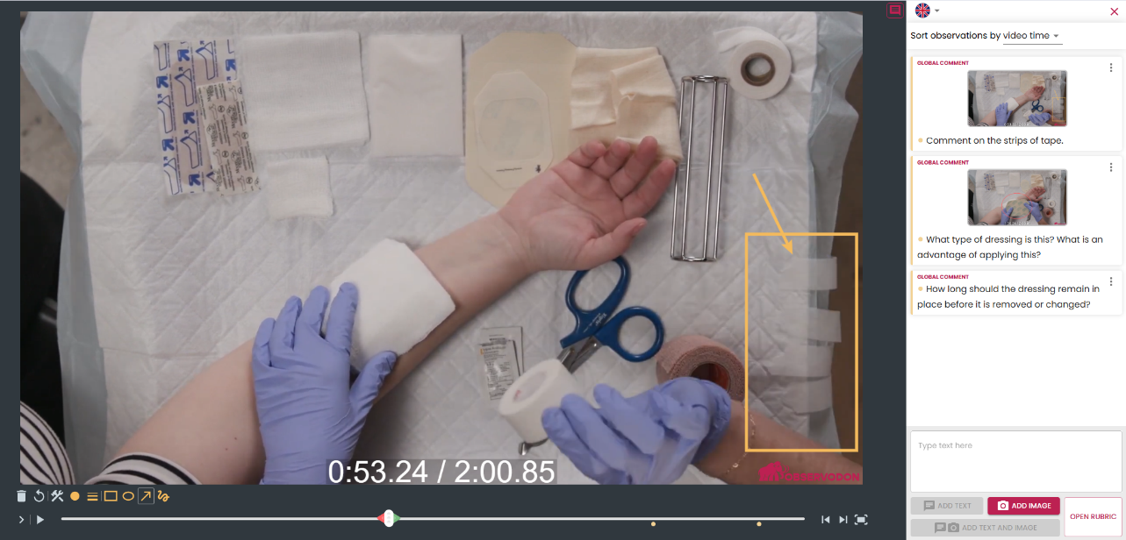
EDUCATOR
LEARNER VIEW

Slide 21
EDUCATOR
LEARNER VIEW

Slide 22
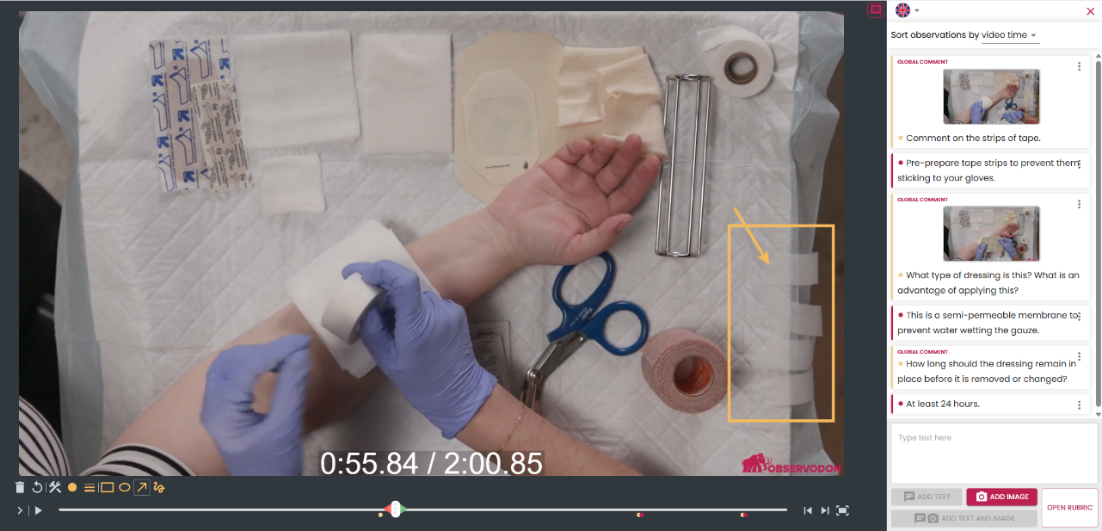
LEARNER
LEARNER VIEW

Slide 23
LEARNER
LEARNER VIEW

Slide 24
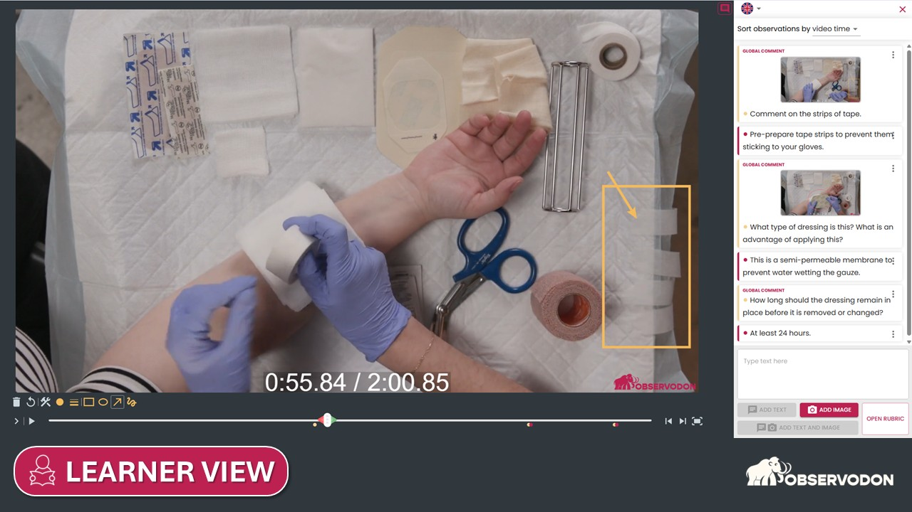

Aligns with UDL's emphasis on active engagement.
Mia is not passively consuming information.
Multiple means of action and expression.
Mia is not restricted to responding
in one way.

Slide 25
LEARNER VIEW

Slide 26
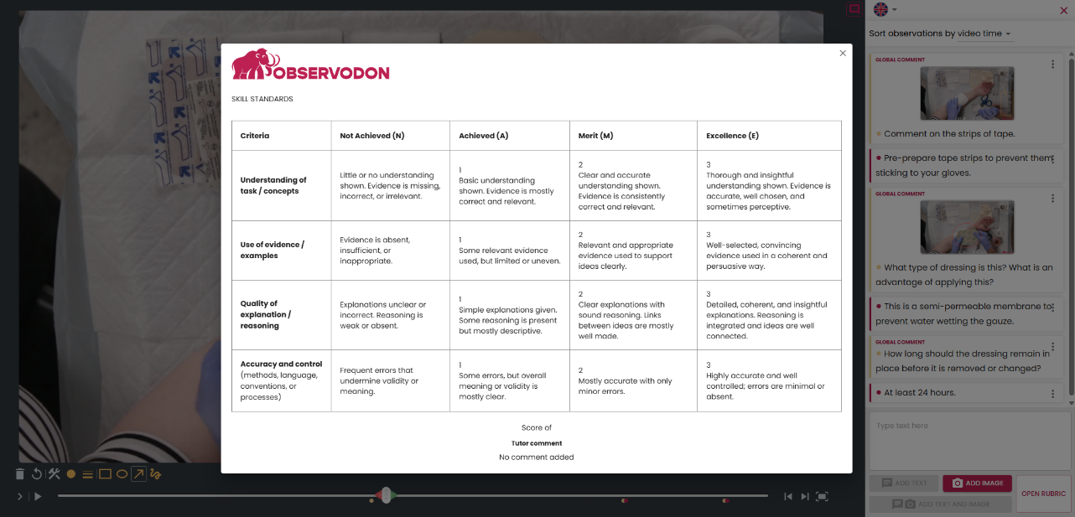
rubric
LEARNER VIEW

Slide 27
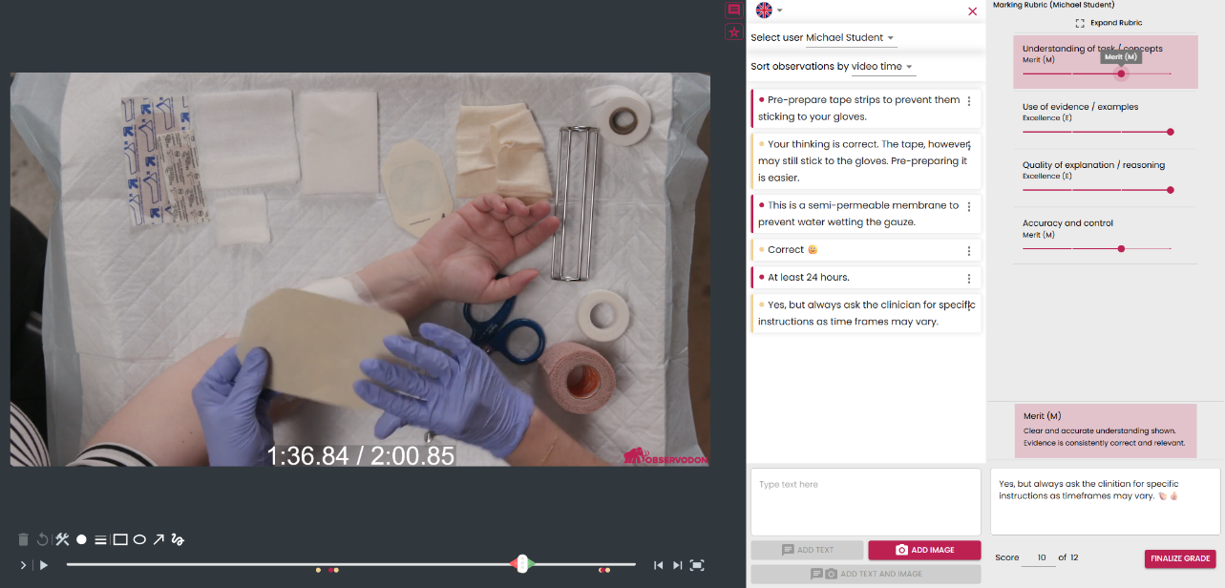

FEEDBACK
Job well done!
EDUCATOR VIEW

Slide 28

EDUCATOR
Job well done!
EDUCATOR VIEW

Slide 29
GRADING
Job well done!
EDUCATOR VIEW

Slide 30
EDUCATOR
EDUCATOR
Job well done!
EDUCATOR VIEW

Slide 31

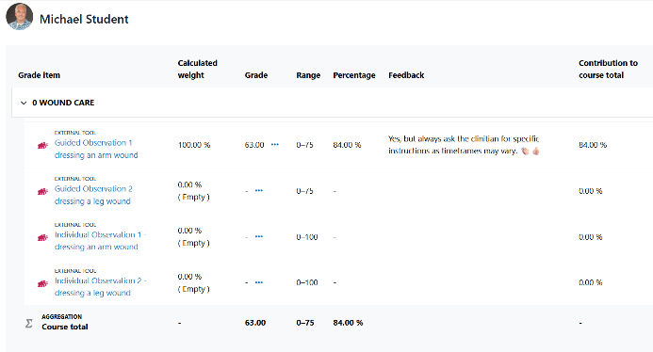
GRADE BOOK
Job well done!

Slide 32
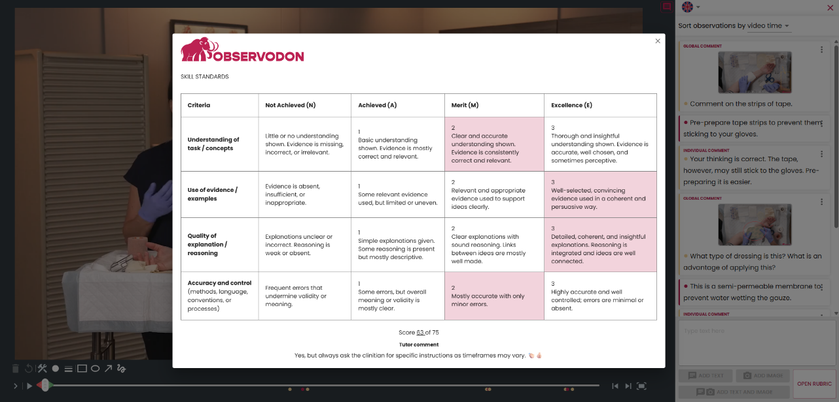
rubric
Job well done!
LEARNER VIEW

Slide 33

2
Mia demonstrates

Slide 34
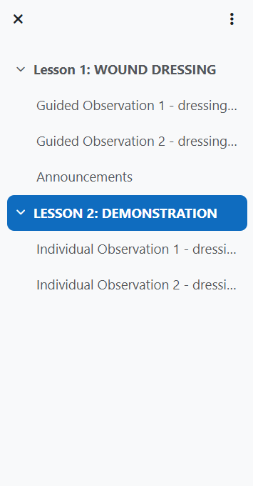

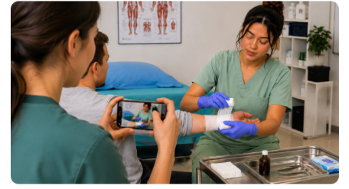
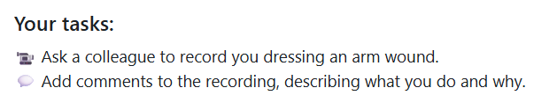


Slide 35
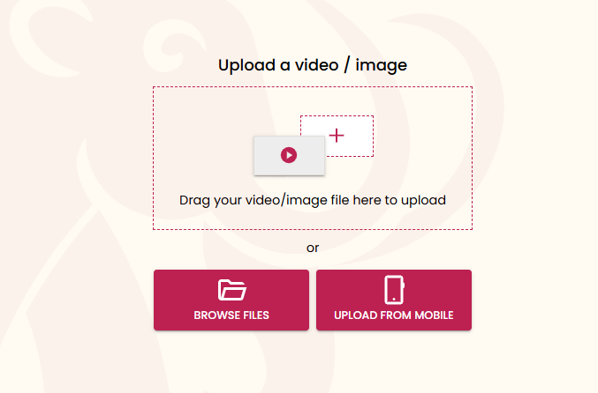

Slide 37
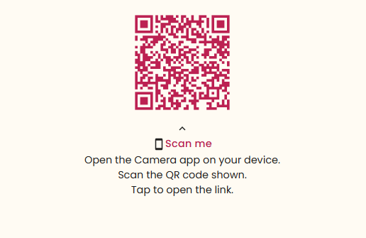
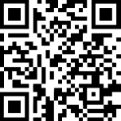
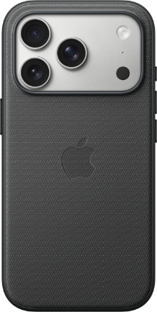

Slide 38


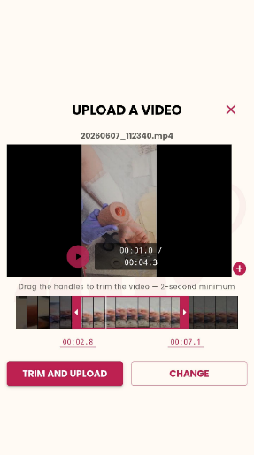
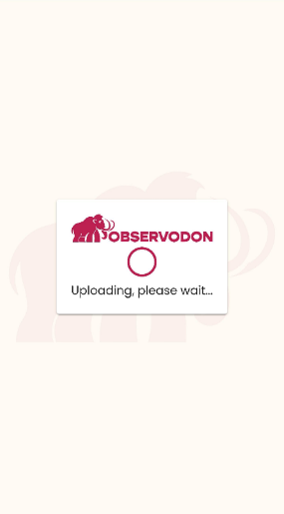

1
2
3

Slide 39
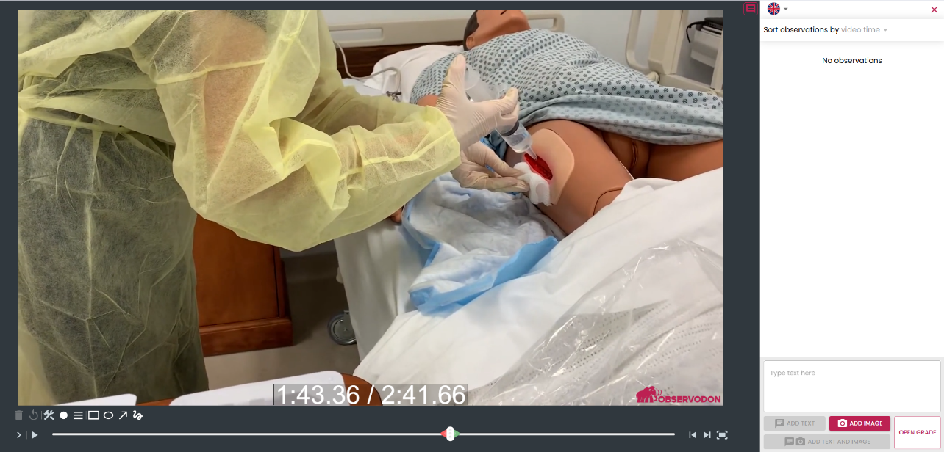
LEARNER
EDUCATOR
LEARNER VIEW

Slide 40
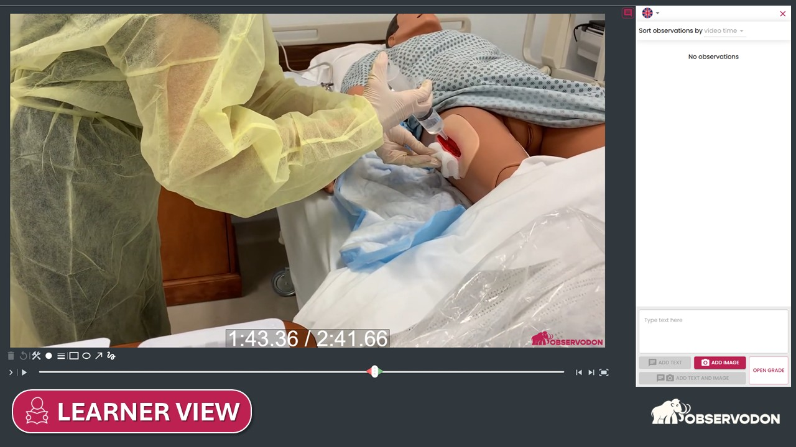

Multiple means of action and expression.
Instead of writing about competence,
Mia can also demonstrate competence
through authentic performance.

Slide 41


Slide 42


Reducing unnecessary barriers.
Cognitive, linguistic, and … technical.

Slide 43



plugs into your existing LMS.
No new system, no new login.
Data sovereignty
Security
Privacy
Compliance
Backup

Slide 44
Your context
Who teaches, assesses, or supports learning that involves people doing something practical?
show of hands

Slide 45





Different contexts.
TRADES
ENGINEERING
SPORTS
HEALTH
TEACHER
EDUCATION
HOSPITALITY
PERFORMING
ARTS

Slide 46





Different contexts.
Same challenge.

Slide 47

Representation
Visual, spoken and written information
Engagement
Multiple ways to engage learners and foster motivation
SUMMARY
Action and Expression
Multiple ways to demonstrate understanding and competence
Self-Regulation
Reflection, review and improvement

Slide 48

Interested in
making practical
learning visible ?
observodon.cloud

Slide 49

webinar with live demo

Slide 50
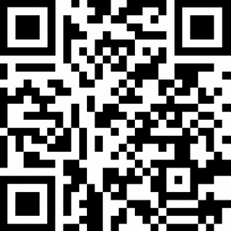
webinar with live demo
SCAN ME

Slide 51

YES. REALLY.
FREE
trial in your LMS

Slide 53

Questions?

Slide 54
observodon.cloud

Slide 55
observodon.cloud
Scan the QR code to access a recording
of this session, complete with .

