Slide 1
Intentional Re-design of a Chemistry Laboratory Program
Susan Hemsley, Educational Designer
Pierre Naeyaert, Lecturer and Director of Senior Chemistry Laboratories
School of Chemistry, Faculty of Science
sydney.edu.au/science/schools/school-of-chemistry.html

Slide 2
Acknowledgement of Country

Slide 3

Introduction
This presentation describes our journey to date in improving the design of the assessments and LMS site for the 3rd year Chemistry undergraduate laboratory program at USyd
We will cover:
  The context
  Issues with original structure/site
  Approach to re-design
  Changes made
  Feedback about the user experience
  Next steps and takeaways

Slide 4
Context
The lab program is inherently complex
  includes students from three 3rd year Chemistry Units of Study
  each student undertakes one of five major projects per unit (therefore 1, 2 or 3 projects, depending on pattern of enrolment).
  each project has multiple experiments, each experiment has multiple small stakes guided experiment-associated assessment tasks, culminating in larger stakes assessments based on an investigative project designed by the students
The program ran as 2 half- Semester blocks with students completing introductory exercises then 1 or 2 projects over 5 weeks
A single LMS (Canvas) site is shared by all students

Slide 5
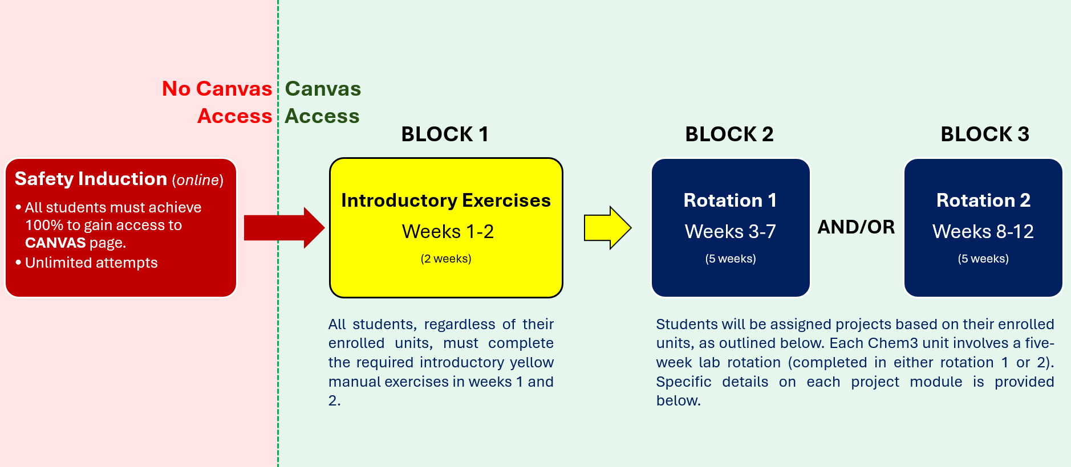
2025 Lab Schedule

Slide 6
2025 Lab Program Structure Canvas Information
The yellow introductory manual experiments in weeks 1-2 require two afternoons/week of lab work, regardless of the total number of CHEM3 units a student is enrolled in. After completing these, students are required to attend the rough equivalent of four hours per week for the rest of the semester for every unit in which they are enrolled. However, these four hours may be arranged in varying ways, as shown below:
Number of Chem3 Units | Total hours | Number of Afternoons/week
1 | 40 | Two for 5 weeks (either weeks 3-7 or 8-12).
2 | 80 | Two for 10 weeks (weeks 3-12) or four for 5 weeks (either weeks 3-7 or 8-12).
3 | 120 | Four for one 5 week rotation (e.g. weeks 3-7) plus two for the other 5 week rotation (e.g. weeks 8-12).

Slide 7
2025 Mark Distribution Communication
Format | Mark distribution
Part 1 Electronic Notebook (ELN) | TOTAL: 20 Marks For projects B & C: ELN report: 19 HIRAC: 1 For projects E, G, J, N & O: ELN report: 7 HIRAC: 1 Samples: 12 For project S ELN report: 7 HIRAC: 1 Proforma #1: 12
Presentation of assessment weightings for Part 1 (of 3)
Covers requirements for all projects for all Units

Slide 8
Specific Barriers to Learning Identified
Condensed lab program
Rushed assignments
Delayed feedback
Confusing Canvas site navigation
Canvas site had a large number of assignments, which appeared overwhelming
All material visible to all students although only a subset was relevant to an individual
Lack of attention to digital accessibility

Slide 9
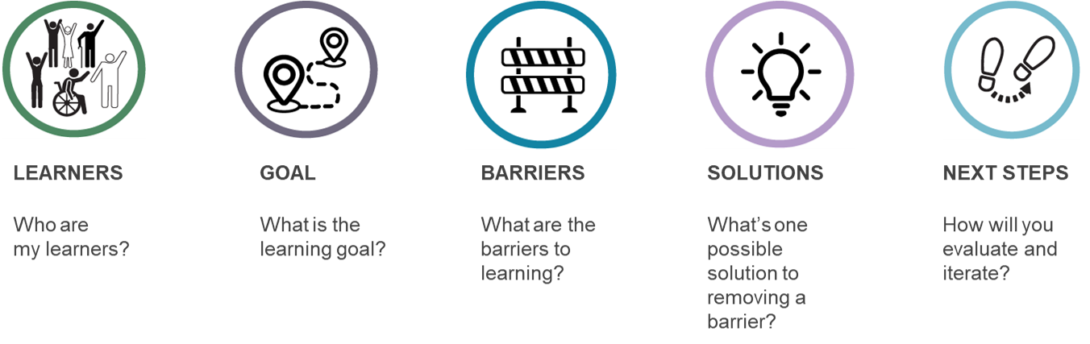
Approach
Primary driver - academic management of the lab program
Three main aims:
  1. Enhance engagement
  2. Support executive functioning
  3. Improve accessibility
The re-design was done intentionally and was aligned with UDL Guidelines 3.0
Sat within broader context of a School-wide strategy of ‘embracing UDL’

Slide 10
Specific Aims
Reduce time pressure
Make lab program structure simpler and assessment aims and processes clearer
Decrease requirements to complete work outside of class
Build in immediate constructive feedback
Build in scaffolding for the independent experimental component
Make it easier to find the relevant information and reduce distractions within Canvas.
Improve accessibility of Canvas content

Slide 11
Changes Made to Program and Assessment Structure
Program ran over the full 13 weeks
Reduction in number of projects with student choice rather than allocated
Assessment structure changes:
  much could be completed in the laboratory, with staff available for immediate support and feedback (consideration 8.2)
  timely feedback on assessment tasks with an emphasis on formative learning (8.5)
  clear, multi-format communication about goals, expectations, logistics and relevance of tasks (1.2 and 7.2)
  scaffolded build up to students designing, managing and presenting their own experimental work (6.2 and 6.4).
  Changes were explicitly explained to the students in an introductory video

Slide 12
2026 Lab Program Structure Canvas Information
Extract from the 2026 Canvas site (found on homepage created for each of Unit)
Week 1 Lab Safety Hurdle (All Students)
The tasks in the Week 1 module are a mandatory, 0-mark hurdle. To access your project modules (e.g., G or J), you must complete all items below.
Before your first lab session (complete at home)
Online Lab Safety Induction Quiz (must be completed before you attend the lab)
In your first lab session (completed in the Yellow Introduction Manual, provided in your first lab session)
Intro Worksheet (completed in the lab and checked off by a demonstrator)
Project Specific Exercise (completed in the lab and checked off by a demonstrator)
HIRAC for your first experiment (completed and checked in the lab)
Projects (Weeks 2–13)
Each student is allocated one project for the semester – either Project G (Organic Reactions) or Project J (Metal Complexes).
Your allocated project is shown in your timetabled lab name (e.g., CH3118-Monday-G = Project G)) and reflected in your Canvas modules and assignments assigned to you.

Slide 13
2026 Lab Program Structure Canvas Information (Table)
Experiment | Assessments
Lab Safety & Intro | Safety quiz, HIRAC (experiment 1), Lab Map Check-off
Experiment 1 | ELN, Technique check, Sample, Short Report
Experiment 2 | HIRAC, ELN, Technique check, Sample, Short Report
Experiment 3 (Part 1) | HIRAC, ELN, Technique check, Sample
Experiment 3 (Part 2 - investigative) | HIRAC, Poster Submission
VIVA | Poster VIVA

Slide 14
2026 Mark Distribution Communication
Mark Distribution for Projects
Component | Weight (%) | Description
HIRACs | 10 | Mandatory pre-lab risk assessments.
Electronic Notebook (ELN) and Discussions | 10 | Data recording & in-lab discussion sign-off.
Lab techniques | 10 | In-lab practical skill checks.
Sample Submissions | 10 | Quality/Yield of physical samples.
Short Reports | 20 | Written reports for Exp 1 & 2.
Poster | 10 | Investigative project poster
Poster Viva | 30 | Oral defense of your poster (Week 13).
Much more clearly laid out but not there are still many subcomponents – a total of 19 for this project, although many were moved to be done in-lab

Slide 15
Changes Made to the Canvas Site
Attention to accessibility (consideration 4.2)
  using Canvas accessibility checker
  chunking blocks of text
  clear delineation of buttons and tables
  using clear language
  video content created for major pain points - captioned and a transcript provided (1.2)
Improved site structure and navigation (4.1 and 7.4)
  more intuitive movement through the site
  site navigation video created
  multiple possible ways of navigating the content)
‘Sections’ used so individual students see only content relevant to them (7.4)

Slide 16
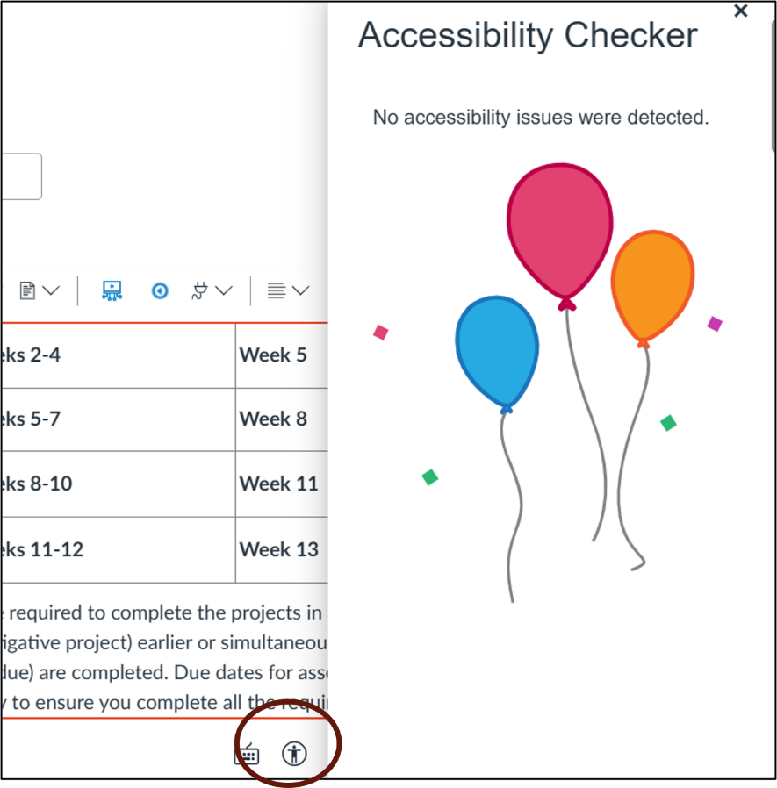
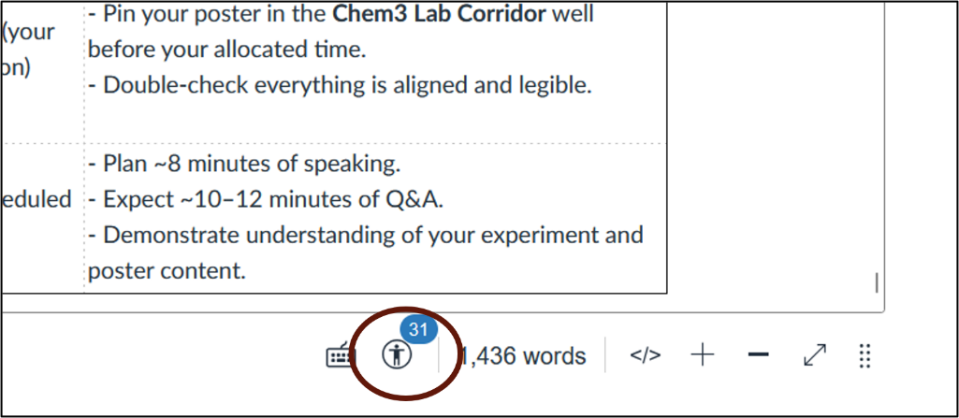
Canvas Accessibility Checker
In-built accessibility checker is an easy way to check things like colour contrast, heading styles, table compliance etc.
A page in the 2025 Canvas site in ‘edit’ mode
A similar, edited, page in the 2026 Canvas site

Slide 17
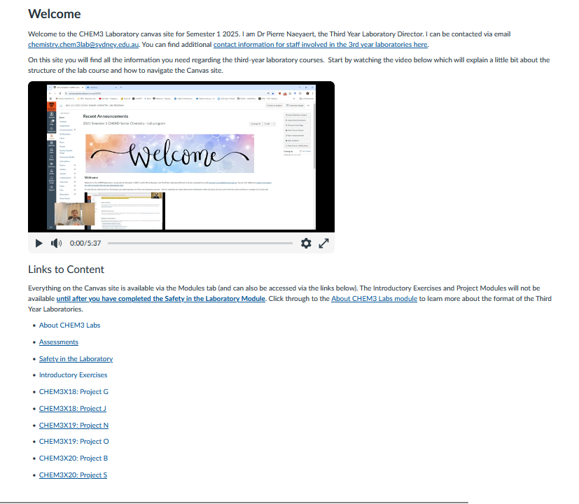
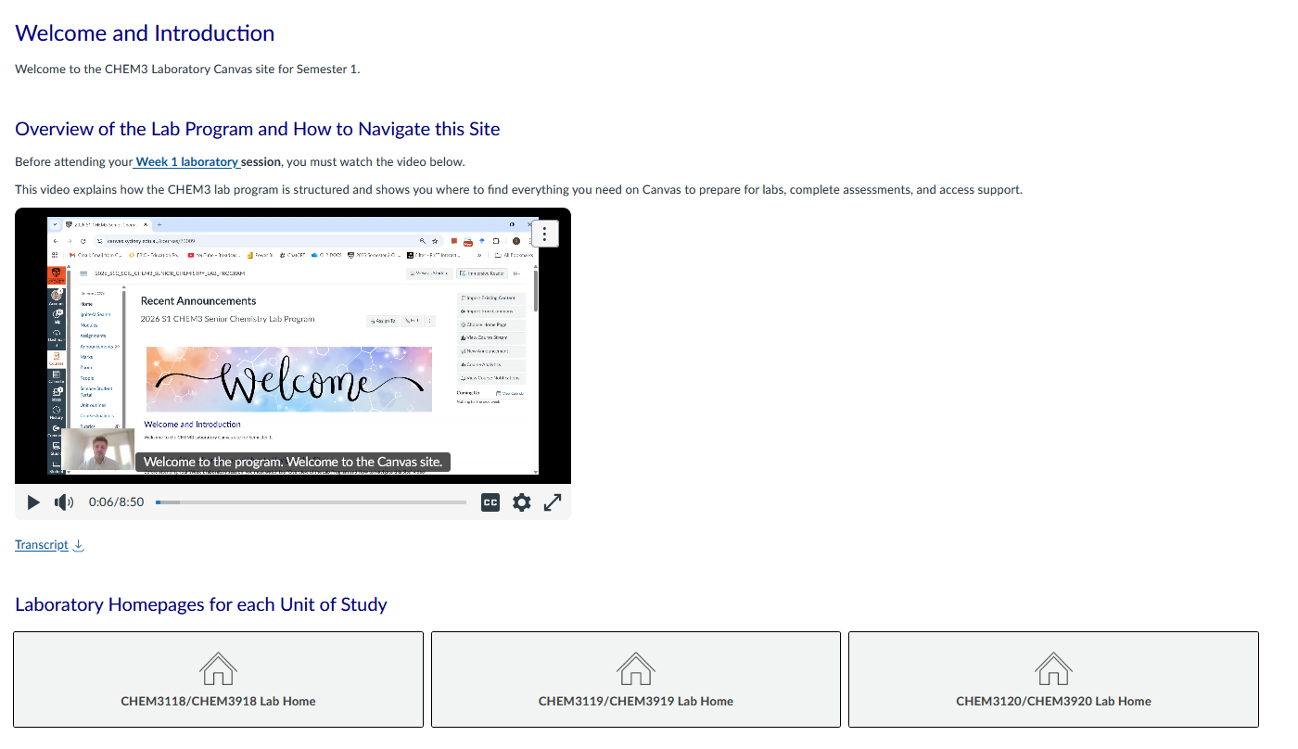
Accessibility: Beyond Accessibility Checker
Homepage 2026 Canvas site
Homepage 2025 Canvas site

Slide 18
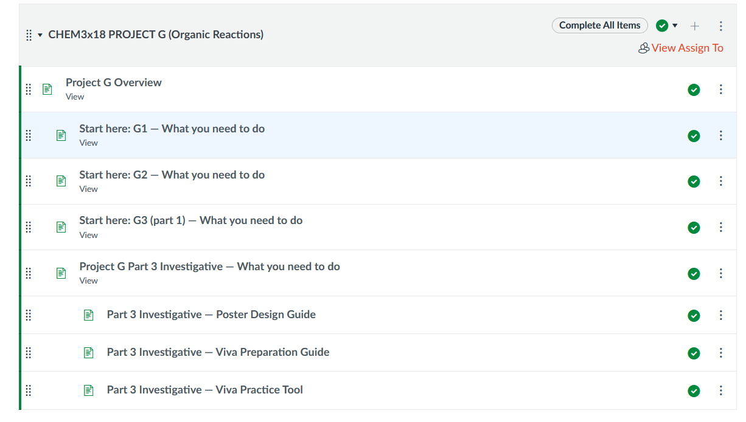
Navigation (1)
Can navigate via the ‘Modules’ area or follow the linked pages inside the site
Modules are restricted only to students needing the material
Module content organised in a logical sequence according to the order in which the tasks need to be completed
Internally, the sequence of pages to visit is clearly signposted
Main module for Project G

Slide 19
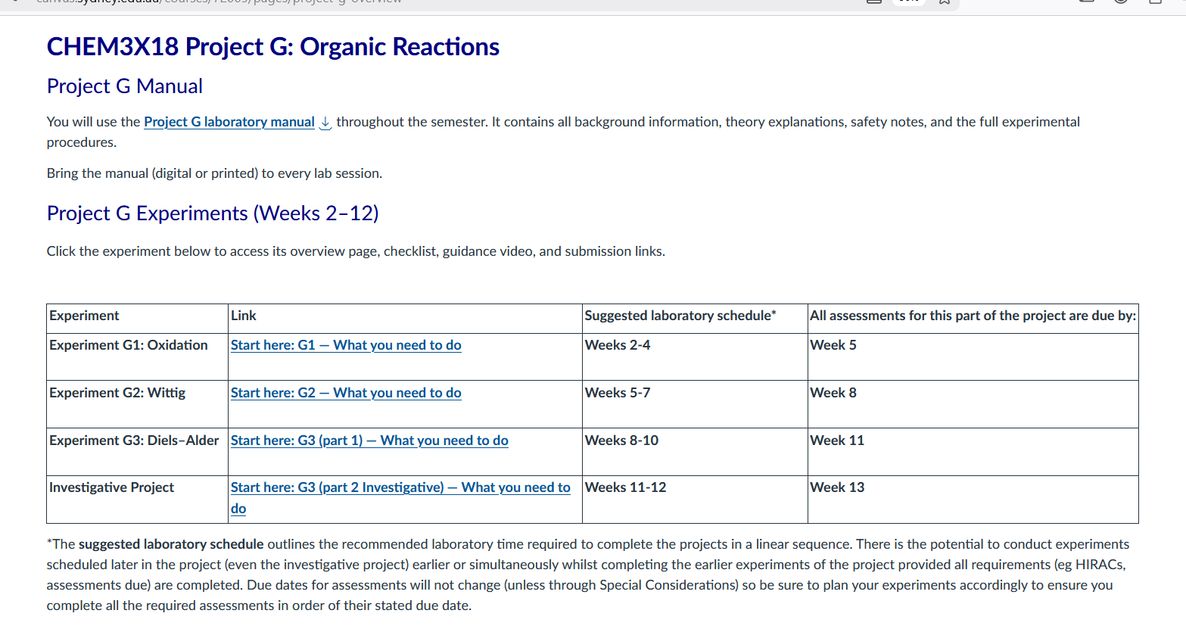
Navigation (2)
Main overview (home) page for project G

Slide 20
Student Feedback (1)
Paper-based in-class survey
  response rate 40/120, 16 students had experienced the lab program previously
For returning students
> 75% found that both the learning experience and Canvas site were improved
  less time pressure
  less stressful
  being able to self-pace
  opportunities to discuss work with demonstrators during lab.
Suggestions for further improvement:
  too many assessments (esp. a problem if doing multiple Units)
  still some confusing aspects to Canvas

Slide 21
Student Feedback (2)
For all respondents
The most beneficial aspects were:
  receiving feedback in time to apply it to later work or remediate work before submission
  immediate feedback (verbal check ins with demonstrators)
  clear structure and expectations
  demonstrators were knowledgeable and supportive (highest rating).
  Canvas rated well (but not as highly as the other aspects )
What they would most like to change:
  too many pieces of assessment

Slide 22
What Next?
Review and iterate!
Look more closely at ‘who are my learners’?
Review assessments- number and weighting
Revisit Canvas navigation – need to tease out specific aspects that can be improved
Consider alternative representation of program/assessments – e.g., graphic timeline
Review accessibility of uploaded documents and any other course material
Gather more feedback, consider focus groups

Slide 23
Takeaways and Tips
We aimed to showcase positive changes that are transferable to other contexts.
This comprehensive redesign took a large collaborative effort but picking one aspect of one change could be applied in a ‘Plus 1’ approach.
For example:
  clear communication about goals, expectations, logistics & relevance of tasks
  immediate feedback where practical
  scaffolding assignments with feedback received in time to apply to later tasks
  some autonomy in learning opportunities
  navigational and assessment guidance videos
  accessibility checks
  providing content in different formats of material (e.g., video + text)

Slide 24
Thank You!

