Slide 1
Beyond the LMS
Aura Farming for Belonging and Agency
Dr Dmitry Zavialov
Learning Designer, Skills Institute
Auckland, Aotearoa New Zealand
skillsinstitute.co.nz
ADCET UDL Symposium 2026
University of Tasmania, Hobart | 26 June 2026
Slide 1 of 17

Slide 2
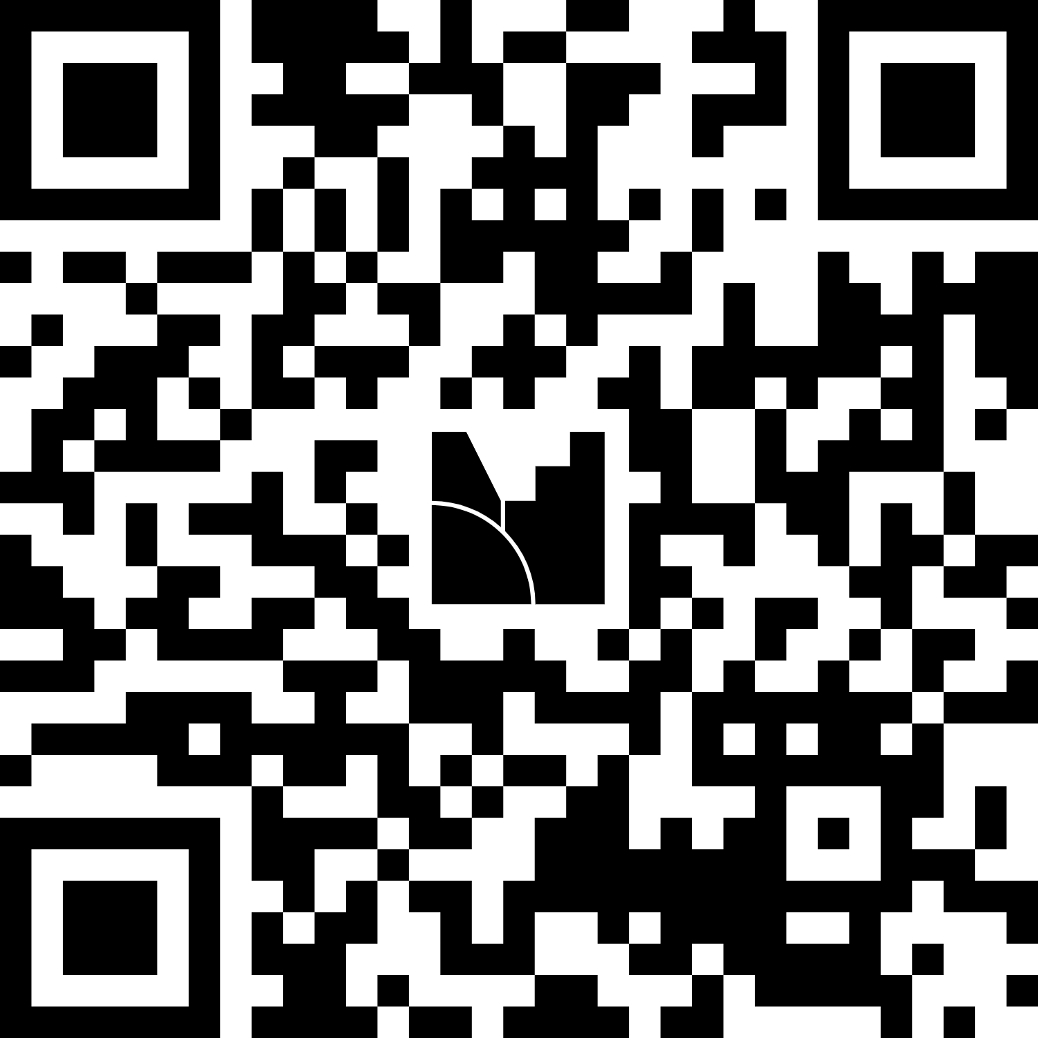
Let Us Start With a Question
How confident are you in designing intentional peer connection activities for your learners?
Take Part
In the room
Scan the QR code on screen
Joining online
Use the link in the chat
Scale:
1 (Not yet)
2
3
4
5 (Very confident)
Beyond the LMS | Skills Institute, Aotearoa New Zealand
Slide 2 of 17

Slide 3
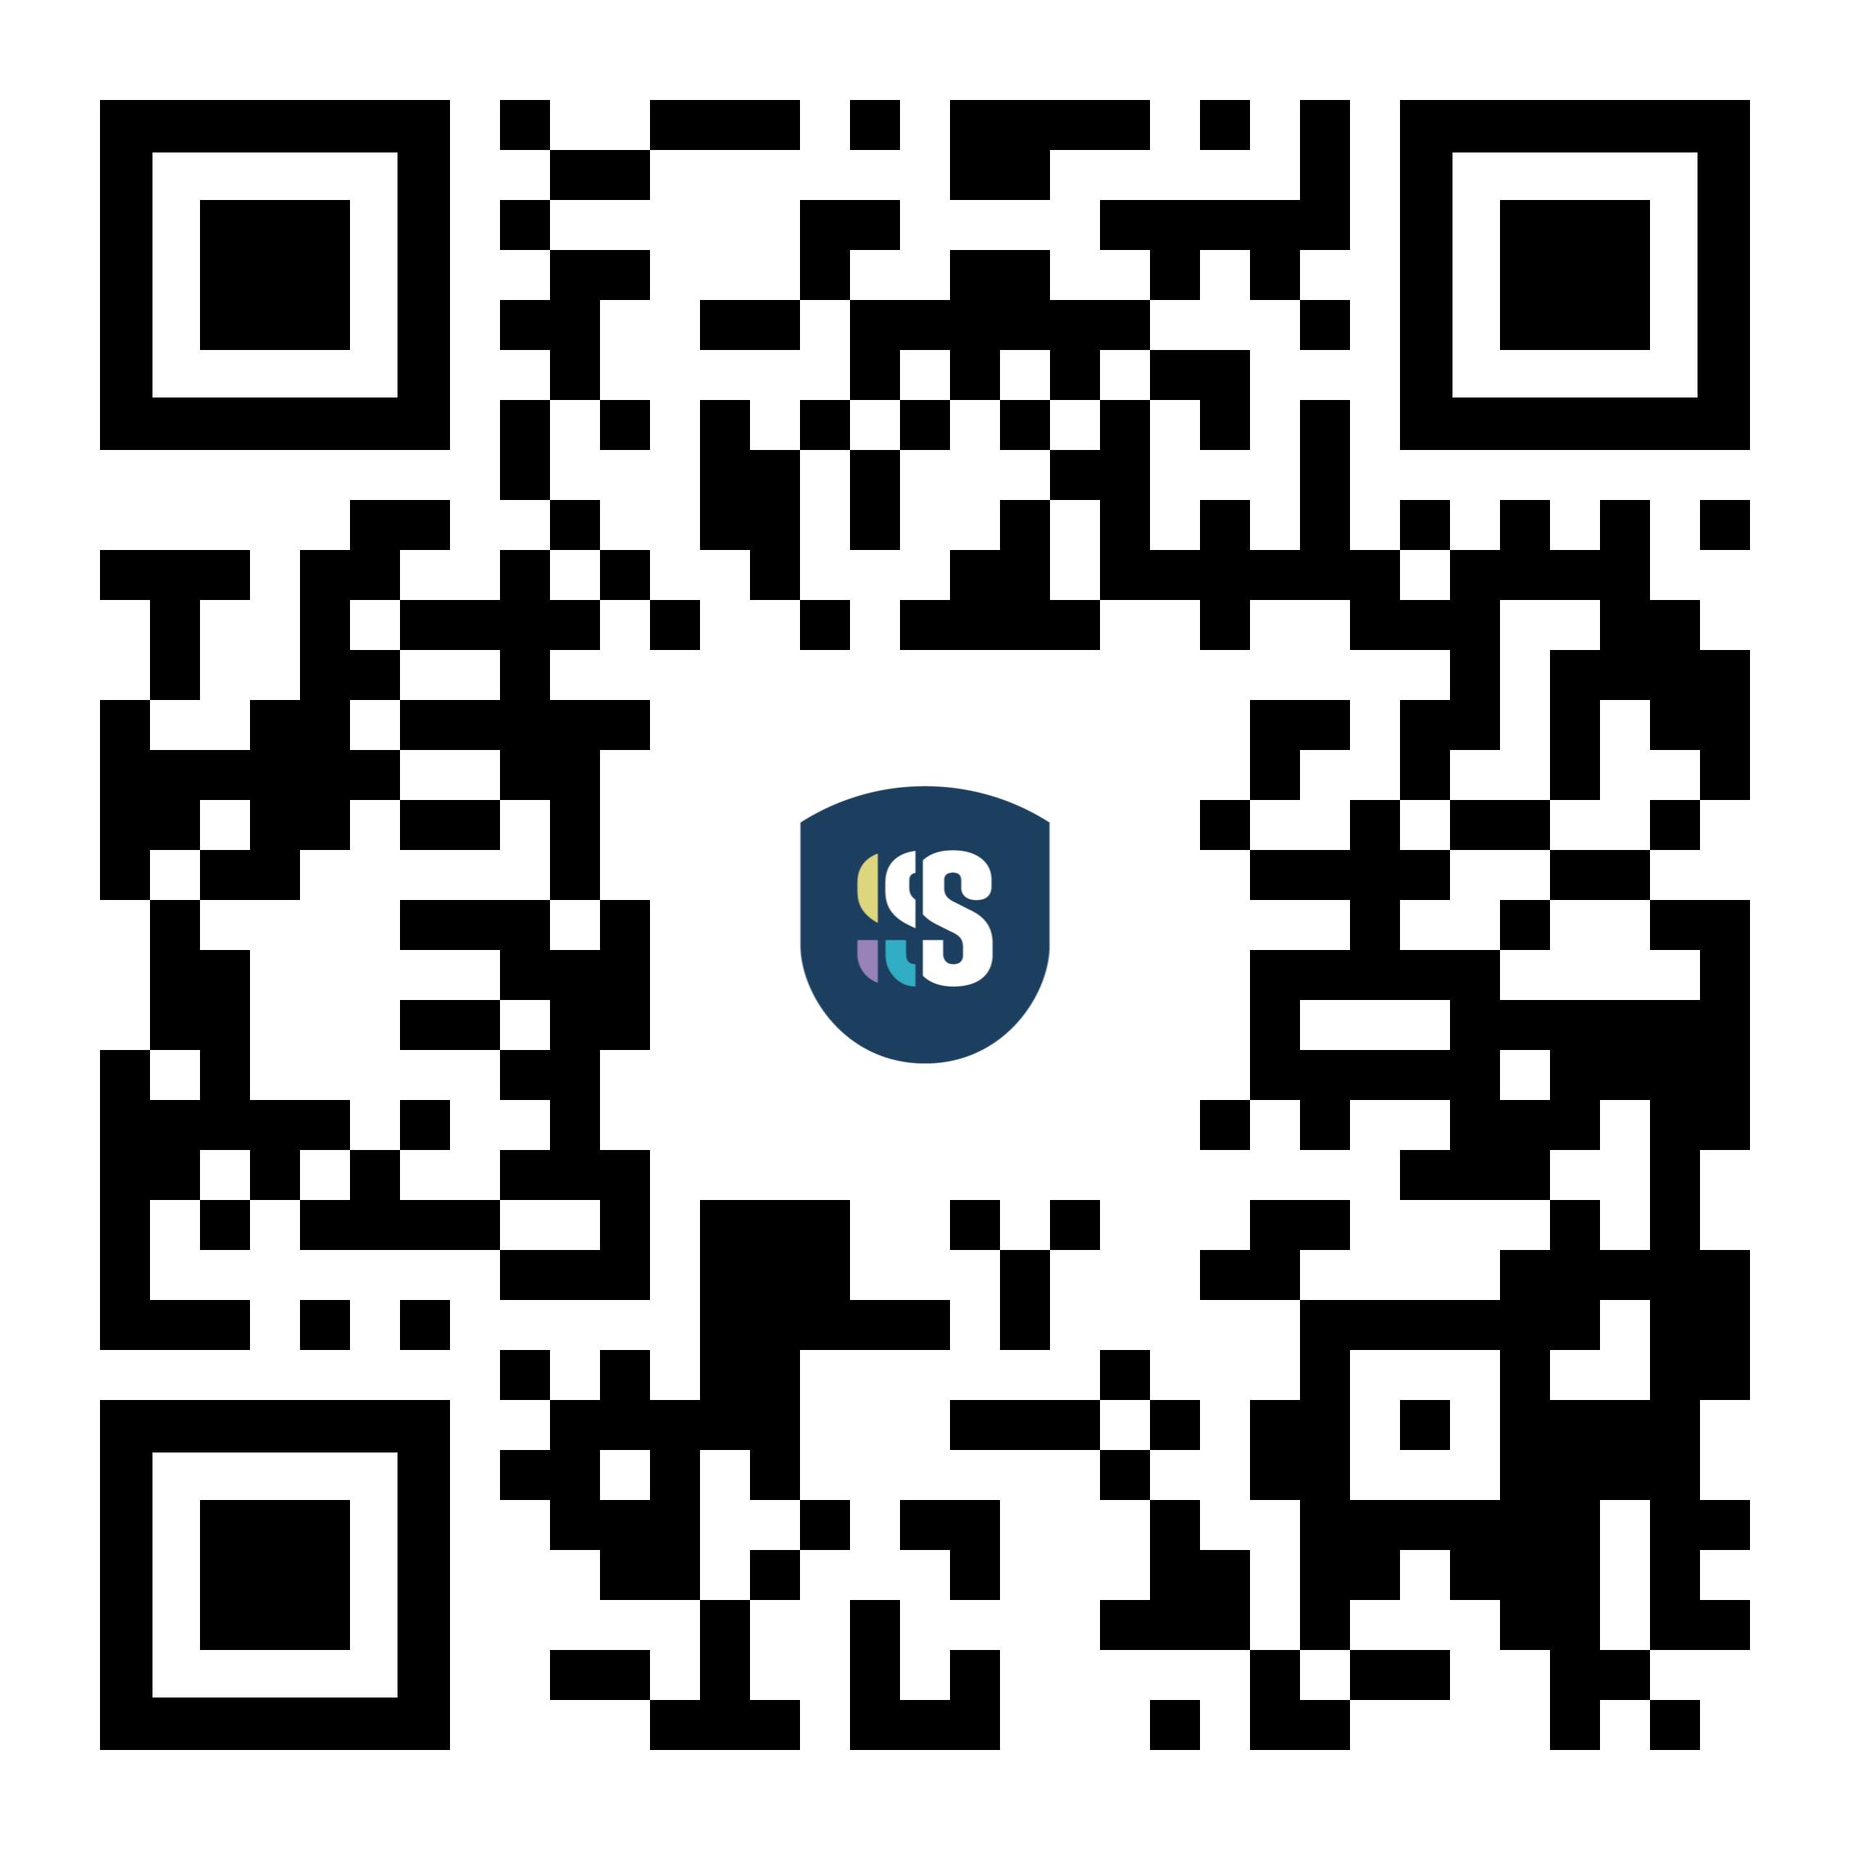
The Loneliness Gap
Curriculum and the LMS rarely cover the spaces in between.
skillsinstitute.co.nz
870,000
excess deaths every year
attributed to loneliness
World Health Organisation
International students
without local networks of support
Quiet attenders
in class but never connected
Curriculum delivery
without a felt sense of belonging
Beyond the LMS | Skills Institute, Aotearoa New Zealand
Slide 3 of 17

Slide 4
Why Design for Connection?
Two philosophical anchors for social learning
skillsinstitute.co.nz
Aristotle
Habermas
Learning is inherently social.
We learn through participation in shared life, in the polis where character is formed.
Design implication
Make space for shared experience, not solitary completion.
Reasoning needs fair dialogue.
Without equitable participation, the conclusions are skewed by who was missing.
Design implication
Design entry conditions so every voice can take part.
Beyond the LMS | Skills Institute, Aotearoa New Zealand
Slide 4 of 17

Slide 5
A Heutagogical Progression
From structured support to growing autonomy and independent practice
skillsinstitute.co.nz
Pedagogy
Structured Foundations
Facilitator-led activities. Buddy Trios assigned. Norms established.
Andragogy
Growing Autonomy
Learner-chosen teams. Self-directed topics. Peer facilitation.
Heutagogy
Independent Practice
Learners initiate connection. Skills transfer to the workplace.
Beyond the LMS | Skills Institute, Aotearoa New Zealand
Slide 5 of 17

Slide 6
Skills Connect
A learner connection and employability initiative
skillsinstitute.co.nz
7
fortnightly
activities
14
week
semester
3
degree
programmes
90
minutes per
session
Voluntary, non-credit-bearing. Open across Applied Business Management, Digital Technology, and Culinary Arts.
Beyond the LMS | Skills Institute, Aotearoa New Zealand
Slide 6 of 17

Slide 7
The Model in Practice
Seven activities across the semester
Wk 1
Wk 3
Wk 5
Wk 7
Welcome
Connect
Walk and
Talk
Kiwi
Quiz Night
Presentation
Challenge
Wk 9
Wk 11
Wk 13
Professional
Presence
Aotearoa
Film Night
Board Games
Night
Beyond the LMS | Skills Institute, Aotearoa New Zealand
Slide 7 of 17

Slide 8
Buddy Trios and Walk and Talk
Two signature elements of the model
skillsinstitute.co.nz
Buddy Trios
Walk and Talk
Groups of three
Continuity across the semester.
Why three, not two?
If one is absent, two still connect.
Trios introduce natural diversity of perspective.
Side-by-side, not face-to-face
Lowers social anxiety. Eye contact is optional.
How it runs
Guided route. Timed pair rotations.
Prompt cards from philosophy and civic life.
Beyond the LMS | Skills Institute, Aotearoa New Zealand
Slide 8 of 17

Slide 9
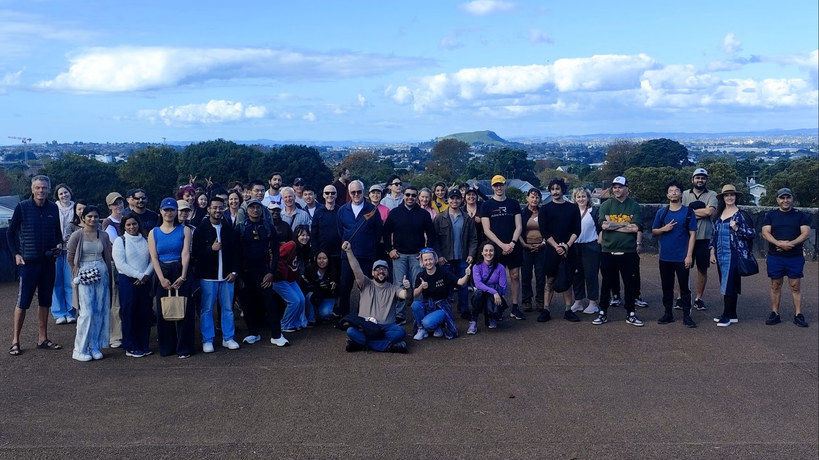
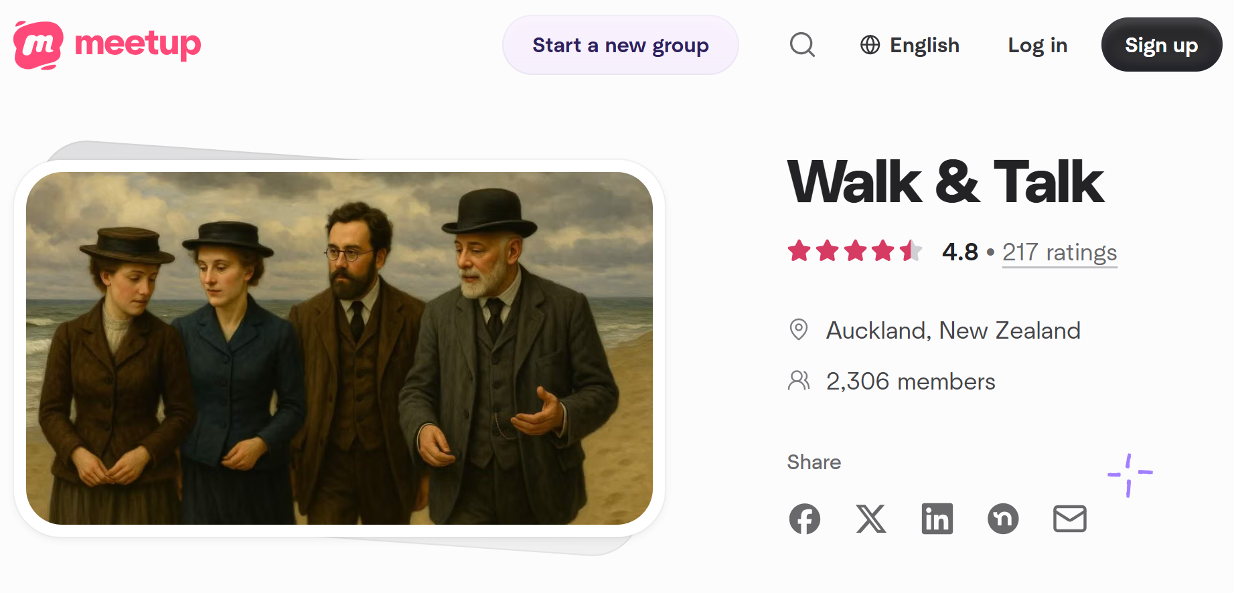
Walk and Talk Meetup
skillsinstitute.co.nz
Walk & Talk event at Cornwall Park
Auckland, April 26, 2026
Screenshot of Walk&Talk Meetup page
Beyond the LMS | Skills Institute, Aotearoa New Zealand
Slide 9 of 17

Slide 10
What is Aura Farming?
Cultivating distinctive presence and professional energy through everyday practice
skillsinstitute.co.nz
Authentic Presence
Showing up as yourself, not a role
Empathy
Listening for what is underneath
Resilience
Staying with discomfort and ambiguity
Ethical Judgement
Making principled everyday choices
Reflective Practice
Noticing growth and adjusting course
Courageous Leadership
Initiating and inviting others in
Beyond the LMS | Skills Institute, Aotearoa New Zealand
Slide 10 of 17

Slide 11
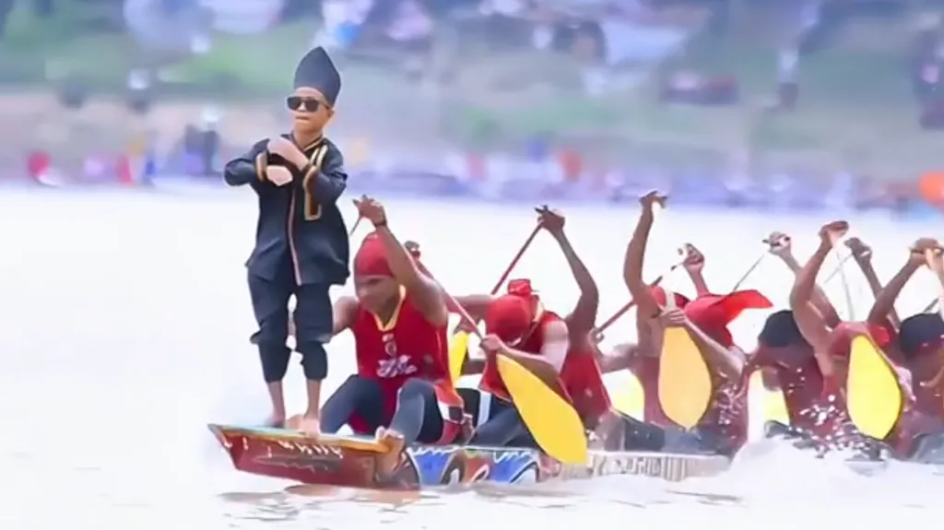
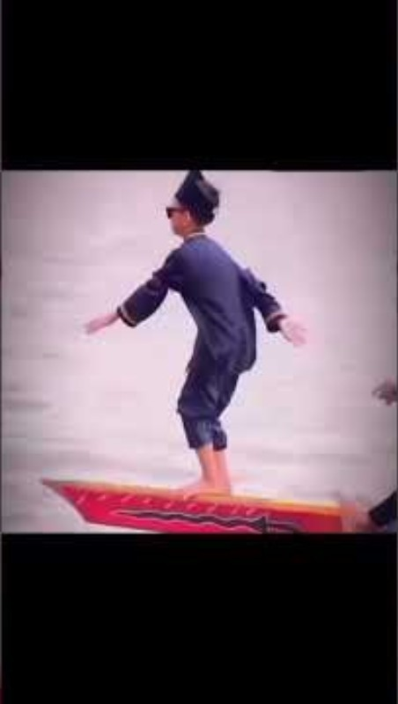
Aura Farming in the Wild
Source: ‘Kid Aura Farming on Boat’, YouTube
Slide 11 of 17

Slide 12
Aligned with UDL Guidelines 3.0
Three guidelines anchor the design
skillsinstitute.co.nz
Nurture Joy and Play
Activities are designed to be enjoyed. Quiz nights, films, board games.
Foster Collaboration and Community
Buddy Trios and rotations give every learner a way in.
Address Biases, Threats, and Distractions
Clear norms, low-stakes options, multiple modes of participation.
Beyond the LMS | Skills Institute, Aotearoa New Zealand
Slide 12 of 17

Slide 13
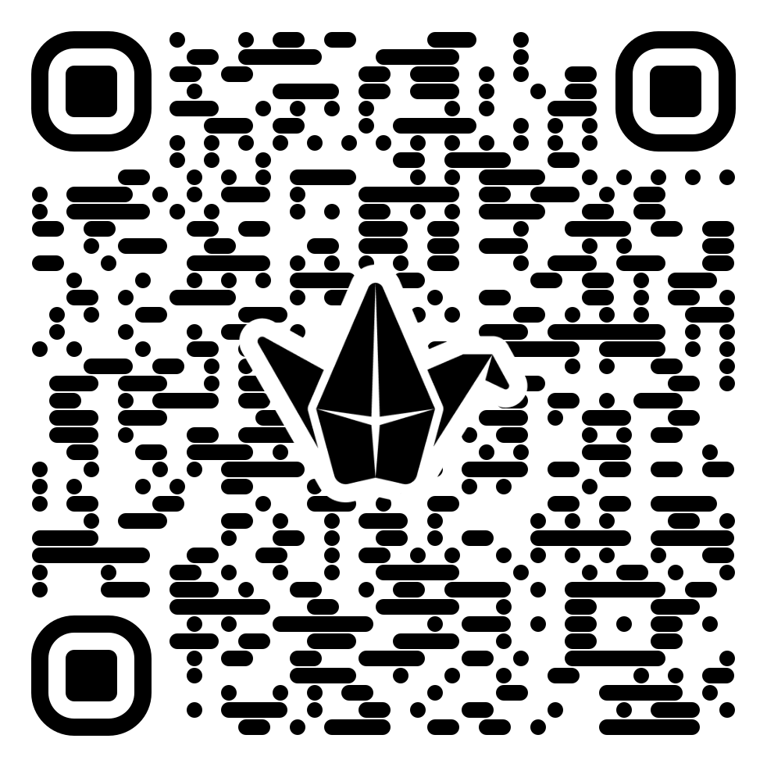
Reflection Pause
Five minutes. Both rooms.
Which element of this model could work in your context, and what would you need to adapt?
In the Room
Turn to your neighbour.
90-second paired exchange.
Joining Online
Share via the chat.
Or post on the Padlet board.
Slide 13 of 17

Slide 14
Impact Evidence
How do we know it is working? Four evidence streams.
skillsinstitute.co.nz
Attendance Tracking
Sign-in and headcount at every event
Repeat Attendance
Proportion returning for later events
1
2
Pulse Surveys
Belonging, confidence, perceived value
Facilitator Observations
Punctuality, teamwork, initiative
3
4
Beyond the LMS | Skills Institute, Aotearoa New Zealand
Slide 14 of 17

Slide 15
Continuous Improvement Cycle
Reviewed each semester with programme teams
skillsinstitute.co.nz
1
2
3
4
Design
Activities and materials
Deliver
Run and observe sessions
Collect
Evidence from four streams
Refine
Adjust based on findings
Activities, resourcing, and communications are refined based on evidence.
Beyond the LMS | Skills Institute, Aotearoa New Zealand
Slide 15 of 17

Slide 16
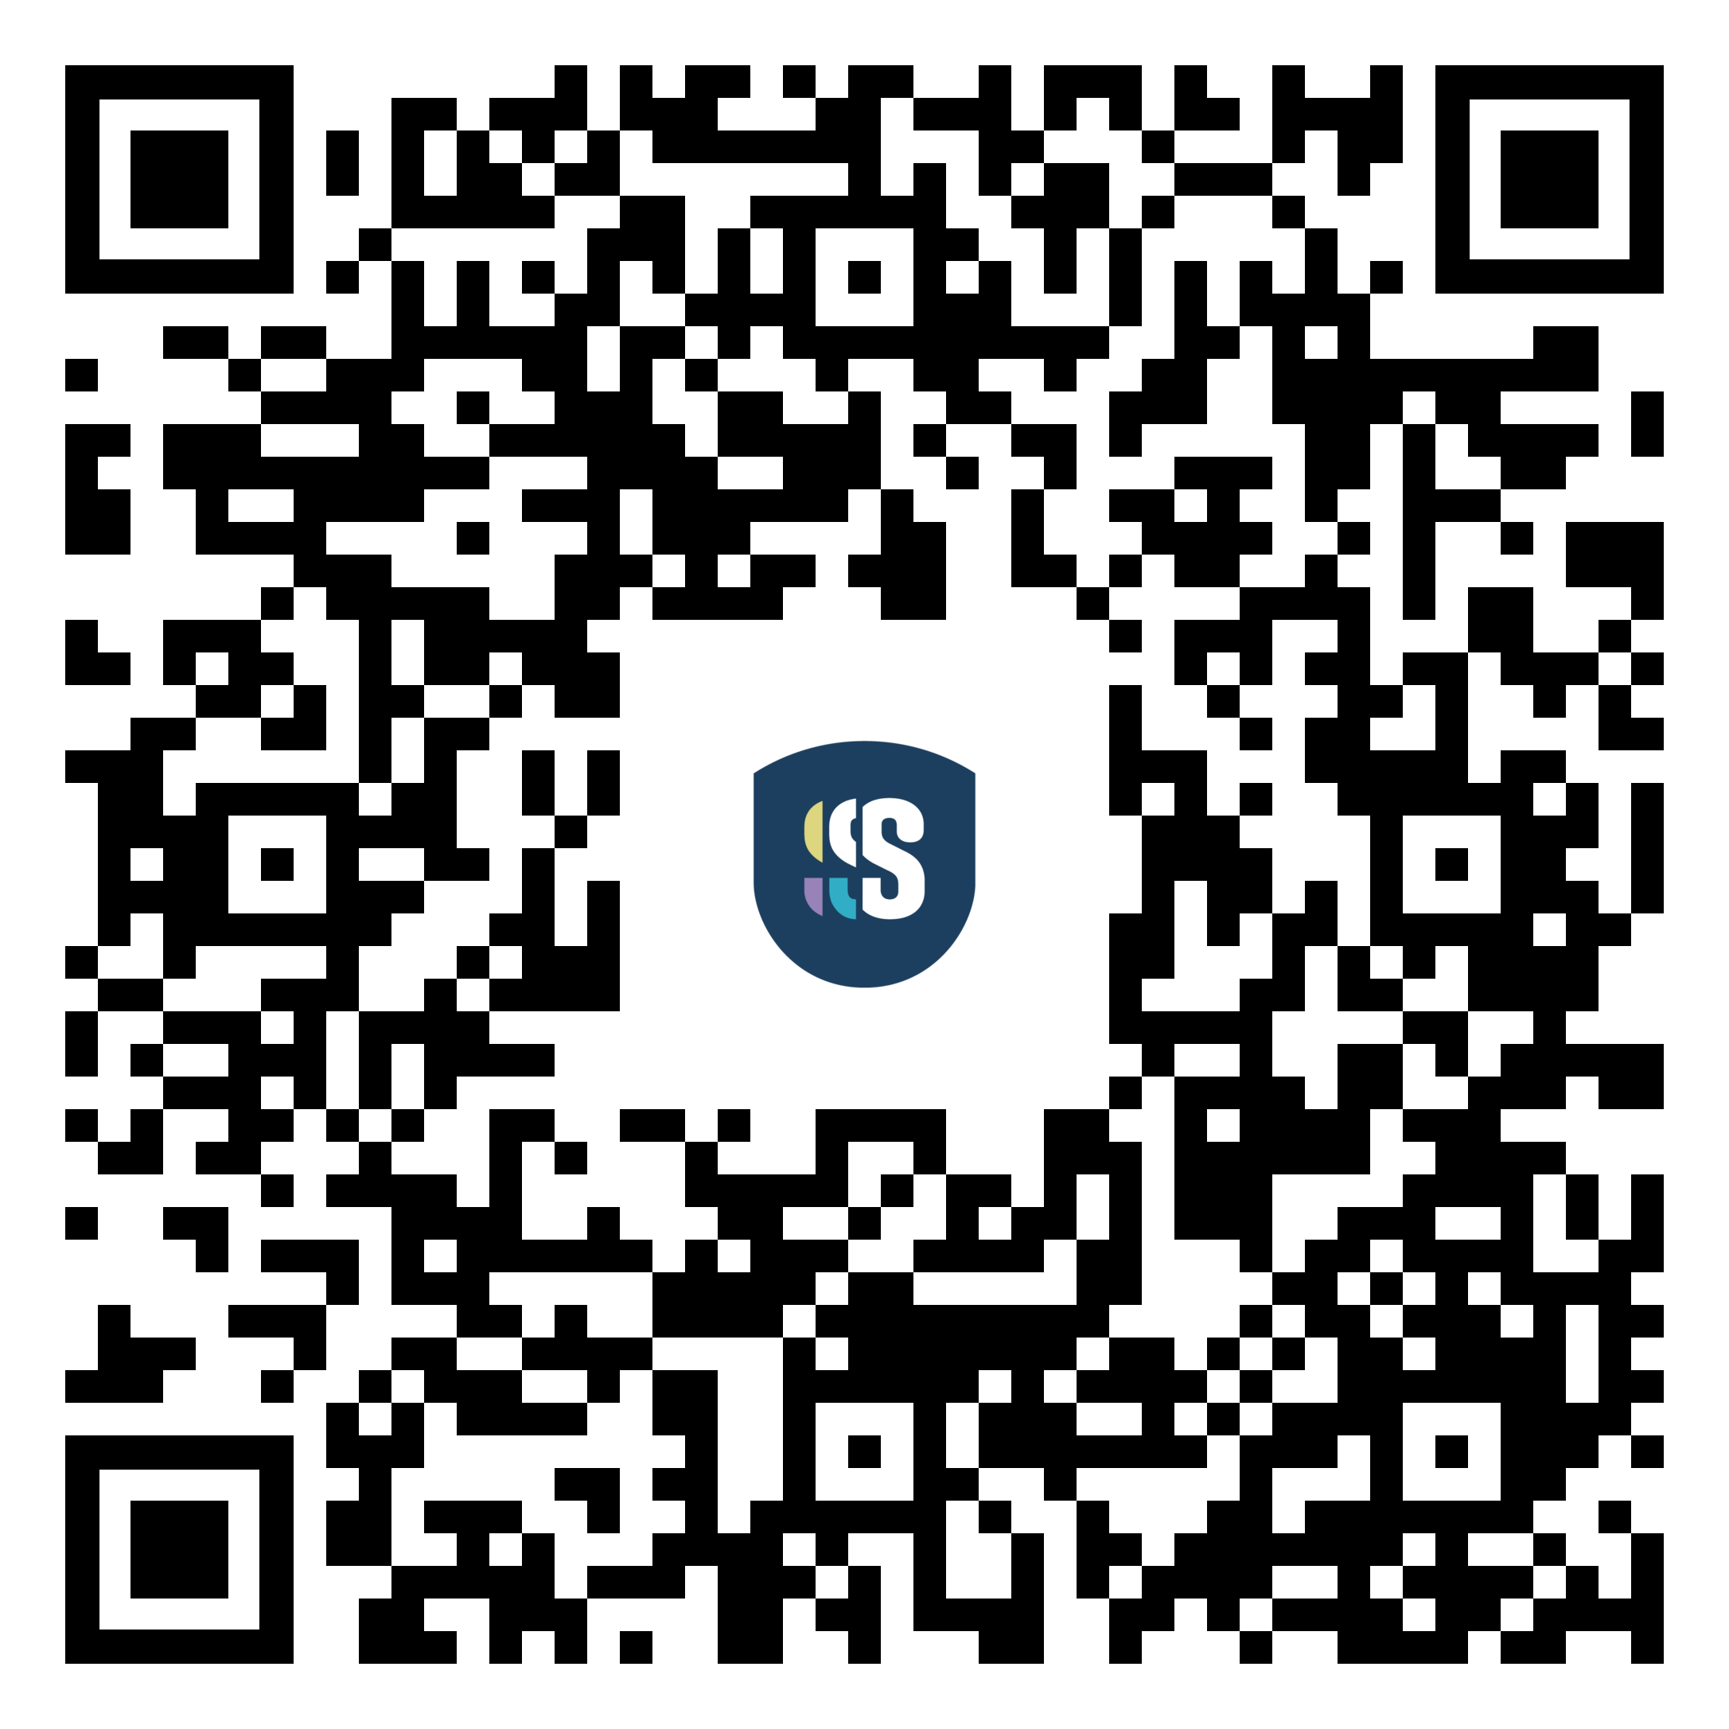
Your Blueprint
Take this away and adapt it for your own context
1
Heutagogical progression: structured to autonomy to independent
Download
the blueprint
2
Buddy Trios: groups of three with continuity
3
Walk and Talk: side-by-side rotations with prompts
4
Aura farming practices: six micro-practices for presence
5
Impact monitoring: four streams plus a review cycle
Beyond the LMS | Skills Institute, Aotearoa New Zealand
Slide 16 of 17

Slide 17
Thank You
Questions from the room and online
Dr Dmitry Zavialov
Learning Designer, Skills Institute
Auckland, Aotearoa New Zealand
Slide 17 of 17

