Slide 1
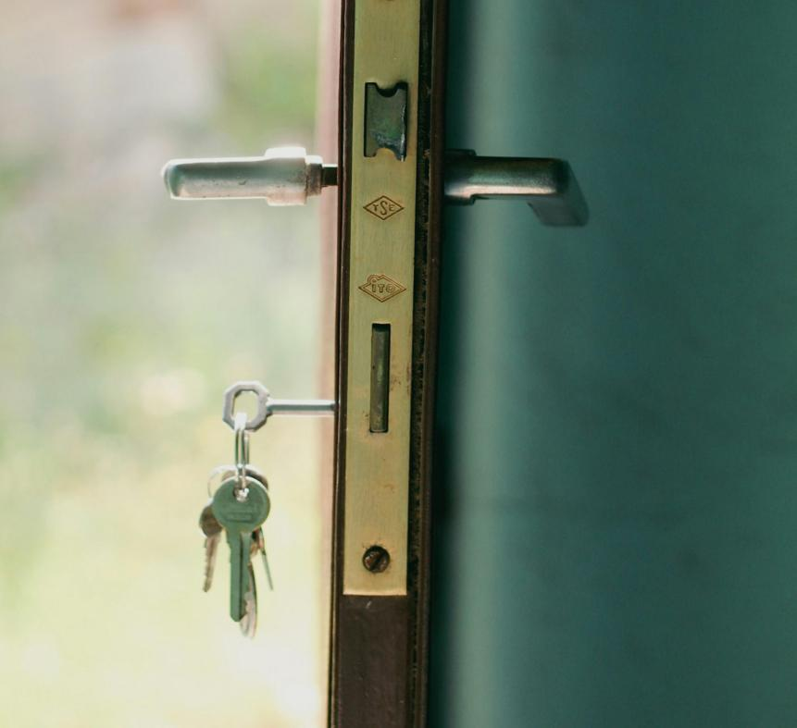
Unlocking the equity potential of AI through
Open Educational Resources (OER)
Sue Sharpe, Lecturer (AI and Inclusive Education), Deakin
Dr Lauren Halcomb-Smith, Lecturer (Open Education), Deakin
Astrid Bovell, Copyright Manager, Deakin
Image credit: Esra Korkmaz on Pexels

Slide 2
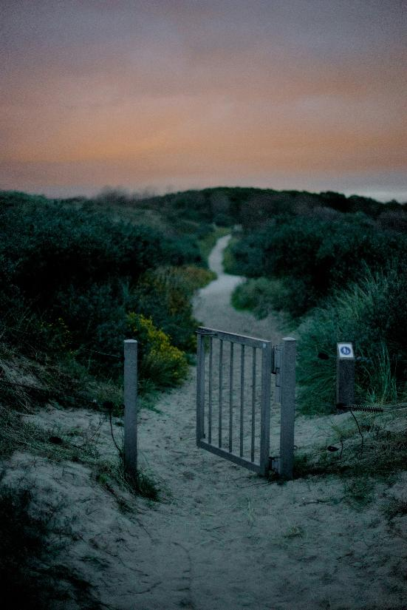
Session format
20-minute session
5 minutes Q&A
Storytelling approach
Menti polls
Interaction & engagement is welcomed,
but not required
2
Image credit: Jochem Raat on Unsplash

Slide 3
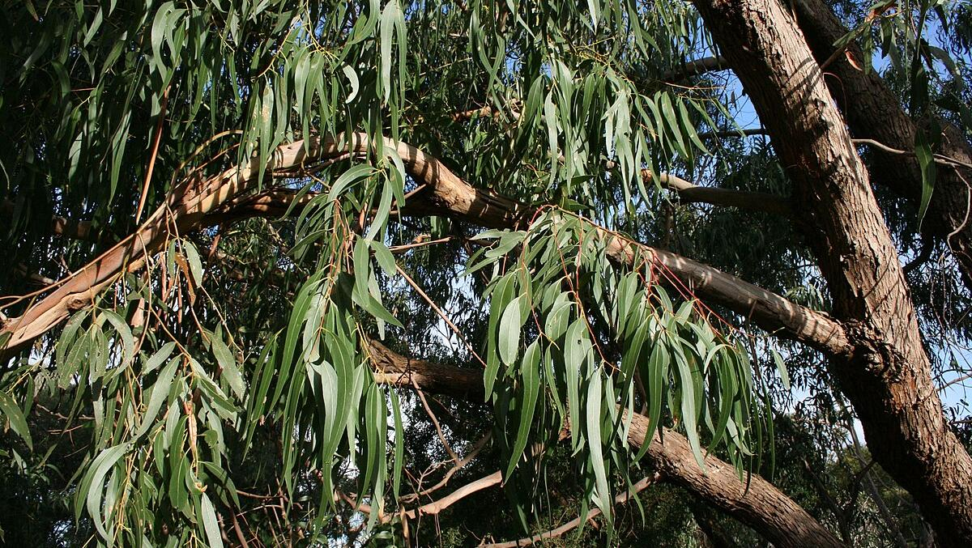
Acknowledgement of Country
We meet today on many different lands.
We want to acknowledge the Palawa peoples of the land we’re on, and the Wurundjeri peoples of the Kulin Nation, the Traditional Custodians of the lands on which we did this work.
We pay our respects to their Elders and Ancestors, and acknowledge their connection to land, water and sky.
Image credit: Neb, Wikimedia Commons

Slide 4
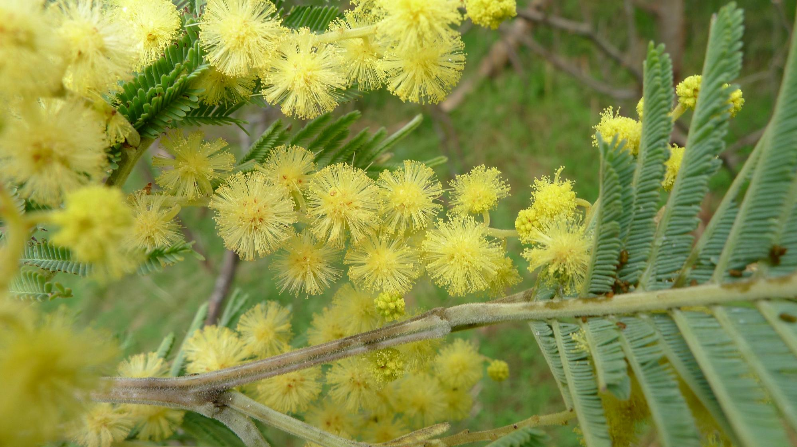
Openness should never override sovereignty, consent or cultural protocol.
Not all knowledge should be open.
As open as possible:
As closed as necessary
Image credit: John Tann, Wikimedia Commons

Slide 5
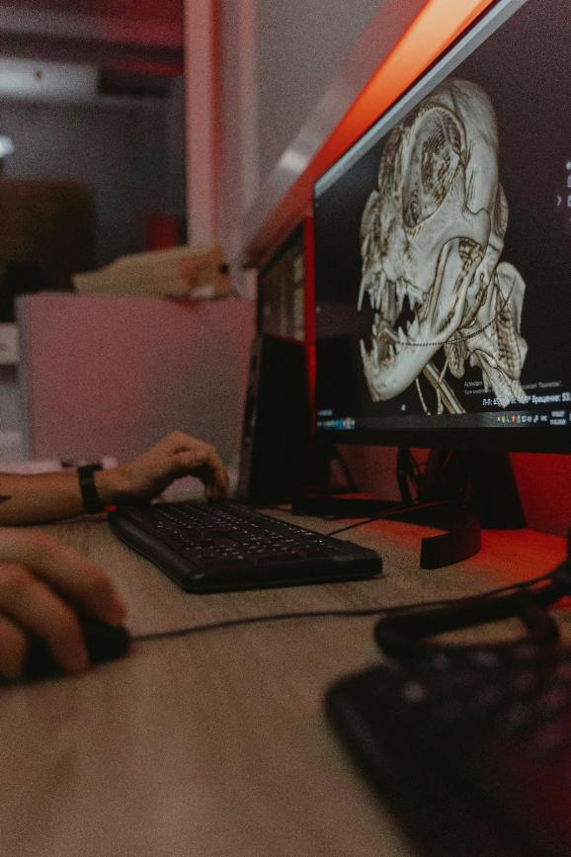
Meet Sam
We’ll explore through the eyes of Sam, and their students.
Sam is an early-career educator teaching a large first-year Veterinary Science subject.
Sam wants:
To do the right thing
To make it easy for their students to do the right thing
5
Image credit: Tima Miroschnichenko, Pexels

Slide 6
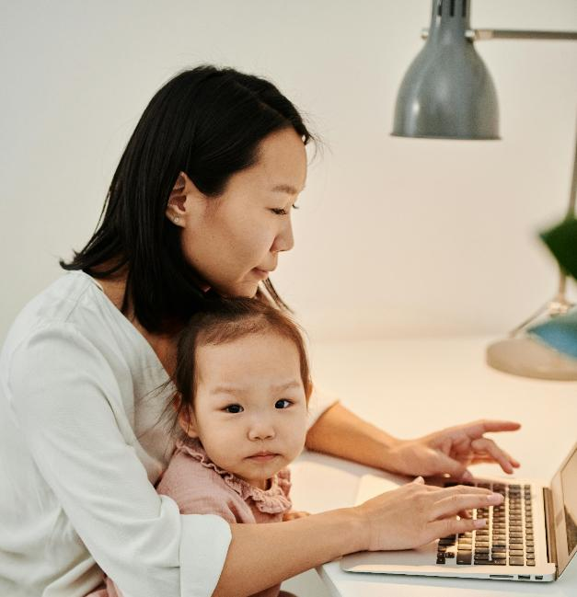
Ji-an
Busy, financially-stressed single mother.
Speaks English as an additional language.
Uses GenAI to summarise and translate the textbook.
Equity affordances offered by GenAI:
Time-savings and cognitive load reduction
Language access and comprehension
Flexible study
6
Image credit: ShotPot, Pexels

Slide 7
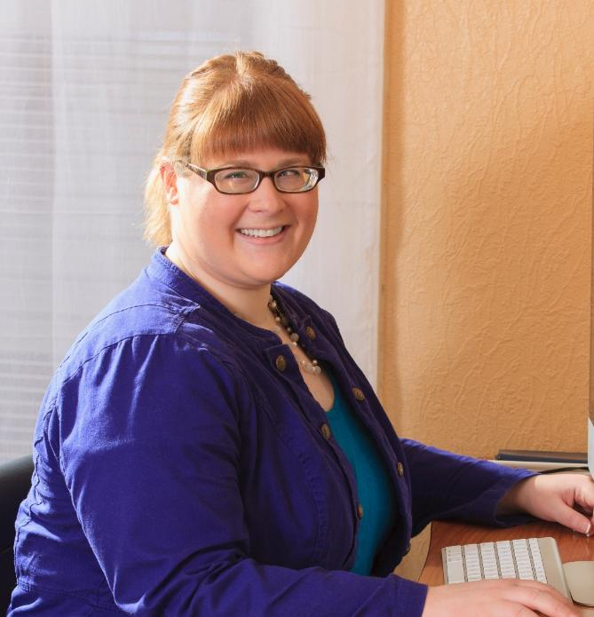
Krystle
High achieving student who has a visual impairment
Uploads lecture notes to AI to check and find
Equity affordances offered by GenAI:
Accessibility checking
Faster discovery and content navigation
Review and revision
Increased agency and independence
7
Image credit: Mark J Hunt, GettyImages

Slide 8
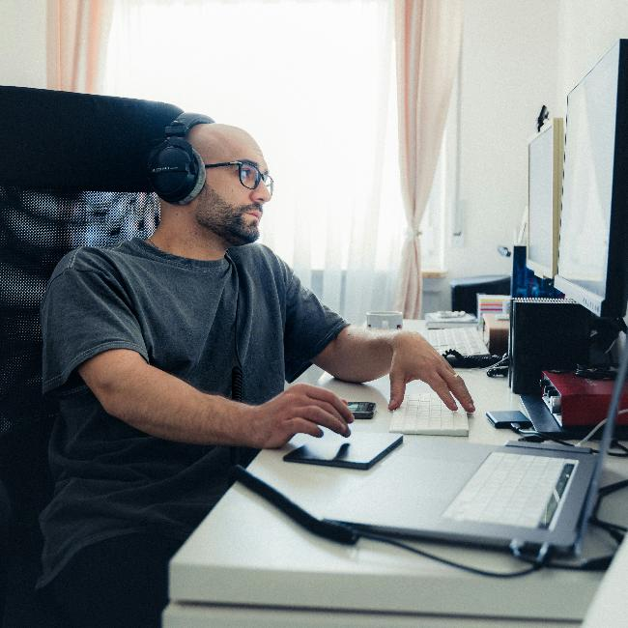
Saeed
A quiet, anxious student who doesn’t speak in class.
Uploads lecture recordings to GenAI
Asks questions to check his understanding.
Equity affordances offered by GenAI:
Low-stakes private rehearsal
Self-paced clarification and targeted remediation
Reduced participation anxiety
8
Image credit: Ante Samarzija on Unsplash

Slide 9
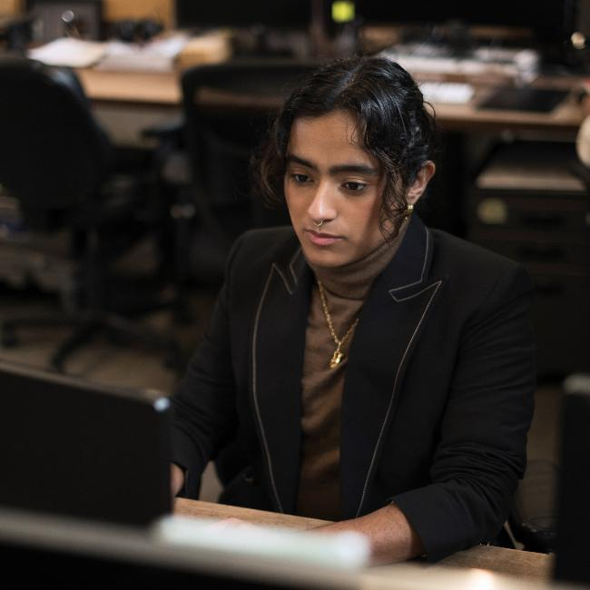
Rima
First in family, has dyslexia, doesn’t know about supports
Uploads assignment outlines and journal articles to Notebook LM
Equity affordances offered by GenAI:
Task clarification
Alternative formats
Scaffolding research literacy
Confidence-building and belonging
9
Image credit: Gender Spectrum

Slide 10
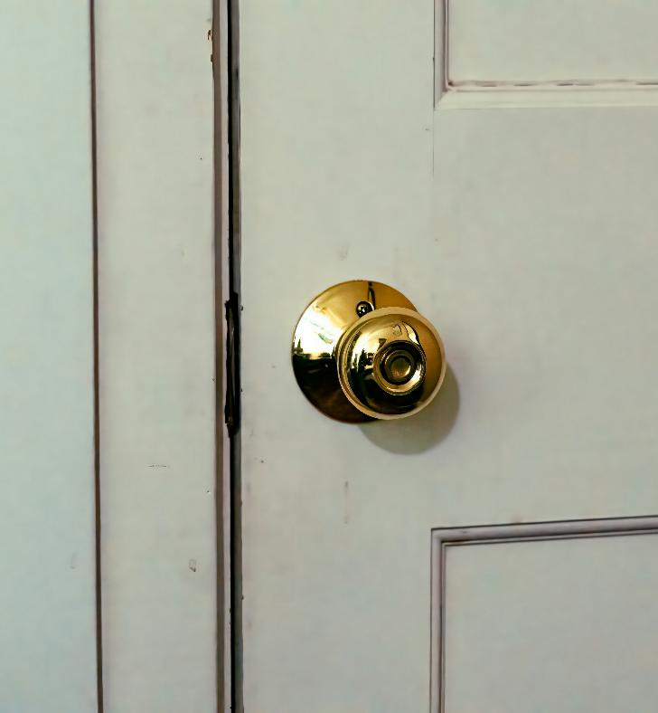
Equity affordances of GenAI tools
GenAI is truly being used in these ways by real students.
These tools can be like a doorknob,
opening the door to more equitable learning.
Image credit: Jason Gooljar on Unsplash

Slide 11
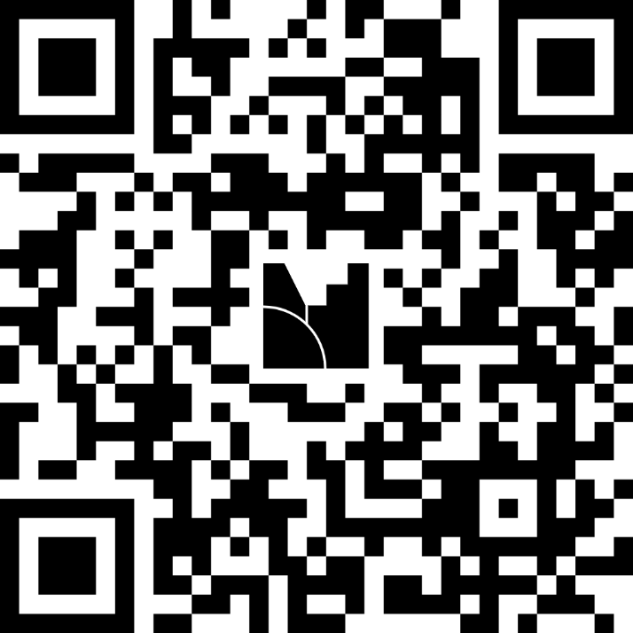
Let’s reflect - Menti
In what ways are these examples relevant to your context?
Let us know in the Menti.
Choose an option:
1. Scan the QR code to join
2. Go to menti.com and enter code: 4265 8684
3. Go to link: https://www.menti.com/alzz5onb8fng

Slide 12

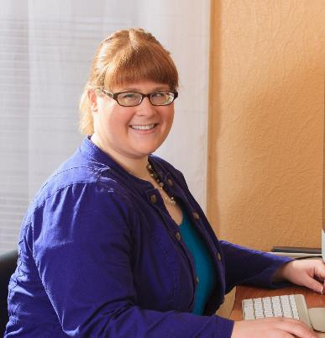
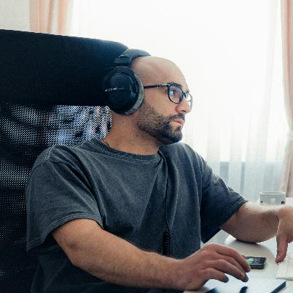
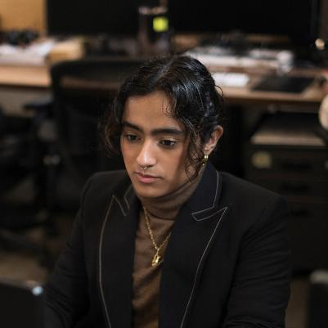
Copyright implications for class
Each student is making a copy of a work, communicating that work to a third party, and allowing that third party to adapt some or all of that work.
Copying, communicating and adapting works are exclusive rights of the copyright holder.
12
Image credits: ShotPot, Pexels (“Ji-an”); Mark J Hunt, GettyImages (“Krystle”); Ante Samarzija on Unsplash (“Saeed”); Gender Spectrum (“Rima)

Slide 13
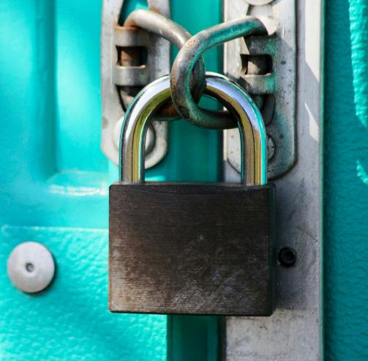
Potential copyright issues
These use cases carry potential padlocks.
Exceptions are not authored with AI in mind.
Subscribed resources often restrict reuse with AI.
Lecture slides and recordings may contain subscribed content.
There's no equity if we don't have a key that fits.
13
Image credit: Kaffeebart on Unsplash

Slide 14

What if we did nothing?
1. Some students will still use AI to assist learning.
  Exposing them to copyright and integrity risk.
2. Some students won’t use AI because they are worried.
  The equity gap widens.
3. Some students will try to navigate the boundaries alone.
  This outsources risk and responsibility to students.
14
Image credit: Javier Allegue Barros on Unsplash

Slide 15

In an ideal world...
Changing the minds of publishers and rights holders is hard.
Changing legislation to afford students better equity is complicated.
But what if we change the way we approach course design?
Photo by Mateus Campos Felipe on Unsplash

Slide 16
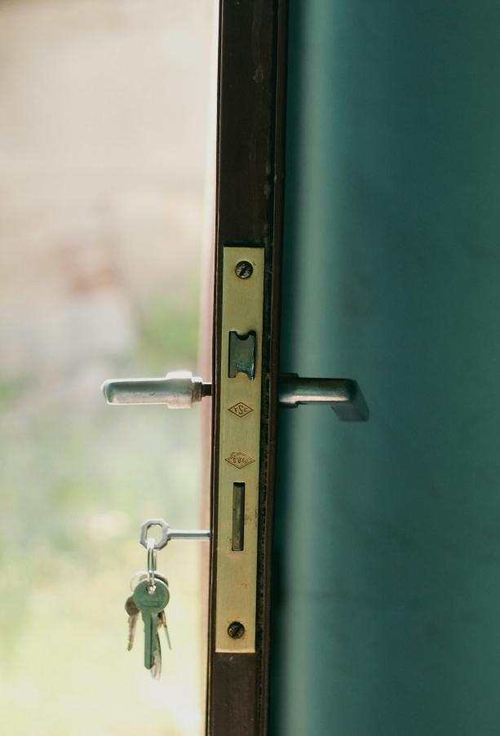
The door metaphor
Less equitable learning environment
Barriers
More equitable
learning environment
Copyright restrictions
AI tools
OER / OA
16
Image generated by Adobe Firefly

Slide 17
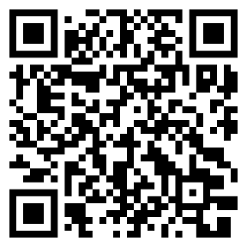
Open Educational Resources
Open Educational Resources (OER) are learning, teaching and research materials in any format and medium that reside in the public domain or are under copyright that have been released under an open license, that permit no-cost access, re-use, re-purpose, adaptation and redistribution by others. (UNESCO, 2019)
For more information, visit our LibGuide: Open Educational Resources (OER) (https://deakin.libguides.com/oer-drm)
17

Slide 18
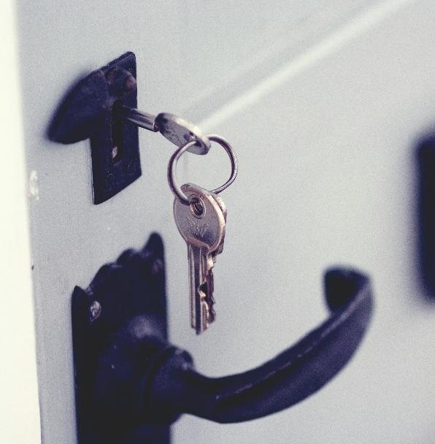
Open Access research articles
Open access (OA) journal articles
are scholarly articles that are free to read online
aren’t strictly OER but support many of the same learning uses
often accessible to AI tools
Open access ≠ openly licensed - Some OA articles are free to read but do not permit adaptation or redistribution.
18
Image credit: Jaye Haych on Unsplash

Slide 19
Sam’s strategies
Sam works with the Library and learning designers to unlock the equity affordances of GenAI by prioritising open. They…
adopt OER for supplementary readings
replace the existing textbook with an OER
use openly licensed images for lecture materials
find OER via MERLOT, OER Commons, & Deakin Open eBooks
provide clear guidance on acceptable GenAI use
prioritise open access (OA) journals for research assignments
make licences visible on all learning content
19

Slide 20



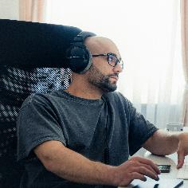
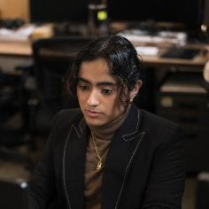
Sam’s unit, Open by design
More equitable learning environment
AI tools
OER / OA
20
Image credits: Door image Image generated by Adobe Firefly; ShotPot, Pexels (“Ji-an”); Mark J Hunt, GettyImages (“Krystle”); Ante Samarzija on Unsplash (“Saeed”); Gender Spectrum (“Rima)

Slide 21
Q&A
Please share your questions or comments in the Slido.

Slide 22
References & AI statement
Attewell, S. (2025, May 21). Student Perceptions of AI 2025. National Centre for AI - JISC. https://nationalcentreforai.jiscinvolve.org/wp/2025/05/21/student-perceptions-of-ai-2025/
Fletcher, R., Chen, E., & Yun He. (2024). How is GenAI used by Dyslexic, Neurodivergent and Disabled students in Higher Education? Trent Institute for Learning and Teaching. https://doi.org/10.13140/RG.2.2.16852.82563
UNESCO. 2012. 2012 Paris OER Declaration. Paris: UNESCO https://unesdoc.unesco.org/ark:/48223/pf0000246687
Varsik, S., & Vosberg, L. (2024). The potential impact of Artificial Intelligence on equity and inclusion in education (OECD Artificial Intelligence Papers No. 23; OECD Artificial Intelligence Papers, Vol. 23). OECD Publishing. https://doi.org/10.1787/15df715b-en
Zhao, X., Cox, A., Chen, X., & Coleman, B. (2024). A Report on the Use and Attitudes Towards Generative AI Among Disabled Students at the University of Sheffield Information School (p. 452872 Bytes). The University of Sheffield. https://doi.org/10.15131/SHEF.DATA.25669323.V1
In the spirit of Open Education’s values of openness and transparency, we share that we used a generative AI tool for early outlining of this presentation. We carefully reviewed, peer-reviewed, refined, and verified all content.
22

Slide 23


Contact us
Sue Sharpe
s.sharpe@deakin.edu.au
Astrid Bovell
a.bovell@deakin.edu.au
Lauren Halcomb-Smith
l.halcombsmith@deakin.edu.au

