Slide 1
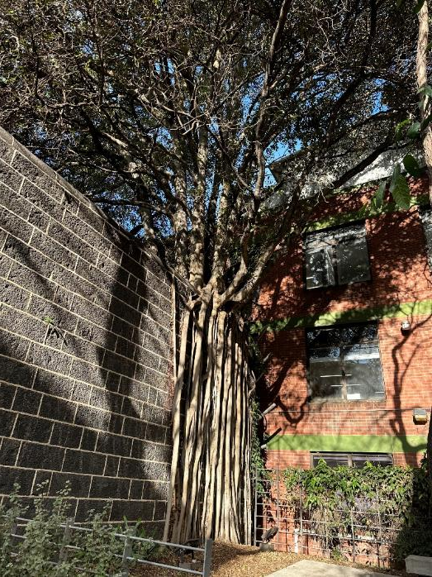
Through Multiple Perspectives Interprofessional Collaboration for Enabling Inclusive Assessment Practices
Photo by Alyce Greenwood

Slide 2
Acknowledgement of Country
RMIT University acknowledges the people of the Woi wurrung and Boon wurrung language groups of the eastern Kulin Nation on whose unceded lands we conduct the business of the University.
RMIT University respectfully acknowledges their Ancestors and Elders, past and present.
RMIT also acknowledges the Traditional Custodians and their Ancestors of the lands and waters across Australia where we conduct our business.
We acknowledge the muwinina and palawa people of Lutruwita.
On Country – muwinina podcast episode provides a rich overview of the history of nipaluna.
Artwork ‘Sentient’ by Hollie Johnson
Hollie is a Gunaikurnai and Monero Ngarigo woman from Gippsland who graduated from RMIT with a BA in Photography in 2016.

Slide 3
Presentation overview
Welcome and framing
Our story: running inclusive assessment workshops for educators
Exploring different perspectives on inclusive assessment
Scaling inclusive assessment at your institution and beyond

Slide 4
1. Welcome and framing
Introduce the session, explain the interactive format, and situate inclusive assessment within UDL and institutional practice

Slide 5

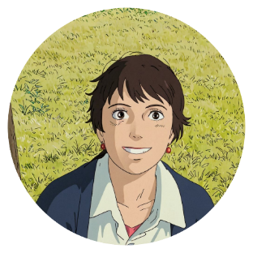

Presenters
Anna Branford
She/Her
Careers Educator
I'm Anna, a middle-aged white woman with dark brown hair. I nearly always wear a gold brooch in the shape of a bee.
Teresa Dowding
She/Her
Manager, Equitable Learning and Accessibility
I’m a woman with short brown hair. I’m often photobombed by a Jack Russell named Jack.
Alyce Greenwood
She/Her
Senior Education Practice Specialist
I’m Alyce. I’m a woman in my late thirties. I have curly reddish brownish hair, and I wear glasses. I enjoy wearing a power suit.​

Slide 6

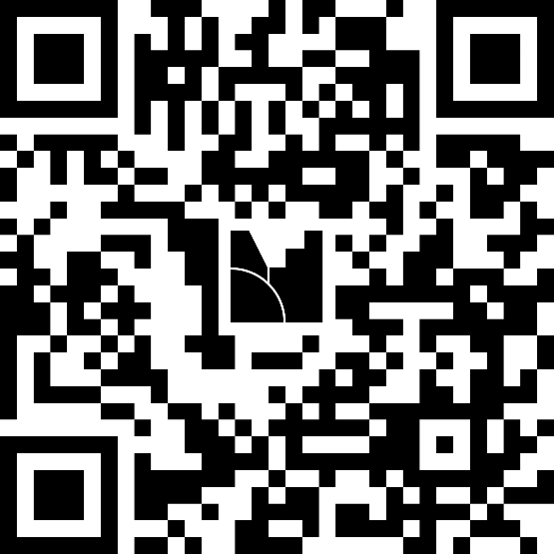
Mentimeter questions 1 and 2
Join:​
Go to menti.com or scan the QR​
Enter code 6462 5087
Photo by Diego PH on Unsplash

Slide 7
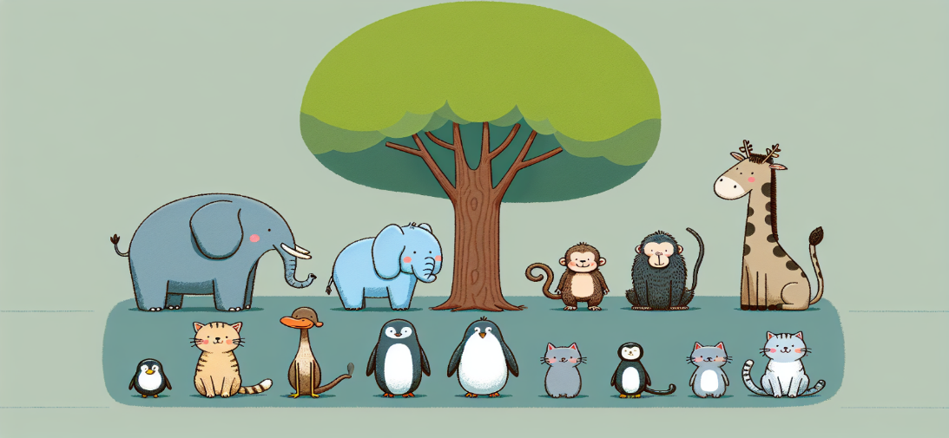
Inclusive assessment and institutional UDL
For a fair assessment everyone needs to climb the tree…
Image generated in Val with the prompt: ‘A fish, a monkey, an elephant, a duck, a penguin, a seal, a cat, a dog in a line in front of a tree.’

Slide 8
2. Our story: running inclusive assessment workshops for educators
Share why and how we co-designed and delivered institution-wide workshops on inclusive assessment

Slide 9
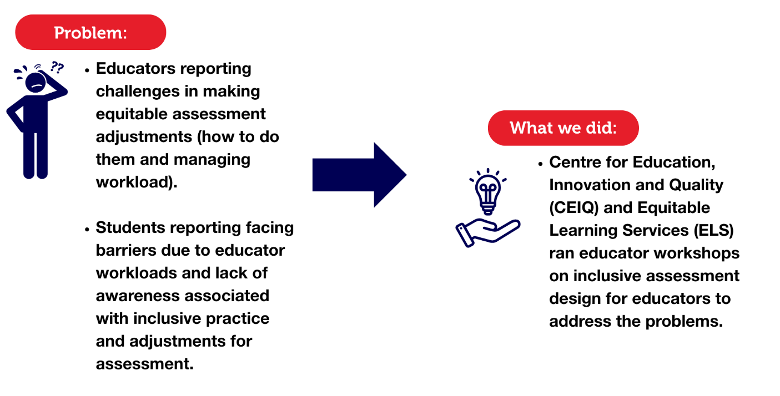
Inclusive assessment workshops for educators

Slide 10
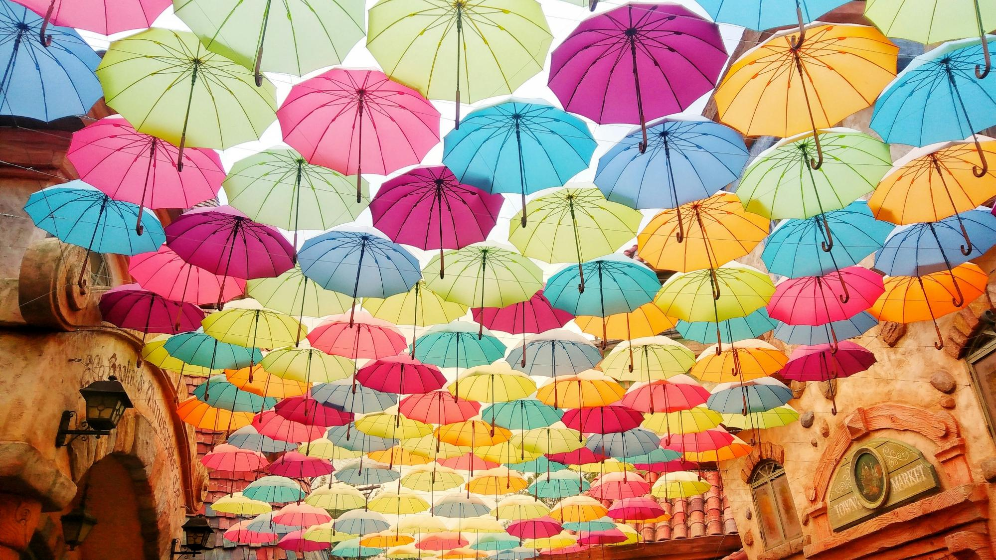
Brain break South Korea umbrella art installation
Photo by Helen Cheng on Unsplash

Slide 11
3. Exploring different perspectives on inclusive assessment
Show how perspectives from educational practice, equitable learning and careers education support inclusive assessment design and delivery

Slide 12
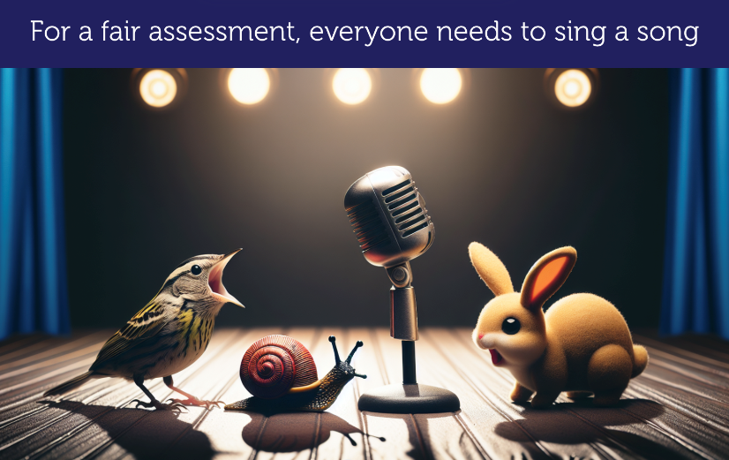
Educational practice: Assuring learning
Designing assessments to be inclusive helps to maintain assessment validity
Removing exclusionary barriers from an assessment aids educators in making valid learning measurement judgements by providing student equity to attain learning outcomes (Dawson, 2020, p.129; Tai, Dollinger, et al., 2022, p. 405; Tai, Ajjawi, et al., 2022)
Image generated in VAL with the prompt: "A bird, a snail and a rabbit on stage singing into a microphone"

Slide 13
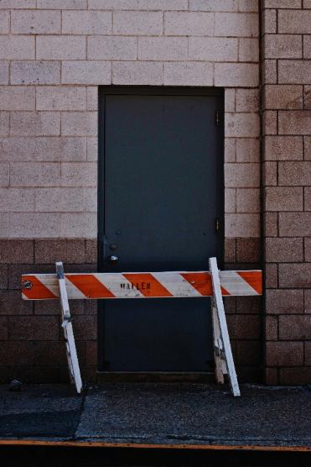
Equitable learning: Unpacking barriers
Attendance requirements
Visual or oral only information
Physically inaccessible learning space
Inaccessible digital course content e.g., lack of headings or alt text
Abstract information in written format only
Expensive learning resources
Group work assessment without designed in supports for students
Unclear assessment feedback
Re-traumatizing practices around the management of extension requests
Culturally unsafe content
Photo by Matthew Garoffolo on Unsplash

Slide 14

Careers education:
Developing lifelong skills
Career Development Learning:
strengths
challenges
'squiggly' vs linear
experimentation
Inclusive assessments, such as those with multimodal submission options, support all students to build the skills and knowledge they need to develop careers they can thrive in.
Image generated in VAL

Slide 15
Mentimeter questions 3 and 4
Join:​
Go to menti.com or scan the QR​
Enter code 6462 5087
Photo by Diego PH on Unsplash

Slide 16

Many different perspectives
Image generated in Adobe Express

Slide 17
4. Scaling inclusive assessment at your institution and beyond
Invite participants to reflect on their own contexts, share practical strategies, and consider how inclusive assessment can be embedded and sustained

Slide 18
Mentimeter questions 5 and 6
Join:​
Go to menti.com or scan the QR​
Enter code 6462 5087
Photo by Diego PH on Unsplash

Slide 19
References
Dawson, P. (2020). Defending Assessment Security in a Digital World: Preventing e-Cheating and Supporting Academic Integrity in Higher Education. Taylor & Francis Group.
Tai, J. H.M., Dollinger, M., Ajjawi, R., Jorre de St Jorre, T., Krattli, S., McCarthy, D., & Prezioso, D. (2022). Designing assessment for inclusion: an exploration of diverse students’ assessment experiences. Assessment & Evaluation in Higher Education, 48(3), 403–417. https://doi.org/10.1080/02602938.2022.2082373
Tai, J., Ajjawi, R., Bearman, M., Boud, D., Dawson, P., & Jorre de St Jorre, T. (2022). Assessment for inclusion: rethinking contemporary strategies in assessment design. Higher Education Research & Development, 42(2), 483–497. https://doi.org/10.1080/07294360.2022.2057451

