Slide 1
Redesign with UDL in mind:
A Collaborative Pilot with Murdoch’s School of Nursing

Slide 2
Acknowledgement of Country

Slide 3
Copyright Notice

Slide 4
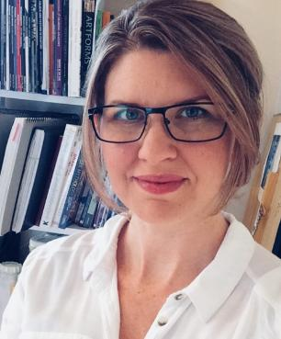
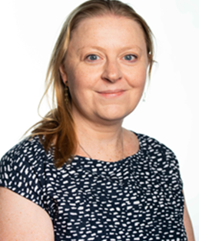
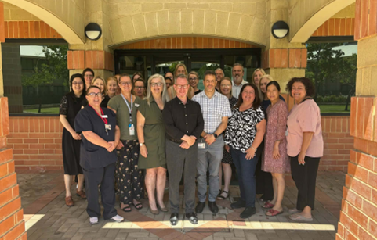
Pilot Team
Bec Inwood
Caroline Browne
School of Nursing
Project Manager: UDL & Inclusive Education​
(UDL specialist & Pilot lead)
bec.inwood@murdoch.edu.au
Associate Professor Nursing
(Pilot lead)
c.browne@murdoch.edu.au
19 Nursing Academics

Slide 5
Objectives
Discover a collaborative model, including key enablers, for supporting academic staff to embed UDL principles across an undergraduate curriculum
Reflect on how the collaborative model may be adapted to your own context.

Slide 6
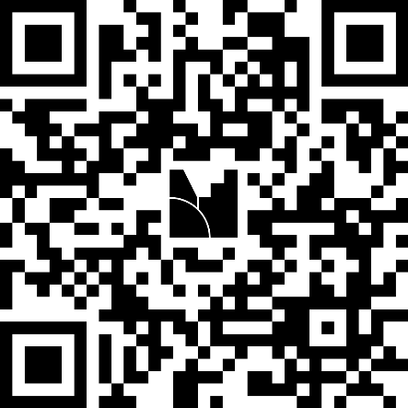


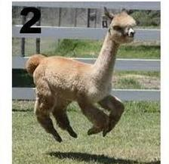
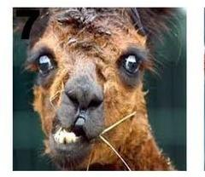
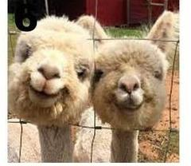

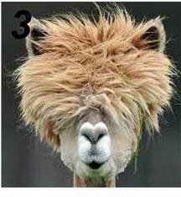
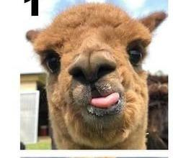


On a scale of Alpaca
How ready do you think your institution is for implementing UDL across a whole course?
Menti poll

Slide 7
About the pilot
2023/2024
BN course review
UDL identified as practical approach to improve student wellbeing and course accessibility
Early 2025
Staff surveyed to guide structure of mentoring pilot
April – Dec 2025
Course re-design
2026
Course roll out & review
Student partnership Research project
Ongoing coaching

Slide 8
Mentoring and coaching structure
All staff
Workshops & Review session
Small Group
Focused discussion, ad hoc advice, brainstorming
  All 3 levels of support received strong positive feedback
Individual
Personalised in-depth support

Slide 9
Feedback from staff
  Summary of individual comments from survey and informal conversations:
  17 of 19 staff said confidence is growing in purposeful and inclusive teaching practices
  safe learning space for teaching staff
  mentoring input from outside of discipline results in creative and innovative solutions
  varied, responsive, practical and adaptive support provides help where and when it is needed
  feedback from classroom observations is really useful and helps me reflect on my practice

Slide 10

Big Wins (and students agree)
Collaborative relationships amongst staff ^{[8.4 8.3]}
Authentic and collaborative learning activities & assessment ^{[7.2]}
Consistency across units (LMS structure, lecture/tutorial slides) ^{[7.4 6.3]}
Weekly learning clearly scaffolded with learning objectives, prior knowledge activation and summary/reflection^{[3.1]}
In class feedback and pulse surveys informing teaching reflection and responsive adaptation ^{[8.2]}
Decreasing attrition before census down from 2% in 2025 to less than 1% in 2026
Image credit: still from TV series Futurama

Slide 11
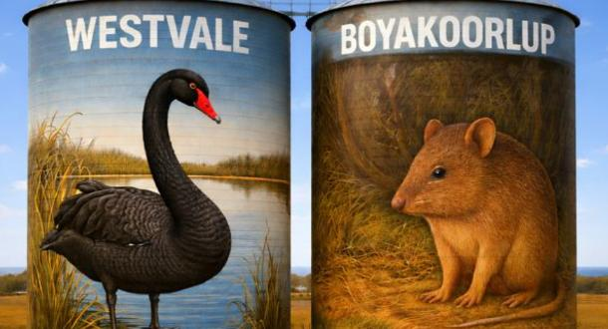
Spotlight: Authentic & creative learning
(more examples in supplementary section at end of PowerPoint)
Virtual village (patients with diverse authentic profiles) ^{[7.2, 1.3, 2.5, 3.1]}
Opportunity for practicing application of skills and knowledge in tutorial activities, practice labs, simulated patient conversations with SimConverse ^{[5.1, 5.3, 7.2]}
Gamification: escape rooms (digital and physical); Monopoly medication; clinical Olympics; quick fire questions. ^{[7.3 4.1 3.3]}
Choice of working individually or in groups in classes ^{[7.1 9.2 6.5]}

Slide 12
Spotlight: Authentic and meaningful assessment
Student voice: “I am actually finding this assessment fun”
Professional practice portfolio ^{[7.2 3.2 3.4]}
Formative feedback and assessment (drafts, online quizzes with inbuilt feedback; dedicated in class time to work on assessments and receive feedback) ^{[8.5]}
Meaningful marking criteria that support goal setting and progress monitoring ^{[6.1 6.4]}
Feed forward comments using a carefully designed feedforward matrix to replace the majority of ad hoc written feedback. It provides learners with consistent action-oriented guidance for future goals and improvement. ^{[6.1 6.4]}

Slide 13
Feed Forward Matrix Example
Area of focus | How to improve | How to improve | How to improve
Understanding and Explanation of Core Value | Further clarify or refine the explanation of the core value. | Strengthen the connection between the core value and the community case study. | Ensure evidence-based information is used consistently.
Application to Case Study | Provide more specific examples to illustrate the application of the core value. | Strengthen the connection between theory and practice. | Address potential challenges in applying the core value.
Engagement and Presentation Style | Use more compelling storytelling or narrative to engage audience | Using varied tone, pace, and volume would make your speech more engaging. | Use relevant examples or visual aids to engage audience

Slide 14
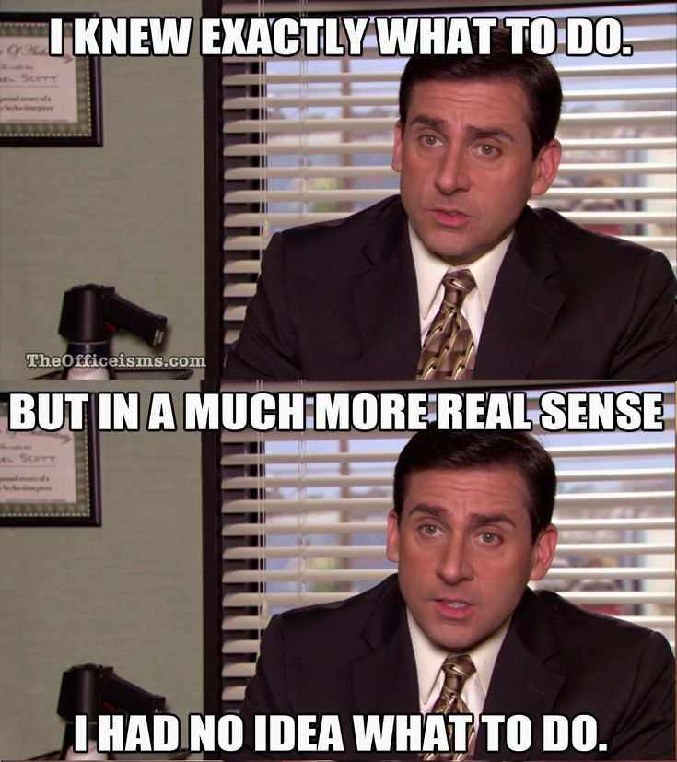
Challenges
Workload
Varying levels of implementation
Persistence in the face of student complacency or negativity
How to inform students about UDL
Image credit: stills from TV series The Office

Slide 15
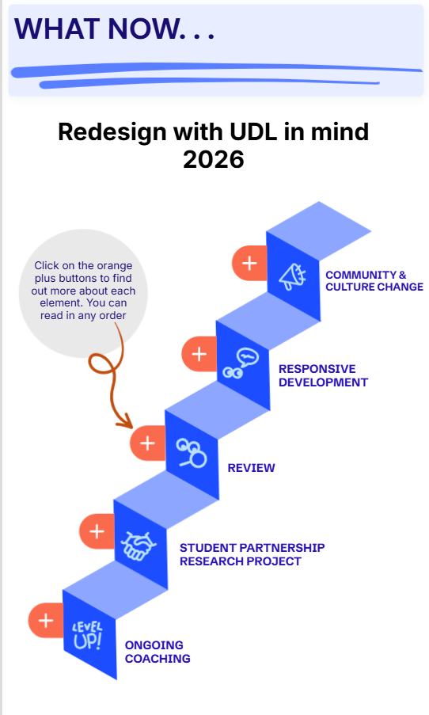
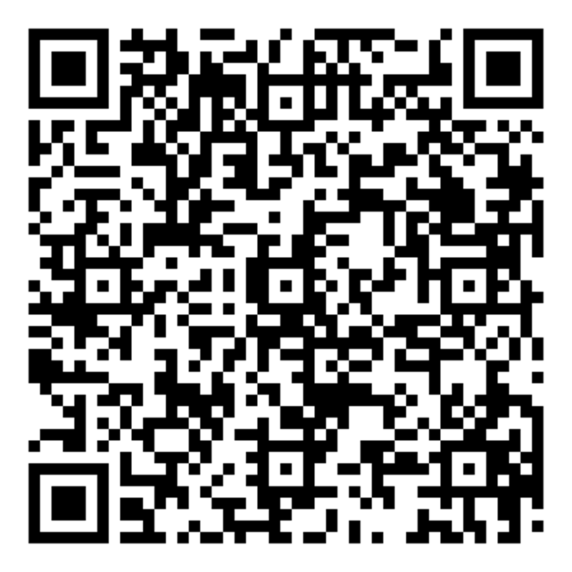
What Now . . .
Scan the QR code to access the interactive poster made with Genially, outlining what we are doing now and planning for remainder of 2026.
Accessibility Note: The poster should be accessible for screen readers however, if you find it is not, the following slide contains the text only version of the poster.

Slide 16
Text only content from interactive poster for screen readers
(QR code previous slide)
Redesign with UDL in mind: 2026
Coaching
Throughout 2026, unit coordinators and tutors have access to responsive individualised coaching to support them in implementing UDL strategies and inclusive teaching. The approach encourages reflective practices and adaptation of strategies, delivering support at the point of need.
Student Partnership Research Project
We have won an internal learning and teaching scholarship to undertake a research project in 2026 that will evaluate the impact of the UDL strategies initially implemented in the new Bachelor of Nursing. A small group of students will be recruited to co-design a student feedback program. The purpose of this is to gather honest student experiences and perspectives about UDL in the Bachelor of Nursing, focusing on perceived changes in learning activities and resources, and impact on learning and engagement. There is limited evidence describing or evaluating the integration of UDL at a curriculum level, so gaining student perspectives on how they recognize, and experience UDL strategies will be invaluable to guiding ongoing development in the Bachelor of Nursing. This evaluation will also help us develop a set of useful strategies and resources, endorsed by our students, that can be shared with other Murdoch Schools.
Review
You may enjoy this amusing 30 second comedy clip from Utopia: Season 5, episode 7 about performance reviews just for fun.
A mid 2026 reflective review workshop for unit coordinators is planned, to share wins and challenges, review student feedback thus far, and collabroatively problem solve. Later in 2026, we will undertake staff interviews and another staff survey to inform areas of focus for future development.
Responsive development
In response to student feedback, teaching staff reflections and coaching feedback, implementation of UDL strategies may be adapted, extended, or changed entirely. As part of good teaching practice and in true UDL style staff are encouraged to embrace a flexible and resilient approach, be open to change and "try, try again." This is an iterative process that should continue to evolve over time.
Community & Culture change
As part of the bigger picture we aim to share the positive impacts of this pilot internally and externally. This will include success stories, resource sharing, peer to peer mentoring, collaborations and expansion of the pilot into other schools. “Alone we can do so little; together we can do so much.” – Helen Keller. “When you’ve worked hard, and done well, and walked through that doorway of opportunity, you do not slam it shut behind you.” – Michelle Obama.

Slide 17
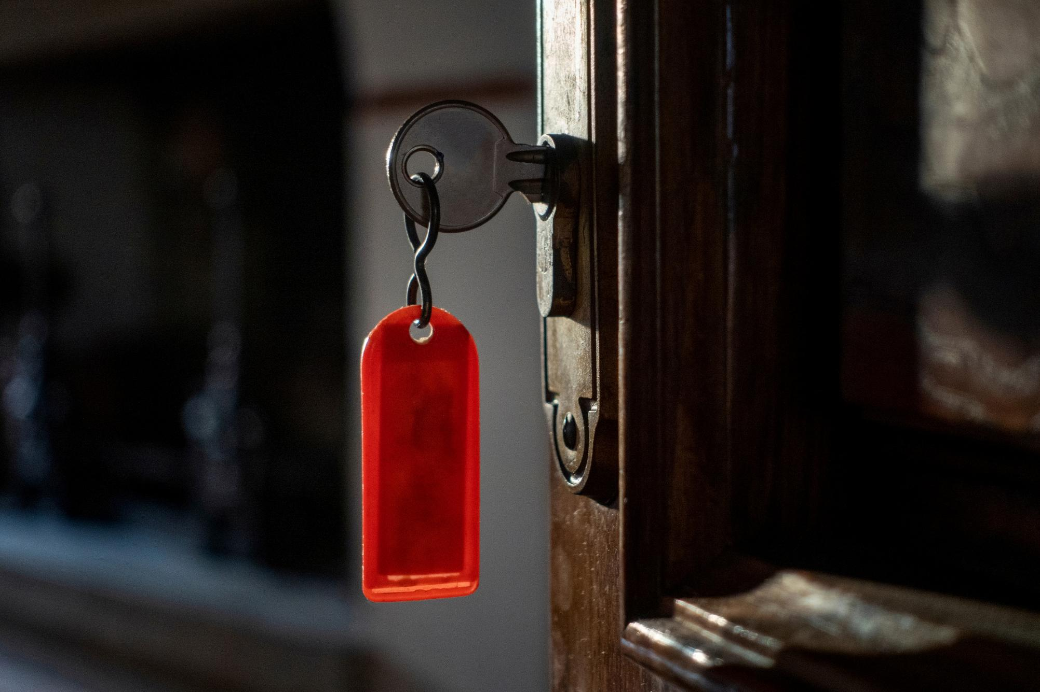
What We’ve Learnt: Keys to Success
Timing
Timely and responsive specialist support at point of need
Strong school leadership
Collaborative relationships

Slide 18
Your thoughts and questions
What ideas does this pilot program inspire for your own context?
What elements of this pilot could be adapted to your own context?
What questions do you have?

Slide 19
Thank you
bec.inwood@murdoch.edu.au
c.browne@murdoch.edu.au

Slide 20
Supplementary information
Because I couldn’t fit everything in that I thought important to include

Slide 21
Spotlight:
More authentic & creative learning
Visual Thinking Strategies (VTS) to promote critical and analytical thinking
Story telling: “Interview” with notable figures in nursing (figures played by actor),
Roleplaying: teaching and simulation staff role play patient
Rotating learning stations
Choice of challenge level in practical labs to practice key skills (Caulfield & Oliver, 2025)

Slide 22

More About Westvale/Boyakoorlup
Welcome to Boyakoorlup, meaning “the place of the rocks”, also known as Westvale, a fictional rural town located two hours’ drive from Perth, Western Australia. B Western Australia. Boyakoorlup/Westvale is a vibrant community, shaped by its rich history in farming and mining, which remain the town's main industries.
Throughout your course, you will encounter a series of profiles of fictional townspeople, each crafted to give you insight into the various aspects of healthcare. These characters have been developed with the support of AI tools to ensure depth, diversity, and realism. The accompanying profile photos are AI-generated images created solely for educational purposes. These individuals represent the diverse needs, backgrounds, and health challenges that are commonly encountered in Australia. As you meet and learn about them throughout your studies, you will deepen your understanding of patient care.
However, it is important to remember that these profiles, while carefully created, are fictional. The scenarios and situations presented may include errors or oversimplifications, as they are meant to spark thought, discussion, and critical thinking. As a nursing student, your role will be to apply your knowledge, skills, and clinical judgment to approach these cases with professionalism, empathy, and the ability to adapt to the nuances of real-world practice.
As you progress through your course, you will meet a variety of people from Boyakoorlup/Westvale who will help shape your understanding of healthcare. These profiles are designed to challenge you to think beyond the textbook and consider the broader context of healthcare delivery.
In addition to the profiles, you will also have the chance to discuss and analyse the challenges faced by healthcare professionals. These interactions will allow you to gain a better understanding of the unique dynamics of healthcare and the skills needed to provide compassionate, patient-centered care.
By the end of this resource, you will have a deeper appreciation for the multifaceted nature of nursing and be better prepared to navigate the complexities that come with caring for individuals in these settings.
We encourage you to approach this resource with curiosity, critical thinking, and an open mind as you engage with the fictional, yet realistic scenarios provided. Your learning in Boyakoorlup/Westvale will not only enhance your clinical skills but will also enrich your understanding of health, making you a more well-rounded and adaptable nursing professional.
Let the journey begin!

Slide 23
References
Caulfield, R., & Oliver, N. 2025. Challenging with chillis: Scaffolding learner led task difficulty into nursing clinical skills. Focus on Health Professional Education: A Multi-Professional Journal, 26(3), 6-8. https://www.researchgate.net/publication/396042241_Challenging_with_chillis_Scaffolding_learner-led_task_difficulty_into_nursing_clinical_skills
Cilauro, S. (Writer), Gleisner T. (Writer), and Sitch, R. (Writer & Director). 2023, July 19. Utopia. (Season 5, Episode 7: Frequently avoided questions). [TV series episode] https://youtube.com/shorts/eFfuSJcRPkE

