Slide 1
Associate Professor Kelly Linden
2025 Equity Fellow, Australian Centre for Student Equity and Success (ACSES)
The importance of universal design for learning for part-time students

Slide 2

Charles Sturt University Context
Regional university, six main campuses located throughout regional New South Wales
Subject/Course
Of our undergraduate students, 56% are from regional, rural and remote (RRR) areas, 24% are from low-socioeconomic backgrounds, 7% of students are living with a disability and 4% of students identify as First Nations
Each year approximately 24,000 students are enrolled online and 10,500 students' study on campus and approximately 70% of students study part-time

Slide 3
Introduction: Part-time study
Traditional university students study full-time and as such, university processes, support and government funding are skewed towards supporting full-time students (Malm & Weber, 2017).
From 2019 to 2022, part-time students were more than twice as likely to drop out of university as full-time students (O'Kane et al., 2024).
Part time study is the single biggest risk for attrition across Australian universities, largely because most part-time students have other major responsibilities at home and at work (Norton et al., 2018).
In 2022, 34 of Australia’s 38 publicly funded universities reported a reduction in study load (EFTSL) per student (O'Kane et al., 2024).

Slide 4
Introduction: UDL
UDL is a pedagogical framework that aims to create flexible, inclusive learning environments that accommodate the diversity of modern students (King-Sears et al., 2023; Rogers-Shaw et al., 2018).
It was initially developed to support students with disability but has since been demonstrated to benefit all students.
The framework promotes diverse representation, flexible expression, and varied opportunities for engagement to support meaningful learning across student circumstances to accommodate student diversity (CAST, 2024).

Slide 5
Aims
What supports part-time students to succeed?
What elements of unit-level design are important for part-time undergraduate students?
Are the same elements of unit-level design important for part-time students with disability?

Slide 6
Methods
965 part-time students from 35 Australian universities completed the survey, with 80 follow-up interviews from 28 Australian universities from all states and territories
Detailed student by semester data from 2 regional and 2 metropolitan universities across 2022 and 2023
2024 sector data from all Australian universities

Slide 7
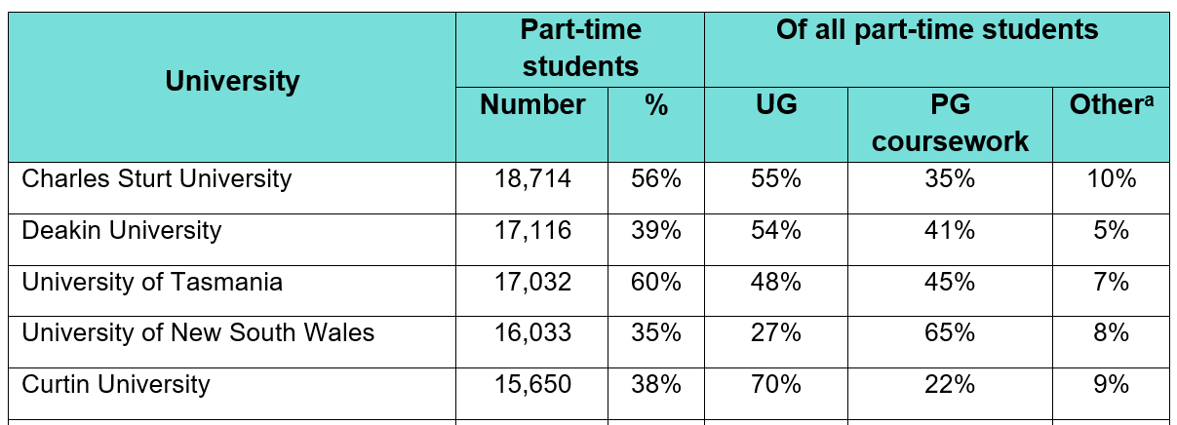
Part-time students in Australia
In 2024, 360,125, or 35% of domestic university students studied part-time
*Other includes PhD, enabling and micro credentials
70%

Slide 8
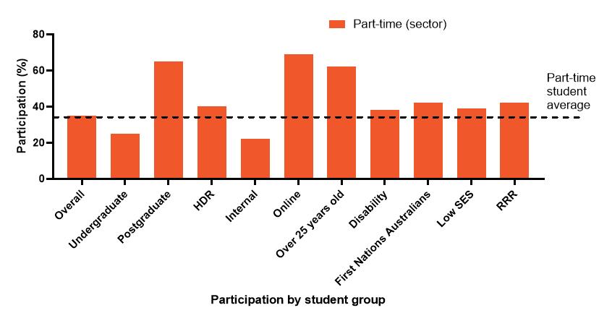
Part-time students in Australia: 2024 sector data
Students from equity cohorts study part-time at a higher rate than average

Slide 9
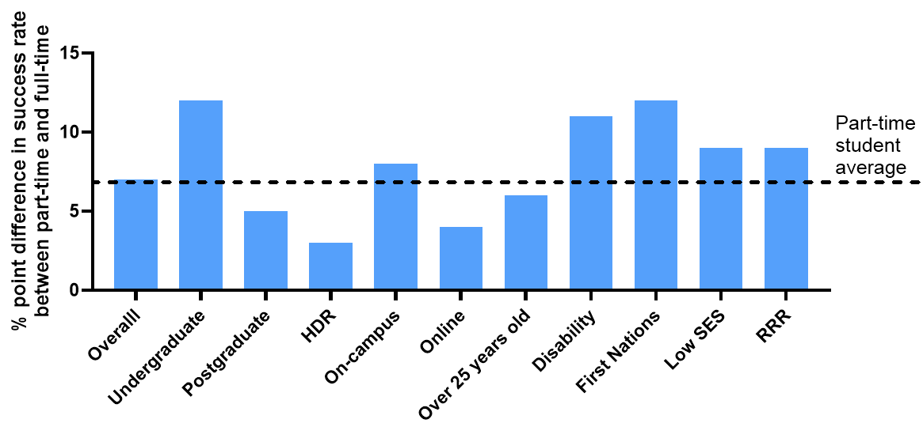
Part-time students in Australia: Success rate
Success 7 percentage points lower than for full-time students

Slide 10
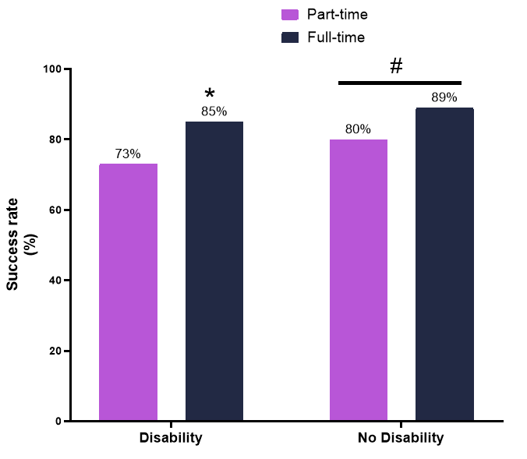
Part-time students in Australia: 4 universities
Student success rate from undergraduate students enrolled in the four universities that provided data.
*, p<0.001 compared to students with disability.
#, p<0.001 compared to part-time.

Slide 11
Part-time students in Australia: Linear Regression Model of 4 universities
When adjusting for other factors, studying part-time one of the biggest risk factors for success and retention. Percentages show adjusted odds ratio.
Undergraduate on-campus
Undergraduate online
Passing
Part-time (49%)
First Nations (60%)
Disability (61%)
Passing
First Nations (57%)
Disability (59%)
Part-time (77%)

Slide 12
Survey Findings: Demographics
Demographics, Work and Caring Commitments of Part-time Students
Demographic | % of Survey Responses
Disability, condition or illness that impacts studies: No | 52%
Yes, and I am registered with my university | 34%
Yes, and I am not registered with my university | 14%
Average age | 34 years old
Average weekly hours of paid employment | 23 hours
Personal caring responsibilities | 43%

Slide 13
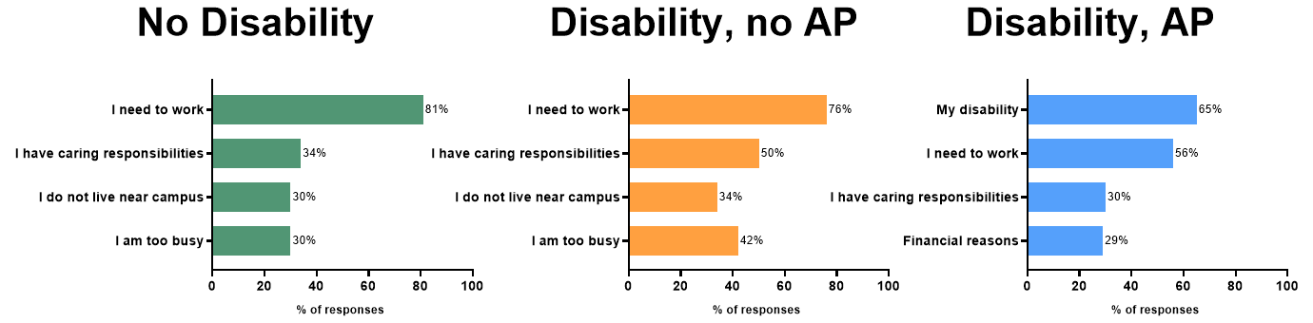
Survey findings: Reasons
‘What influenced your decision to study part-time?‘

Slide 14
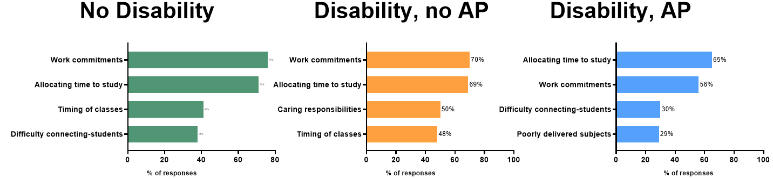
Survey findings: Challenges
‘What are the main challenges in studying part-time?’

Slide 15
Survey findings: Success
The most important factor in successful part-time study is quality learning and teaching, which includes engaging and understanding lecturers.
“When lecturers are understanding and show an awareness of the monumental juggling act that is post graduate study with small children, it can completely change your mindset and your ability to engage with your course. Knowing that you have someone in your corner is invaluable.”

Slide 16
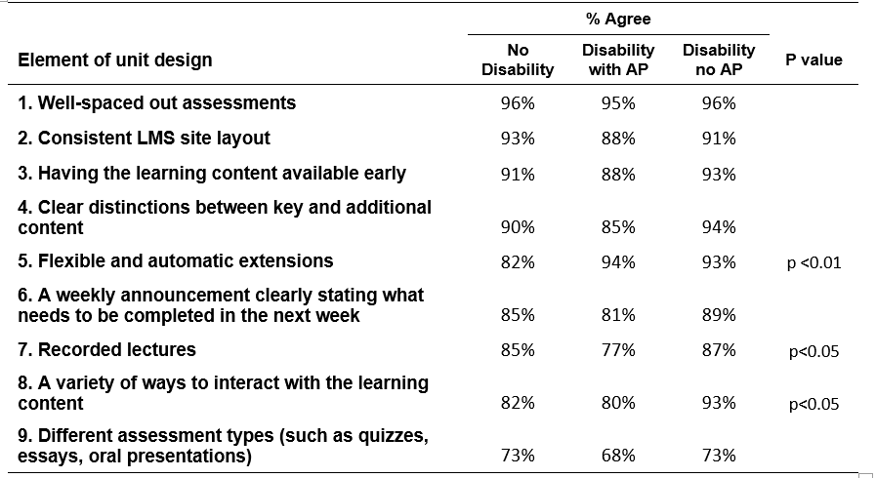
Survey findings: Unit design
The Nine Elements of Unit Design and the Percentage of Students Who Agree that they are Important.

Slide 17
Well-spaced assessments (96% of survey responses agree)
Student feedback clearly demonstrates a strong need for well-spaced assessments (n=13 survey responses), particularly for students working full time or studying multiple units.
“It would allow me to do more work when I have the time available instead of falling behind for a couple weeks until I have the time to catch up”
“If I had two assignments due on the same day, having a week meant that I could devote one weekend here and one weekend there”
“The assessments are being marked well outside of the timeframe that they're supposed to... and we won't have the feedback... the second assessment was supposed to inform the final one”

Slide 18
Consistent LMS site layout (91% of survey responses agree)
In surveys, student feedback highlighted the importance of a consistent and clearly structured LMS layout (n=53) to support understanding, reduce cognitive load, and enable effective planning across units.
“Course formats are consistent, so once familiar, you don't have to re learn for each unit”
“There is no consistency between units”
“They don't have a standard across the unit sites of how it should be displayed. Where information is, every teacher does it differently which makes it really hard to access”
“You get used to one pattern and then ... I got maybe 6 weeks into the subject and didn't realise that there was a second page of lectures. So I'd only been watching half of what I needed to ... the fact that they were different just I didn't think to look”

Slide 19
Having the learning content available early (90% of survey responses agree)
In survey responses, students consistently commented on the importance of having learning content available early (n=77).
“Having all of the weekly modules, assignments, etc. available from the first week of each semester rather than slowly releasing it piece by piece”
“Give it to me early. I needed to see what hill I am climbing. I need to know how to pace myself because I’ve got other responsibilities. How am I going to pace myself?”
“When you are a busy person, you sometimes find you end up doing your work in chunks as opposed to week by week by week”
“I had to withdraw from a unit because the content that was necessary for an assessment was not made available early enough”
“Having all content available at the start of the semester is extremely important for disabled students whose energy levels fluctuate”

Slide 20
Distinctions between key and additional content (89% of survey responses agree)
Student feedback consistently highlighted the need for a clear distinction between key and additional content within units (n=13) to support both effective learning and time management.
“I wish I had more time to focus on all material. However, I only have time to properly focus on key materials for assignments. Learning how to juggle full time work and part time study was a massive challenge. I waste more time trying to find the detrimental material over the material that isn’t as important”
Students explicitly requested guidance on “What content is key... and what is extra information”

Slide 21
Flexible and automatic extensions (87% of survey responses agree)
In surveys, students commented on the value of simple or automatic extensions (n=65), with students emphasising the effectiveness of short, built in flexibility.
“Feels like the only way I can handle workloads without risking failure”
Extensions provided “flexibility with assessment due dates due to caring responsibilities and disabilities”
“When my kids or I am unwell those 3 days really give me the best chance”
“Because I have caring responsibilities... If it's due on a Monday, and I've only got 3 more days. Well, if I'm working those 3 days I'm not going to get it done, anyway. So if I could get a whole week that would be more beneficial”

Slide 22
Conclusion
Universities need to do more to support part-time students and part-time students with disability
University workload policies should provide adequate time and resourcing for:
Recommendation 1: Quality learning and teaching
• Academics to connect, engage and empathise with students.
• High quality units with consistent layout and clear expectations.
• Learning content to be released early.
• All classes to be recorded.
• Opportunity to connect with peers.

Slide 23

I would like to thank Dr Sarah Teakel and Dr Noelia Roman for her help on this project.
Questions?

