Slide 1

Designing tertiary education to support executive functioning
A Universal Design for Learning approach
Amber Kaiwi, Everway

Slide 2
Understanding the student experience
What students actually experience
Not what we design

Slide 3

Opera scene
3

Slide 4
*Punchline*
“I took out the bins.”

Slide 5

“Turn off the words Mum”
5

Slide 6
My student experience
I didn’t ask for this.
I built it.

Slide 7
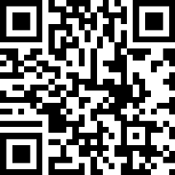
Activity #1
Take out your phone and visit slido.com
Enter this slido code: 8551567
Finish this sentence in one or two words:
At university, I was expected to manage my…

Slide 8
Activity #2 – show of hands
How many of you have ever had a student who you knew was capable… but just couldn’t get started?

Slide 9

The cost of untapped potential
How many Spielbergs didn’t make it?

Slide 10
Designing for learner variability
What if your accommodation register is telling you something about the design?

Slide 11
Activity #3
Where in your institution do you assume executive capacity that you haven't designed for?

Slide 12
Preparing every learner for success
All students deserve to arrive.

Slide 13
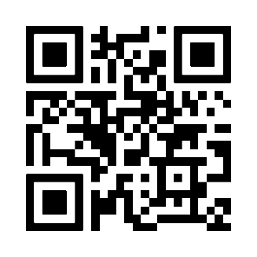

Access additional Executive Functioning resources
Continue the conversation
Enter your details and we’ll send you the guide.

