Slide 1

Embedding UDL 3.0 in Institution-Wide Academic Support Resource Design
Dr Boya Zhang
Learning Adviser
Southern Cross University
Project developed collaboratively by the Learning Advisers in the Study Support Team.

Slide 2

Acknowledgement of Country
We acknowledge Widjabal Country as the Country where Southern Cross University originated and grew, and from where it continues to grow. It seeded the growth of our Gumbaynggirr Campus in Coffs Harbour, our Yugambeh Campus in Coolangatta and it planted the seeds to transform the Countries we are on.
Understanding our origins will make each step into the future a more purposeful one, leading all to transform tomorrow.

Slide 3
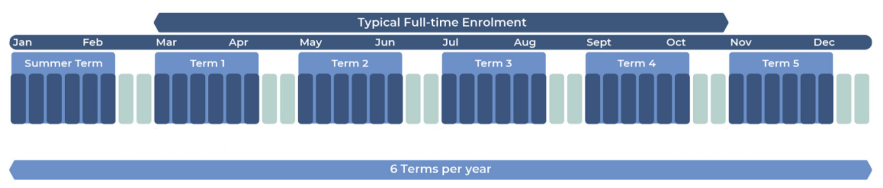
Why We Developed an Institution-wide Assessment-focused Resource
Student Needs
  Many students need support to navigate assessment requirements and expectations.
  SCU’s educational model encourages early engagement with assessment tasks.

Slide 4
Why We Developed an Institution-wide Assessment-focused Resource (Cont’d)
Research Evidence
  Assessment literacy can be developed through explicit teaching and targeted learning resources (e.g. Liu & Li, 2014; Smith et al., 2013).
  Assessment literacy helps students build confidence in their learning and assessment performance (e.g. Price, 2012; Saligari et al., 2024).

Slide 5
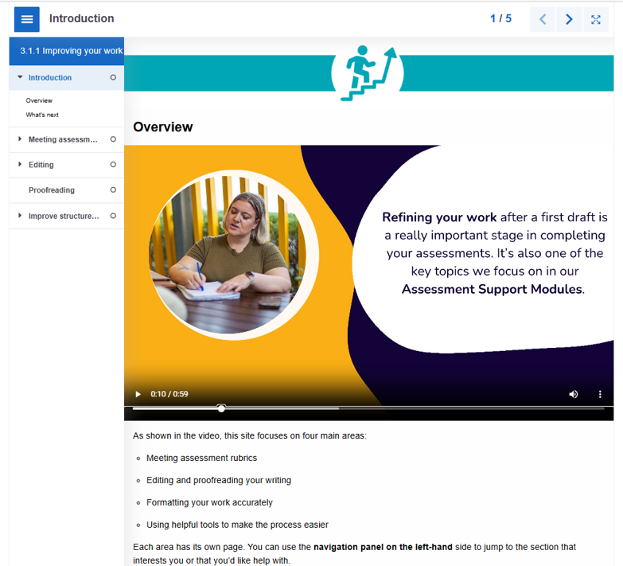
Initial Approach: Tool-driven Design
What We Planned
Interactive H5P books combining multimedia content and practice activities.

Slide 6
Initial Approach: Tool-driven Design (Cont’d)
What We Assumed
What We Learned
Greater interactivity and technology would increase student engagement and support learning.
Accessibility barriers, particularly for screen-reader users, highlighted the need to prioritise pedagogy and accessibility alongside technology.
📌 This led us to redesign the resource within Blackboard Ultra.

Slide 7
Our Resource Design Framework
1. Understand learners and their context
2. Identify the assessment literacy skills students need
6. Review and refine the resource
3. Identify potential learning barriers
5. Apply UDL 3.0 principles to resource design
4. Identify the support Learning Advisers can provide and how to provide it

Slide 8
Key Insights from the Design Process
Time-poor students
Keep resources concise, easy to navigate, and organised into manageable chunks.
Learner variability
Resources should provide multiple pathways to support diverse learning needs and preferences.
Pedagogical approaches
Explicit teaching, modelling, and guided practice support assessment literacy development.
Purpose and agency
Choice and clear purpose support motivation and self-regulation.

Slide 9

How UDL 3.0 Principles Informed Our Resource Design
Engagement
Support motivation, relevance, and agency
Representation
Offer multiple ways to access and process information
Action & Expression
Supporting practice, self-monitoring, and skill development

Slide 10
From the Perspective of Engagement
Scenario-based Entry Points
Students choose pathways based on their assessment needs rather than following a single sequence.
Supports autonomy, relevance, and self-regulation.

Slide 11
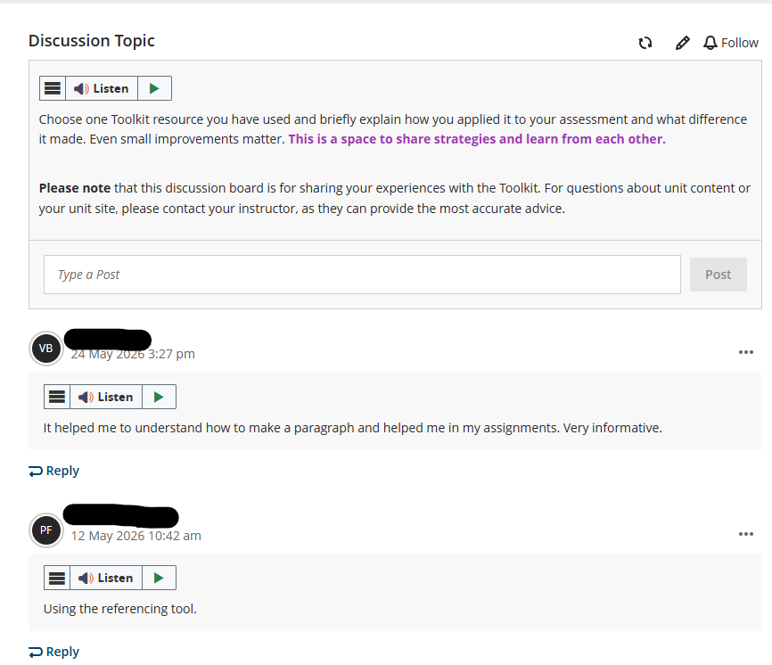
From the Perspective of Engagement (Cont’d)
Community and Belonging
Create a Discussion space where students can share their experiences.
Supports connection, belonging, and collective learning.

Slide 12
From the Perspective of Representation
Multiple Ways of Accessing Information
Text, diagrams, icons, videos, and worked examples support different ways of processing information
Alternative text and video transcripts support accessibility.

Slide 13
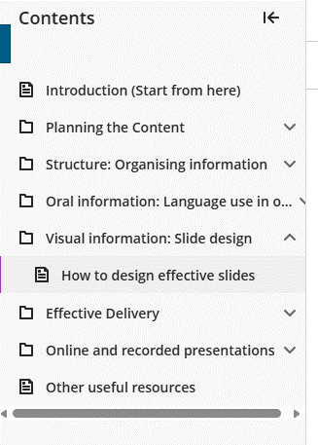
From the Perspective of Representation (Cont’d)
Managing Complexity
Content is organised into manageable sections with clear navigation and transitions to reduce cognitive load.

Slide 14
From the Perspective of Representation (Cont’d)
Clear and Supportive Communication
Student-friendly language and an encouraging tone support understanding and confidence

Slide 15
From the Perspective of Action & Expression
Practice and Self-Evaluation
Students engage in H5P activities that allow them to apply and monitor their learning.
Guided Expression
Planners, templates, and scaffolded prompts support students in applying assessment skills to authentic tasks.
Accessible Learning
Core learning content is provided through Blackboard Ultra.

Slide 16
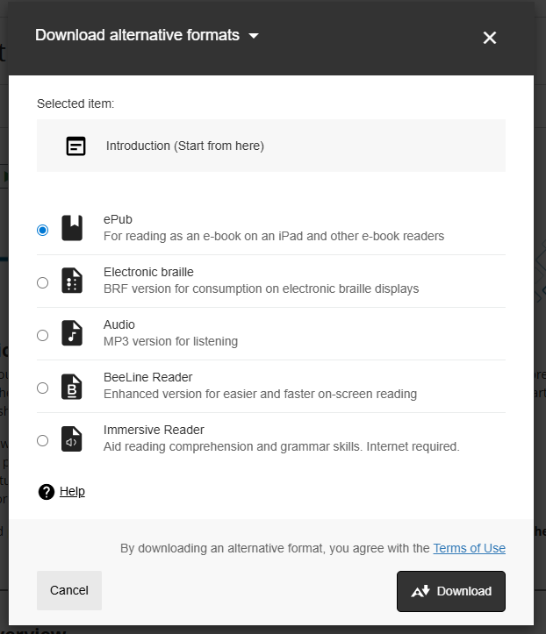
Reducing Barriers Through Platform Design
Alternative Formats
Blackboard Ally automatically provides alternative formats, including audio and screen-reader-friendly versions.

Slide 17
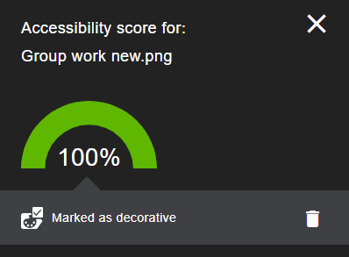
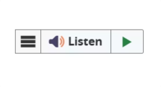
Reducing Barriers Through Platform Design (Cont’d)
Accessibility Monitoring
Ally accessibility checker prompted us to review content for accessibility issues, such as adding alternative text to informative images.
Flexible Access
Blackboard Ultra supports text-to-speech.

Slide 18

What Students Are Saying
Student Survey responses (n = 69)
85%
87%
found the resource helpful or very helpful
reported gaining skills they could apply in future study
Student Valued
Clear, step-by-step explanations
Opportunities to apply learning
Increased confidence
Transferrable skills

Slide 19

Next Steps: Continuing to Improve the Resource
Partnership
Continue working with colleagues and UDL specialists to strengthen the resource design.
AI-Supported Navigation
Explore AI-enabled features to help students navigate resources and identify support relevant to their needs.
Accessibility
Gather more feedback from students, particularly those with accessibility needs.

Slide 20
Experience the Resource as a Student
Scenario
You are a first-year student working on a group presentation.
  The assessment is due in three weeks.
  Your group has just been formed.
  You are worried that some members may not contribute equally.
  You are unsure how to organise meetings and make the most of your group's meeting time.
Your Task
Review the Group Work Module Overview page and choose the option(s) you would select first to support yourself.
Group work assessments: Introduction

Slide 21
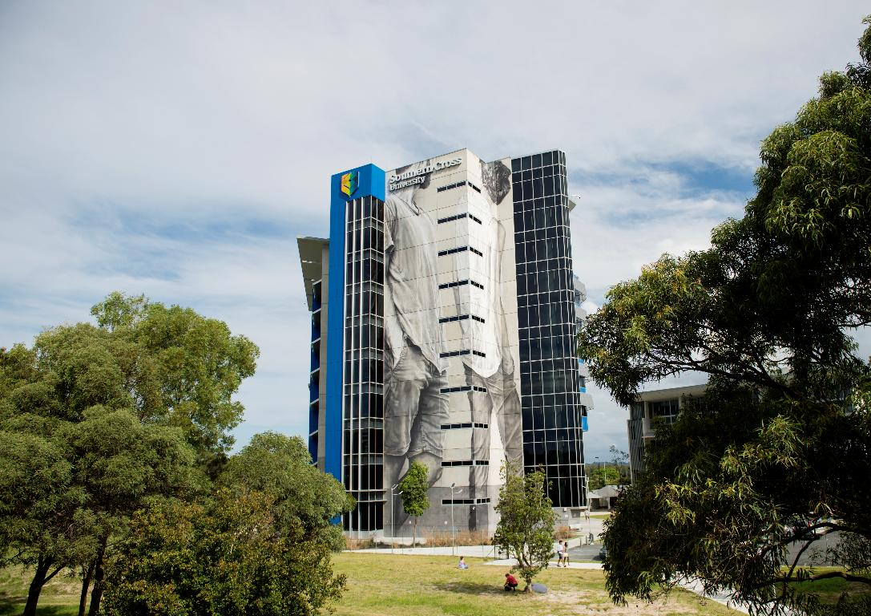

Thank You
Questions and Discussion
Dr Boya Zhang
Learning Adviser
Southern Cross University

Slide 22
References
Liu, X., & Li, L. (2014). Assessment training effects on student assessment skills and task performance in a technology-facilitated peer assessment. Assessment & Evaluation in Higher Education, 39(3), 275-292. https://doi.org/10.1080/02602938.2013.823540
Price, M., Rust, C., O’Donovan, B., Handley, K., & Bryant, R. (2012). Assessment Literacy: The Foundation for Improving Student Learning. Oxford Brookes University.
Saligari, M. J., Fox, J. L., Rivera Munoz, C. A., Frankland, S., & Willems-Jones, A. (2024). Undergraduate Science and Agriculture Students Perceive Improved Academic Judgement Upon Use of an Assessment Literacy Module. International Journal of Innovation in Science and Mathematics Education, 32(5), 25-40. https://doi.org/10.30722/IJISME.32.05.002
Smith, C. D., Worsfold, K., Davies, L., Fisher, R., & McPhail, R. (2013). Assessment literacy and student learning: The case for explicitly developing students ‘assessment literacy’. Assessment & Evaluation in Higher Education, 38(1), 44-60. https://doi:10.1080/02602938.2011.598636

