Slide 1


Acknowledgement
Bendigo Kangan Institute acknowledges and pays respect to the past, present and future Traditional Custodians and Elders of this nation and the continuation of the cultural, spiritual and educational practices of Aboriginal and Torres Strait Isander peoples.
Artwork by Phill Bell

Slide 2
Inclusion from the Ground Up:
Using Equity Impact Assessment to Embed UDL in the Hume Tech School
Hume Tech School: a Victorian STEM education centre delivering hands-on, industry-connected learning experiences for secondary school students.
Alice Bennett Diversity & Inclusion Manager
Alex Sipidias Program Manager, Hume Tech School
Progress13%

Slide 3

Equity Impact Assessments 1
Niki Vincent,
Commissioner for Gender Equality in the Victorian Public Sector
Progress 20%

Slide 4
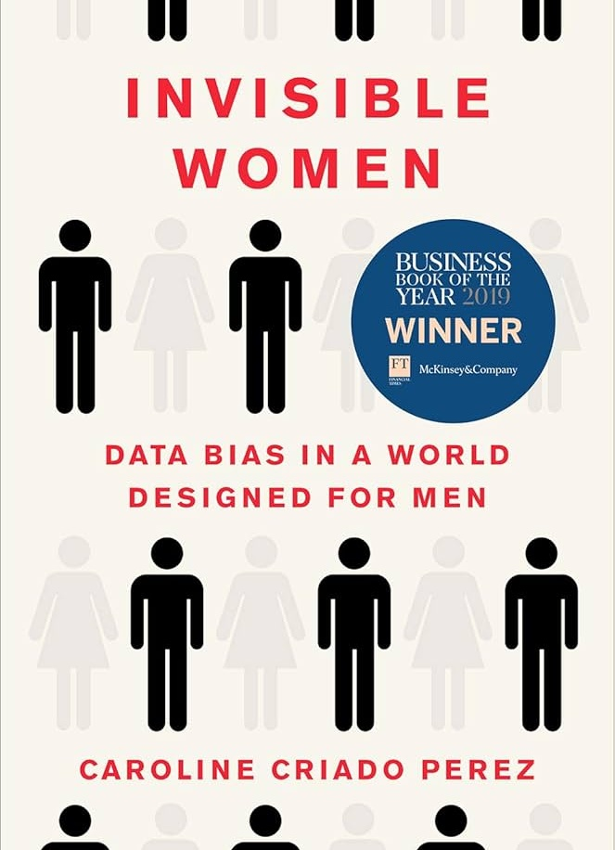
Equity Impact Assessments 2
Niki Vincent,
Commissioner for Gender Equality in the Victorian Public Sector
Caroline Criado Perez,
Invisible Women: Data Bias in a World Designed for Men
Progress 27%

Slide 5

Equity Impact Assessments 3
In the Victorian Public Sector, defined entities must undertake a Gender Impact Assessment on any new or reviewed policy, program or service that has a direct and significant impact on the public
Bendigo Kangan Institute takes the opportunity to consider other equity areas as well as gender
Progress 33%

Slide 6
Equity Impact Assessments 4
Step 1: Define the issue and challenge assumptions
Step 2: Understand the context
Step 3: Options, analysis and development
Step 4: Recommendations
Progress 40%

Slide 7

Hume Tech School
Equity Impact Assessment 1
How can we ensure engagement and skills in digital technologies remains equal amongst all genders?
How can we ensure authentic, diverse representation so young people can see themselves pursuing a career in STEM?
What barriers to equal participation do priority cohorts face in digital technologies, and how can we remove them?
Progress 47%

Slide 8
Hume Tech School
Equity Impact Assessment 2
Demographic data, City of Hume
Partner school profiles: 28 schools including 5 specialist schools and 7 religious schools
Review of diversity & inclusion in STEM research and initiatives
Review of tools and frameworks relevant to diversity & inclusion in STEM, including UDL
Progress 53%

Slide 9
Hume Tech School
Equity Impact Assessment 3
Option 1:
We develop a tool for Hume Tech School teachers to embed the following in all programs:
  Gender equity
  First Nations pedagogies
  Universal Design Principles
  Positive social positioning for all identity groups and intersections
Option 2:
We don’t develop a tool, or
We develop a series of tools for Hume Tech School teacher to draw upon when designing programs
Progress 60%

Slide 10

AI Tools – Inclusive STEM Design
Program design inclusion checklist
Inclusive Prompt Script
CoPilot Agent
Cogniti Agent
Progress 67%

Slide 11
Inclusive agent in action 1
Sustainathon: 3-day Design Thinking program.
Students tackled real industry waste challenges, prototyped solutions, and pitched ideas to repurpose materials
Progress 73%

Slide 12
Inclusive agent in action 2
High-energy challenges risk favouring already-confident students
Limited access for neurodivergent, EAL, or less-confident students
Reduce dependence on live pitching as the main success measure
Publish a plain-language, program overview to help families understand the intent and value, even without STEM backgrounds
Progress 80%

Slide 13
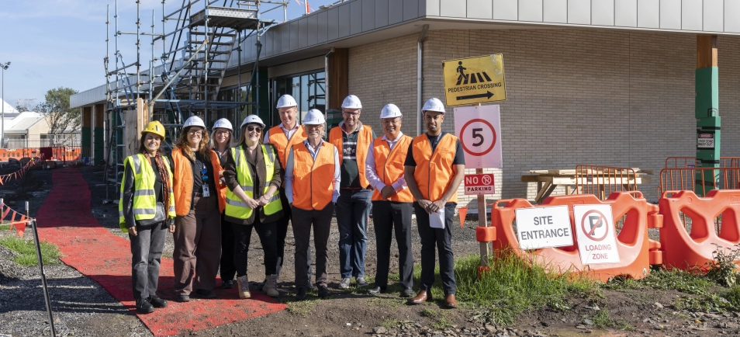
Impacts for Hume Tech School 1
Progress 87%

Slide 14

Impacts for Hume Tech School 2
Every program can be challenged against who benefits / vs who is excluded
Programs reflect local cultural identity and learners, not just generic STEM
ICT devices configured for multilingual users
Intentional procurement of inclusive technologies and equipment
Inclusion is no longer dependant on individual capability or awareness
More students can access, engage and succeed in STEM experiences
Progress 93%

Slide 15
Key Takeaways
If you are part of a Victorian public sector body, use the Gender Equality Act 2020 as a tool to embed UDL in your institution
If not, consider using this example to embed Equity Impact Assessments as a proven tool for generating more equitable outcomes
Contribute to resource bank to continuously improve inclusive agent design
Progress 100%

