Slide 1

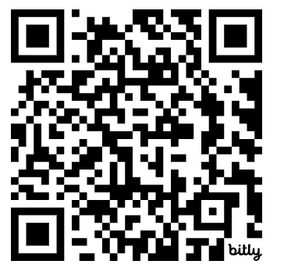
International UDL Open Research Hub: Share your feedback
ADCET UDL Symposium 2026
Homebase: https://bit.ly/UDLresearchHub

Slide 2
Acknowledgement of Country
We acknowledge the Palawa/Pakana peoples of Lutruwita upon whose lands this session is hosted. We pay our respects to their Ancestors and descendants, who continue to have cultural and spiritual connections to Country. We recognise their valuable contributions to Australian and global society. We also acknowledge the traditional custodians of all the lands across Australia, and for those of us joining online, the lands from which we join from.

Slide 3
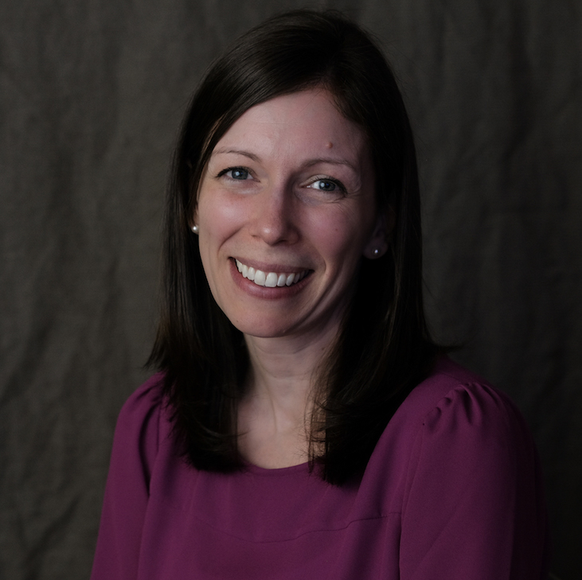
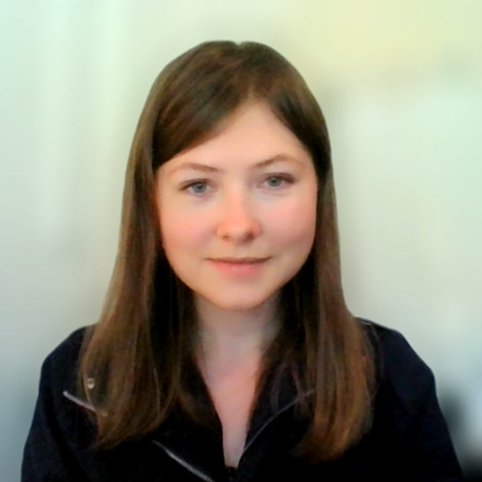
Introductions
Elizabeth Hitches
Inclusive Education Researcher/Teacher
CAST National Faculty
Jenna Gravel
Senior Director of PreK-12 Research
CAST

Slide 4
Goals of the session
To explore the idea of an International UDL Open Research Hub
To partner as co-designers and share your feedback on the Hub concept
To make connections with other practitioners and researchers who are interested in developing the Hub
What are your goals for today? Please feel free to share in the chat or in the Homebase

Slide 5
Agenda for today
Explore the Hub concept
Break into groups to share your feedback
Share out ideas with whole group
Explore ways to get involved in further developing the Hub idea

Slide 6
The "What"
A universally designed and accessible "Hub" to share UDL research, evidence-based practices, and examples of practice.
A space to spark global collaboration around UDL interventions, implementation, methodologies, and outcomes.

Slide 7
Goals of the Hub
An open space where researchers, students, educators, school leaders, families, and other community members from around the world can come together to:
Share and access UDL research and resources
Collaborate across disciplines and contexts
Strengthen the connection between research and practice

Slide 8
The "Why"
Opportunity for shared learning and coherence as UDL research continues to expand
Opportunity to create an accessible space for connection and collaboration for the growing UDL community
Opportunity to center international UDL research perspectives
Opportunity to strengthen the UDL research–practice loop
Opportunity to model the values of UDL through open research

Slide 9
Share Your Feedback!
Breakout Rooms
Room/Table 1: The Hub through the lens of Engagement
Room/Table 2: The Hub through the lens Representation
Room/Table 3: The Hub through the lens of Action & Expression
Share-out: Prepare to share out your top 3 recommendations

Slide 10
Room 1/Table 1: Engagement
How can we build the Hub as a welcoming space that builds community?
How can we build the Hub to be authentic and relevant?
How could we embed collaboration in designing and further developing the Hub?
Please document your ideas in the Homebase doc

Slide 11
Room 2/Table 2: Representation
What information should be represented? How should this be represented?
What resources and supports would help you to make meaning and develop your own areas of interest and expertise?
Please document your ideas in the Homebase doc

Slide 12
Room 3/Table 3: Action & Expression
How can individuals interact with and navigate the information?
How can the Hub support breaking down biases and expanding perspectives on research methodologies, how research is communicated, and who it’s for?
Please document your ideas in the Homebase doc

Slide 13
Share out
Please share your group's top 3 recommendations for moving forward with developing the Hub

Slide 14
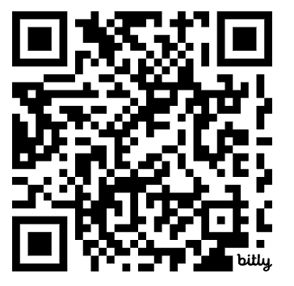
Let's stay connected!
Please complete this brief survey if you'd like to continue to partner with us as co-designers and further develop the Hub idea.
https://bit.ly/UDLhubSurvey

