Slide 1

Acknowledgement of Country
We respectfully acknowledge our Elders past and present and remember that they have passed on their wisdom to us in various ways. Let us hold this in trust as we work and serve our communities.
We acknowledge that this artwork was created exclusively for First Peoples and Equity Pathways by Gilimbaa.

Slide 2


Introduction
Pictured: Marie Kondo, who brought the phrase 'spark joy' into the mainstream.

Slide 3
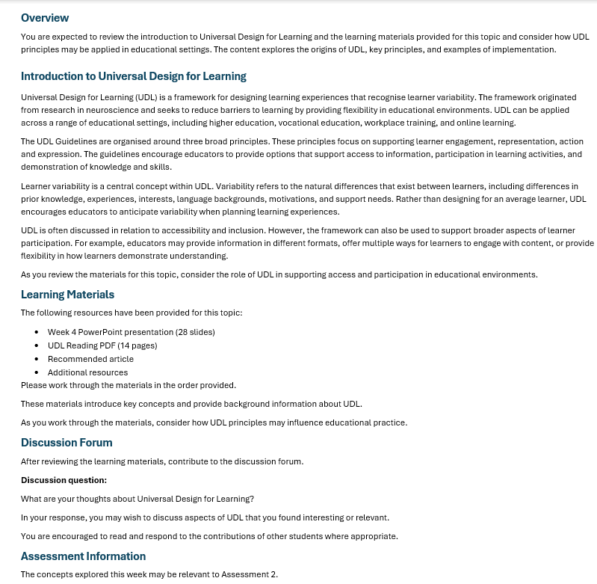
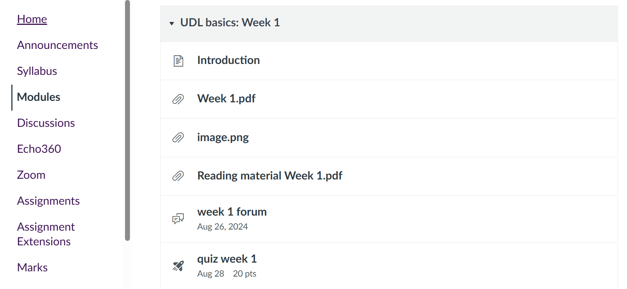
Does this SPARK JOY?

Slide 4

How do we SPARK JOY?

Slide 5


DESIGNING FOR JOY:
inclusive
engagement in
asynchronous
learning

Slide 6



WHAT WE WILL DO
01. reflect
02. explore
03. apply
Where does joy fit into engagement?
What strategies can we use to spark joy?
Use design strategies on a case study

Slide 7



SHIFT TO ASYNCHRONOUS
CLASSROOM
SCREEN
???

Slide 8
DESIGN TENSIONS
authentic joy
forced fun
inclusive
default
belonging
solitude
real-time dialogue
delayed reaction
internal
external

Slide 9
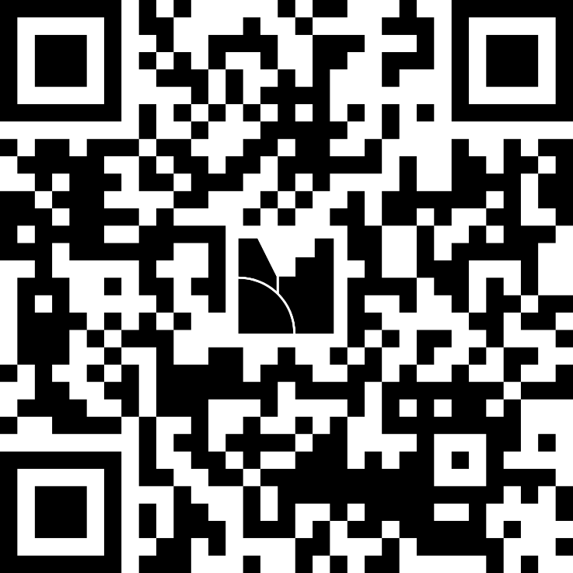
Reflect
When you hear “online engagement,” what comes to mind?
Menti: 8713 3563

Slide 10

ENGAGEMENT BEHAVIOURS
VISIBLE actions
semiVISIBLE metrics
  Discussion posts
  Assessment submissions
  Questions asked
  Collaborative contributions
  Page views
  Video views
  Resource downloads
  LMS activity
INVISIBLE ENGAGEMENT
  Reading
  Reflecting
  Connecting ideas to experience
  Critical thinking
  Revisiting content
  Applying learning in practice

Slide 11

Reflection
"It is difficult to definitively conceptualise exactly where joy begins and ends and itsentanglement with associated positive emotions."
(White et al, 2026)
what is "joy" for adult learners?
Menti: 8713 3563

Slide 12



Joy?
"You feel it when you hold a puppy or wear your favourite outfit."
"It is a warm and positive feeling."

Slide 13


Nurture joy and play
CONSIDERATION 7.3:
01
02
03
Joy is a core aspect of engagement
Joy is
subjective
Variation and flexibility are needed

Slide 14

The ‘C’s of joy
CHOICE
CLARITY
CHALLENGE
COMMUNICATION
CONFIDENCE
CARE
CONNECTION
CREATIVITY
This Photo by Unknown Author is licensed under CC BY-NC

Slide 15
Reflection
It can be hard to nurture joy and play in adult asynchronous learning.
What are some ways to do this?
One approach = low stakes active learning activities

Slide 16
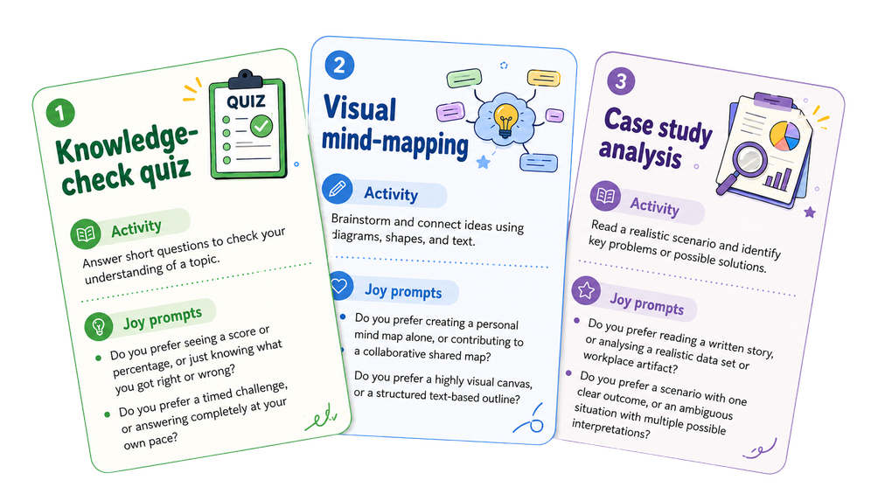
Activity 1: joy strategy deck
Step 1:
Explore the 'joy deck'. Select one that interest you.
Step 2:
Discuss with the people sitting at your table or online in the chat.
    Where do your opinions match and where do they differ?
    When might you use it?
Step 3:
Repeat step one!

Slide 17


Key ideas
Joy comes in many forms
There is no single formula for joy
Joy is personal, flexible, and often quiet
Let’s apply these ideas to a real design example!

Slide 18

Scenario
A student logs into their LMS, ready to begin Week 1.
They then see:
  a 14‑page PDF
  a 28‑slide deck, and
  a 900‑word block of text.
They immediately close the tab.
What do you think happened?
A: Cognitive overload
B: Poor navigation
C: Lack of perceived relevance

Slide 19
Joy checking
  Is it crystal clear, removing the frustration of confusion?
  Does it help the learner feel capable and safe to try? Can they feel pride of their accomplishments?
  Does it make the learner feel connected to the content, a community, or real life? Does it represent a variety of identities?
  Does the learner have autonomy over how they engage?
  Is it novel, creative, or challenging enough to engage with?

Slide 20
Activity 2: redesigning for joy
Step 1:
Select one thing from your “Sample LMS content” to redesign.
Step 2:
Use a strategy from the Joy Strategy Deck to redesign your chosen thing.
Think about how to increase either clarity, confidence, connection, choice, challenge or creativity.
Note: Think small; we only have 15 minutes.
Step 3:
Champion your ideas with your peers at the table, or share your ideas directly in the online chat.
Note: Work individually if desired.

Slide 21
share your ideas
01
One redesign
02
One insight
03
One thing you’ll try

Slide 22

Key ideas
takeaway 1
takeaway 3
Engagement is meaning-making.
Adding joyful aspects to design can create and support engagement.
takeaway 2
takeaway 4
Invisible engagement may be a pathway to joy.
UDL approaches allow for learners to engage joyfully.

Slide 23
Post workshop challenge
Post workshop challenge
Write a little promise card to yourself.
“One thing I will redesign next week…” ex…
  a discussion prompt,
  announcement,
  module intro,
  feedback approach.

Slide 24

thank you!
THANK YOU

Slide 25
References
References
  Beer, C., Lawson, C., Mann, G., & Clark, D. (2017). Measuring engagement: an institution-wide implementation of learning analytics to increase retention. Proceedings STARS.
  CAST (2024). CAST Universal Design for Learning Guidelines version 3.0. Retrieved from https://udlguidelines.cast.org
  Halverson, L. R., & Graham, C. R. (2019). Learner engagement in blended learning environments: A conceptual framework. Online learning, 23(2), 145-178.
  Hu, J., & Xiao, W. (2025). What are the influencing factors of online learning engagement? A systematic literature review. Frontiers in Psychology, 16, 1542652.
  Hussein, J. W. (2008). An existential approach to engaging adult learners in the process of legitimizing and constructing meanings from their narrative knowledge. Action Research, 6(4), 391-420.
  Kapuza, A., Getman, A., Kotlikova, A., Gerasimova, I., Urtenova, P., & Kharakhordina, M. (2025). Predicting students engagement in asynchronous online learning: a mixed-method approach. Educational technology research and development, 1-23.
  Ketchum, C., Phompheng, E., Yeats, C., LaFave, D., & Hardy, J. (2022). The impact of video feedback on student assessments and performance. American Journal of Distance Education, 36(4), 288-301.
  Kim, S., Cho, S., Kim, J. Y., & Kim, D. J. (2023). Statistical assessment on student engagement in asynchronous online learning using the k-means clustering algorithm. Sustainability, 15(3), 2049.
  Love, S., & Marshall, D. (2022). Video feedback and instructor social presence in an asynchronous online course. Journal of Effective Teaching in Higher Education, 5(2), 43-58.
  Martin, F., & Borup, J. (2022). Online learner engagement: Conceptual definitions, research themes, and supportive practices. Educational Psychologist, 57(3), 162-177.
  Mason, T., & Rodriguez, M. (2025). Choosing Joy over Dread: Bringing Art, Playfulness, and Agency to Learning. In Joy-Centered Pedagogy in Higher Education (pp. 46-61). Routledge.
  Motta, R. (2025). Invisible Confidence: Exploring Participation, Expression, and Engagement in Virtual Classrooms for Adult Learners (Doctoral dissertation, State University of New York at Buffalo).
  Zanjani, N. (2017). The important elements of LMS design that affect user engagement with e-learning tools within LMSs in the higher education sector. Australasian Journal of Educational Technology, 33(1).
  Watson, S., Sullivan, D. P., & Watson, K. (2023). Teaching presence in asynchronous online classes: It’s not just a façade. Online Learning, 27(2), 288-303.
  White, L., Mason, W., Grant, V., Romaine, A., Cleary, G., & Tulloch, S. (2026). Towards a pedagogy of joy. British Journal of Sociology of Education, 1-18.

Slide 26
Further reading
Explore the following resources at your leisure.
  UDL Guidelines: Nurture, joy, and play
  Active Learning (in Educational Psychology. Hoose, 2020)
  Joy-Centered Pedagogy in Higher Education. edited by Eileen Kogl Camfield, 2025.

