Slide 1
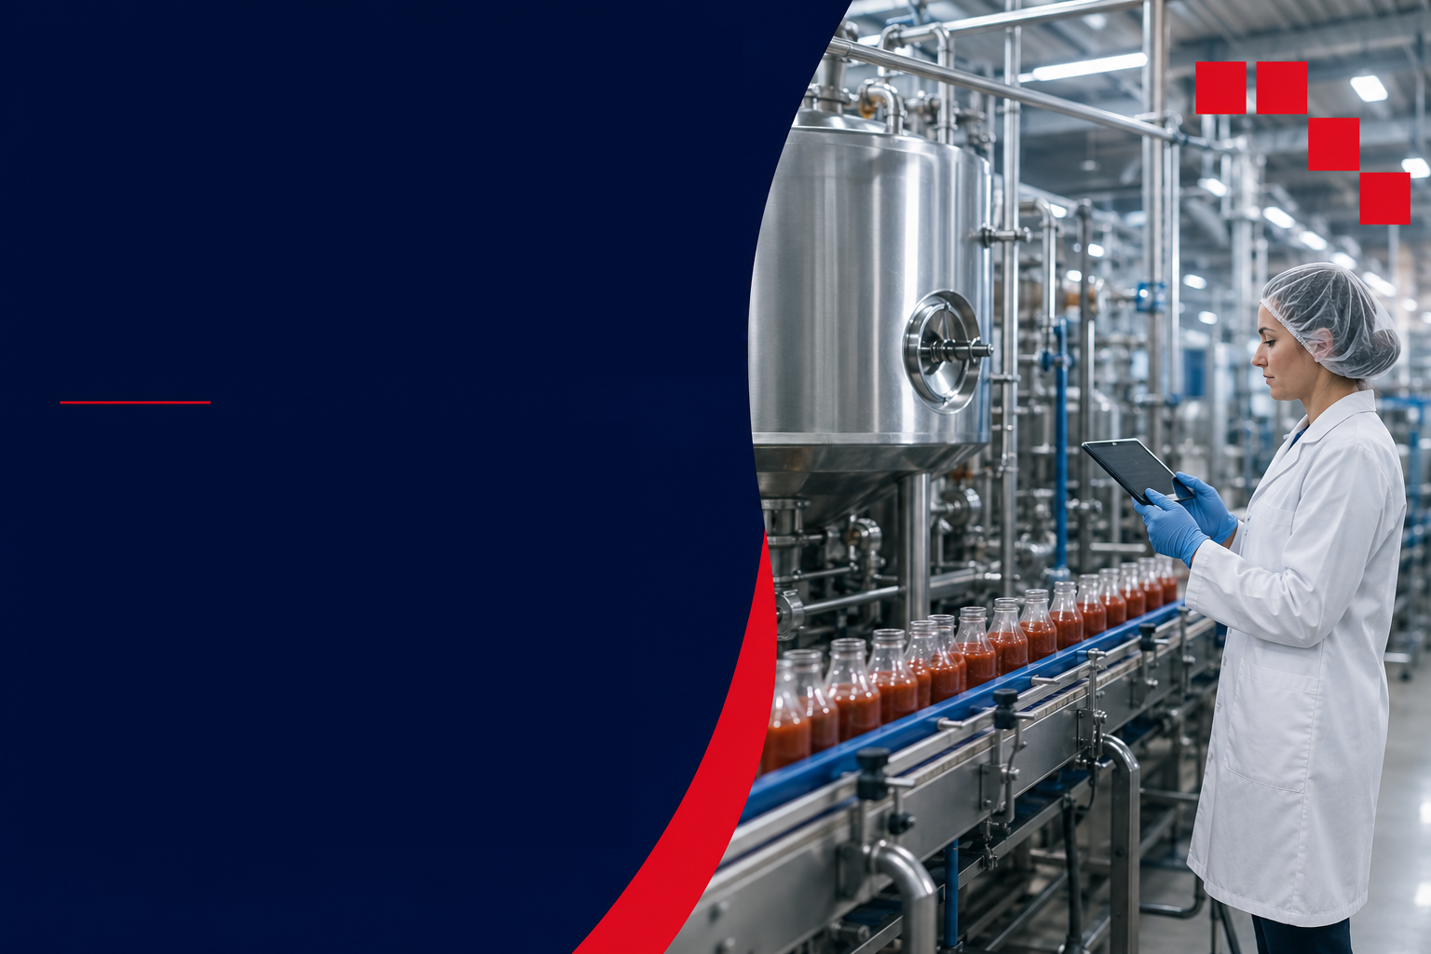




Slide 2
Why this course matters: from principles to food processing decisions
Food processing decisions affect food safety, shelf life, product quality, nutrition, sustainability and consumer acceptance.
Engineering principles
Processing technologies
Product and industry outcomes
⚙️
🏭
📦
• Heat transfer
• Mass transfer
• Mass balance
• Fluid flow
• Bernoulli equation
• Thermal processing
•Drying, evaporation and distillation
• Refrigeration and freezing
• Membrane filtration and HPP
• Ultrasound
• Food safety and shelf life
• Sensory quality and nutrition
• Sustainability and feasibility
• Consumer acceptance
•Industry-ready decisions
✓
The learning challenge is helping students connect these topics and apply them to justified food processing decisions.

Slide 3
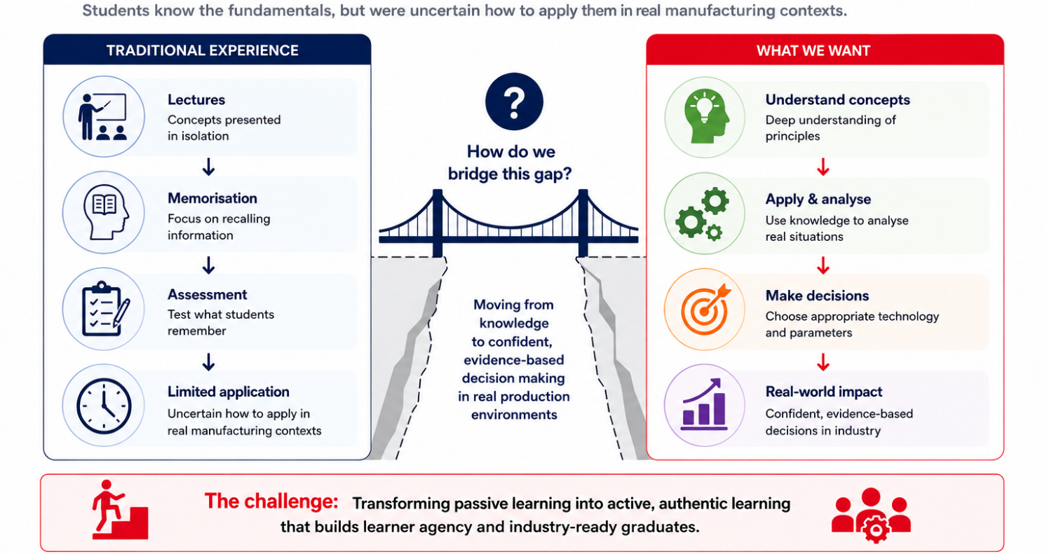
The teaching & learning challenges

Slide 4
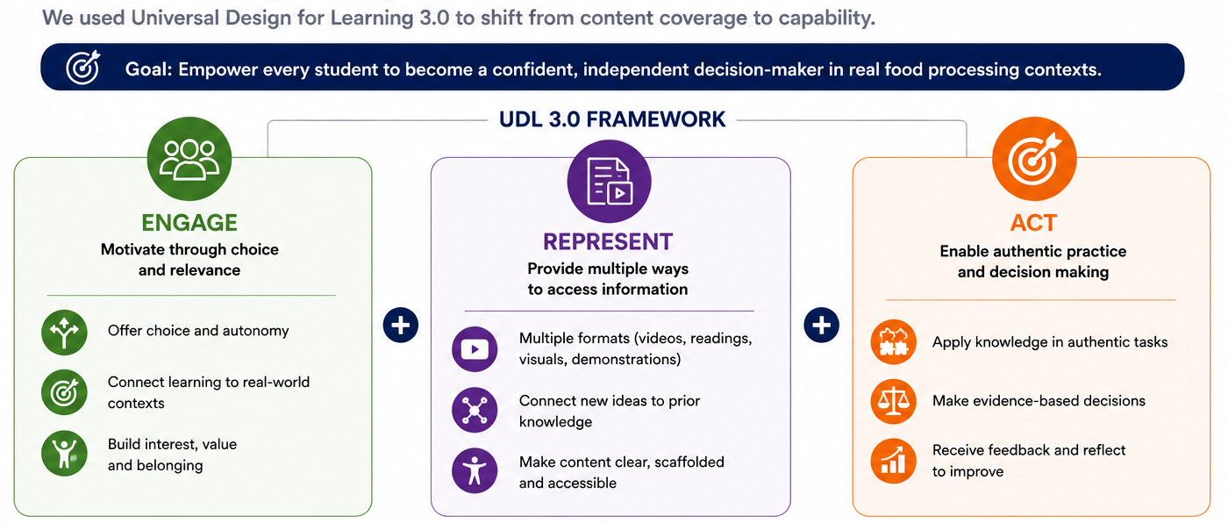
Our redesign approach: UDL 3.0

Slide 5
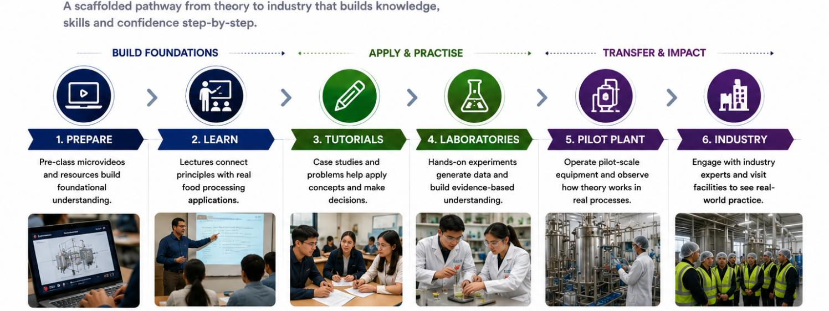
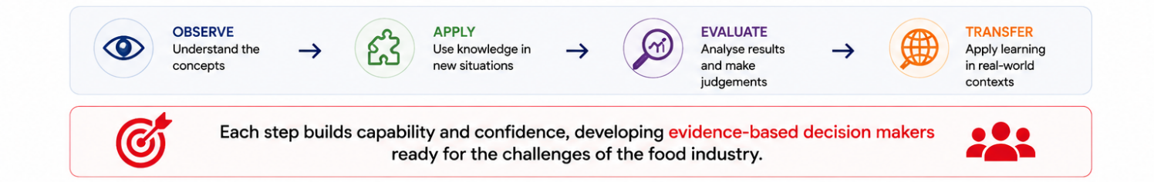
Our learning journey

Slide 6
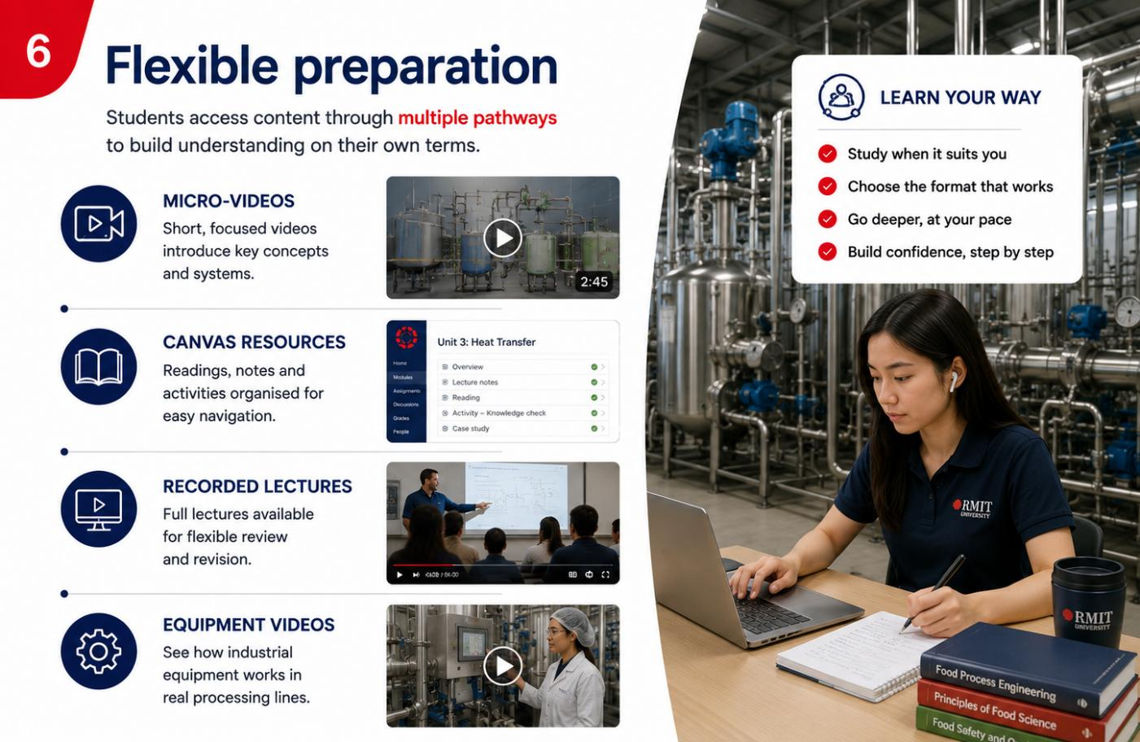
Flexible access to learning

Slide 7
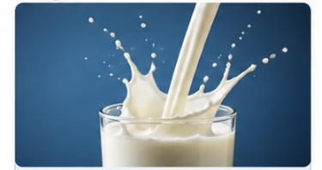
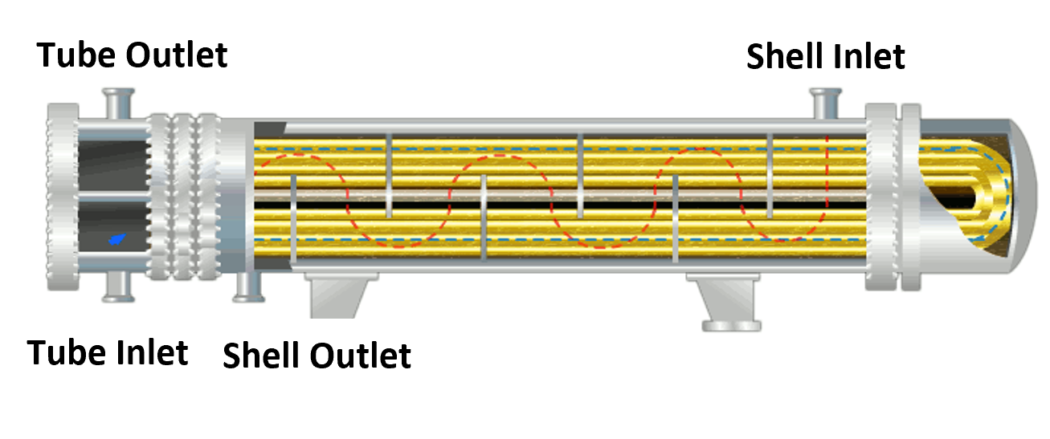
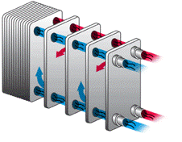
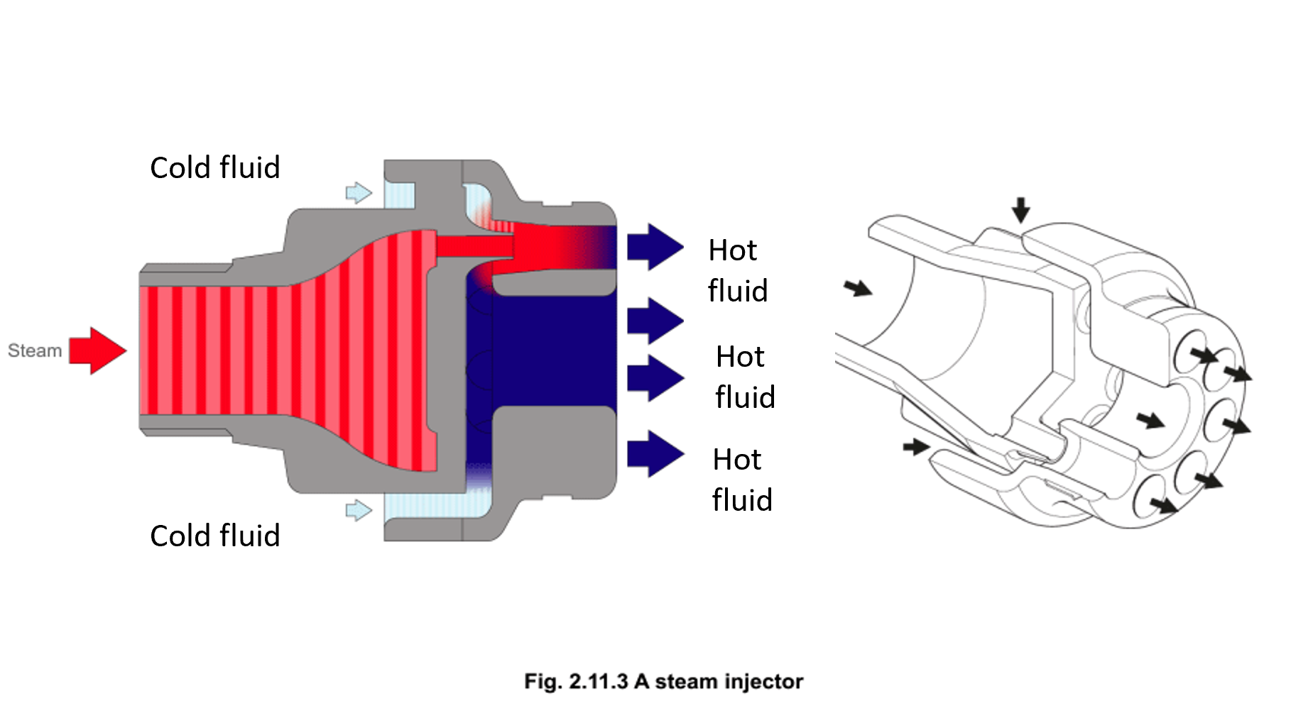

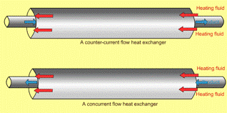
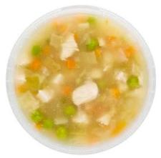
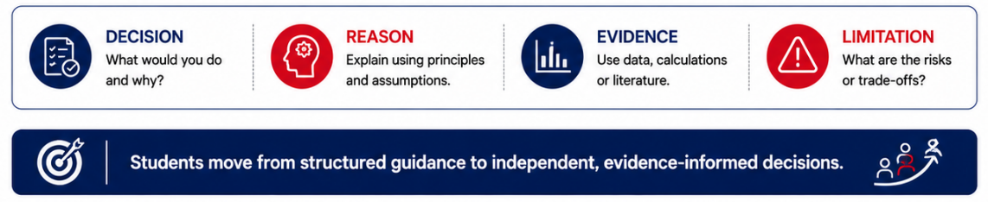
Tutorials bridge theory to application
Weekly tutorials use authentic food scenarios to help students make, justify and communicate processing decisions.
Milk
Tomato sauce
Soup with particles

Slide 8
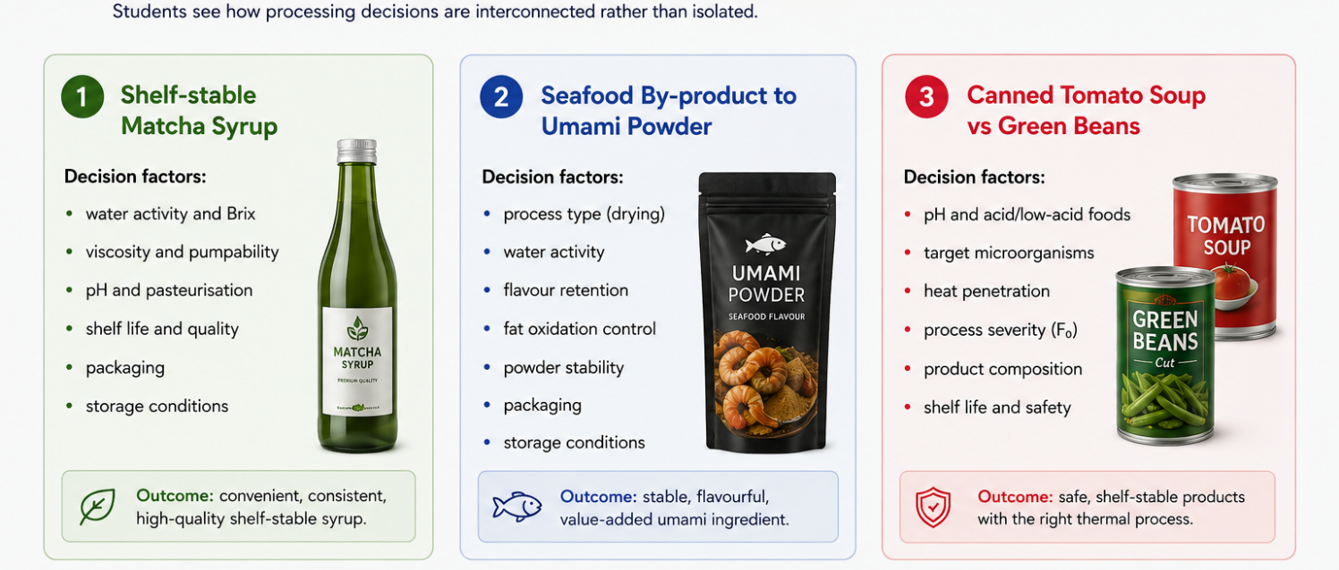
Product design in action;
Learning through case studies

Slide 9
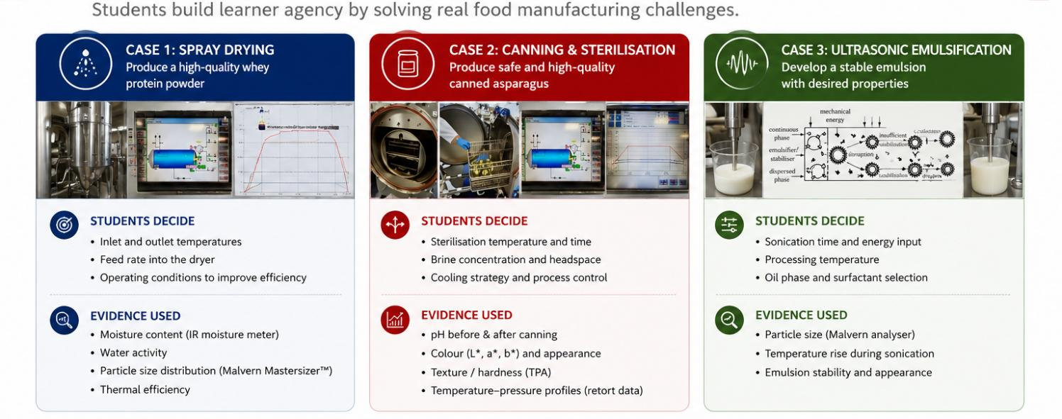
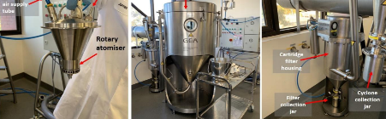
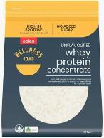
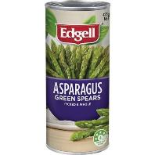
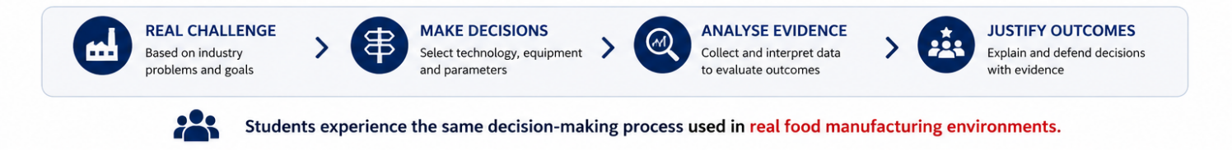
From classroom to pilot plant practice
Comparing lab-made and commercial products

Slide 10
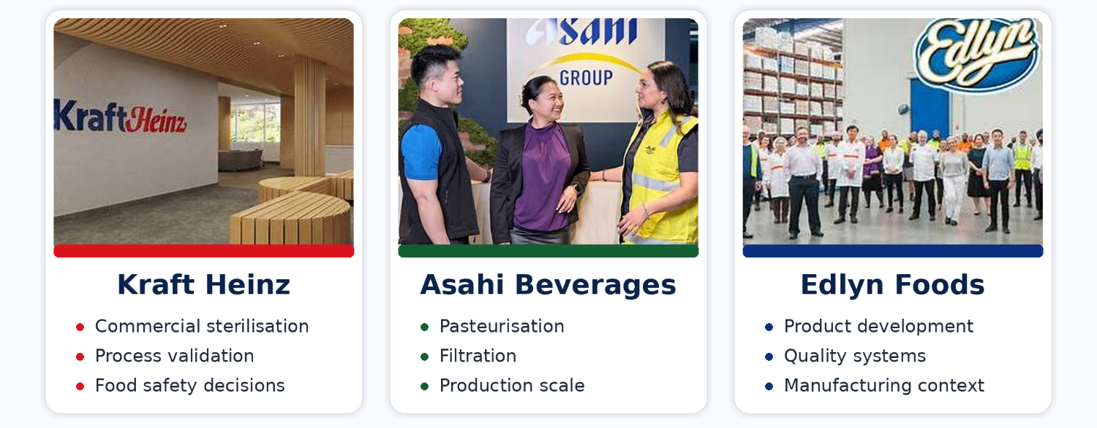
Learning from industry experts
Guest speakers helped students see how food processing concepts are applied in real manufacturing decisions.
Real insights. Real challenges. Real impact
Industry guests bridge the gap between theory and practice by showing how processing decisions affect safety, quality, production scale and consumer-ready products.

Slide 11
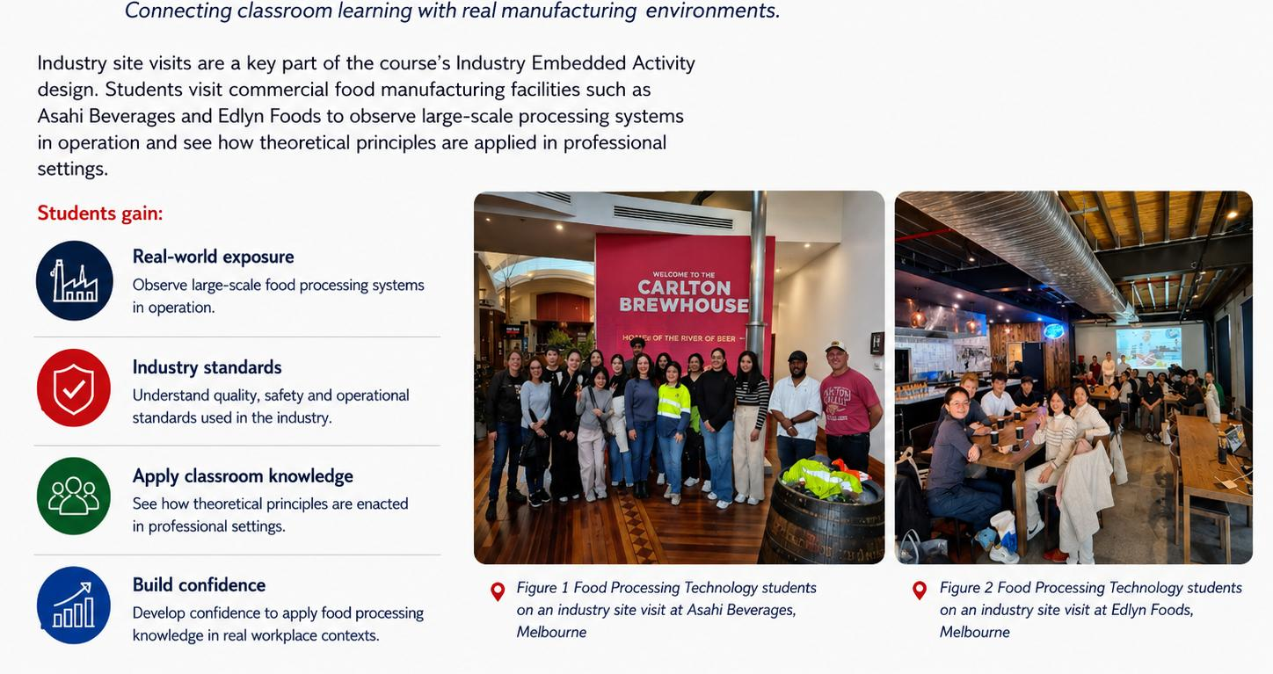
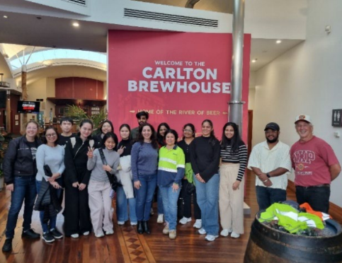
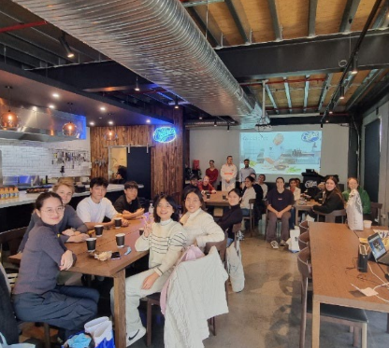
Industry site visit

Slide 12
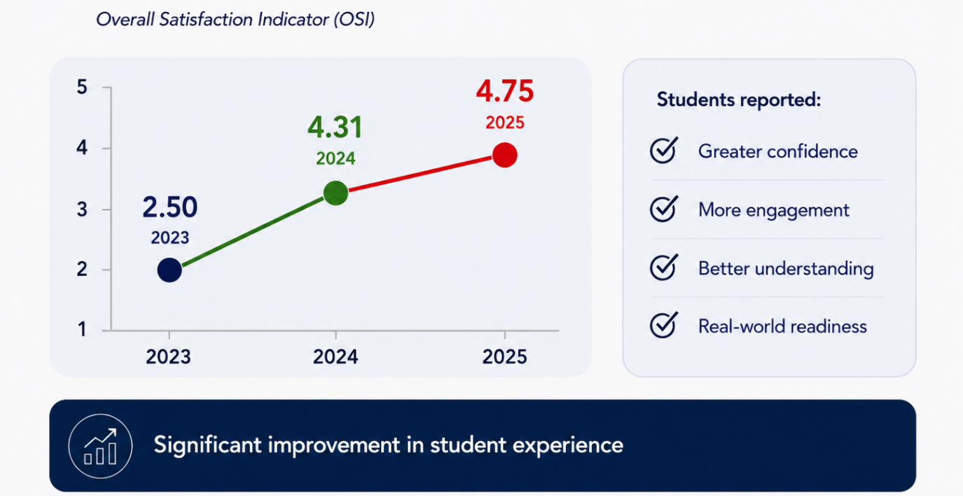
Evidence of impact

Slide 13
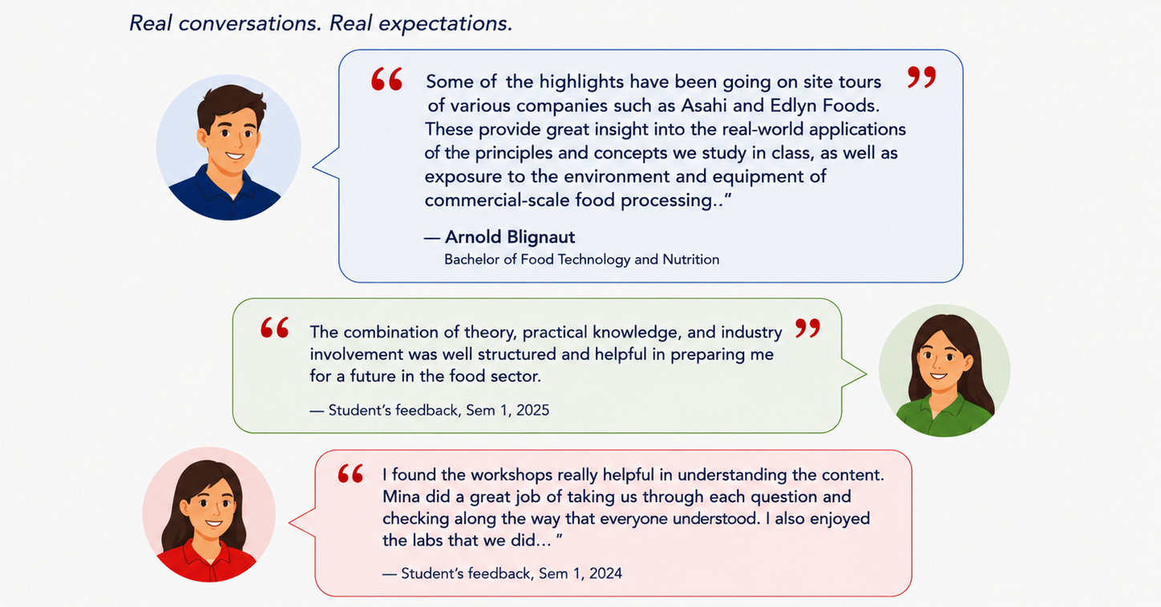
Student voices

Slide 14
Your turn: Think like a food technologist
A sample tutorial case: choosing processing technologies based on product outcomes
Industry scenario
A dairy company wants to produce shelf-stable drinking milk that can be stored at room temperature for 6 months.
Students consider:
• food safety
• shelf life
• product quality
• packaging
• storage conditions
✓
UDL connection: Students compare technologies, justify decisions, and connect processing choices with real product outcomes — rather than simply recalling techniques or equipment principles.

Slide 15

A dairy company wants to produce drinking milk that remains shelf-stable for 6 months. Which processing strategy is most appropriate?

Slide 16
Justification
Why is the selected processing strategy the most appropriate?
16

Slide 17




