Slide 1
A Programmatic approach to
Universal Design for Learning in Postgraduate Health Promotion

Slide 2
Presenters
Dr Bridie Kean
SENIOR LECTURER, PUBLIC HEALTH
Associate Professor Jane Taylor
DISCIPLINE LEAD, PUBLIC HEALTH
Nick Yates
ACADEMIC DEVELOPER
Tara Gamble
ASSOCIATE LECTURER, PUBLIC HEALTH

Slide 3
Our Values and Commitment
Equity
Inclusion
Lifelong learning

Slide 4
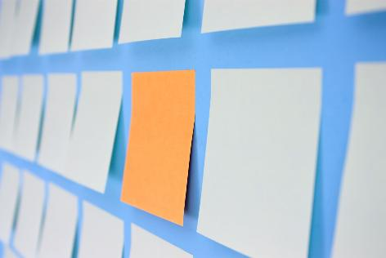
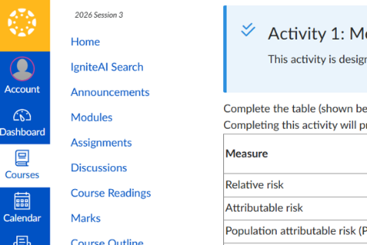

Outline
Programmatic approach to redesign
UDL Changes to
Canvas LMS Module Template
Impact of changes

Slide 5
Programmatic Approach to Redesign

Slide 6
Please rank how you could see UDL being programmatically implemented in your institution? (i.e. which one could benefit your institution the most)
Do not edit
How to change the design
The Slido app must be installed on every computer you’re presenting from

Slide 7

Changing Cohort of Students
Decreasing
Success rate 85% in 2021 to 76.2% in 2025
Passing rate 80.5% in 2021 to 73% in 2025
Student groups
Students with caring responsibilities
Students with competing demands

Slide 8
Previous Programmatic Learning Design
Program constructive alignment
Module main points weren’t emphasised
Scaffolding of learning activities towards assessment tasks and outcomes underutilised
Module pages weren’t consistent across program
Needed optimised Canvas module template and page design

Slide 9
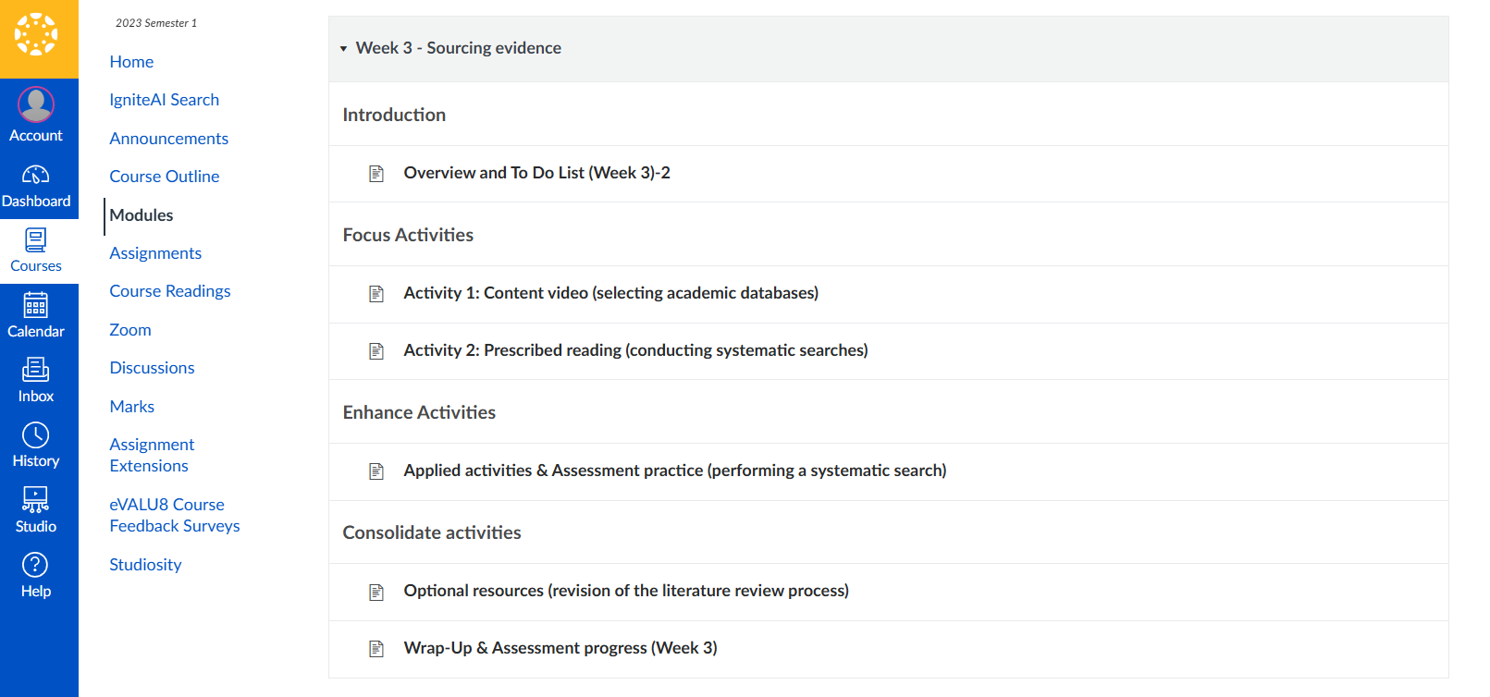
Previous Programmatic Learning Design - Screenshot

Slide 10
Programmatic Learning Redesign
Program collective with small leadership team
Seek buy in and support
Constructive alignment
Optimised canvas module template

Slide 11
How are you programmatically implementing UDL to remove barriers across a program or curriculum?
Do not edit
How to change the design
The Slido app must be installed on every computer you’re presenting from

Slide 12
UDL Changes to Canvas LMS Module Template

Slide 13
Programmatic Plus One’s
Design a consistent student learning experience
Increase formative feedback opportunities
Enhance asynchronous learning strategies for diverse cohort of post-graduate learners
Scaffold student’s practice and application towards assessments and outcomes

Slide 14
Barrier: Inconsistent Student Learning Experience
Different course, different experience
Students spent time learning to navigate

Slide 15
Solution: Module Template
UDL
UDL Consideration 7.4 – Addresses biases, threats, and distractions
Solutions
Create consistent learning experience
Make explicit the learning design and experience
Create routines and remove distractions
Guide educators towards purposeful media and remove text/visual distractions

Slide 16
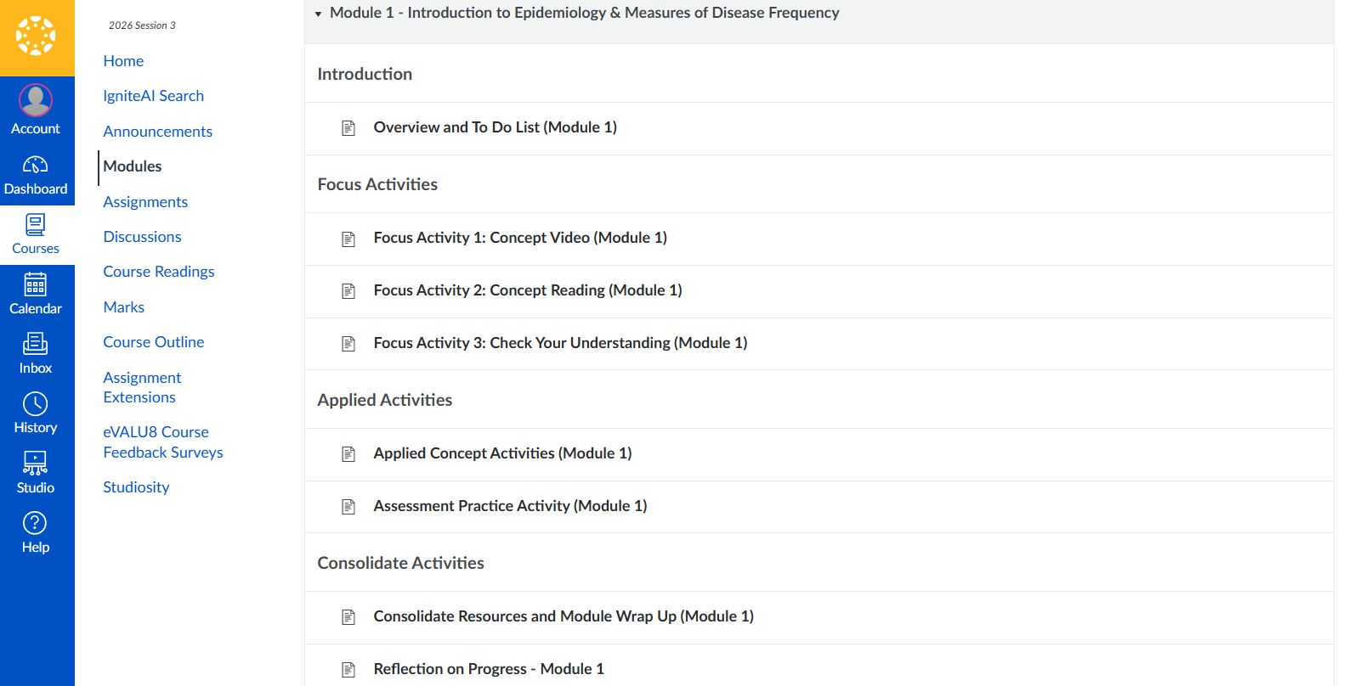
Solution: Module Template (Screenshot)

Slide 17
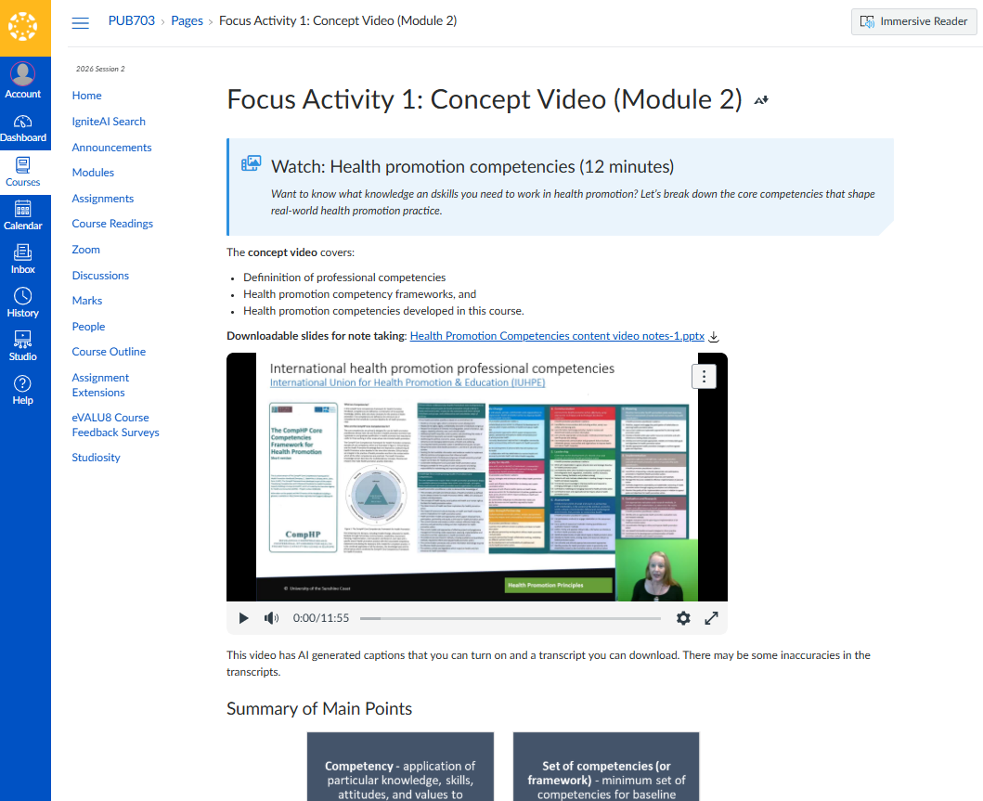
Solution: Page Template (Screenshot)

Slide 18
Barrier: Minimal Feedback
Less feedback available in asynchronous learning
Students asking for more feedback

Slide 19
Solution: Design Feedback into Template
UDL
UDL Consideration 8.5 – Offer action oriented feedback
  Offer specific and timely feedback
Solutions
Interactive learning activities with feedback embedded
Worked response to applied learning activities

Slide 20
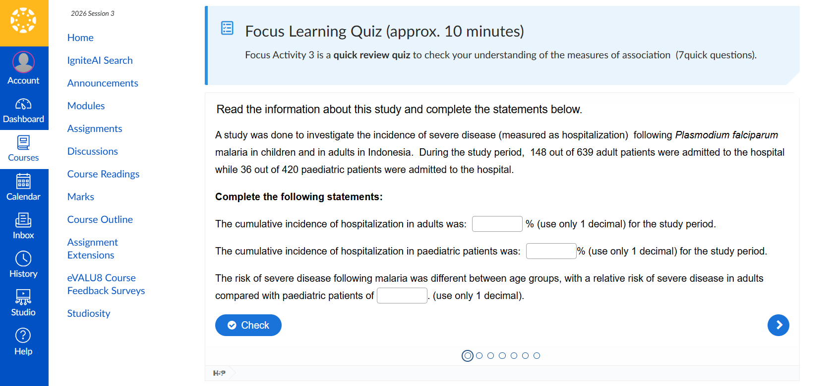
Solution: Design Feedback into Template (Screenshot)

Slide 21
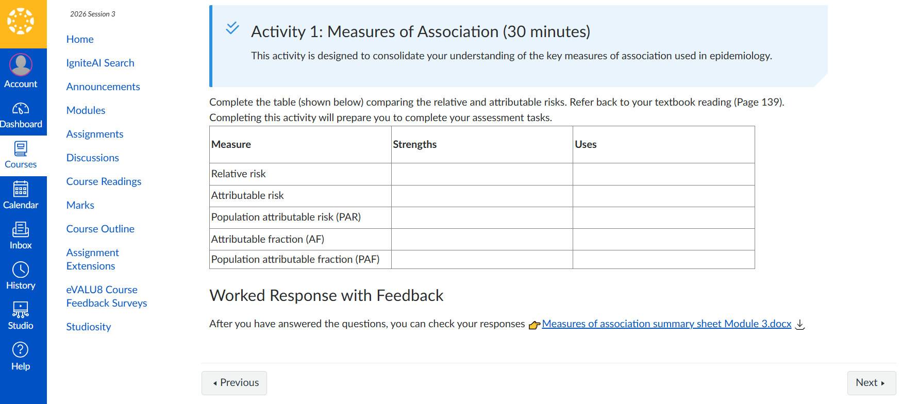
Solution: Design Feedback into Template (Screenshot)

Slide 22
Barrier: Post-reading understanding
More diverse students need scaffolding when completing readings
Time-poor students don’t complete all reading

Slide 23
Solution: Design Visual Summary
UDL
UDL Consideration 2.5 – Illustrate through multiple media
Support knowledge acquisition by making text more relatable and comprehensible
UDL Consideration 3.2 – Highlight critical features, big ideas and relationships
Highlight key elements visually
Solution
Post-Reading visual diagrams

Slide 24
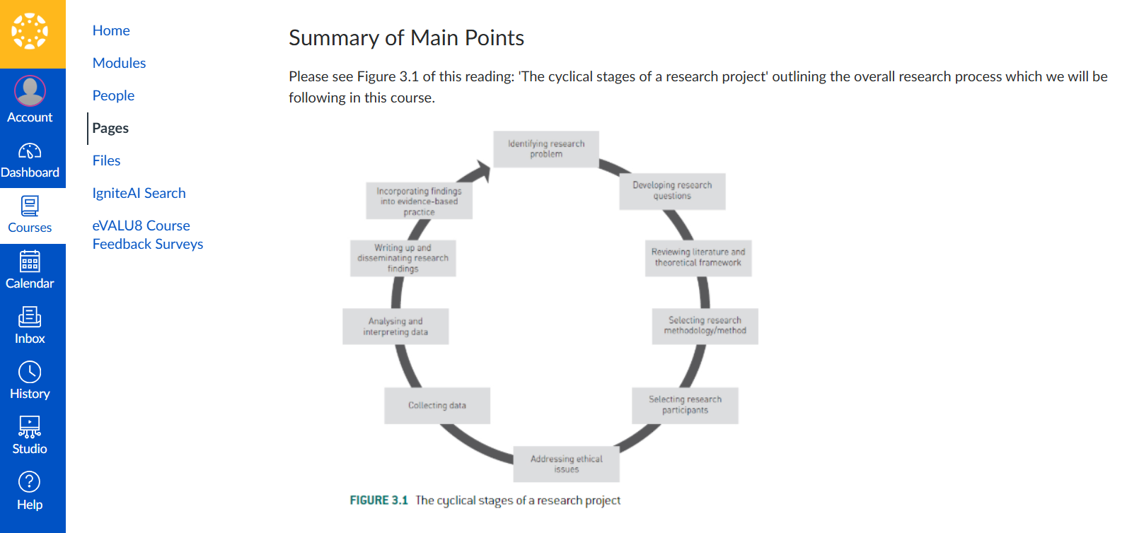
Solution: Design Visual Summary (Screenshot)

Slide 25
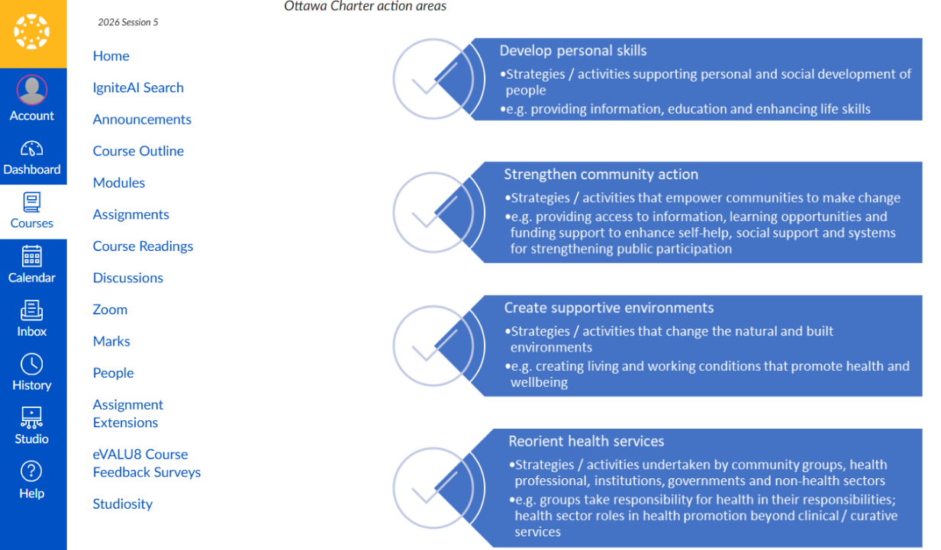
Solution: Design Visual Summary (Screenshot)

Slide 26
Barrier: Less practice before assessment tasks
More diverse cohort need practice before assessment tasks
Time-poor students don’t apply skills in practice before assessment tasks

Slide 27
Solution: Applied Practice Tasks
UDL
UDL Consideration 5.3 – Build fluencies with graduated support for practice and performance
  Scaffolded practice with feedback before assessment tasks
Solution
Applied practice tasks with feedback

Slide 28
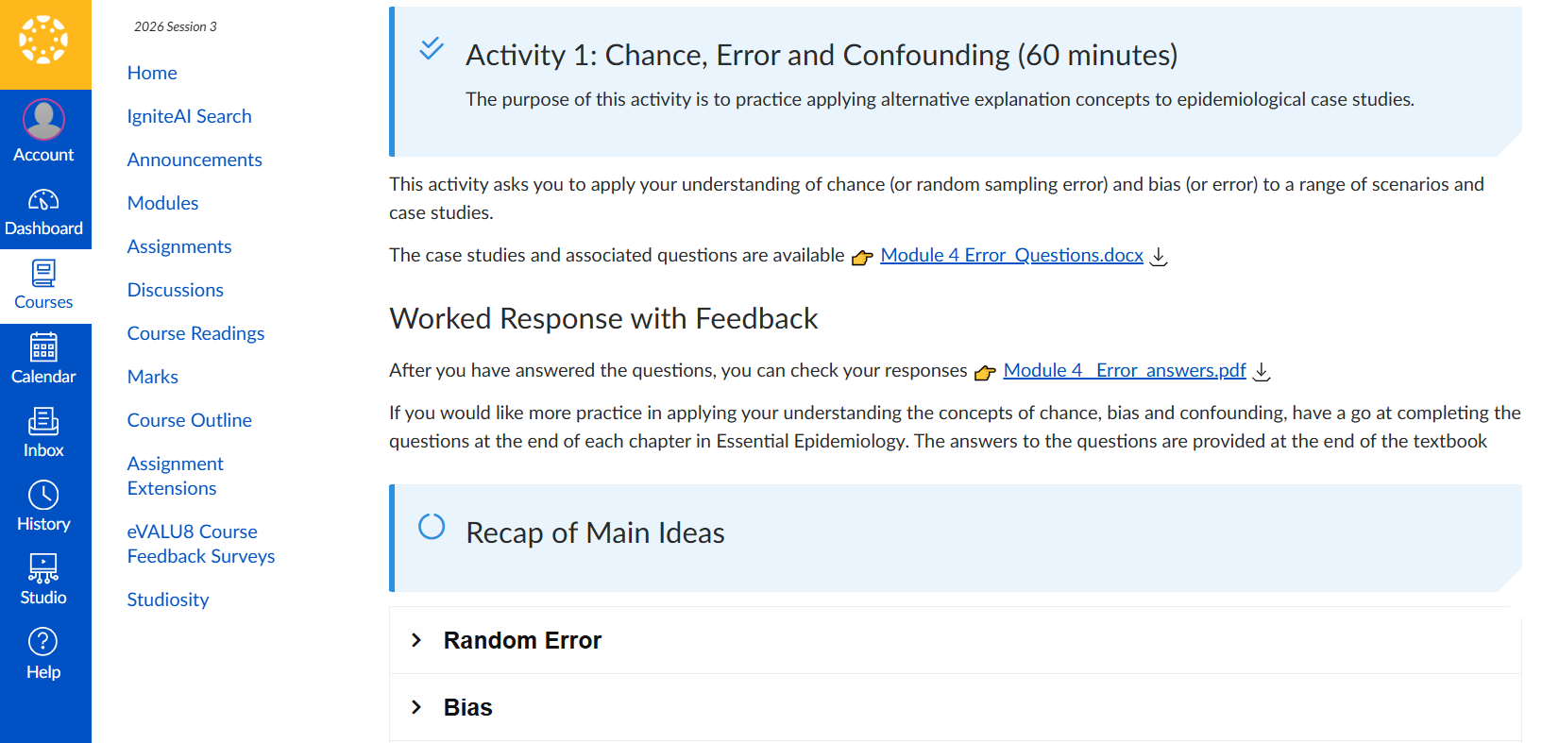
Solution: Applied Practice Tasks(Screenshot)

Slide 29
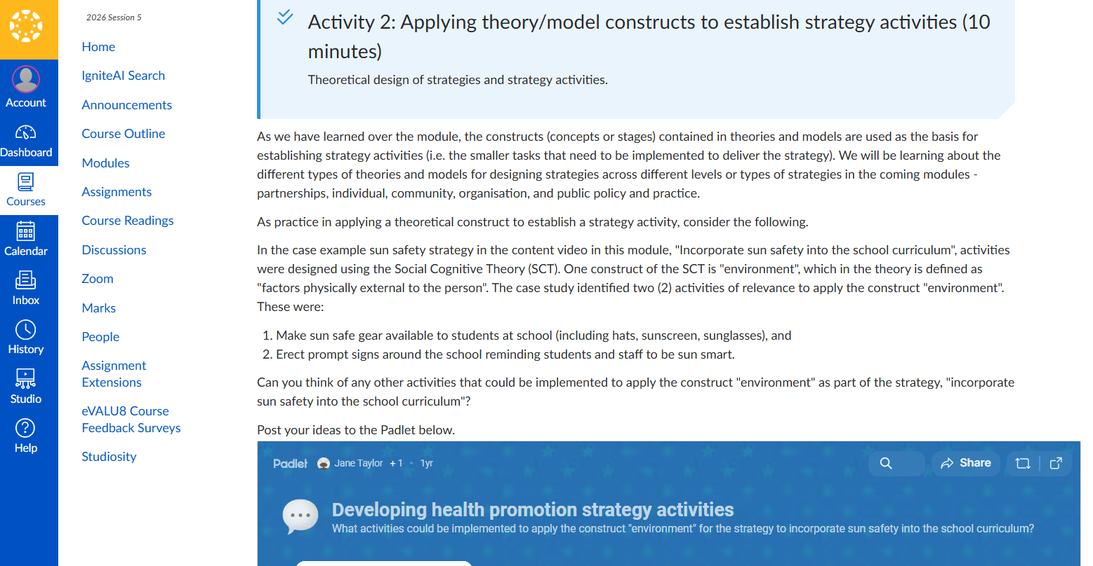
Solution: Applied Practice Tasks (Screenshot)

Slide 30
How are you programmatically implementing UDL to remove barriers across a program or curriculum?
Do not edit
How to change the design
The Slido app must be installed on every computer you’re presenting from

Slide 31
Which UDL considerations are highly used and valued within your programmatic implementation?
Do not edit
How to change the design
The Slido app must be installed on every computer you’re presenting from

Slide 32
Evidence of Impact

Slide 33
Quotes from staff and students
"As a manager responsible the curriculum of our programs, the template provides me with confidence that best practice asynchronous learning principles are being realised across our courses."
"Once course is completed, less upkeep and less enhancements, so shift workload and priorities to other projects"
"I very much enjoyed the teaching style and material" - unsolicited email from a graduate student

Slide 34
External Review
“Significant support has been provided by various university professional staff teams to ensure professional, interactive and contemporary student experience…. Students appreciate the accessible, interactive and engaging learning tasks plus opportunities to drop in and contact staff. The coordinated and consistent approach to the processes and setup of LMS Canvas and processes across courses within the nested programs was noted and appreciated”

Slide 35
Which UDL considerations are highly used and valued within your programmatic implementation?
Do not edit
How to change the design
The Slido app must be installed on every computer you’re presenting from

Slide 36
Next Steps
Evaluate the module template
Collect ideas and refinements
Update in the next program cycle

Slide 37
Audience Q&A
Do not edit
How to change the design
The Slido app must be installed on every computer you’re presenting from

