Slide 1
Inclusive Learning in a Virtual Gallery Space
Innovative UDL practices in teaching and learning
Dr Arianna Dick – Lecturer
Ms Thoa Mai Phuoc Nguyen – Senior Learning Designer
Mr Keith Hibbert – Augmented & Virtual Reality Designer

Slide 2
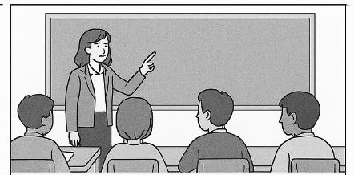
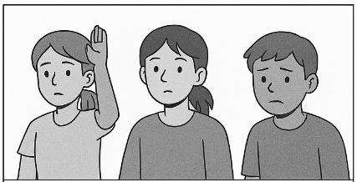
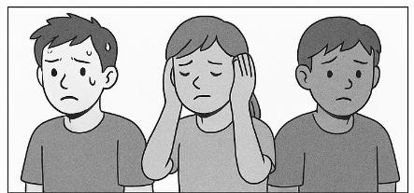
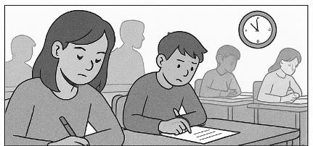
Background
The visual storyboards were created using an AI image generation tool (Microsoft Copilot, 2026).
Traditional learning environments often limit the ways students engage and demonstrate their understanding^{[1]}
These barriers are especially pronounced during assessments and live classroom interactions
and tend to disadvantage learners who experience anxiety, sensory sensitivities, or communication challenges^{[2,3]}
Conventional formats may fail to accommodate diverse learning styles^{[4,5]}

Slide 3
Project aim
To develop and implement a virtual gallery platform designed to enhance inclusive learning experiences for all students, particularly those with disabilities, mental health challenges, neurodivergence, and varied cultural, linguistic, and educational backgrounds, offering multiple ways to participate and demonstrate knowledge.
Objectives:
To design two interactive spaces:
A space where students can upload assessment materials and get peer feedback
A learning environment for persona-based interactions
To pilot the gallery in a STEM course in Semester 2, 2026, at RMIT University

Slide 4
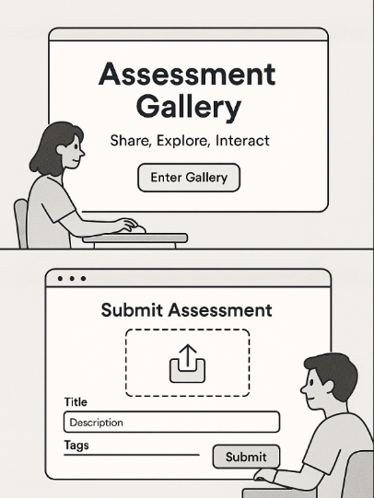
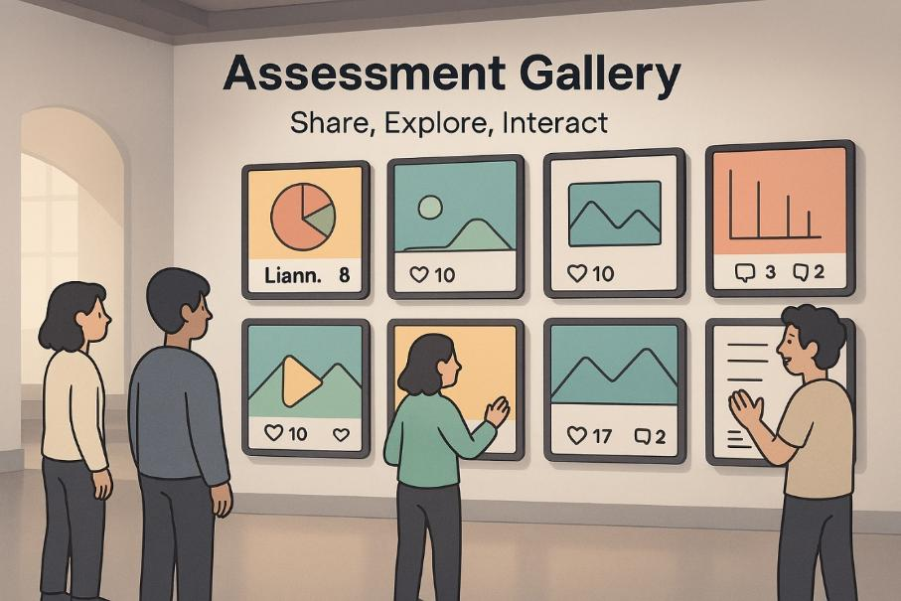
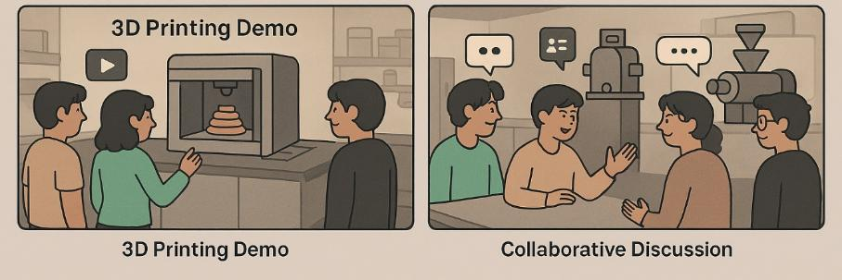
Two galleries/rooms
Two galleries/rooms:
Assessment Gallery
Interactive exploration of advanced food processing equipment
The visual storyboards were created using an AI image generation tool (Microsoft Copilot, 2025).

Slide 5
Embedding UDL principles in practice
Designing for learning variability across the Virtual Gallery
Multiple Means of Engagement
Self-paced exploration
Low-stakes knowledge checks
Belonging space for connection and agency
Asynchronous participation
Multiple Means of Representation
Video, text, visuals, and 3D models
Guided and self-directed pathways
Journey maps, information panels, and support resources
Central Lobby
Equipment Discovery Lab
Poster Presentation Gallery

Slide 6
UDL and Assessment Design
Create
Share
Feedback
Reflect
Multiple Means of Action and Expression
Flexible Assessment Formats
Students choose formats like PDFs, images, slides, or videos to demonstrate learning without barriers.
Interactive Presentation Gallery​
Poster-style gallery promotes engagement, peer feedback, and authentic academic communication.​
Iterative Learning Workflow​
Assessment follows Create, Share, Feedback, Reflect cycle emphasizing continuous learning and reflection.​
Inclusion and Autonomy Support​
Design supports learner choice, inclusion, consistent criteria, and real-world communication practices.

Slide 7
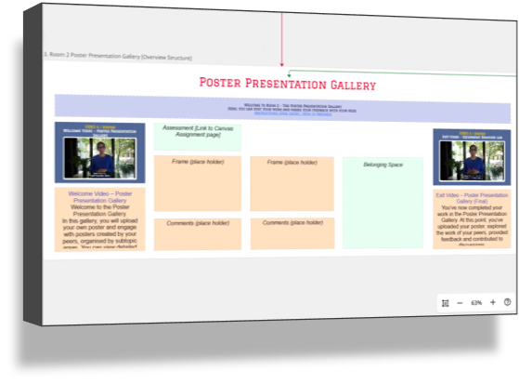
Planning with a UDL lens
Our Design Process
Map learner journeys Identify barriers and friction points Provide meaningful choices Align learning, assessment and course learning outcomes Iterate through multidisciplinary collaboration

Slide 8
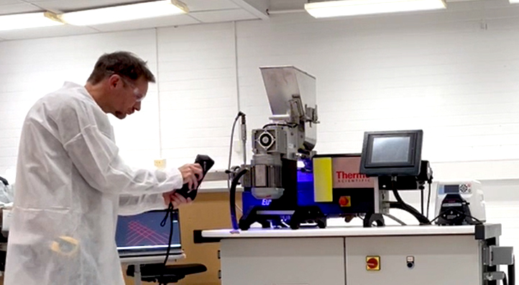
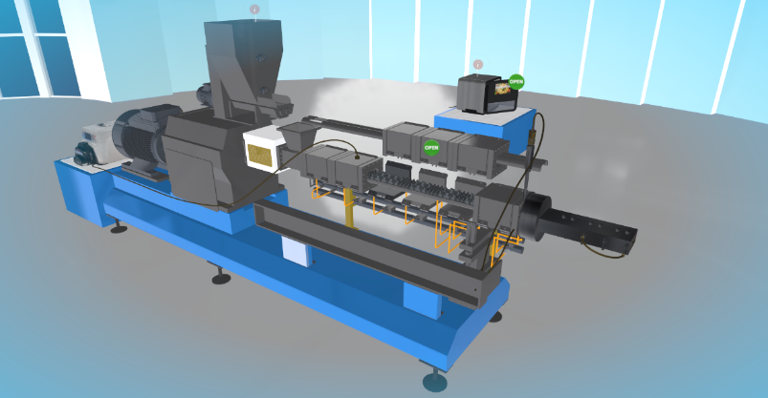
Design and development process
Multidisciplinary team
Development process
Design decisions/constraints
3D Laser scanning
3D Modelling

Slide 9
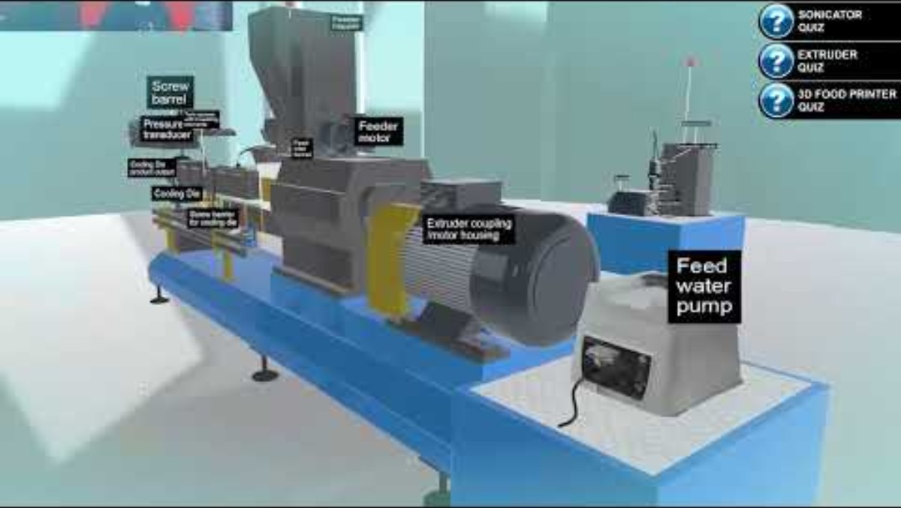
Equipment Discovery Lab - Walkthrough
https://youtu.be/O6IkEKvCFxM

Slide 10
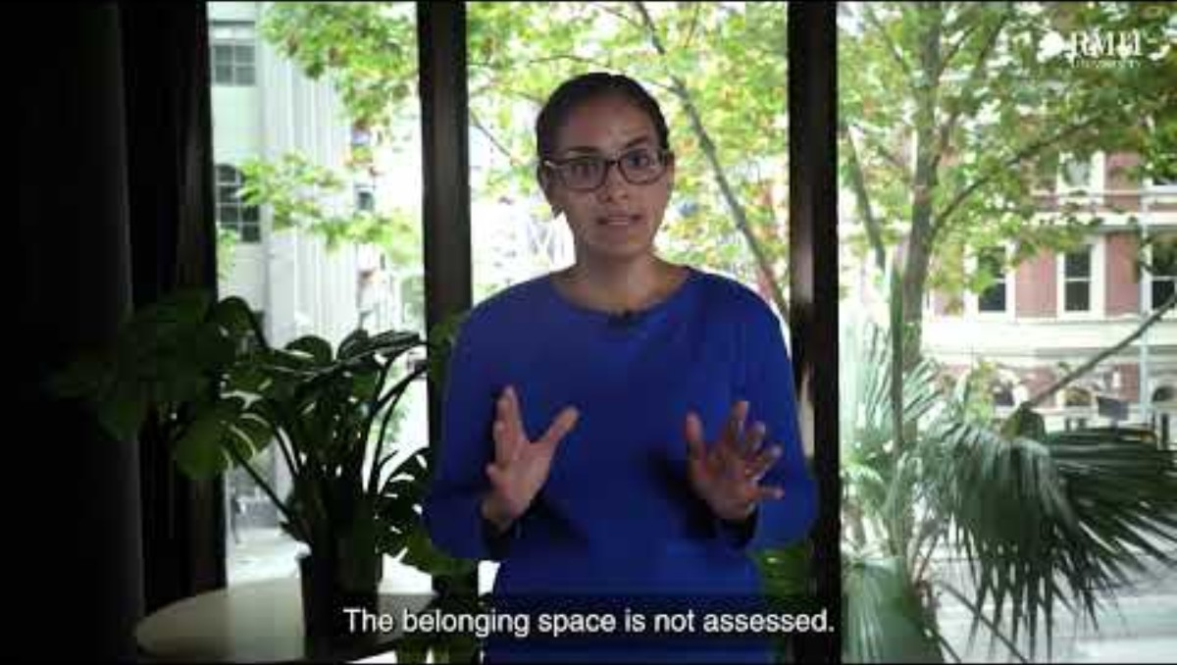
Poster Presentation Gallery- Walkthrough
https://youtu.be/A64vKD_Ju6I

Slide 11
Conclusion and key takeaways
The gallery offers multiple means of representation, expression, and engagement.
It employs technology tools to foster autonomy, creativity, and peer connection, while reducing the cognitive and emotional load often associated with traditional formats.
UDL informed not only what students experienced but also how the entire learning journey was designed.
Students are working toward the same learning outcomes, but they are not constrained to a single format for demonstrating their learning.

Slide 12
Reflection
Where might learner choice be expanded in your assessments?
What barriers could immersive or flexible environments address?

